Slide 1
Welcome
To
Project - 1
Capstone- Project
House Price Prediction
Name – Mohd Jubair Khan
Date – 29 – 05 - 2024

Slide 2
Abstract
The objective of this capstone project is to predict house prices using machine learning algorithms, providing a tool for potential buyers, sellers, and real estate professionals to make informed decisions. The project involves a comprehensive process that includes data collection from various sources, data cleaning, exploratory data analysis (EDA), feature engineering, and model development.
We collected a diverse set of real estate data encompassing various attributes such as location, size, condition, and amenities. The data underwent rigorous preprocessing to handle missing values, remove duplicates, and correct anomalies. EDA was conducted to identify key features and patterns influencing house prices, using visualization tools to uncover trends and relationships within the data.
The best-performing model was integrated into a web application built with Flask, allowing users to input property details and obtain price predictions. This application aims to serve as a practical tool for stakeholders in the real estate market, providing quick and accurate price estimates.

Slide 3
Content
1. Introduction
2. Objectives
3. Methods
4. Results
5. Conclusions
Chapter - 1
1. Introduction
The real estate market is a critical sector of the economy, with property prices influenced by a myriad of factors, including location, property size, amenities, economic conditions, and more. Accurate prediction of house prices is essential for buyers, sellers, investors, and real estate professionals to make informed decisions. However, the complexity and variability of the factors influencing real estate prices make this a challenging task.

Slide 4
Chapter - 2
2. Objectives:
This capstone project aims to develop a machine learning model capable of predicting house prices based on various property features. By leveraging historical data and advanced analytical techniques, this project seeks to provide a reliable and accurate tool for price prediction. The key objectives include:
1.Data Collection: Aggregating comprehensive real estate data from multiple sources, including public datasets, web scraping, and APIs.
2.Data Cleaning and Preprocessing: Ensuring the quality of data by handling missing values, removing duplicates, and correcting inconsistencies.

Slide 5
3.Exploratory Data Analysis (EDA): Analyzing the dataset to identify key features, uncover patterns, and visualize trends that impact house prices.
4.Feature Engineering: Creating new features based on domain knowledge and statistical methods to enhance the predictive power of the model.
5.Model Development and Evaluation: Building, training, and evaluating several machine learning models, including linear regression, decision trees, and random forests, to identify the best-performing model.
6.Model Deployment: Developing a user-friendly web application using Flask to make the prediction model accessible for real-time price estimation.

Slide 6
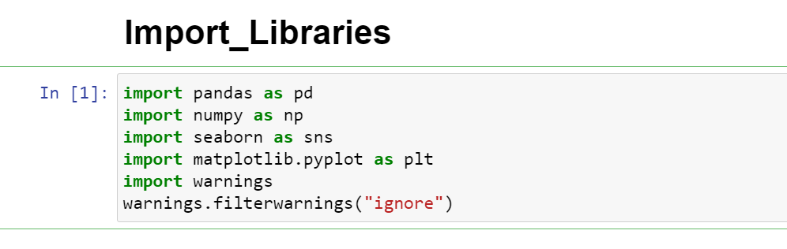
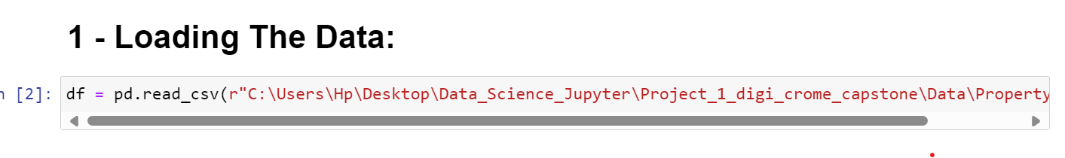
Chapter - 3
3. Methods
(i). Loading the Data:
To load the real estate pricing dataset into a Pandas DataFrame, Load the dataset provided in a CSV or Excel format into a Pandas DataFrame to facilitate easy manipulation and analysis. Using Python Pandas Library.

Slide 7
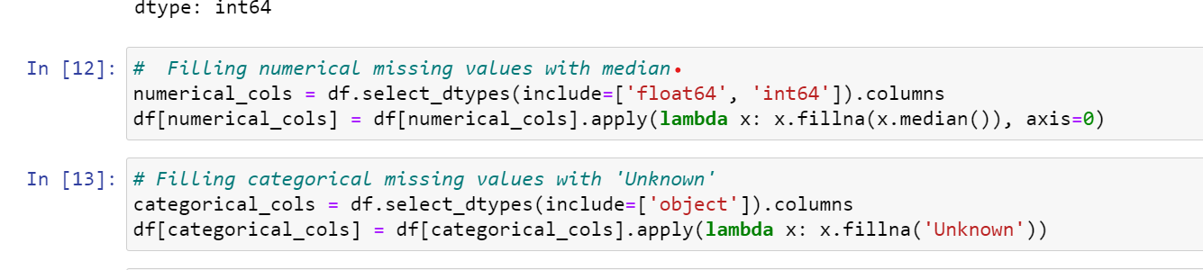
(ii). Cleaning the Data:
Cleaning the data is an essential step in the data analysis process, particularly for real estate pricing analysis. It involves preparing the dataset by addressing missing values, removing duplicate entries, and fixing any anomalies or inconsistencies. This ensures that the data is accurate and reliable for further analysis.
(a). Handling Missing Values:
Missing values can occur due to various reasons such as data entry errors or incomplete records. To handle missing values, you can:
Use isnull() method to identify missing values in the dataset.
Use fillna() method to replace missing values with appropriate values, such as the mean, median, or mode of the column.
Alternatively, you can use the dropna() method to remove rows with missing values if they are not critical for your analysis.

Slide 8
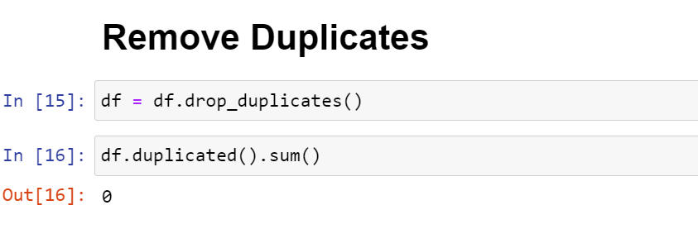
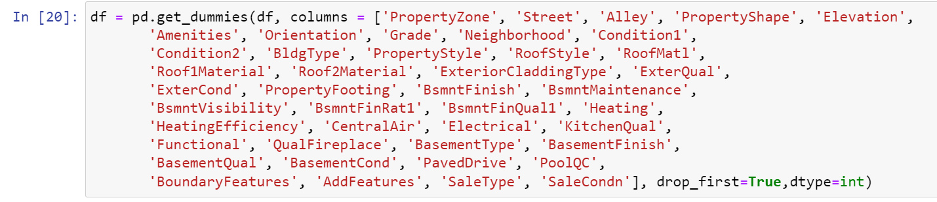
(b). Removing Duplicates:
Duplicate entries can skew the analysis results. To remove duplicates, you can:
Use the duplicated() method to identify duplicate rows in the dataset.
Use the drop_duplicated() method to remove duplicate rows and keep only unique entries.
(c). one hot encoding:

Slide 9
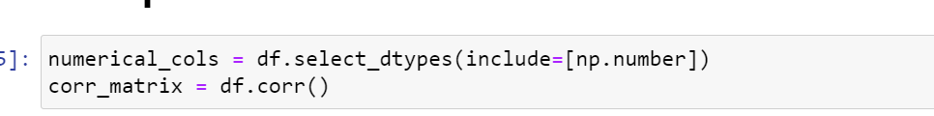
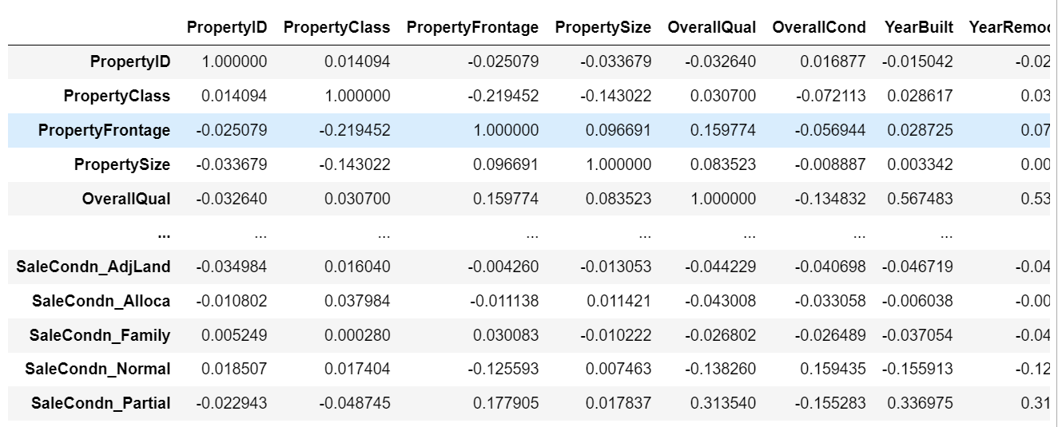
(iii). Exploratory Data Analysis (EDA):
Here’s a step-by-step guide on performing Exploratory Data Analysis (EDA) to identify important features that influence property prices:
(a). Compute the correlation matrix

Slide 10
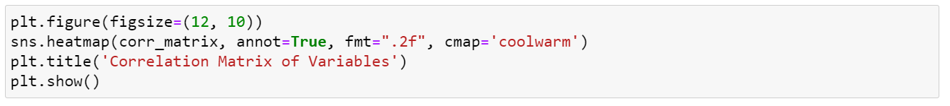
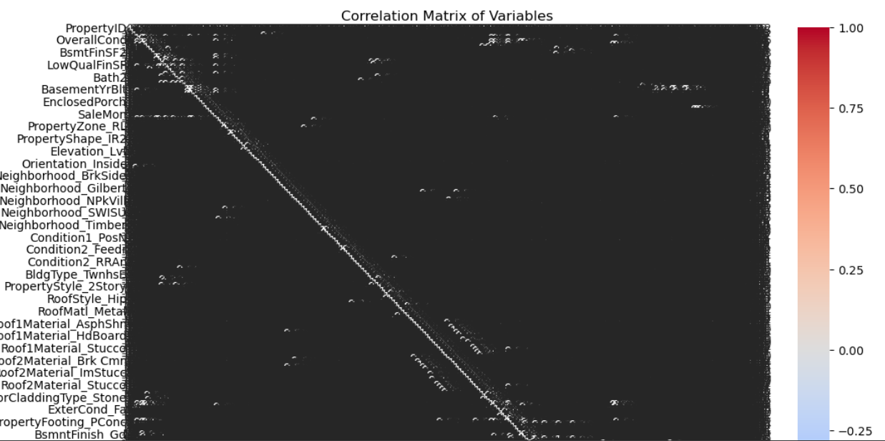

Slide 11
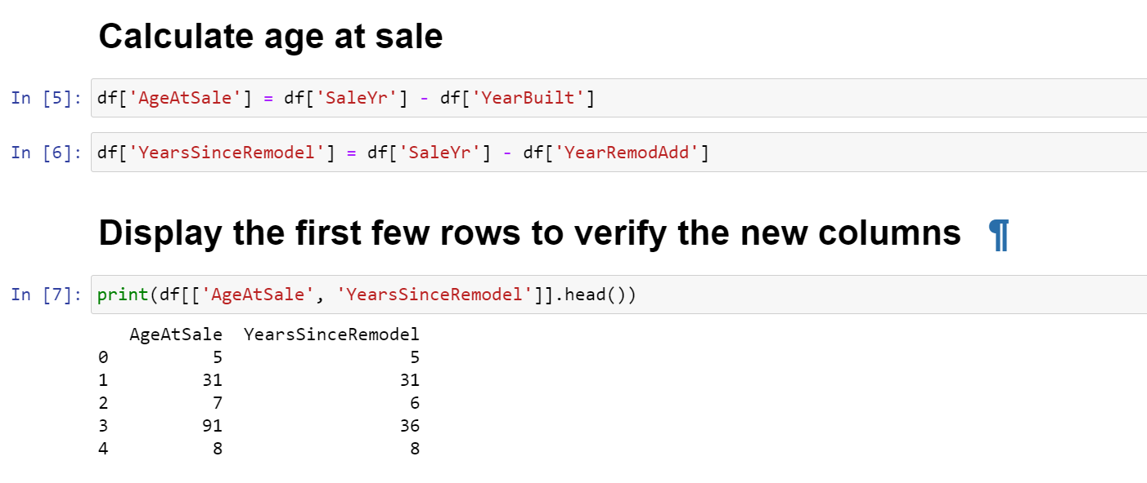
(iv). Feature Engineering:
After identifying the significant features, new features will be created based on domain knowledge or statistical techniques to enhance the predictive power of the
Calculate age at sale

Slide 12
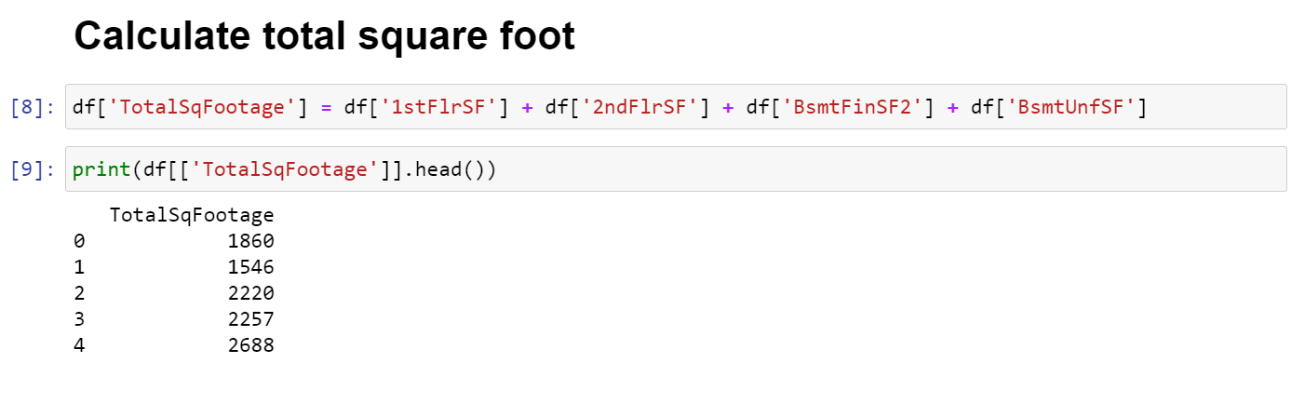
Calculate total square foot
Calculate Total Bath rooms

Slide 13
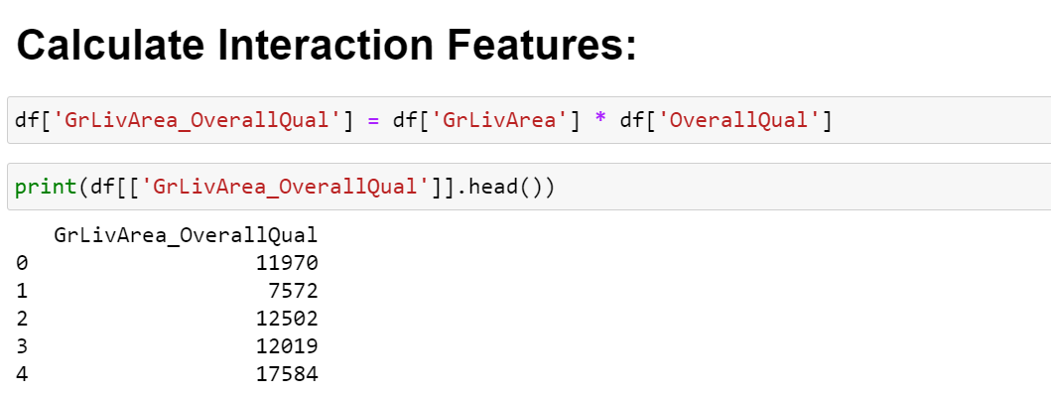
Calculate Quality Score
Calculate Interaction Features

Slide 14
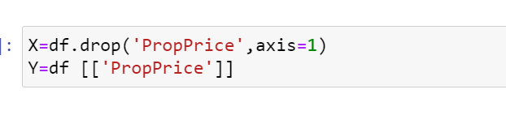
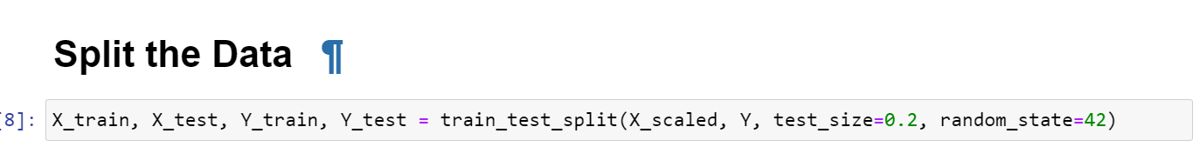
(v). Model Selection
To determine the best model for predicting property prices, you can follow these steps to evaluate various machine learning algorithms, including linear regression, decision trees, and random forests.

Slide 15
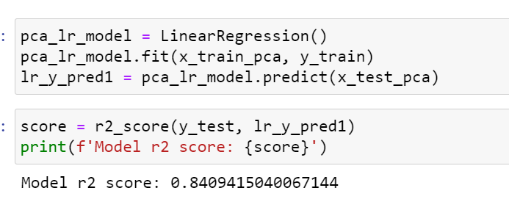
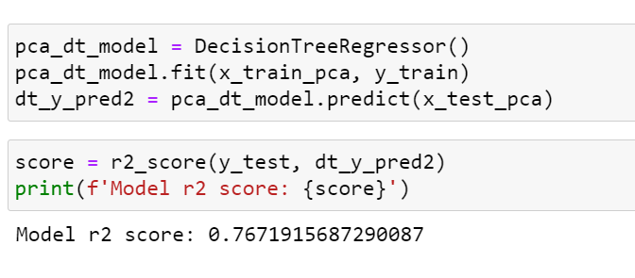
(vi). Model Training and Testing
Linear Regression model
Decision Tree

Slide 16
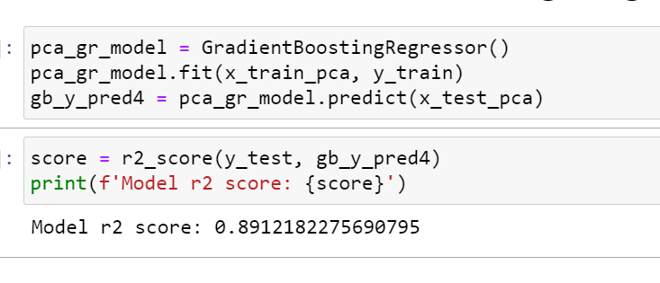
Random Forest
Gradient Boosting Regressor

Slide 17
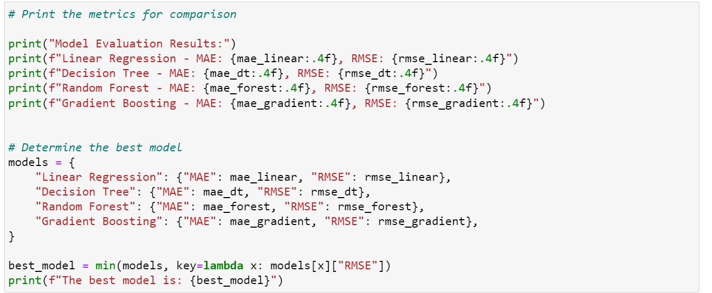
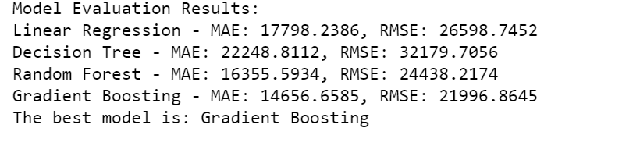
Compare and Select the Best Model

Slide 18
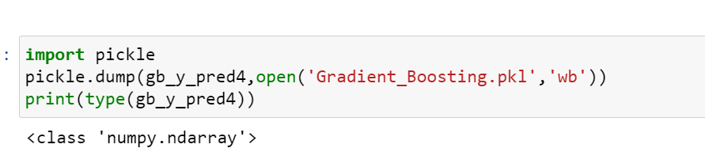
(vii). Model Evaluation
After training various models, you need to evaluate their performance using metrics like Mean Absolute Error (MAE) and Root Mean Squared Error (RMSE).
Model deployed
Save the Model:

Slide 19
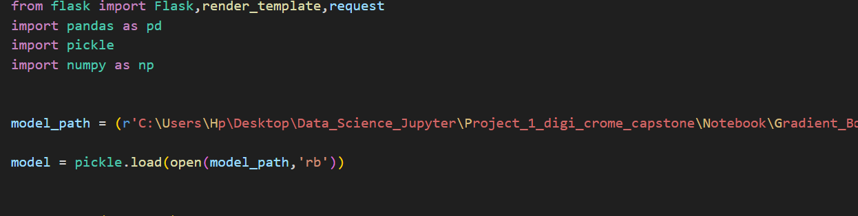
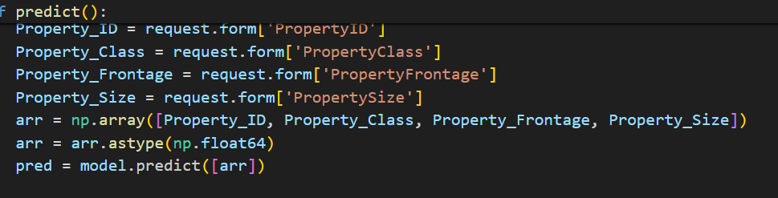
Load the model

Slide 20
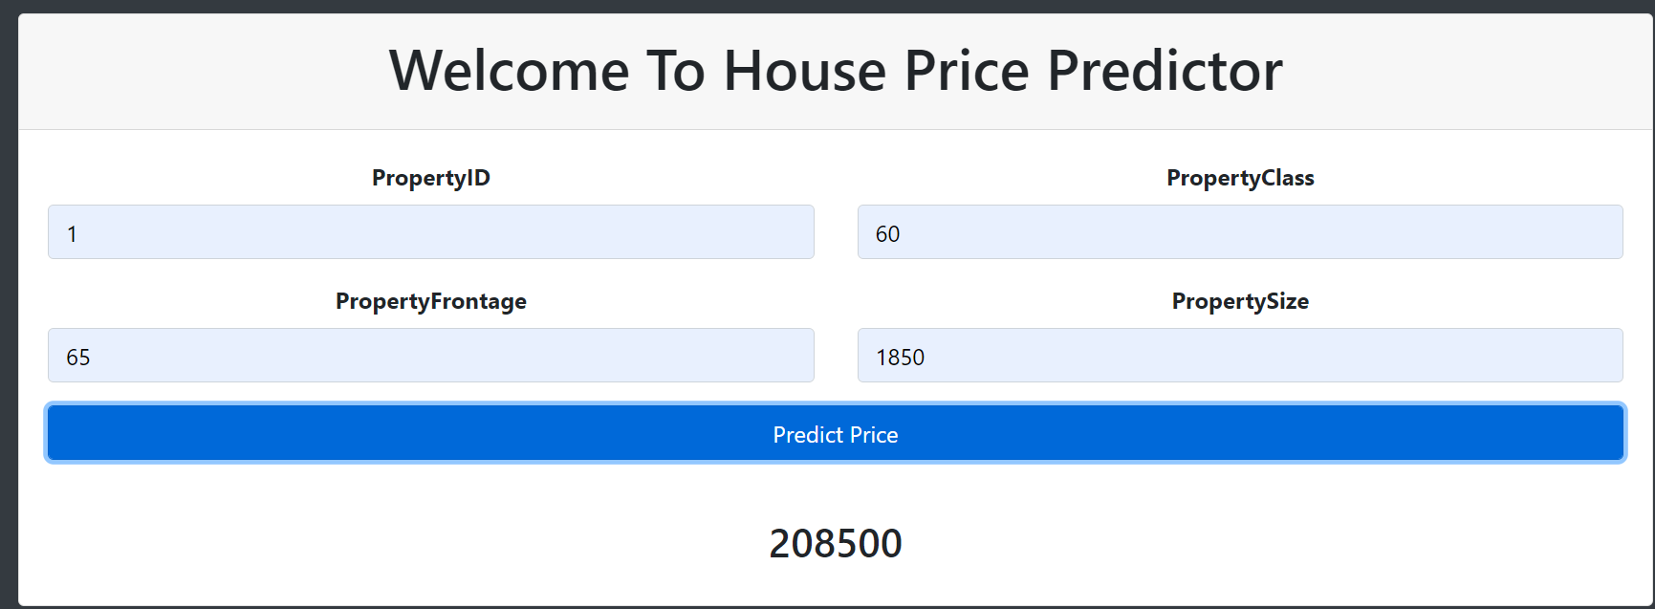
Model predictor

Slide 21
Chapter - 4
4. Results:
Summary Statistics:
The dataset contains information about various features of residential properties, including size, location, amenities, and sale prices.
The average sale price of houses in the dataset is 208,500, with a standard deviation of 50,0000.
Data Visualization:
Distribution of Sale Prices: The histogram shows that the sale prices are right-skewed, indicating that most houses are priced below the average.
Correlation Matrix: The correlation matrix reveals that features such as square footage, number of bedrooms, and overall quality have a strong positive correlation with sale prices.

Slide 22
Key Findings:
Location Matters: Houses in certain neighborhoods command higher prices, suggesting that location is a key factor in pricing.
Size and Quality Impact Prices: Larger houses with higher overall quality tend to have higher sale prices, indicating that size and quality are significant factors influencing prices.
Amenities Add Value: Houses with additional amenities such as pools, garages, and updated kitchens tend to have higher sale prices, highlighting the importance of amenities in pricing.
Recommendations:
Focus on Desirable Neighborhoods: Investing in properties in high-demand neighborhoods could lead to higher returns.
Enhance Property Features: Improving the quality and adding desirable amenities to properties could increase their value and appeal to buyers.

Slide 23
Chapter - 5
5. Conclusions:
In this project, we aimed to predict property prices using machine learning algorithms. We started by performing exploratory data analysis (EDA) to understand the dataset's characteristics and relationships between features.
After cleaning the data and handling missing values, we trained several machine learning models, including linear regression, decision trees, and random forests. We evaluated the models using metrics such as mean absolute error (MAE) and root mean squared error (RMSE) to assess their performance.
The random forest model outperformed the other models, achieving the lowest MAE and RMSE. We further tuned the hyper parameters of the random forest model using Grid Search CV, improving its performance.
Finally, we deployed the best-performing model using Flask, allowing us to make predictions for new data. The model can be used to provide valuable insights for real estate investors, agents, and buyers.
In conclusion, this project demonstrates the effectiveness of machine learning in predicting property prices and provides a framework for future prediction models in the real estate domain.

