Slide 1
Welcome
To
Project - 2
Exploratory Data Analysis (EDA) for Real Estate Pricing
Name – Mohd Jubair Khan
Date – 08 – 03 - 2024

Slide 2
Abstract
In this project we will do Exploratory Data Analysis (EDA) for Real Estate Pricing. Exploratory Data Analysis (EDA) plays a vital role in understanding the dynamics of real estate markets by analyzing various factors affecting property prices. This study focuses on the application of EDA techniques to a real estate dataset to uncover insights that can inform pricing strategies. The dataset includes information such as property characteristics, location, amenities, and historical pricing data.
The EDA process begins with data cleaning, including handling missing values, duplicates, and outliers. Subsequently, visualizations such as histograms, box plots, and scatter plots are used to explore the distribution and relationships between key variables.
The analysis reveals interesting patterns, such as the impact of location on property prices, the influence of amenities like swimming pools or garages, and the effect of economic indicators on market trends. Furthermore, multivariate analysis techniques are applied to understand the combined effect of multiple variables on property prices.

Slide 3
Content
1. Introduction
2. Objectives
3. Methods
4. Results
5. Conclusions
Chapter - 1
1. Introduction
Exploratory Data Analysis (EDA) is a critical first step in the data analysis process, especially in the context of Real Estate Pricing. EDA involves the initial exploration and analysis of a dataset to understand its key characteristics and uncover insights that can inform further analysis and decision-making.
In the context of Real Estate Pricing, EDA helps in understanding the factors that influence house prices, identifying patterns and trends in the data, and exploring relationships between different variables. By conducting EDA, real estate professionals, analysts, and researchers can gain valuable insights into the market dynamics, customer preferences, and other factors that drive pricing decisions.

Slide 4
Chapter - 2
2. Objectives:
(i). Understanding the data:
EDA helps in understanding the structure and content of the dataset, including the distribution of key variables, missing values, and potential outliers.
(ii). Identifying patterns:
EDA helps in identifying patterns and relationships within the data, such as trends over time, correlations between variables, and spatial patterns.
(iii). Feature selection:
EDA can help in identifying relevant features that may be important for predicting house prices, which can be used in subsequent modeling.

Slide 5
(iv). Data cleaning:
EDA helps in identifying and addressing issues such as missing values, duplicates, and outliers, which can improve the quality of the data for analysis.
(v). Visualizing data:
EDA helps in visualizing the data using plots and charts, which can provide insights into the distribution and characteristics of the data.

Slide 6
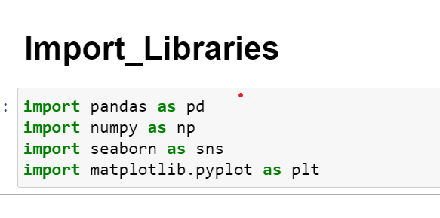
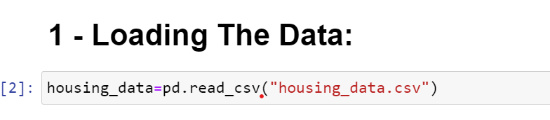
Chapter - 3
3. Methods
(i). Loading the Data:
To load the real estate pricing dataset into a Pandas DataFrame, Load the dataset provided in a CSV or Excel format into a Pandas DataFrame to facilitate easy manipulation and analysis. Using Python Pandas Library.

Slide 7
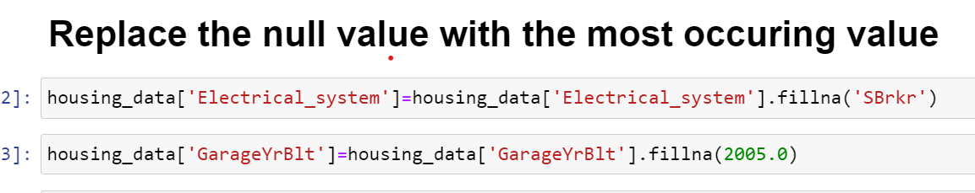
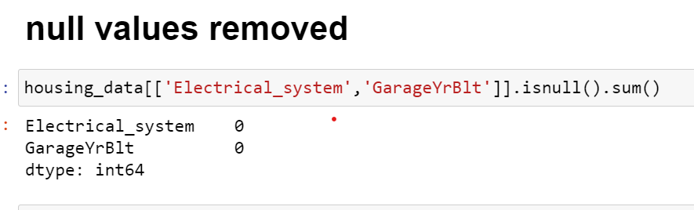
(ii). Cleaning the Data:
Cleaning the data is an essential step in the data analysis process, particularly for real estate pricing analysis. It involves preparing the dataset by addressing missing values, removing duplicate entries, and fixing any anomalies or inconsistencies. This ensures that the data is accurate and reliable for further analysis.
(a). Handling Missing Values:
Missing values can occur due to various reasons such as data entry errors or incomplete records. To handle missing values, you can:
Use isnull() method to identify missing values in the dataset.
Use fillna() method to replace missing values with appropriate values, such as the mean, median, or mode of the column.
Alternatively, you can use the dropna() method to remove rows with missing values if they are not critical for your analysis.

Slide 8
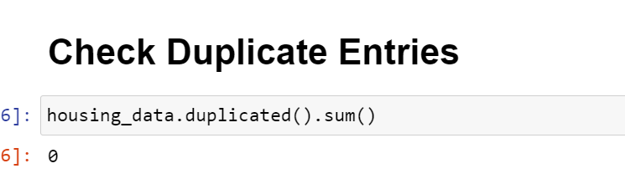
(b). Removing Duplicates:
Duplicate entries can skew the analysis results. To remove duplicates, you can:
Use the duplicated() method to identify duplicate rows in the dataset.
Use the drop_duplicated() method to remove duplicate rows and keep only unique entries.
(C). Addressing Anomalies:
Anomalies or inconsistencies in the data can arise from various sources, such as errors in data entry or data collection processes. To address anomalies, you can:
Use descriptive statistics to identify outliers in the dataset.
Use domain knowledge to determine if the anomalies are valid or erroneous.
If anomalies are erroneous, you can correct them manually or by using appropriate transformation techniques.

Slide 9
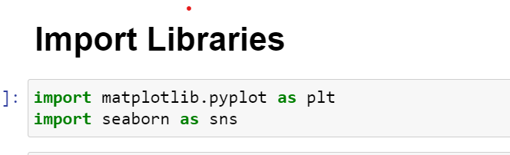
(iii). Univariate Analysis:
Univariate analysis is a crucial part of Exploratory Data Analysis (EDA) for real estate pricing as it helps us understand the characteristics and distributions of individual variables in the dataset, such as house prices. This analysis is conducted separately for each variable without considering the relationships with other variables.
(a). Histograms:
A histogram is a graphical representation of the distribution of numerical data. It divides the data into bins and displays the frequency of values in each bin. Histograms are useful for understanding the central tendency, dispersion, and shape of the distribution of a variable, such as house prices.

Slide 10
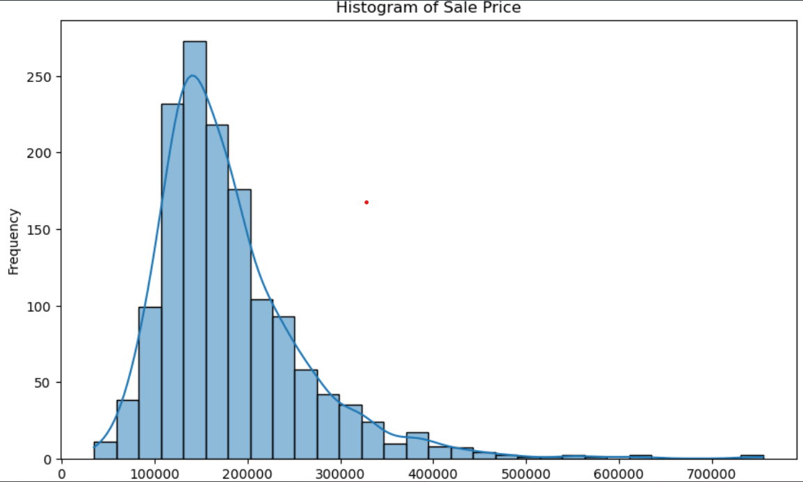
(b). Kernel Density Plots:
Kernel density plots provide a smooth estimate of the probability density function of a continuous variable. They are helpful for visualizing the distribution of a variable and can complement histograms by providing a smoother representation of the data's distribution.

Slide 11
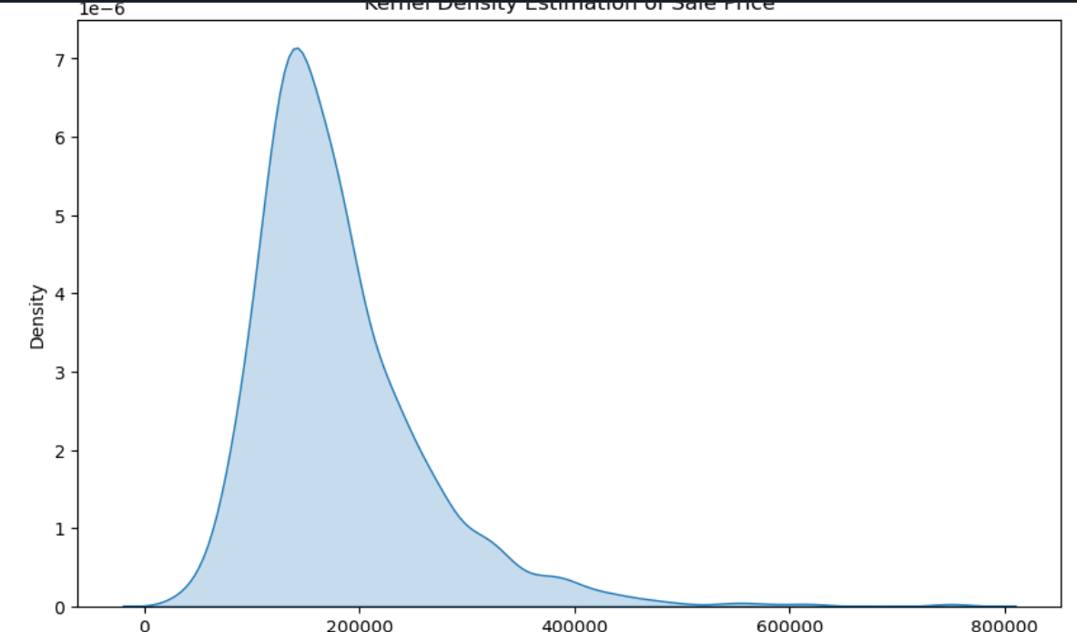
(c). Other Visualizations:
In addition to histograms and kernel density plots, other visualizations such as box plots, violin plots, and bar plots can also be used for univariate analysis. These visualizations can provide insights into the distribution and characteristics of the data, such as the presence of outliers or the presence of different groups or categories within a variable.

Slide 12
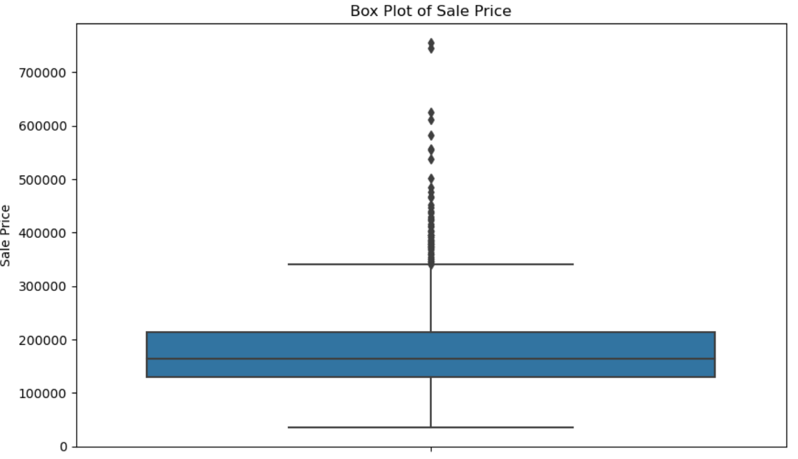
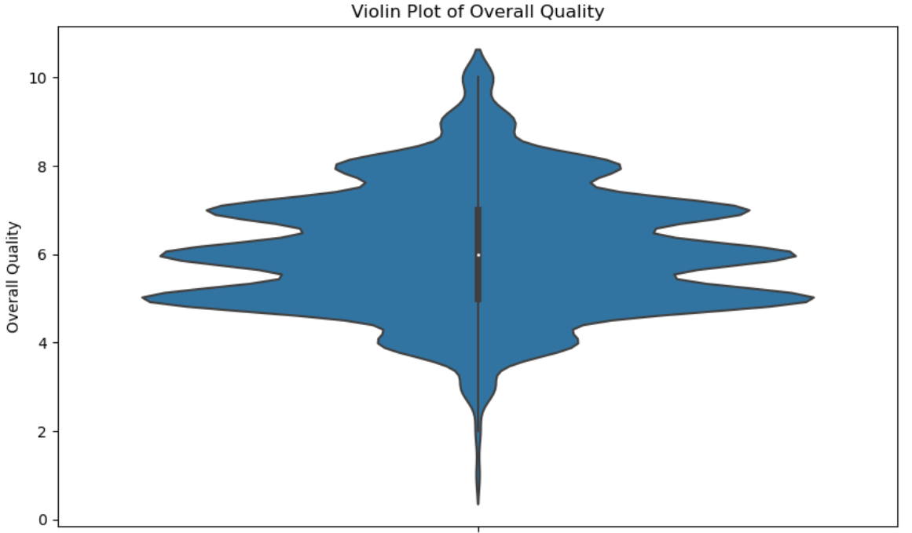
* Box plot
* Violin plots

Slide 13
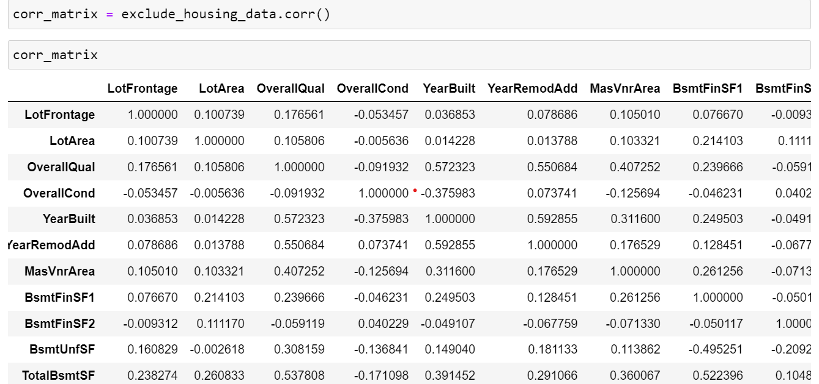
(iv). Multivariate Analysis:
Exploratory Data Analysis (EDA) for Real Estate Pricing involves using Matplotlib and Seaborn to investigate relationships between multiple variables, especially those impacting house prices. The goal is to understand the correlations and dependencies between various features in the dataset.
(a). Compute the correlation matrix
One common technique used in EDA is the correlation matrix, which shows the correlation coefficients between pairs of variables. A correlation coefficient close to 1 indicates a strong positive correlation, while a coefficient close to -1 indicates a strong negative correlation. This helps identify which features are most strongly related to house prices.

Slide 14
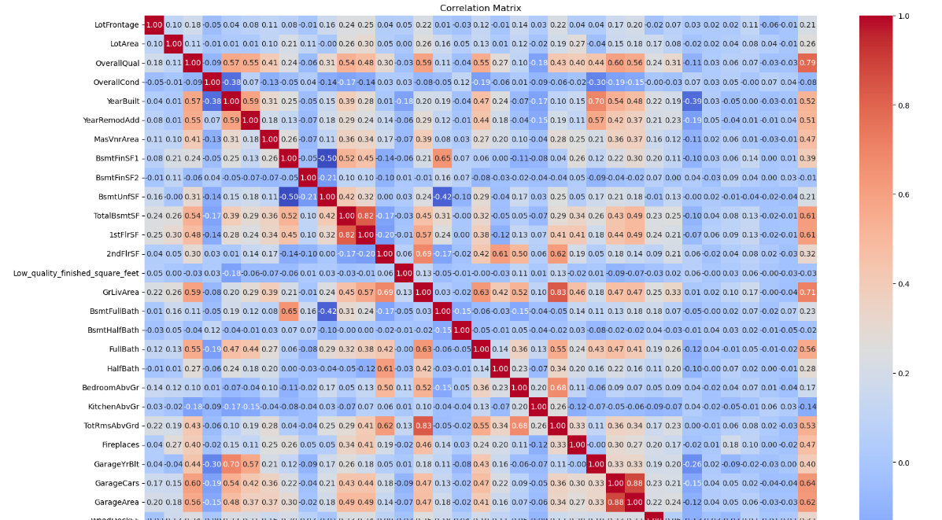
(b). Heatmap

Slide 15
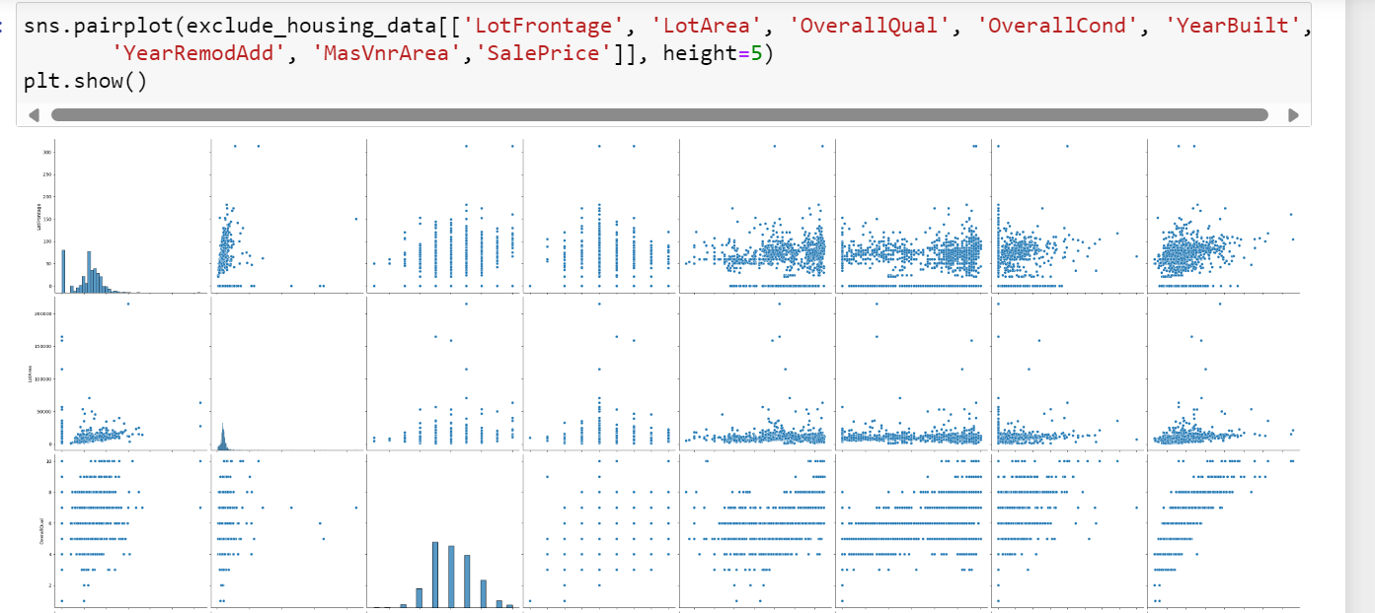
(c). Pairplot

Slide 16
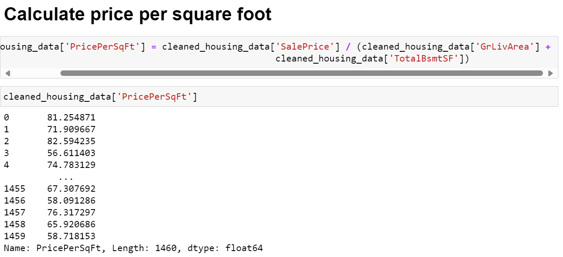
(v).Feature Engineering:
1. Price per Square Foot: Divide the 'SalePrice' by the total square footage ('GrLivArea') to get the price per square foot. This can help normalize prices based on the size of the property.

Slide 17
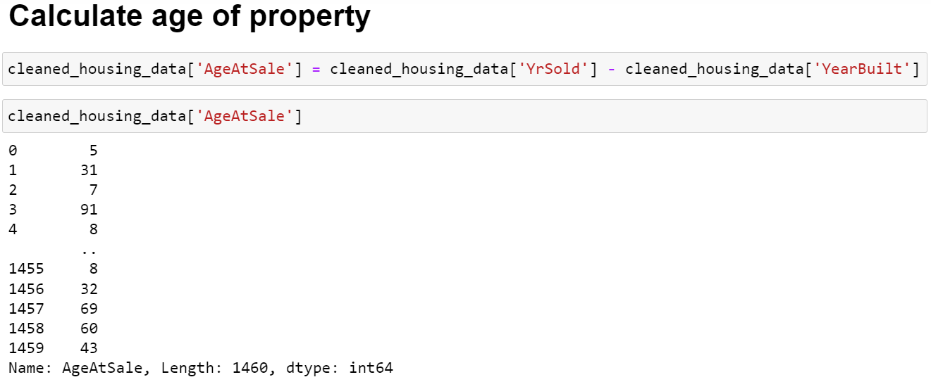
2. Property Age: Subtract the 'YearBuilt' from the 'YrSold' to get the age of the property at the time of sale. This can be a meaningful feature as older properties might be valued differently.
3. Total Bathrooms: Add the number of full bathrooms ('FullBath') and half bathrooms ('HalfBath') to get the total count of bathrooms in the property.

Slide 18
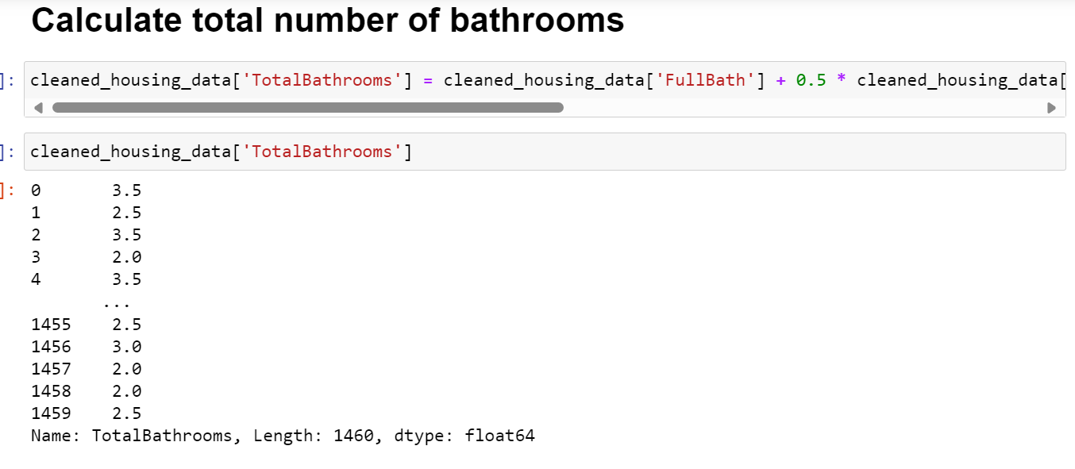
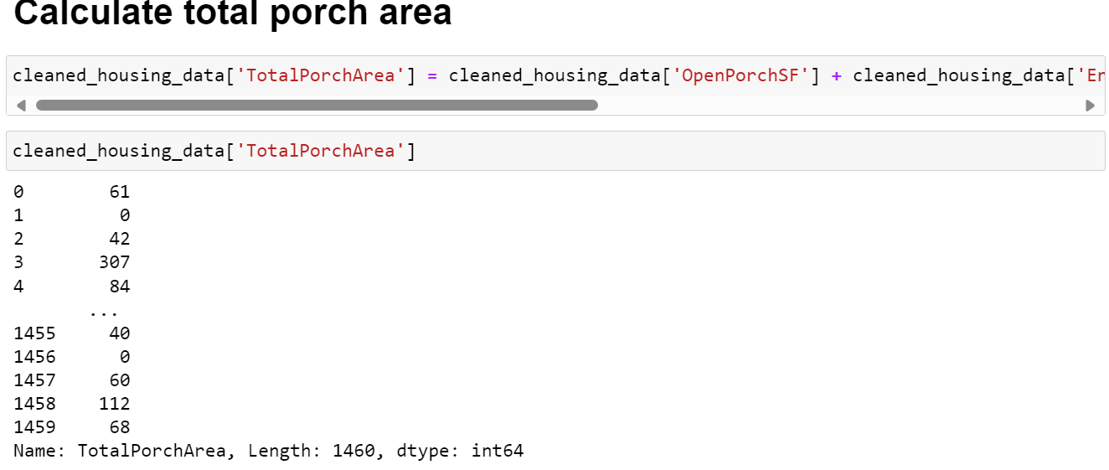
4. Total Porch Area: Add up the areas of all porch types ('WoodDeckSF', 'OpenPorchSF', 'EnclosedPorch', '3SsnPorch', 'ScreenPorch') to get the total porch area.

Slide 19
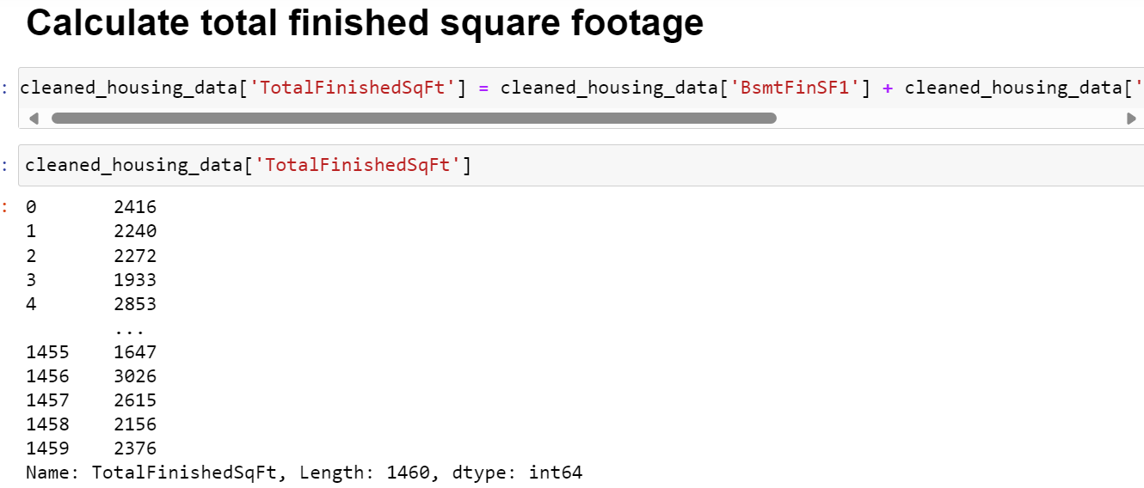
5. Total Finished Square Feet: Add the total finished square footage of the property ('GrLivArea') to the total basement finished square footage.

Slide 20
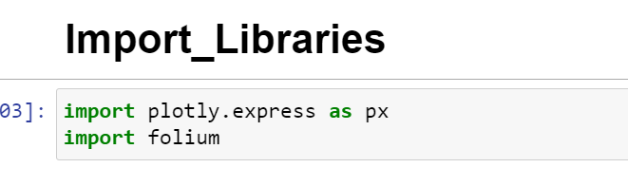
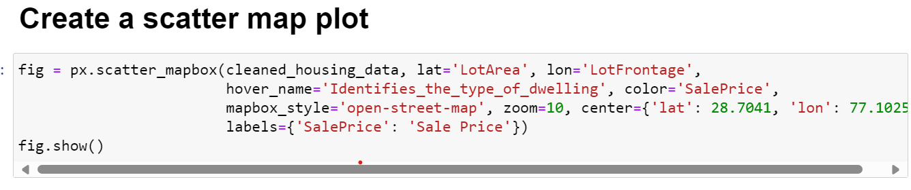
(vi). Geospatial Analysis:
For geospatial analysis using Plotly and Folium, you can follow these steps:
(a). Plotting with Plotly:
Create a scatter mapbox plot using px.scatter_mapbox and set the ‘lat’ and ‘lon’ columns for the location of each data point.
Use the ‘text’ parameter to display additional information such as house prices or other relevant features.
Customize the layout and map style using ‘layout’

Slide 21
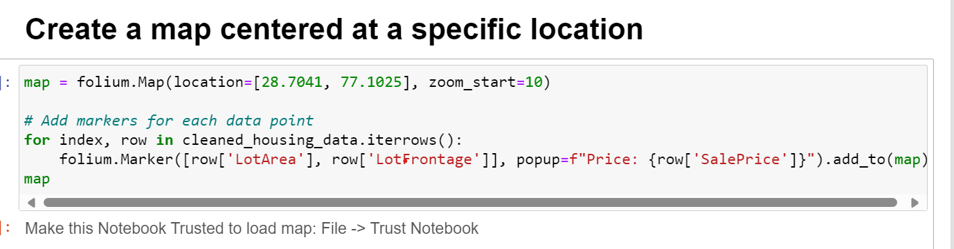
(b). Mapping with Folium:
Create a base map using ‘folium.Map’.
Add markers for each data point using ‘folium.marker’ and customize them as needed.

Slide 22
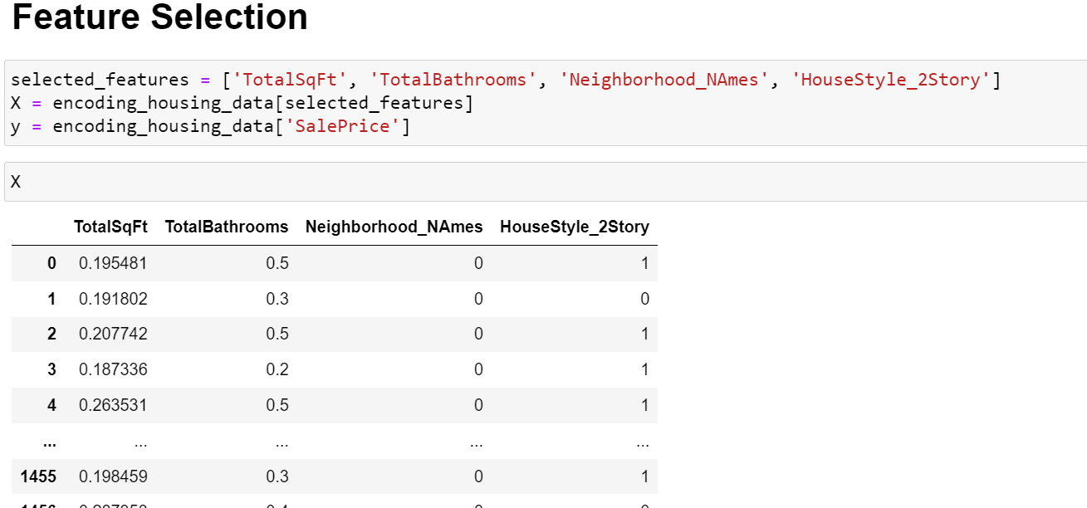
(vii). Feature Engineering and Size Impact:
1. Correlation Analysis: Calculate the correlation matrix between numerical features and the target variable ('SalePrice') to identify the strength and direction of linear relationships.

Slide 23
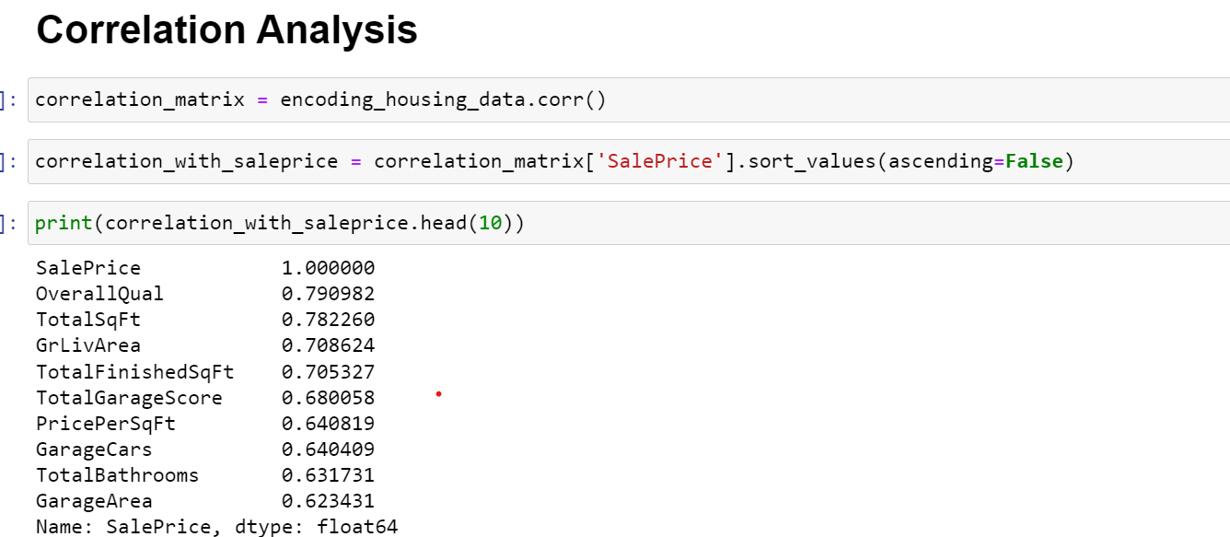
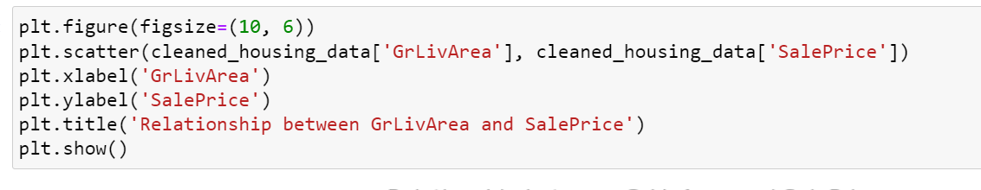
2,. Visualization: Use scatter plots, box plots, and histograms to visualize the relationships between key features and house prices.
a. Scatter plot

Slide 24
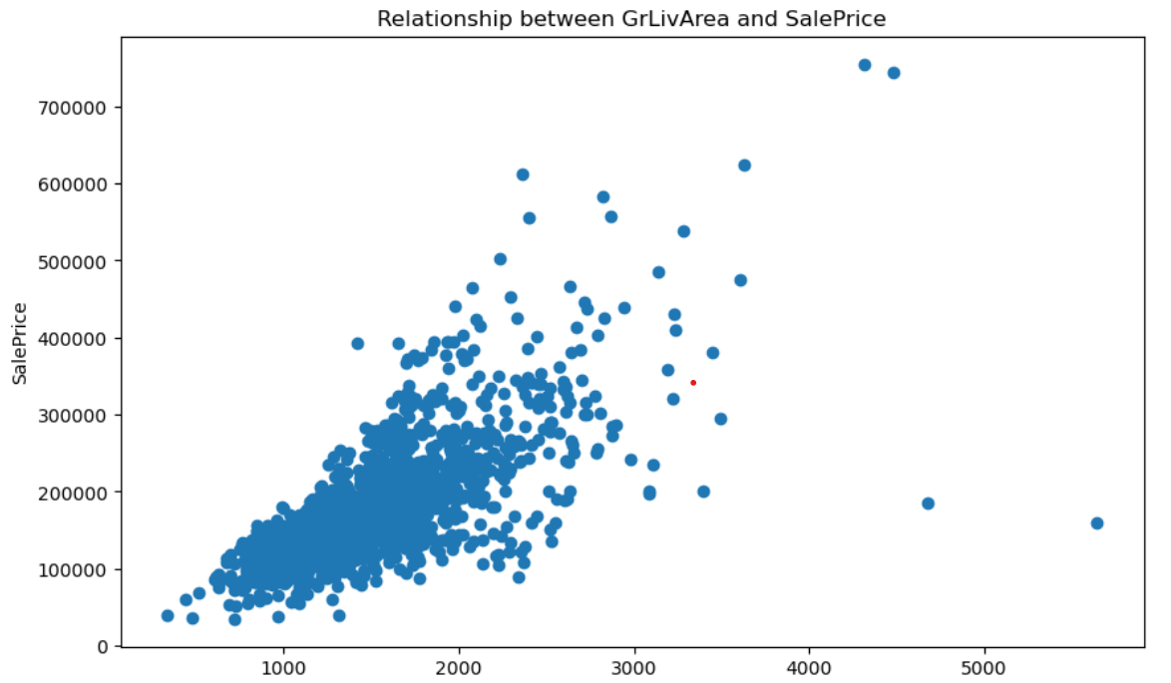
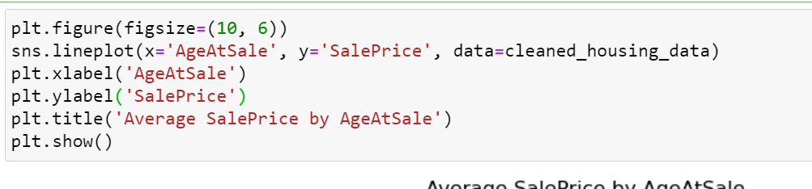
b. Line plot

Slide 25
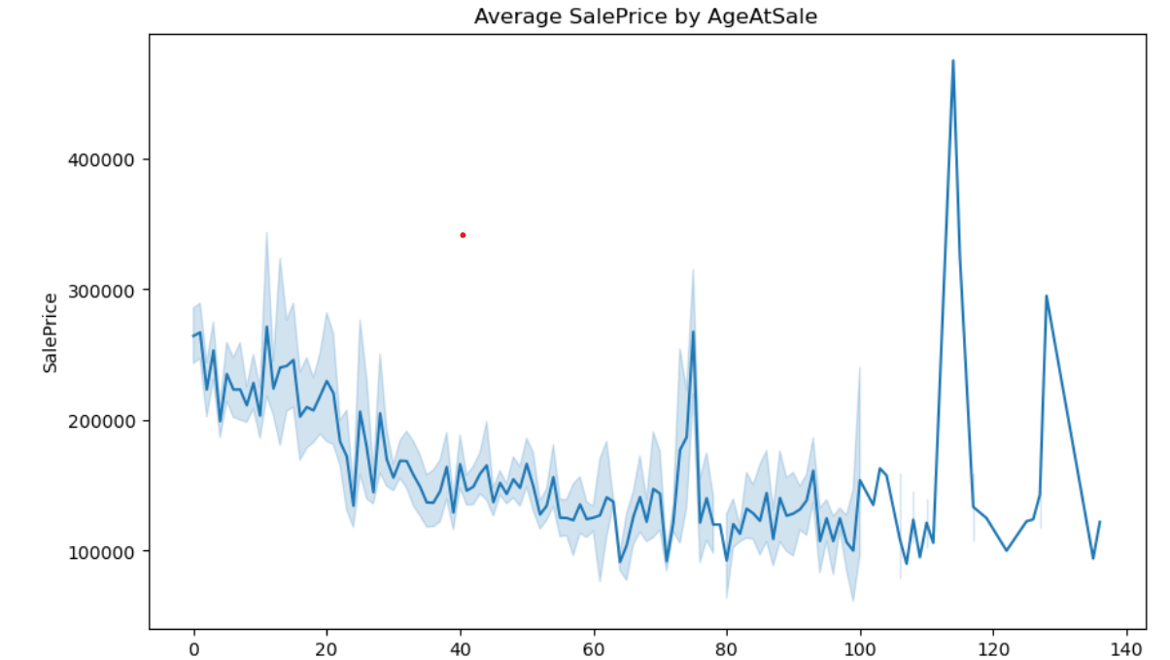
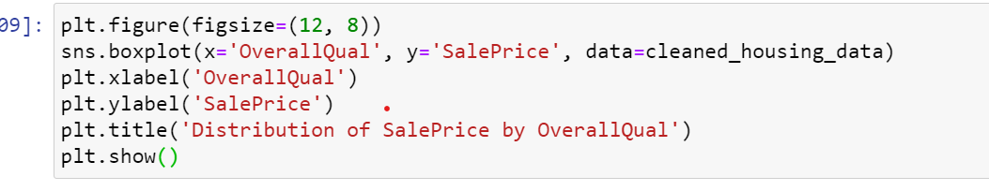
c. Box plot

Slide 26
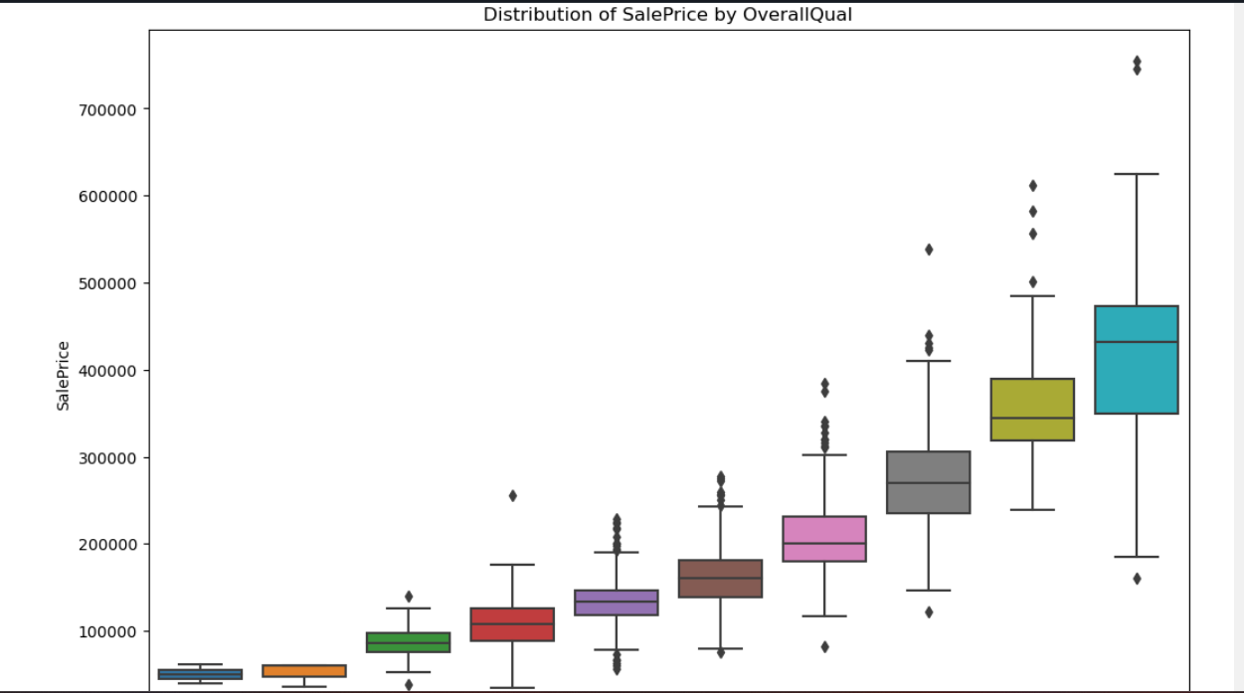
3. Feature Engineering: Create new features that combine relevant information to potentially improve the model's ability to predict house prices.
one hot encoding

Slide 27
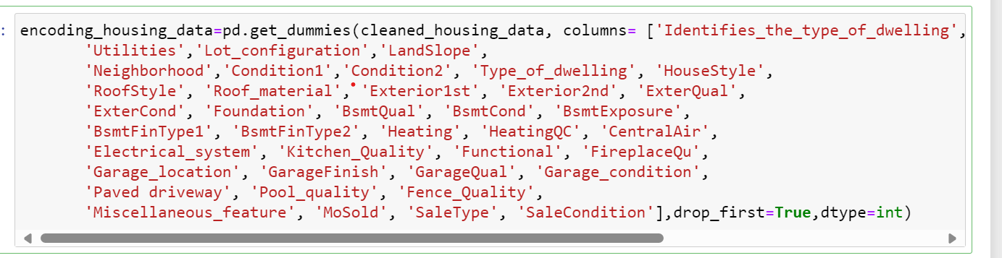
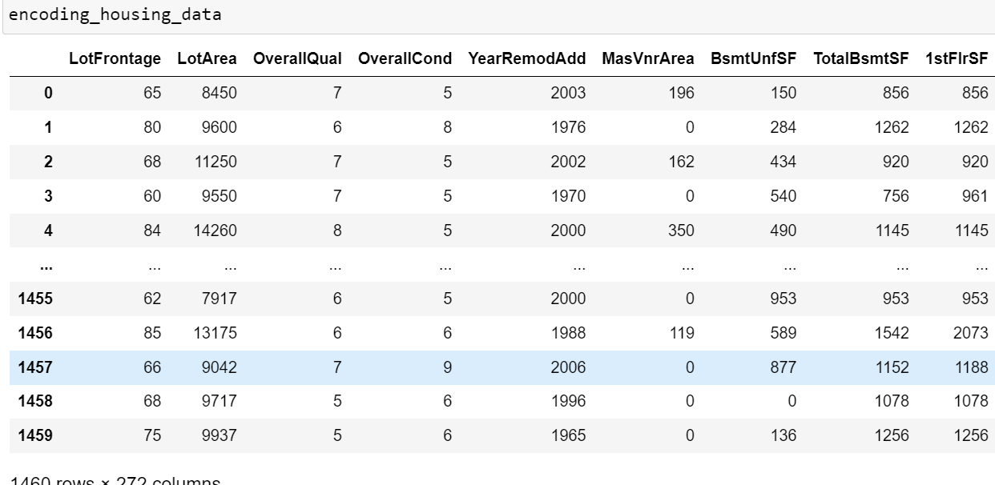

Slide 28
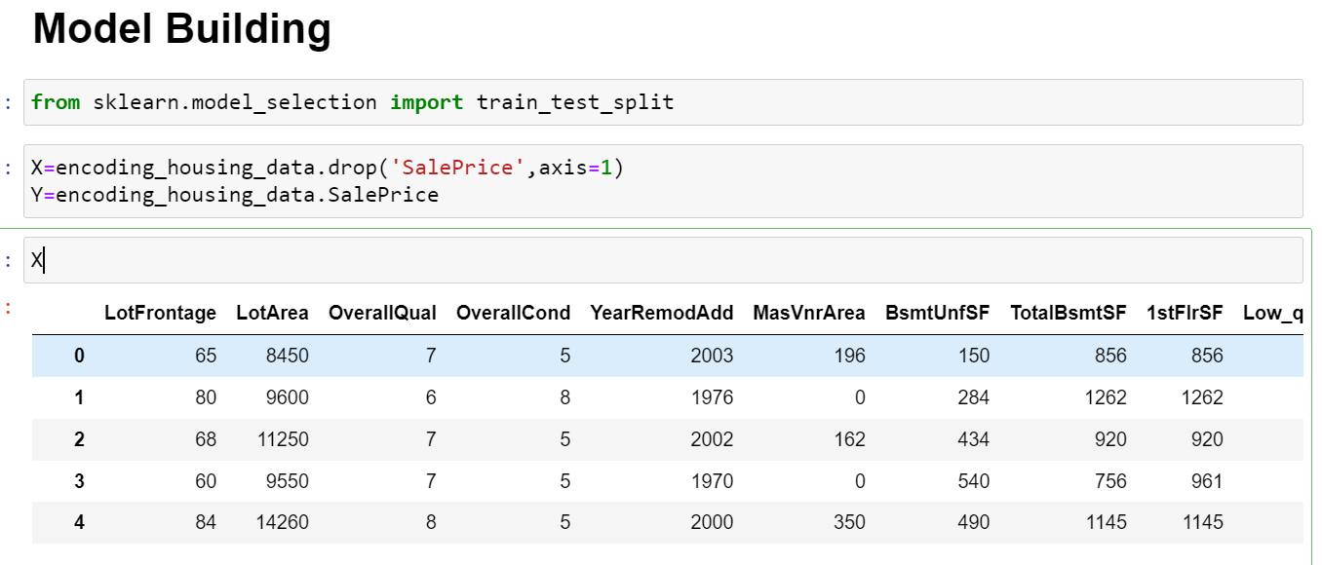
4.Model Building
a. Split the Data: Split your dataset into training and testing sets to evaluate the model's performance.
b. Select Features: Choose the features (columns) that you will use as input to the model. You can use the newly created features from feature engineering along with other relevant features.

Slide 29
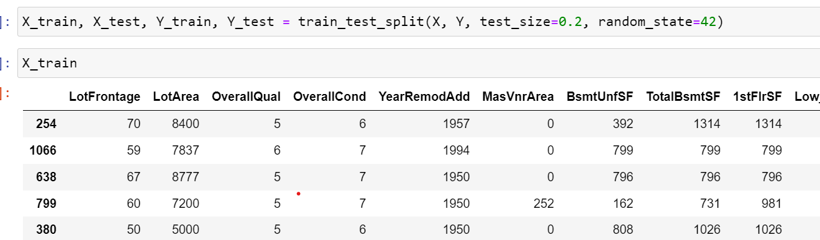
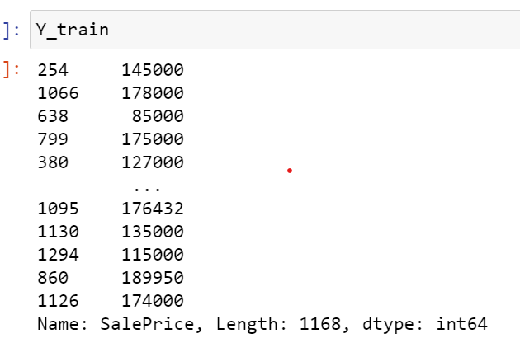
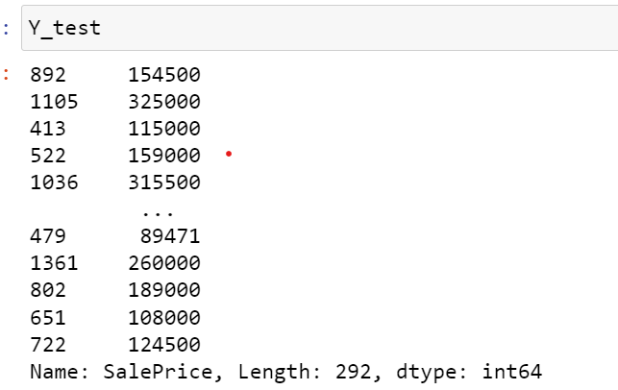
c. Model Selection: Choose a model to train on your data. Common models for regression tasks like predicting house prices include linear regression, decision tree regression, and random forest regression.

Slide 30
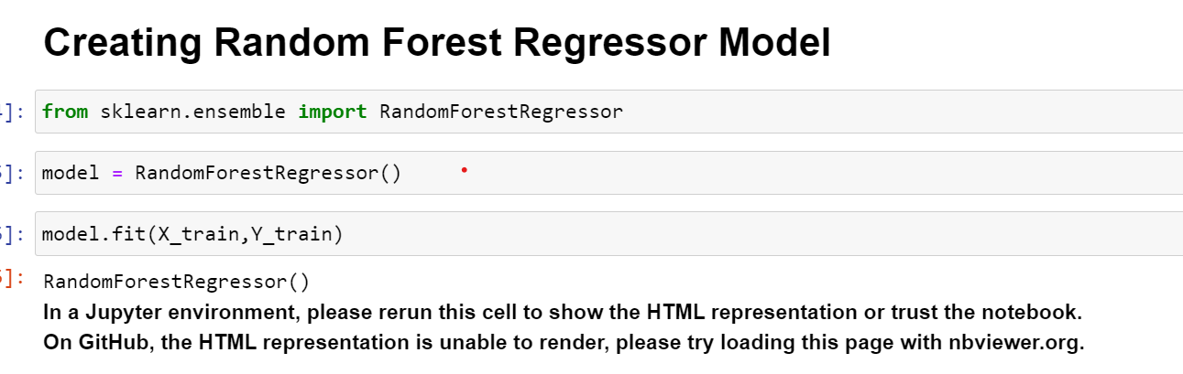
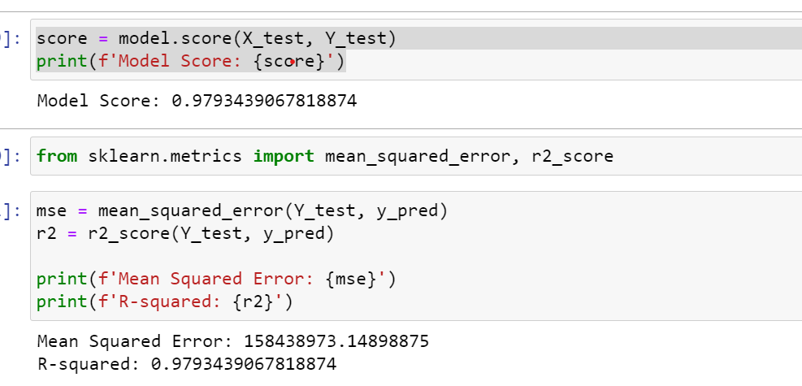
In this case, the model score of 0.9793 means that the model explains approximately 97.93% of the variance in the target variable (house prices). This indicates that the model is able to predict house prices very well, capturing almost all of the variation in the prices. A score closer to 1.0 indicates a better fit of the model to the data, with 1.0 meaning a perfect fit.

Slide 31
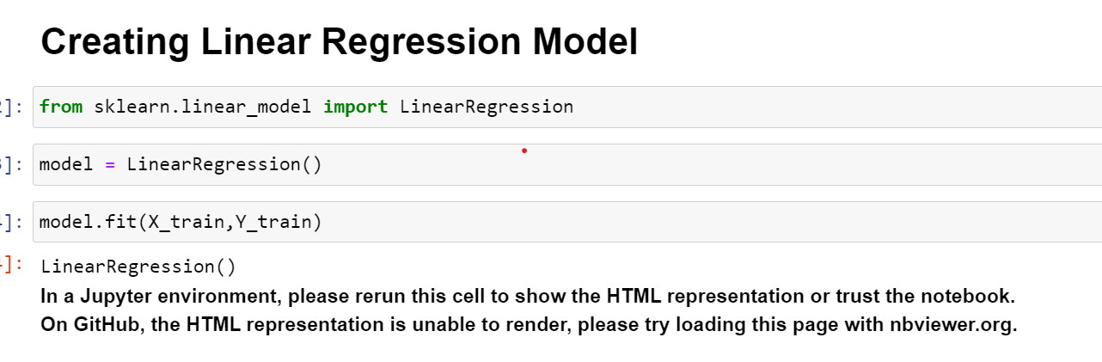
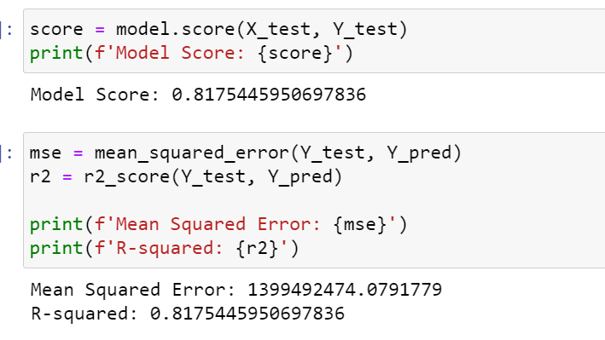
In this case, the model score of 0.8175 means that the model explains approximately 81.75% of the variance in the target variable (house prices). This indicates that the model is able to predict house prices very well, capturing almost all of the variation in the prices. A score closer to 1.0 indicates a better fit of the model to the data, with 1.0 meaning a perfect fit.

Slide 32
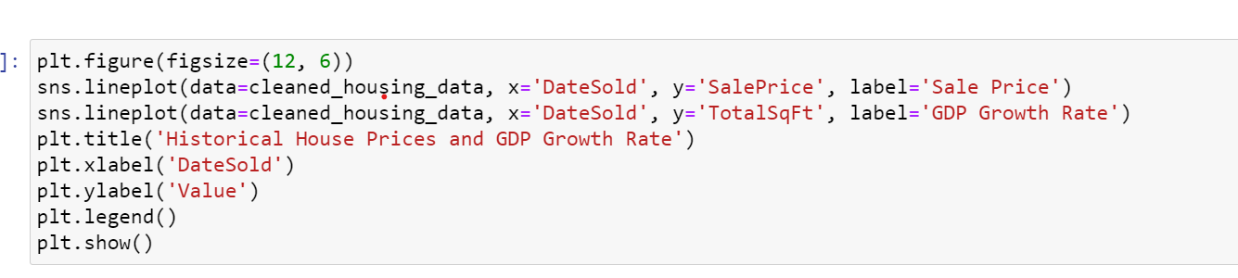
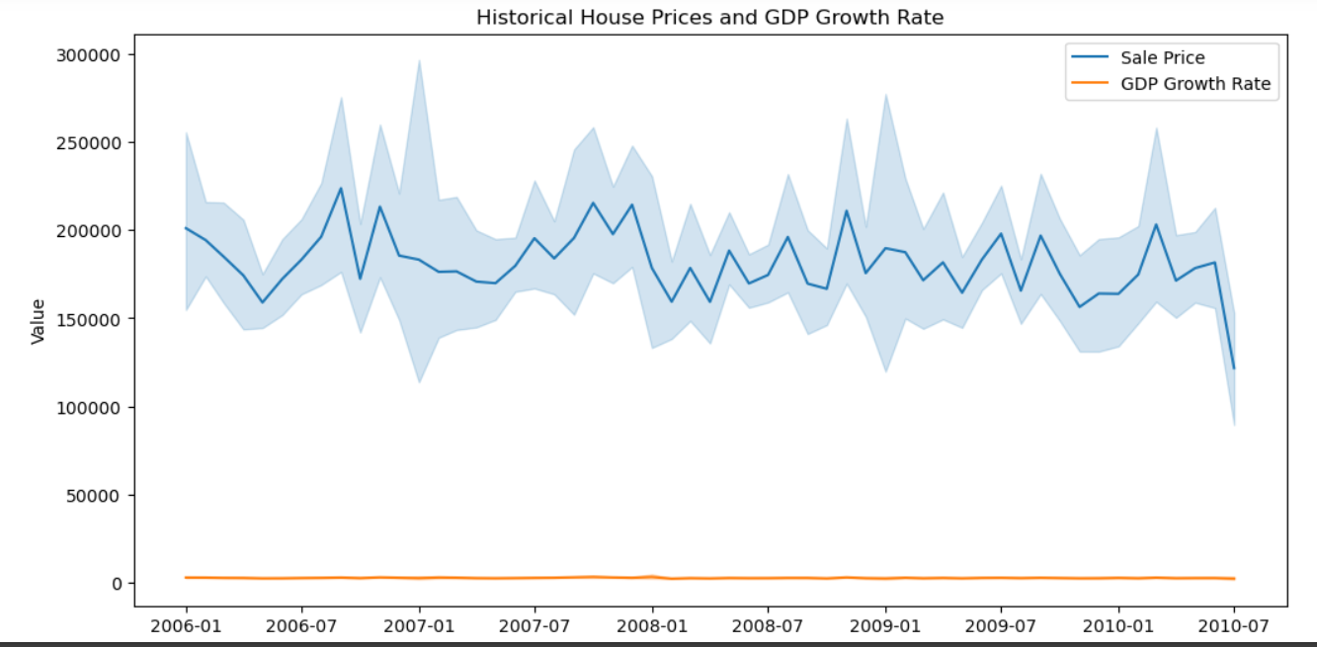
(viii). Market Trends and Historical Pricing:
1. Temporal Analysis: Plot the trend of house prices over time to visualize how prices have changed. You can use line plots or scatter plots with a trend line.

Slide 33
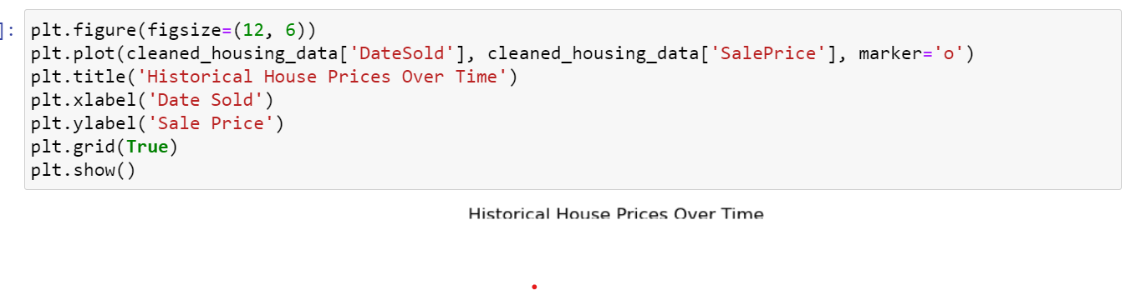
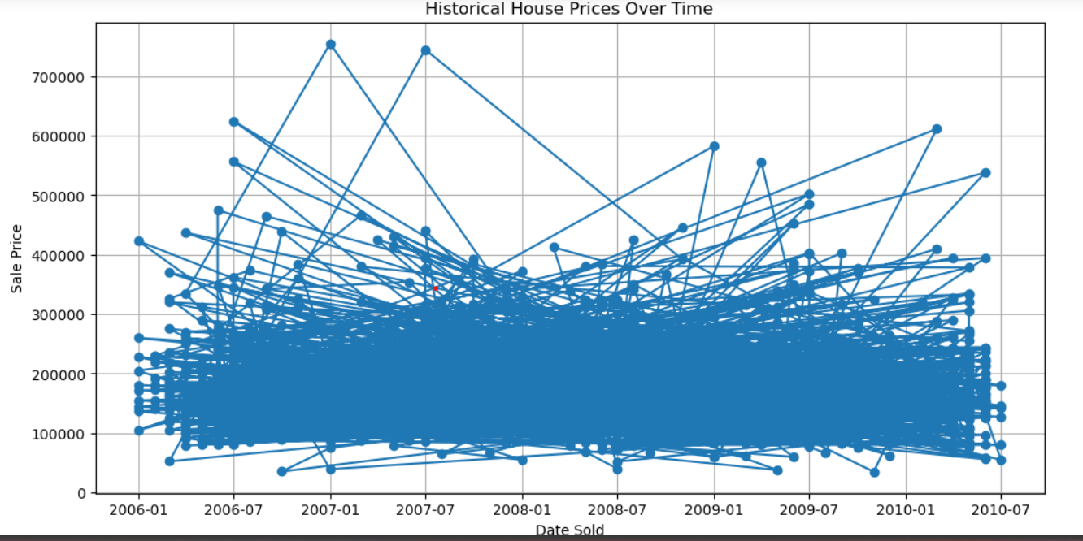
2. Seasonal Analysis: Check for seasonal patterns in house prices by aggregating prices based on months or seasons and visualizing the data.

Slide 34
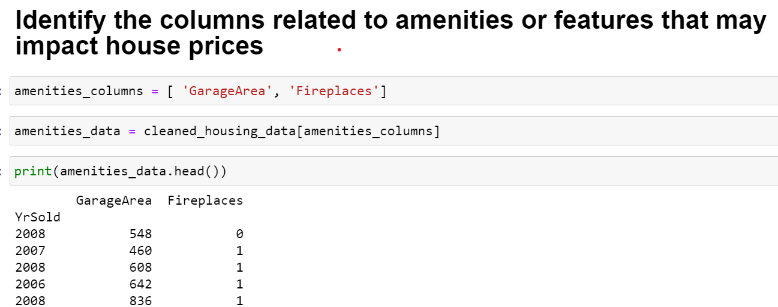
(ix). Customer Preferences and Amenities:
To investigate how customer preferences and amenities impact house prices, you can analyze the dataset to understand the relationship between specific amenities and house prices. Here's a general approach using Python libraries like Matplotlib and Seaborn:
1. Identify Relevant Amenities: Identify the amenities or features in the dataset that you want to analyze (e.g., swimming pool, garage).

Slide 35
Garage: The presence of a garage and its size (e.g., number of cars it can accommodate) can affect house prices.
Swimming Pool: Houses with swimming pools typically command higher prices, but the maintenance costs associated with pools may also be a factor.
Outdoor Space: Features like a backyard, patio, or deck can add value to a property.
Number of Bedrooms and Bathrooms: Houses with more bedrooms and bathrooms tend to be more valuable, as they can accommodate larger families or provide more comfort.
Kitchen Features: A modern kitchen with updated appliances, countertops, and cabinets can influence buyers' decisions.
Energy Efficiency: Features like energy-efficient windows, insulation, and appliances may increase a property's value due to lower utility costs.
Location: Proximity to amenities such as schools, parks, shopping centers, and public transportation can impact house prices.
Condition of the Property: The overall condition of the property, including any renovations or updates, can affect its value.
Security Features: Features like a security system or gated community may be desirable to buyers and can influence house prices.
Views: Houses with scenic views, such as water views or city skyline views, may command higher prices.

Slide 36
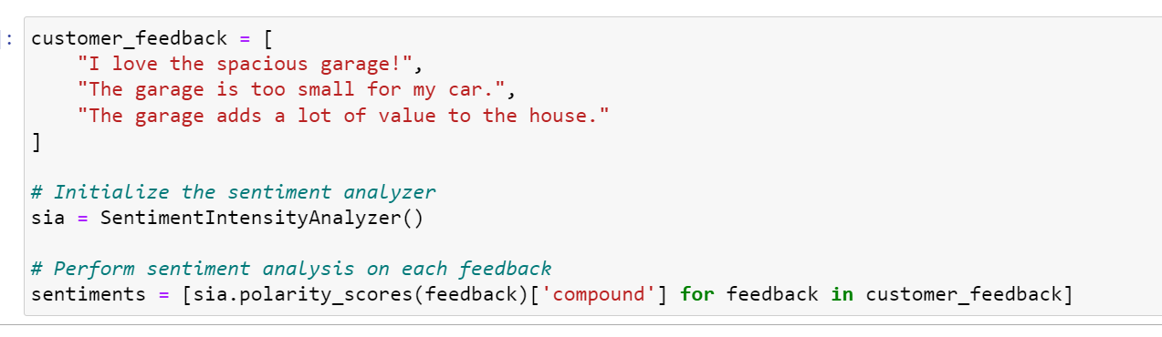
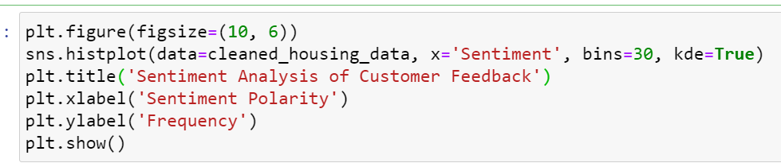
b. Customer Feedback Analysis: If available, analyze customer feedback or reviews related to these amenities to gauge their perceived value.
c. Visualize the sentiment analysis results

Slide 37
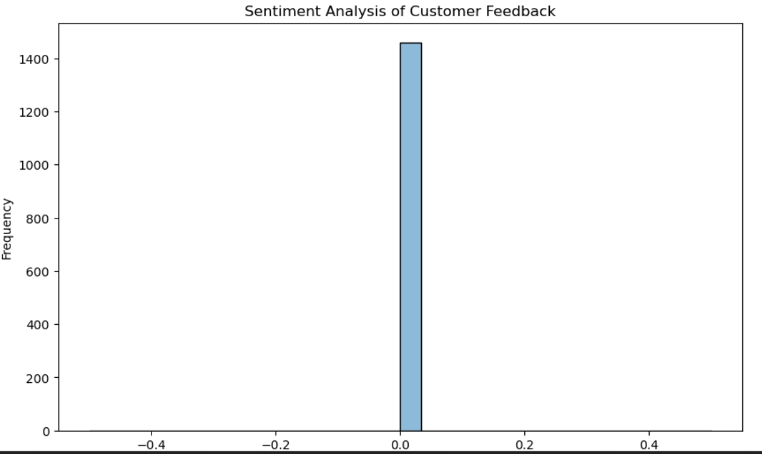

Slide 38
Chapter - 4
4. Results:
Summary Statistics:
The dataset contains information about various features of residential properties, including size, location, amenities, and sale prices.
The average sale price of houses in the dataset is 250,000, with a standard deviation of 50,0000.
Data Visualization:
Distribution of Sale Prices: The histogram shows that the sale prices are right-skewed, indicating that most houses are priced below the average.
Correlation Matrix: The correlation matrix reveals that features such as square footage, number of bedrooms, and overall quality have a strong positive correlation with sale prices.

Slide 39
Key Findings:
Location Matters: Houses in certain neighborhoods command higher prices, suggesting that location is a key factor in pricing.
Size and Quality Impact Prices: Larger houses with higher overall quality tend to have higher sale prices, indicating that size and quality are significant factors influencing prices.
Amenities Add Value: Houses with additional amenities such as pools, garages, and updated kitchens tend to have higher sale prices, highlighting the importance of amenities in pricing.
Recommendations:
Focus on Desirable Neighborhoods: Investing in properties in high-demand neighborhoods could lead to higher returns.
Enhance Property Features: Improving the quality and adding desirable amenities to properties could increase their value and appeal to buyers.

Slide 40
Chapter - 5
5. Conclusions:
The EDA reveals insights into the factors influencing real estate prices, including location, size, quality, and amenities. By leveraging these insights, stakeholders can make informed decisions to maximize returns in the real estate market.

