Slide 1
Pure‎ Link
Be the reason for someone's heartbeat.

Slide 2
Table of contents_
01
03
02
Introduction
Work
Distribution
Template_
Display

Slide 3
01
Introduction_

Slide 4
What is Pure_Link?_
I am pleased to introduce Pure Link, a distinguished blood donation software meticulously designed to facilitate seamless blood donations and distributions. Our professional team, comprised of dedicated staff members, ensures the smooth collection, processing, and storage of donated blood. When individuals or hospitals require specific blood types, Pure Link responds with urgency, delivering the needed blood in the shortest possible time. We pride ourselves on our commitment to professionalism, confidentiality, and efficiency, striving to make a significant impact on the lives of patients. Join us in this noble mission of saving lives through the power of blood donation

Slide 5
02
Template_ Display

Slide 6


Slide 7
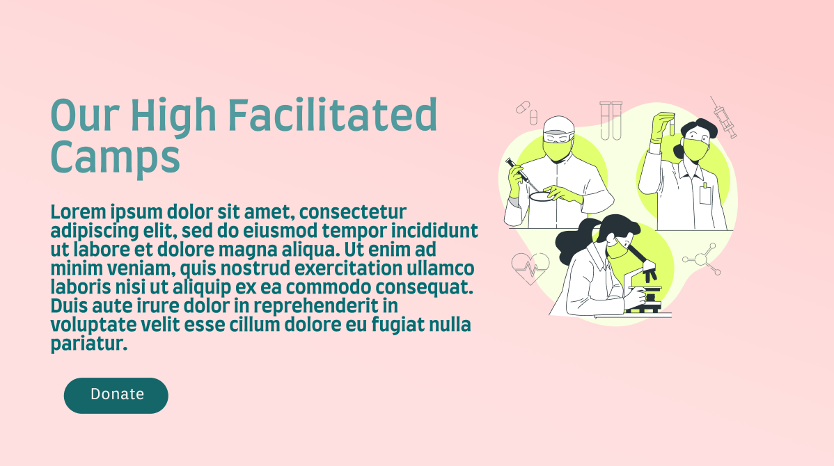

Slide 8


Slide 9


Slide 10
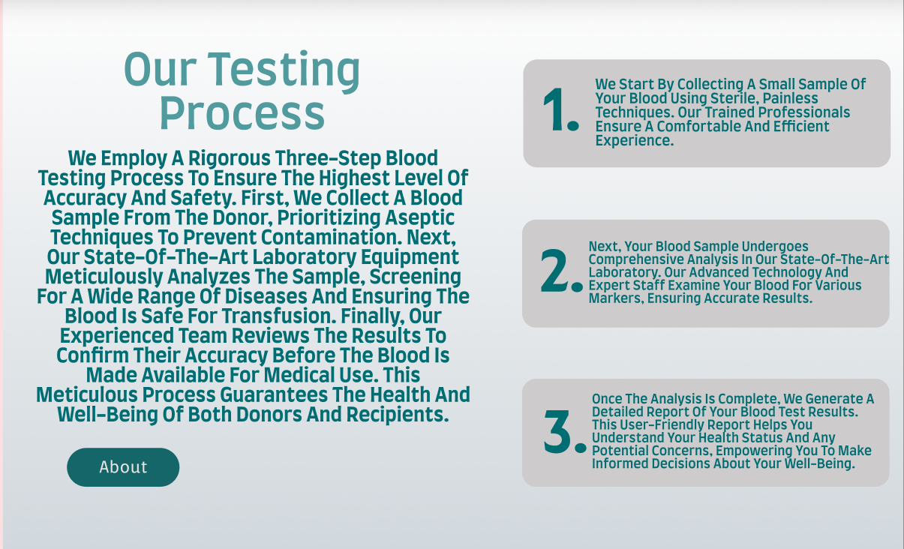

Slide 11
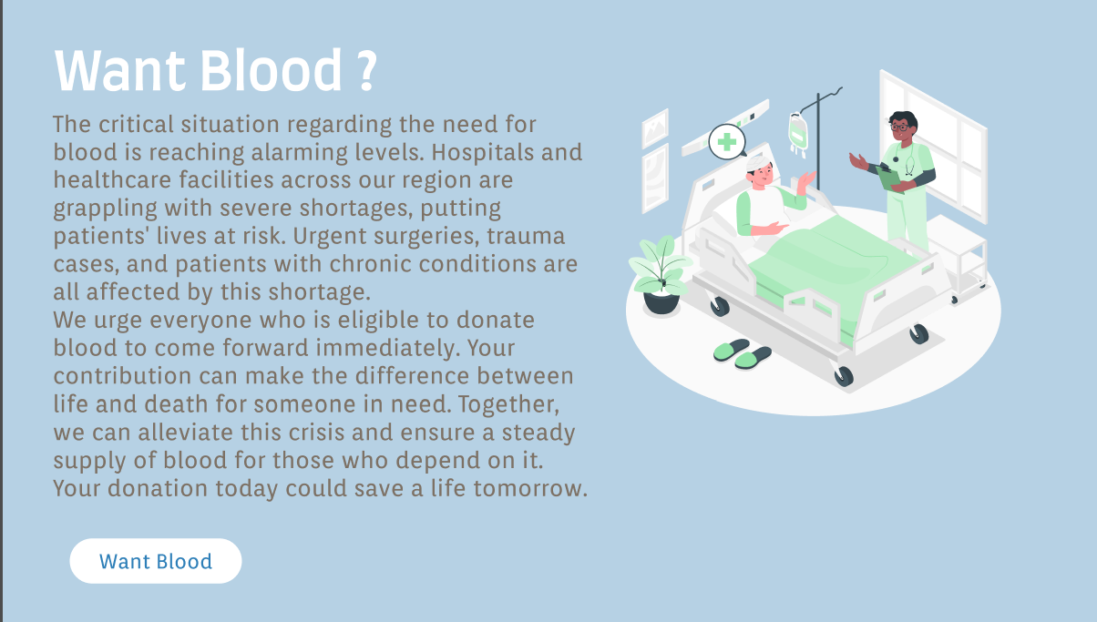

Slide 12
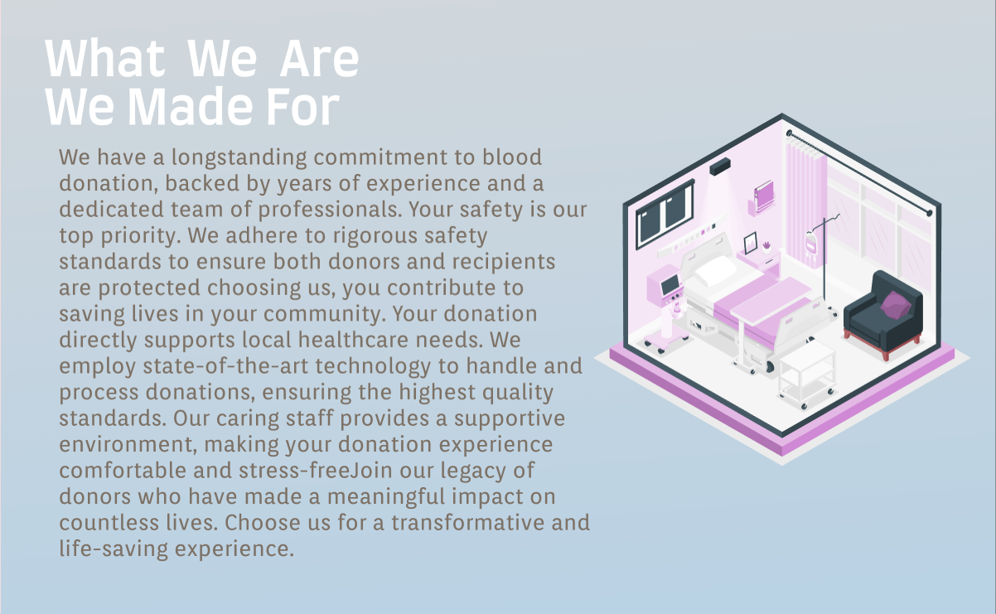

Slide 13
03
Work_ Distribution

Slide 14
Hero Section
Adil Athif

Slide 15
Donation
D5 Tech

Slide 16
Collection_
Service
Jeevan

Slide 17
Medical Team
Mukthar

Slide 18
Testing
Process
Faise

Slide 19
Request Blood
Affan

Slide 20
Why Us?
Anupam

Slide 21
THANKS FOR
L I S T E N I N G
ALL THE BEST

