Slide 1


UNIVERSITY INSTITUTE OF ENGINEERING
Academic Unit V
Bachelor of Engineering (Computer Science & Engineering)
Biology For Engineers
23SZT-148
Biology for Engineers
DISCOVER . LEARN . EMPOWER

Slide 2
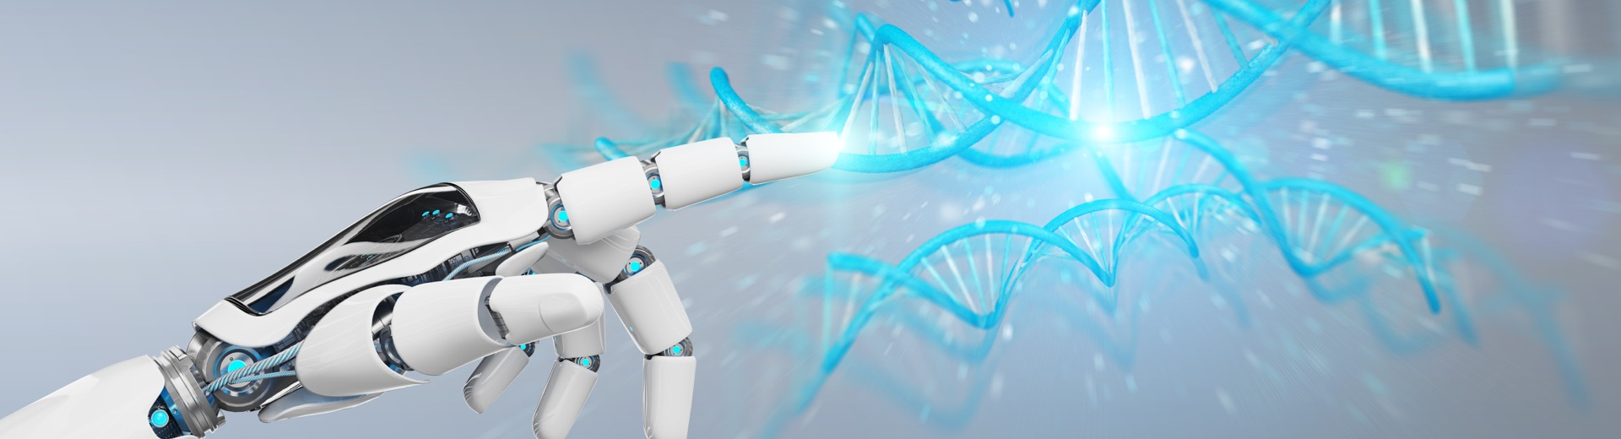
INTRODUCTION
Course Objective
This subject is designed to impart fundamental knowledge on basic of genetics and emerging fields of biology like biomedical recording system and medical instrumentation.
It is designed to impart knowledge that how to apply basics of biology in engineering.
https://www.uic.es/sites/default/files/uic-grau-bioenginyeria-hero-header_1.jpg
Biology for Engineers

Slide 3

INTRODUCTION
Course Outcome
CO Number | Title | Level
CO1 | Identify the biological concepts from an engineering perspective. | knowledge
CO2 | Development of artificial systems mimicking human action. | Understand
CO3 | Explain the basic of genetics that helps to identify and formulate problems | Analyze
CO4 | Apply knowledge of measurement system, biomedical recording system and biosensors to excel in areas such as entrepreneurship, medicine, government, and education. | Apply
CO5 | Integrate biological principles for developing next generation technologies, | Create
Will be covered in this lecture
Biology for Engineers

Slide 4
SYLLABUS
Unit-1 | Importance of Biology In Engineering | Contact Hours: 15
Chapter 1 Significance of Biology in Engineering Chapter 2 Genetics | Introduction: Fundamental Differences between Science and engineering by drawing a comparison between eye and camera, Bird flying and aircraft. Significance of Biology in Engineering, Discuss how biological observations of 18th Century that lead to major discoveries, Examples from Brownian motion and the origin of thermodynamics by referring to the original observation of Robert and Julius Mayor. Genetics: Mendel’s laws, Concept of segregation and independent assortment, concept of allele, gene mapping, Gene interaction, Epitasis, Meiosis and Mitosis as a part of genetics. Mechanism of how genetic material passes from parent to offspring. Concepts of recessiveness and dominance. Concept of mapping of phenotype to Genes, single gene disorders in humans, concept of complementation using human genetics.
Biology for Engineers

Slide 5
BIOLOGICAL OBSERVATIONS OF 18TH CENTURY THAT LEAD TO MAJOR DISCOVERIES
Biology for Engineers

Slide 6
History of Biology
The study of living things has a rich and exciting history.
The key events of biological discoveries has significant impacts on humankind.
We live on a planet covered in life, and humans have tried to understand how living things work for as long as we have been around.
This knowledge has supported, and continues to support, our success as a species.
Biology for Engineers

Slide 7
Ancient Biology
The word biology actually comes from the Greek words, ‘bios’ meaning life and ‘logos’ meaning discourse!
History of biology begins with the careful observation of external aspects of organisms and continues with investigations into the functions and interrelationships of living thigs.
The ancient Greek philosopher Aristotle is credited with establishing the importance of observation and analysis as the basic approach for scientific investigation.
By A.D. 200, studies in biology were centered in the Arab world. Most of the investigations during this period were made in medicine and agriculture.
Arab scientists continued this activity throughout the Middle Ages.
Biology for Engineers

Slide 8
17 and 18th Century
In 17th and 18th Centuries, biological study primarily consisted of classifying organisms and understanding the human body on the macroscopic level.
But the advent of the microscope opened up a whole new world of living things!
The earliest microscopes were developed in the Netherlands in the late 16th century, but were extensively put to use throughout the 17th century when Robert Hooke identified the first cells by examining cork tissue.
In the early 18th century, botanist Carl Linnaeus established the classification system that we use today in his work, Systema naturae (System of nature).
This system of binomial nomenclature assigns a two-part name to species in which the genus name is capitalized and precedes the species epithet; both are italicized.
  For example, the scientific name for human beings is Homo sapiens.
Biology for Engineers

Slide 9
Biological sciences emerged from traditions of medicine and natural history reaching back to ayurveda, ancient Egyptian medicine and the works of Aristotle and Galen in the ancient Greco-Roman world.
This ancient work was further developed in the Middle Ages by Muslim physicians and scholars such as Avicenna. During the European Renaissance and early modern period, biological thought was revolutionized in Europe by a renewed interest in empiricism and the discovery of many novel organisms.
The growing importance of natural theology, partly a response to the rise of mechanical philosophy, encouraged the growth of natural history (although it entrenched the argument from design).
For instance Charles Darwin's explanation in The Origin of Species (1859) showed how the processes of random variation and natural selection could combine to produce what appeared to be instances of "design" in the natural world (humans and animals developed through an evolutionary process).
Biology for Engineers

Slide 10
Nature-Inspired Discoveries
Mother Nature is a huge classroom that offers many lessons for those who take the time to reflect and discover.
Scientists and inventors study characteristics of things in nature and comes up amazing technologies and products invented as a result of studying nature.
Biology for Engineers

Slide 11
Law of Gravitational Force
It was Sir Issac Newton, a mathematician, who deduced the Law of Gravitational Force.
It is well-known that he was once sitting under an apple tree when an apple fell down from the tree, compelling him to wonder how it came down to earth and did not go upward.
This resulted in Newton formulating that it is the gravitational force of earth that attracts all objects to itself.
It was formulated in Newton’s work Philosophiæ Naturalis Principia Mathematica or The Principia, first published in July 1687.
Biology for Engineers

Slide 12
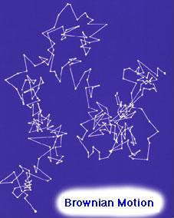
Brownian Motion and The Origin of Thermodynamics
Brownian motion, also called Brownian movement, any of various physical phenomena in which some quantity is constantly undergoing small, random fluctuations.
It was named for the Scottish botanist Robert Brown, the first to study such fluctuations (1827).
He was observing a suspended pollen grain in water. While looking at this pollen grain underneath a microscope, he notices that it undergoes a type of random walk.
The figure depicts the type of random, seemingly unpredictable motion, that the suspended particle underwent.
Biology for Engineers

Slide 13
This random motion is now referred to as BROWNIAN MOTION, but the motion itself may be easily remembered as the "Drunken Sailor Walk".
At first Brown attributed this motion to signs of life.
However, when he repeated the experiment with an inorganic body he observed the same motion.
Now the phenomenon of Brownian motion has been discovered, but...
HOW DO WE EXPLAIN THIS SEEMINGLY RANDOM MOTION?
This question leads to two school of thought and a debate that lasted for 68 years!
Biology for Engineers

Slide 14
The phenomenon of Brownian motion caused much debate on the possible causes for this motion.
These debates lead to two opposed and contradicting sides.
There were the ENERGETICS, lead by William Ostwald, and the ATOMISTS, lead by Ludwig Boltzmann.
Biology for Engineers

Slide 15
THE GREAT ATOM DEBATE
ENERGETICS
View the world through macroscopic properties
Use Classical Thermodynamics to explain phenomenon
NO such thing as particles!
ATOMISTS
View the world through microscopic properties
Use the Molecular Kinetic Theory of Heat to explain phenomenon
Fluids behave AS IF they are composed of particles
Biology for Engineers

Slide 16
Now let's take some time to discuss what each of these points mean:
Point 1:
The Energetics believed that everything in the world could be explained by using macroscopic properties such as energy, volume, pressure, and temperature.
The Atomists viewed the world by modeling gases and fluids as though they were composed of tiny particles that moved around, this lead them to having to use statistics to explain phenomenon.
Biology for Engineers

Slide 17
Point 2:
The Energetics used the theoretical framework of Classical Thermodynamics to describe phenomenon mathematically. The most basic equation from this formulism is given by the ideal gas law, which states, as before, that PV = CT.
The Atomists used the theoretical framework of the Molecular Kinetic Theory of Heat to describe phenomenon mathematically. The most basic equation from this point of view relates the kinetic energy, or the moving energy, of a single particle to the temperature by a constant known as Boltzmann's Constant.
Biology for Engineers

Slide 18
Point 3
The Energetics did not believe that matter was discrete. They believed that you could cut up matter into smaller and smaller pieces indefinitely.
The Atomists on the other hand, viewed matter in much the same way as Democritus, by saying that eventually you will reach a point where you can no longer cut any further.
Biology for Engineers

Slide 19
Classical Thermodynamics
There are three laws which describe all of Classical Thermodynamics:
  Energy cannot be created or destroyed.
    This basically means that you cannot get something for nothing.
    As a result, the amount of energy in the entire universe is a constant value.
    All that we observe is the exchange of energy from one from to another.
      For example the energy from the sun is used to grow vegetables, we in turn eat these vegetables to gain energy. We then walk, run, work etc. and expend this energy which we really received from the sun!
Biology for Engineers

Slide 20
Classical Thermodynamics
The entropy of a system always increases
  Entropy is basically the randomness or order of a system.
  The entropy always increasing, means that the randomness of the system increases or the order of the system decreases.
  The system is becoming more chaotic.
    For example, a liquid has more entropy than a solid and less entropy than a gas. This is because a solid has a very definite structure and is well ordered. Whereas a liquid has less order and a gas has even less! See the figure below, which depicts the structure of a solid, liquid and gas respectively.
Biology for Engineers

Slide 21
Classical Thermodynamics
You can never reach absolute zero.
  This is just a way of saying that you can never decrease the temperature to a point where the system has no energy, meaning it does not move.
  The temperature where this would happened is known as absolute zero, and is -273.15 degrees Celcius! Otherwise known as 0K or zero degress Kelvin.
Biology for Engineers

Slide 22
Julius von Mayer – Energy can neither be created or destroyed
On November 25, 1814, German physician and physicist Julius Robert von Mayer was born.
He is best known for enunciating in 1841 one of the original statements of the conservation of energy or what is now known as one of the first versions of the first law thermodynamics, namely that “energy can be neither created nor destroyed“.
“Nature has put itself the problem of how to catch in flight light streaming to the Earth and to store the most elusive of all powers in rigid form. The plants take in one form of power, light; and produce another power, chemical difference.”
— Julius Robert von Mayer, Die organische Bewegung in ihrem Zusammenhange mit dem Stoffwechsel (1867)
Biology for Engineers

Slide 23
Julius Mayer studied medicine at the University of Tübingen. In 1838 he earned his doctorate and Staatsexamen.
German physician Julius Robert Mayer in 1842, after observations made in Java where he served as a ship’s surgeon of a Dutch merchant ship, established the basis of the mechanical theory of the heat that will lead to the First Law of Thermodynamics.
Mayer made the observation that storm-whipped waves are warmer than the calm sea started him thinking about the physical laws, in particular about the physical phenomenon of warmth and the question whether the directly developed heat alone (the heat of burning), or the sum of the quantities of heat developed in direct and indirect ways are to be accounted for in the burning process.
After his return in February 1841, Mayer devoted all his energies to solving this task.
Biology for Engineers

Slide 24
Mayer suspected that the heat production of the human body decreases at high temperatures, since his physiological observations in the tropics revealed an unusually bright red color of venous blood, which he attributed to a reduced “burning” of oxygen.
During 1841, Mayer completed his first scientific paper titled “On the Quantitative and Qualitative Determination of Forces“, in which he postulated a “conservation law of force” (meaning energy).
He presented a value in numerical terms for the mechanical equivalent of heat. He also was the first person to describe the vital chemical process now referred to as oxidation as the primary source of energy for any living creature.
Unfortunately for Julius Mayer, he was back then not really taken seriously and most credit was given to James Joule.
Julius Mayer was the first person to state the law of the conservation of energy, one of the most fundamental tenets of modern day physics.
Biology for Engineers

Slide 25
Discussions with physicist Johann Gottlieb Nörremberg gave Mayer a number of valuable suggestions on how the idea could be examined experimentally.
For instance if kinetic energy transforms into heat energy, water should be warmed by vibration.
Mayer managed to perform the demonstration and to determine the quantitative factor of the transformation, calculating the mechanical equivalent of heat.
The result of his investigations was published 1842 in the May edition of Justus von Liebig‘s Annalen der Chemie und Pharmacie.
It was translated as Remarks on the Forces of Inorganic Nature.
Mayer further specified the numerical value of the mechanical equivalent of heat: at first as 365 kgf·m/kcal, later as 425 kgf·m/kcal; the modern values are 4.184 kJ/kcal for the thermochemical calorie and 4.1868 kJ/kcal for the international steam table calorie.
It is implied that, although work and heat are different forms of energy, they can be transformed into one another.
This law is called the first law of the caloric theory and led to the formulation of the general principle of conservation of energy, definitively stated by Hermann von Helmholtz in 1847.
Biology for Engineers

Slide 26
Julius von Mayer was aware of the great importance of his discovery, but his inability to express himself scientifically, his penchant for speculation, and his confessional religiosity did not earn him the desired reputation as a scientist.
Biology for Engineers

Slide 27
15 Great Biological Discoveries that Revolutionized Life Science
Biology for Engineers

Slide 28
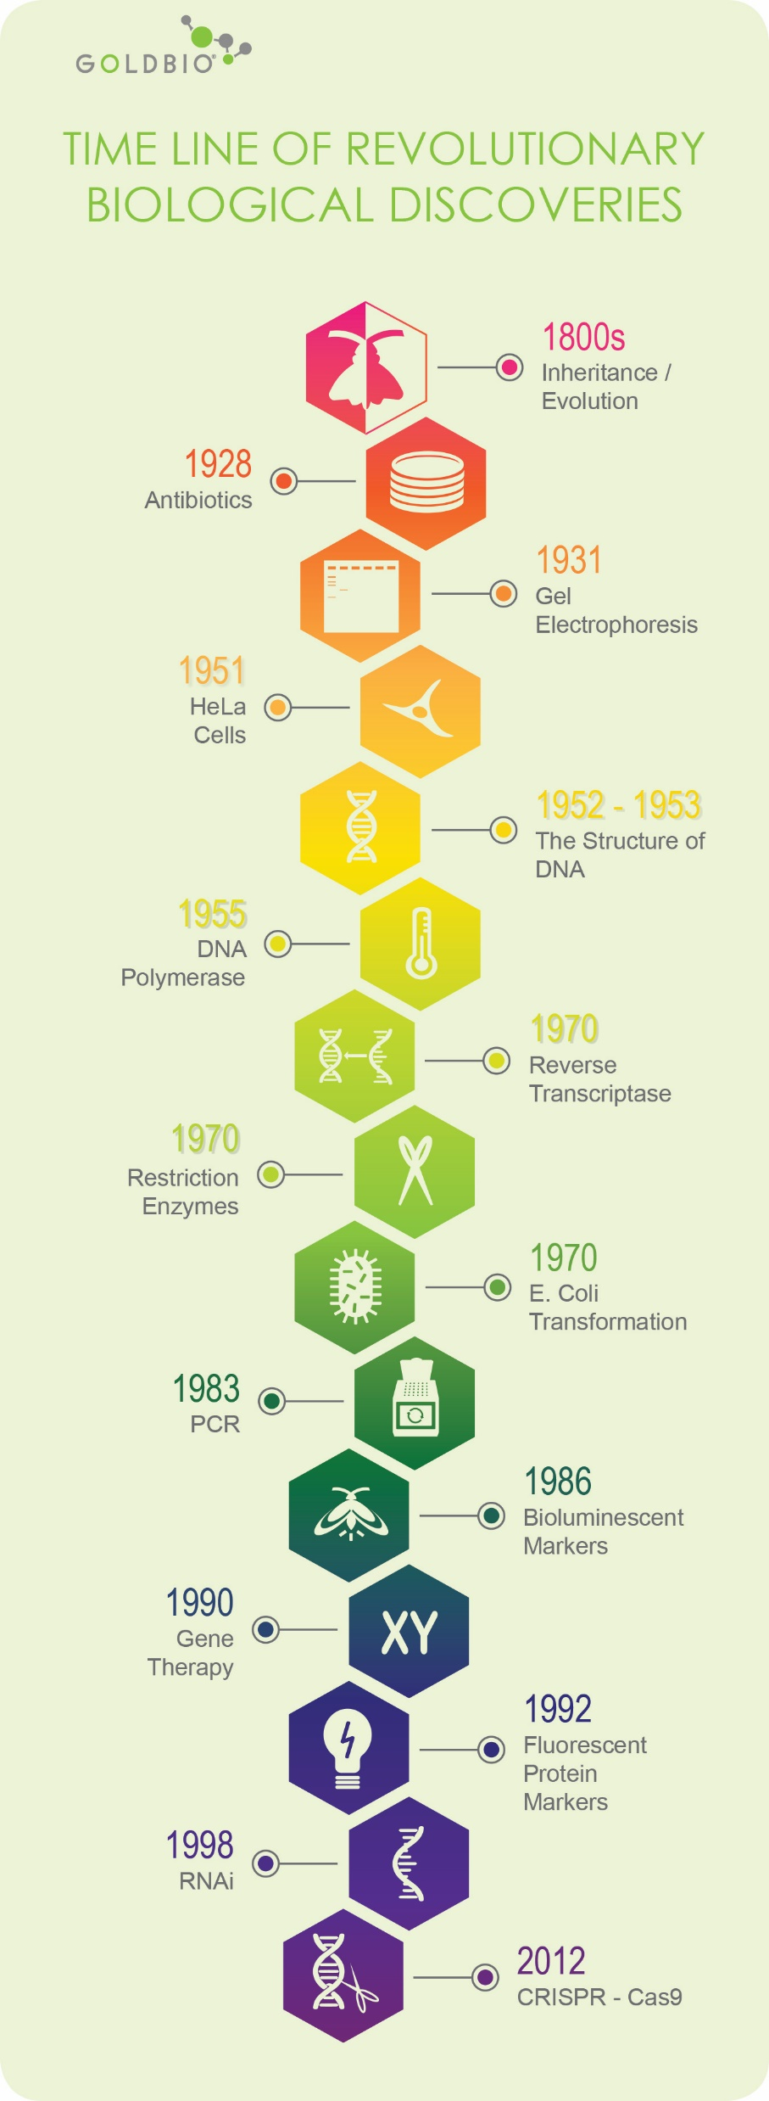
Inheritance/Evolution (1800s)
Antibiotics (1928)
Gel Electrophoresis (1931)
HeLa Cell Discovery (1951)
The Structure of DNA (1952-1953)
DNA Polymerase (1956)
Reverse transcriptase (1970)
Restriction enzymes (1970)
E. coli transformation (1970)
PCR (1983)
Bioluminescent markers (1986)
Gene Therapy (1990)
Fluorescent protein markers (1992)
RNAi (1998)
CRISPR-Cas9 (2012)
Biology for Engineers

Slide 29
References
Biology - Important discoveries in biological science - Study, Evolution, Century, and Organisms - JRank Articles https://science.jrank.org/pages/885/Biology.html#ixzz75TcQUL6c
https://study.com/academy/lesson/key-events-in-the-history-of-biological-study.html
https://www.goldbio.com/articles/article/15-Great-biological-discoveries-that-revolutionized-life-science
http://scihi.org/julius-von-mayer-energy/#:~:text=Julius%20Robert%20von%20Mayer%20(November,of%20the%20founders%20of%20thermodynamics.&text=In%201842%2C%20Mayer%20described%20the,energy%20for%20any%20living%20creature.
Biology for Engineers

Slide 30


Biology for Engineers

