Slide 1


UNIVERSITY INSTITUTE OF ENGINEERING
Academic Unit V
Bachelor of Engineering
(Computer Science & Engineering)
Biology For Engineers
23SZT-148
Biology for Engineers
INTRODUCTION
DISCOVER . LEARN . EMPOWER

Slide 2

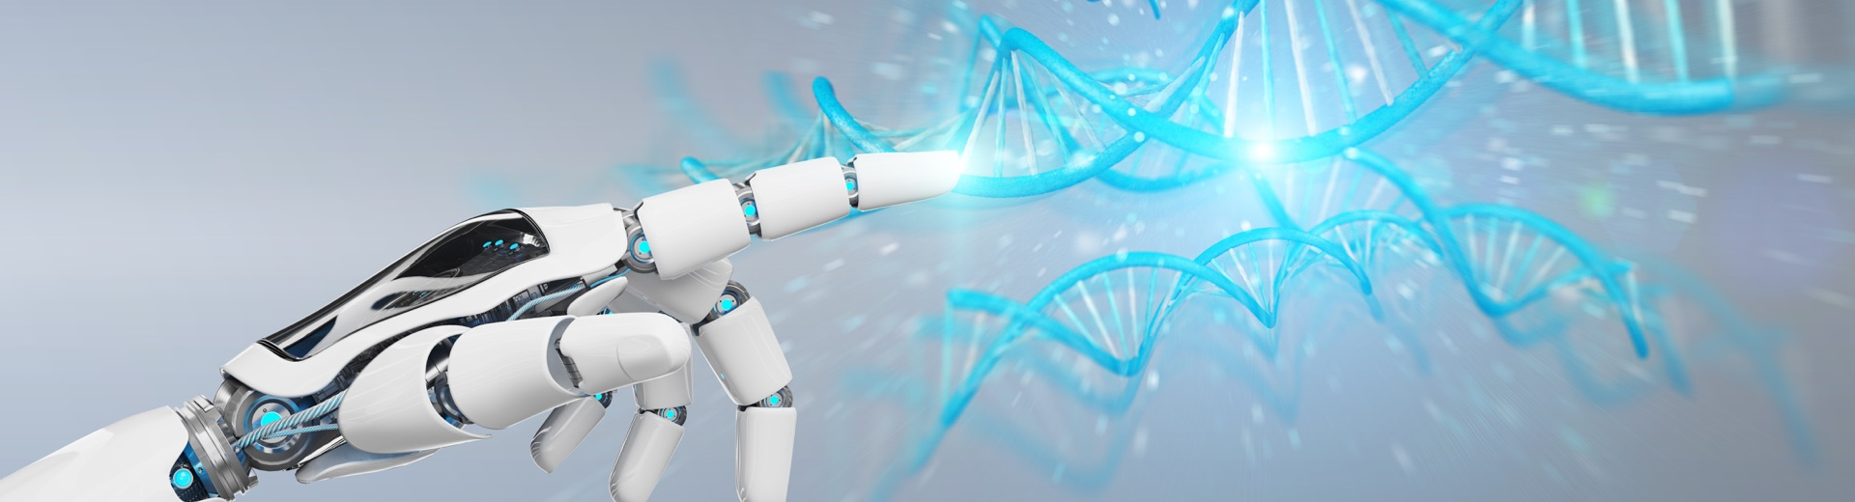
INTRODUCTION
Course Objective
This subject is designed to impart fundamental knowledge on basic of genetics and emerging fields of biology like biomedical recording system and medical instrumentation.
It is designed to impart knowledge that how to apply basics of biology in engineering.
https://www.uic.es/sites/default/files/uic-grau-bioenginyeria-hero-header_1.jpg
Biology for Engineers

Slide 3
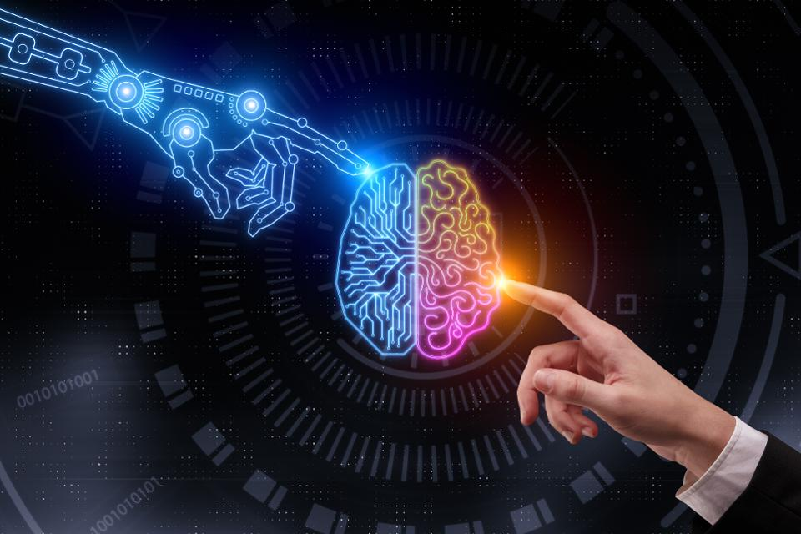
INTRODUCTION
Space for visual (size 24)
Course Outcome
CO Number | Title | Level
CO1 | Identify the biological concepts from an engineering perspective. | knowledge
CO2 | Development of artificial systems mimicking human action. | Understand
CO3 | Explain the basic of genetics that helps to identify and formulate problems | Analyze
CO4 | Apply knowledge of measurement system, biomedical recording system and biosensors to excel in areas such as entrepreneurship, medicine, government, and education. | Apply
CO5 | Integrate biological principles for developing next generation technologies, | Create
Will be covered in this lecture
https://specials-images.forbesimg.com/imageserve/1034901762/960x0.jpg?fit=scale
Biology for Engineers

Slide 4
SYLLABUS
Unit-1 | Importance of Biology In Engineering | Contact Hours: 15
Chapter 1 Significance of Biology in Engineering Chapter 2 Genetics | Introduction: Fundamental Differences between Science and engineering by drawing a comparison between eye and camera, Bird flying and aircraft. Significance of Biology in Engineering, Discuss how biological observations of 18th Century that lead to major discoveries, Examples from Brownian motion and the origin of thermodynamics by referring to the original observation of Robert and Julius Mayor. Genetics: Mendel’s laws, Concept of segregation and independent assortment, concept of allele, gene mapping, Gene interaction, Epitasis, Meiosis and Mitosis as a part of genetics. Mechanism of how genetic material passes from parent to offspring. Concepts of recessiveness and dominance. Concept of mapping of phenotype to Genes, single gene disorders in humans, concept of complementation using human genetics.
Biology for Engineers

Slide 5
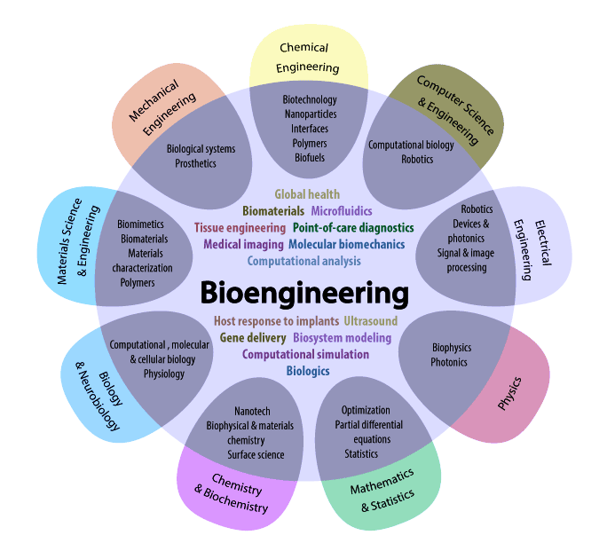
WHY DO WE NEED TO KNOW BIOLOGY
To find solutions to challenges, that face mankind
Biology is us, we are all biological creatures
Biology for Engineers
https://i.pinimg.com/originals/68/c9/30/68c930e95113ceb2e3dfc9de2f164680.png

Slide 6

DIFFERENCE BETWEEN SCIENCE AND ENGINEERING
Biology for Engineers

Slide 7
Fundamental Difference between Science and Engineering
Generally, Science is the study of the physical world, while Engineering applies scientific knowledge to design processes, structures or equipment.
Both Engineers and Scientists will have a strong knowledge of science, mathematics and technology, but Engineering students will learn to apply these principles to designing creative solutions to Engineering challenges.
So when we think of a scientist versus engineer, the two aren’t separate entities but belong to each other – without science, there wouldn’t be engineering
Biology for Engineers

Slide 8
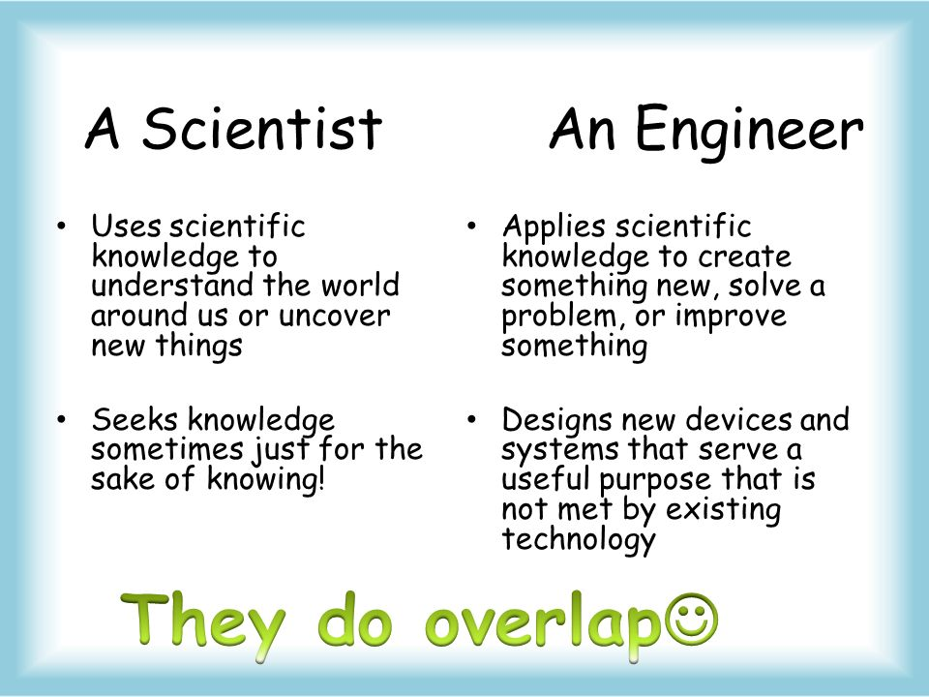
FUNDAMENTAL DIFFERENCE BETWEEN SCIENCE & ENGINEERING
Biology for Engineers
https://qph.fs.quoracdn.net/main-qimg-36e90eb8a3984ab484ff3888b4376e36.webp

Slide 9
Science
Science is the study of the nature and behavior of natural things and the knowledge that we obtain about them
Science is the field of study concerned with discovering and describing the world around us by observing and experimenting
Science is defined as the observation, identification, description, experimental investigation, and theoretical explanation of natural phenomena
Biology for Engineers

Slide 10
Engineering
Engineering, the application of science to the optimum conversion of natural resources to the uses of humankind
Engineering is the creative application of scientific principles to design or develop structures, machines, apparatus, or manufacturing processes, or works utilizing them singly or in combination; or to construct or operate the same with full cognizance of their design; or to forecast their behavior under specific operating conditions; all as respects an intended function, economics of operation and safety to life and property
Biology for Engineers

Slide 11
There are four questions that can help you frame your explanation of the differences between engineering and science
Biology for Engineers

Slide 12
What’s the simple definition?
Science is the body of knowledge that explores the physical and natural world. Engineering is the application of knowledge in order to design, build and maintain a product or a process that solves a problem and fulfills a need (i.e. a technology).
The essence of science is inquiry; the essence of engineering is design.
  Scientific inquiry expands the scope of human perception and understanding; engineering design expands the scope of human plans and results
Science is knowledge of facts and engineering is application of these facts
Biology for Engineers

Slide 13
What’s the procedure?
Scientists use the scientific method.
The scientist starts with asking a question. Then they do background research, formulate a hypothesis, test that hypothesis by conducting an experiment, analyze the data and communicate their results.
Engineers use the engineering design process.
Engineers start by defining the problem, then they identify the criteria and constraints, brainstorm ideas, plan, create a technology and improve upon their design.
Biology for Engineers

Slide 14
What’s the goal?
Scientists and engineers have different goals.
  Scientists seek to describe and understand the natural world.
  Engineers consider various criteria and constraints in order to design solutions to problems, needs and wants that better the lives of humans, animals and/or the environment.
Biology for Engineers

Slide 15
What’s the result and impact?
Scientists use their varied approaches—controlled experiments or longitudinal observational studies—to generate knowledge. The final result might be a research paper or a book, and the knowledge therein can be used to help us understand and make predictions about the natural world.
Engineers use scientific knowledge to create a technology.
What does this mean in a real-world context?
  Example: A virologist is a scientist who researches how viruses are spread and how they affect the human body. A biomedical engineer can use the virologist's research to create an anti-viral drug that blocks a certain virus from spreading to new cells in the body.
In this way, both engineers and scientists are extremely important, and both fields benefit from the ingenuity and hard work of its counterpart. In some cases, scientists rely on the innovations that engineers design to further their research (e.g. microscopes or monitors)
Biology for Engineers

Slide 16
COMPARISON BETWEEN EYE AND CAMERA
Biology for Engineers

Slide 17
Comparison between eye and camera
Eye is an organ of sight while a camera is equipment that is used to record images
How eye works….. The facts gathered by using different fields of science (like biology, physics etc.) and then human engineered camera by using these facts
Biology for Engineers

Slide 18
Comparison between eye and camera
The human eye lets us see the world by sending impulses to our nervous system. In many ways, it is very similar to other optical devices, including cameras.
Your eyes and your brain work together to allow you to see. In fact, human eyes and brains have been coevolving for millions of years.
Your eyes are a bit like something else that captures images of the world: a camera.
Biology for Engineers

Slide 19
Comparison between eye and camera
The camera and the human eye have much more in common than just conceptual philosophy — the eye captures images similar to the way the camera does.
The anatomy of the camera bears more similarities to a biological eyeball than many would imagine, including the lens-like cornea and the film-like retina.
Similarities like these give the camera the appearance of a robotic eye. However, though there are many similarities between cameras and eyes, they are by no means identical.
Biology for Engineers

Slide 20
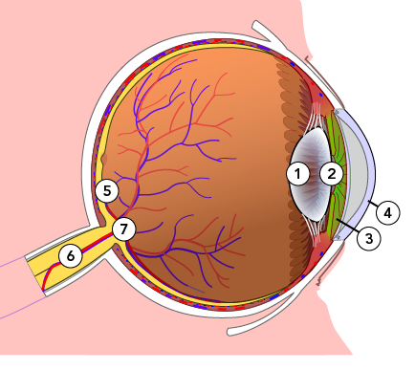
How are an eye and a camera similar?
An eye and a camera both have lenses and light-sensitive surfaces.
Your iris controls how much light enters your eye.
  Your lens helps focus the light.
  The retina is a light-sensitive surface at the back of your eye. It captures an image of what you’re looking at.
  Then, the retina sends impulses to your brain along the optic nerve. Finally, the brain interprets what you’re seeing.
A human eye has a lens (1), pupil (2), iris (3), cornea (4), retina (5), optic nerve (6), and blind spot (7)
Biology for Engineers

Slide 21
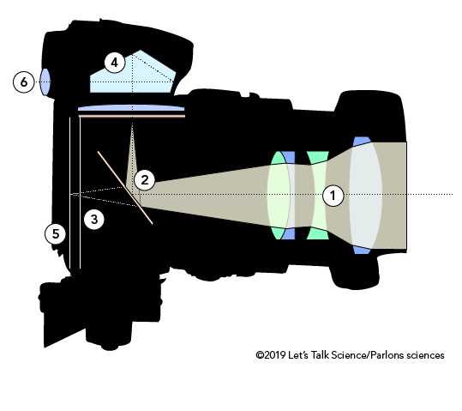
How are an eye and a camera similar?
This is similar to what happens when a camera captures an image.
  First, light hits the surface of the camera’s lens.
  The aperture controls how much light enters the camera.
  Then, the light makes its way to a light-sensitive surface.
  For a long time, this surface was the camera’s film. In today’s digital cameras, this surface is an imaging sensor chip.
Cross-section of a single-lens reflex (SLR) camera (© 2019 Let’s Talk Science)
An SLR camera has a lens (1), mirror (2), aperture (3), prism (4), film or imaging sensor (5) and eyepiece (6)
Biology for Engineers

Slide 22
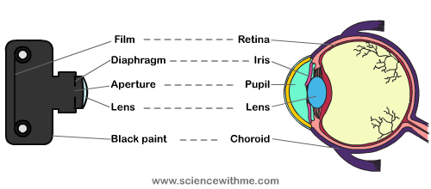
ANATOMY OF CAMERA & EYE
Biology for Engineers
https://sites.google.com/site/humaneye12/_/rsrc/1329590059679/resume/eye2C.png

Slide 23
Cornea and Lens
The cornea is the “cap” of the eye. This transparent (like clear jelly) structure sits to the front of the eye and has a spherical curvature.
The lens of a camera is also transparent (glass) and sits at the front of the body.
Like the cornea, the lens also maintains a spherical curvature.
The corneal and lens curvature allows for the eye and camera to view, though not in focus, a limited area to both the right and the left.
That is, without the curve, the eye and camera would see only what is directly in front of it.
Biology for Engineers

Slide 24
Iris and Aperture
Light adjustment: Both the eye and a camera can adjust quantity of light entering.
  On a camera, it’s done with the aperture control built into your lens, whilst in your eye, it’s done by having a larger or smaller iris.
The aperture is to the camera as the iris is to the eye, and this reveals one of many similarities between cameras vs. eyes.
The aperture size refers to how much light is let into the camera and will ultimately hit the sensor or film.
As with the human eye, when the iris contracts itself, the pupil becomes smaller and the eye takes in less light.
When the iris widens in darker situations, the pupil becomes larger, so it can take in more light. The same effect happens with the aperture; larger (lower) aperture values let in more light than a small (higher) aperture value.
The lens opening is the pupil; the smaller the opening, the less light let in.
Biology for Engineers

Slide 25
Focus in Eyes and Cameras
Image focusing: Human and camera lenses both focus an inverted image onto light-sensitive surface.
  In the case of a camera, it’s focused onto film or a sensor chip.
  In your eyes, the light-sensitive surface is the retina on the inside of your eyeball.
Both the eye and camera have the ability to focus on one single object and blur the rest, whether in the foreground (shallow depth of field) or off at a distance.
Likewise, the eye can focus on a larger image, just as a camera (greater depth of field) can focus and capture a large scape.
Biology for Engineers

Slide 26
Scope and Field of View
As the eye, the camera has a limited scope to take in what is around it.
The curvature of the eye and the lens allow for both to take in what is not directly in front of it.
However, the eye can only take in a fixed scope, while a camera’s scope can be changed by the focal length of different types of lenses
Biology for Engineers

Slide 27
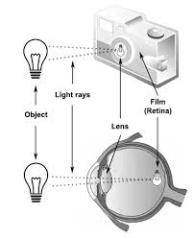
Retina and Film
The retina sits at the back of the eye and collects the light reflected from the surrounding environment to form the image. The same task in the camera is performed either by film or sensors in digital cameras.
Retinas, film, and imaging sensor chips all have one other thing in common. They all receive an inverted (upside-down) version of the image. Why? The lens in both an eye and a camera is convex, or curved outwards. When light hits a convex object, it refracts. This flips the image upside-down.
But you don’t see images upside-down. And the movies you watch aren’t upside-down either. Why not?
This is because your brain steps in to help your eyes. It knows the world is supposed to be right side up. So it flips the image over again.
Digital cameras are programmed to make the correction on their own. Non-digital cameras contain a prism or mirror that flips the image so it appears right side up. Film is transparent so you can view the images on it the right way around.
Biology for Engineers

Slide 28
How are an eye and a camera different?
The human eye contains small muscles that contract and relax – and this enables the lenses in your eyes to change shape and stay focused on a moving object.
These muscles also capable of changing the thickness of the lens to accommodate the image being viewed.
A camera lens can’t do this. That’s why photographers change lenses, depending on how far away they are from an object. Mechanical parts in the camera lens also adjust to stay focused on a moving object.
Biology for Engineers

Slide 29
How are an eye and a camera different?
Simply speaking, the human eye is a subjective device.
Your eyes work in harmony with your brain to create the images you perceive: Your eyes are adjusting the focus (by bending the light through the lens in your eyeballs) and translating photons (light) into an electrical impulse your brain can process.
From there onwards, it’s all about your brain: It is continuously readjusting its colour balance according to the lighting context.
In other words, our eyes know what must be seen as red or white or black etc.
Biology for Engineers

Slide 30
How are an eye and a camera different?
A camera, on the other hand, is an absolute measurement device — It is measuring the light that hits a series of sensor, but the sensor is ‘dumb’, and the signals recorded need to be adjusted to suit the color temperature of the light illuminating the scene, for example
  Lens focus: In camera, the lens moves closer/further from the film to focus. In your eyes, the lens changes shape to focus: The muscles in your eyes change the actual shape of the lens inside your eyes.
  Sensitivity to light: A film in a camera is uniformly sensitive to light. The human retina is not. Therefore, with respect to quality of image and capturing power, our eyes have a greater sensitivity in dark locations than a typical camera.
Biology for Engineers

Slide 31
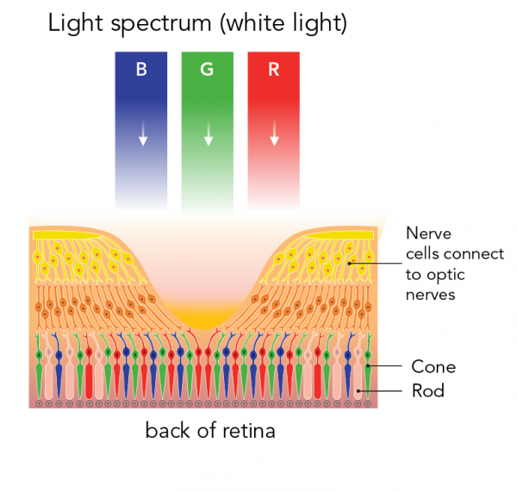
How does an eye process colour differently from a camera?
Your retinas contain two types of photoreceptors: rods and cones.
  Rods allow you to see in low light. They aren’t useful for colour vision.
  Cones let you see in colour. There are three types of cones. Each type responds to different wavelengths of light. Red cones respond to long wavelengths. Blue cones respond to short wavelengths. Green cones respond to medium wavelengths.
When your brain activates different combinations of cones, you can see the world in colour.
Location of rods and cones and how they react to different wavelengths of light (Let’s Talk Science based on an image by Graphic_BKK1979 via iStockphoto).
Biology for Engineers

Slide 32
How does an eye process colour differently from a camera?
Cameras also have photoreceptors. But they only have one type.
Cameras respond to red, blue and green light using filters placed on top of their photoreceptors.
The photoreceptors in a camera are evenly distributed across the lens.
In the human eye, however, the cones are concentrated at the center of the retina. There are no rods at all at the center of the retina.
Biology for Engineers

Slide 33
How else are your eyes different from a camera?
Because a camera has photoreceptors all over its lens, it always sees a “full” picture.
Your eyes, on the other hand, have a blind spot. That’s the point where the optic nerve connects to the retina. It has no photoreceptors at all.
Most of the time, you don’t notice your blind spot. This is because when light hits this area of one eye, your brain uses information from your other eye to fill in the gap.
If you want to test your blind spot, you can with a simple experiment.
Biology for Engineers

Slide 34
References
Biomimicry: Innovation Inspired by Nature28 Jul, 2009 by Janine M. Benyus.
Video link: https://www.digimat.in/nptel/courses/video/121106008/L01.html
https://youtu.be/ld3A065dELc
https://medium.com/photography-secrets/whats-the-difference-between-a-camera-and-a-human-eye-a006a795b09f
https://letstalkscience.ca/educational-resources/stem-in-context/eye-vs-camera
https://unfoldanswers.com/5-similarities-between-birds-and-aircraft/
https://nptel.ac.in/courses/121/106/121106008/
https://www.utoledo.edu/engineering/bioengineering/undergrad/prospective/whatisbioe.html#:~:text=Bioengineering%20is%20the%20application%20of,health%20care%20and%20other%20fields.
https://i.pinimg.com/originals/68/c9/30/68c930e95113ceb2e3dfc9de2f164680.png
https://youtu.be/FBUpnG1G4yQ
Biology for Engineers

Slide 35

Biology for Engineers

