Slide 1

INSTITUTE UIE
DEPARTMENT ACADEMIC UNIT-1
Bachelor of Engineering (Computer Science & Engineering)
Subject Name Semi Conductor Physics
Subject Code 23SPH-143
Prepared By
Navjeet Kaur
Lecture-1.1.2
Basic P-N junction diode, structure
DISCOVER . LEARN . EMPOWER

Slide 2
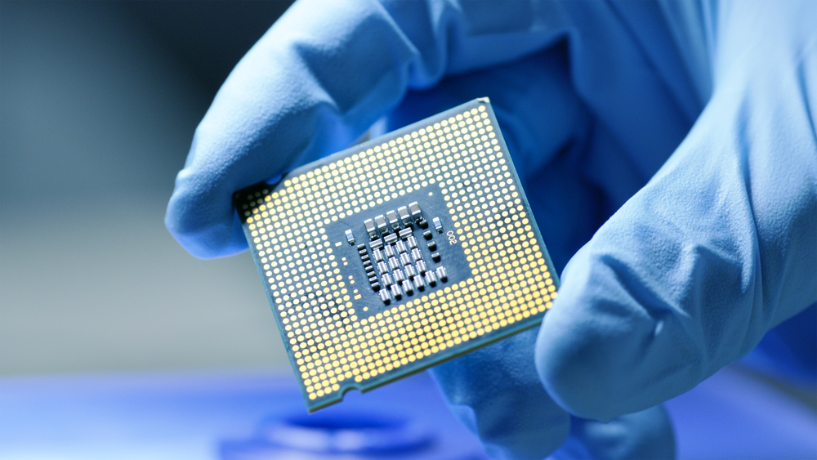
Course Objectives
S. No. | Objectives
1 | To understand the basic materials and properties of semiconductors.
2 | Understand the basic of semiconductor and components like diode, transistor, FET, MOSFET and Energy Sources.
3 | To give knowledge about semiconductor physics and discus working and applications of basic devices, including p-n junctions, BJTs and FETs.
https://www.iqsdirectory.com/resources/everything-you-ever-wanted-to-know-about-semiconductors/

Slide 3
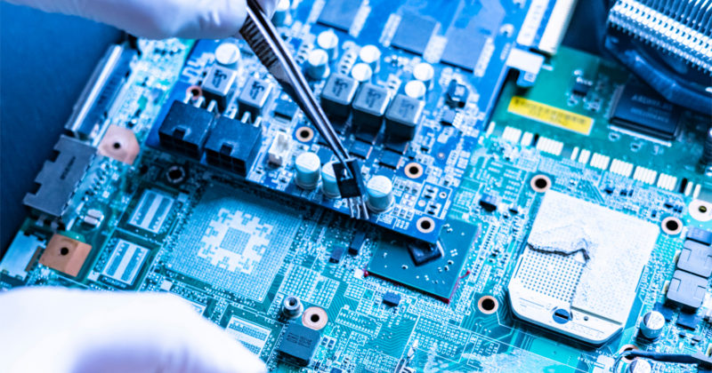
Course Outcomes
S.NO | Description | Blooms’ Taxonomy Level
CO1 | To apply the knowledge of basic semiconductor material physics and understand fabrication processes. | EASY
CO2 | To understand the characteristics of different electronic devices such as diodes, transistors. | MEDIUM
CO3 | To derive the relationships between the parameters in diode, FET, configurations of Transistor and MOSFETs. | MEDIUM
CO4 | To describe the working and design considerations for the various photonic devices like photo detectors, solar-cells and LEDs. | HARD
CO5 | To provide problem solving experience and learning of concepts through it in semiconductor physics. | HARD
https://lot.dhl.com/5-things-the-current-semiconductor-slowdown-tells-us-about-the-global-economy/

Slide 4
What is Electronics
Electronics is the science of how to control electric energy, energy which the electrons have a fundamental role.
Its also deals with electrical circuits that involve active electrical components such as vacuum tubes, transistors, diodes and integrated circuits, and associated passive electrical components and interconnection technologies.
You will work with a number of basic electronic components when building electronic circuits, including resistors, capacitors, diodes, transistors, and integrated circuits. Here is a brief overview of the functions of each of these basic electronic components.
Notes:
Fig-3

Slide 5
Content
Introduction to Semiconductor
Energy band for semiconductor device
Introduction to n-type semiconductor
n-type conductivity
Introduction to p-type semiconductor
p-type conductivity

Slide 6
SEMICONDUCTOR
A semiconductor is a substance which has very few free electrons at room temperature. Consequently, under the influence of potential difference, a semiconductor practically conducts no current.
Semiconductors (e.g. germanium, silicon etc.) are those substances whose electrical conductivity lies in between conductors and insulators.

Slide 7
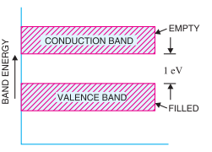
SEMICONDUCTOR
In terms of energy band, the valence band is almost filled and conduction band is almost empty.
Further, the energy gap between valence and conduction bands is very small as shown in Fig. 1
Figure 1: Energy band for semiconductor device
(Source: V K Mehta , Rohit Mehta "Principles of Electronics" 12/e , S. Chand Publishing)

Slide 8
SEMICONDUCTOR
Semiconductor is a substance which has resistivity (10⁻⁴ to 0.5 Ωm) in between conductors and insulators e.g. germanium, silicon, selenium, carbon etc.
The two most frequently used materials are germanium (Ge) and silicon (Si). It is because the energy required to break their co-valent bonds (i.e. energy required to release an electron from their valence bands) is very small; being about 0.7 eV for germanium and about 1.1 eV for silicon.
A semiconductor in an extremely pure form is known as an intrinsic semiconductor, whereas by adding small amount of impurity to a semiconductor it is known as extrinsic semiconductor.

Slide 9
Types of Semiconductors
Depending upon the type of impurity added, extrinsic semiconductors are classified into:
n-type semiconductor
p-type semiconductor

Slide 10
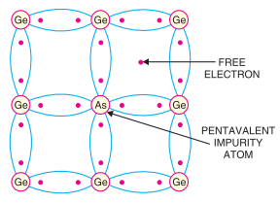
n-type Semiconductor
When a small amount of pentavalent impurity is added to a pure semiconductor, it is known as n-type semiconductor.
The addition of pentavalent impurity provides a large number of free electrons in the semiconductor crystal. Typical examples of pentavalent impurities are arsenic and antimony.
Such impurities which produce n-type semiconductor are known as donor impurities because they donate or provide free electrons to the semiconductor crystal.
Figure 2: Formation of n-type semiconductor using Ge and As Energy band for semiconductor device
(Source: V K Mehta , Rohit Mehta "Principles of Electronics" 12/e , S. Chand Publishing)

Slide 11
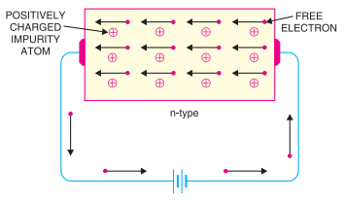
n-type conductivity
The current conduction in an n-type semiconductor is predominantly by free electrons i.e. negative charges and is called n-type or electron type conductivity.
When p.d. is applied across the n-type semiconductor, the free electrons (donated by impurity) in the crystal will be directed towards the positive terminal, constituting electric current.
As the current flow through the crystal is by free electrons which are carriers of negative charge, therefore, this type of conductivity is called negative or n-type conductivity.
Figure 3: Conductivity of n-type semiconductor
(Source: V K Mehta , Rohit Mehta "Principles of Electronics" 12/e , S. Chand Publishing)

Slide 12
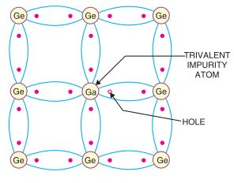
p-type Semiconductor
When a small amount of trivalent impurity is added to a pure semiconductor, it is called p-type semiconductor. The addition of trivalent impurity provides a large number of holes in the semiconductor. Typical examples of trivalent impurities are gallium and indium.
Such impurities which produce p-type semiconductor are known as acceptor impurities because the holes created can accept the electrons
Figure 4: Formation of p-type semiconductor using Ge and Ga
(Source: V K Mehta , Rohit Mehta "Principles of Electronics" 12/e , S. Chand Publishing)

Slide 13
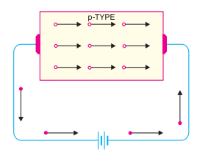
p-type conductivity
The current conduction in p-type semiconductor is predominantly by holes i.e. positive charges and is called p-type or hole-type conductivity.
When p.d. is applied to the p-type semiconductor, the holes (donated by the impurity) are shifted from one co-valent bond to another.
As the holes are positively charged, therefore, they are directed towards the negative terminal, constituting what is known as hole current.
It may be noted that in p-type conductivity, the valence electrons move from one co-valent bond to another unlike the n-type where current conduction is by free electrons.
Figure 5: Conductivity of p-type semiconductor
(Source: V K Mehta , Rohit Mehta "Principles of Electronics" 12/e , S. Chand Publishing)

Slide 14
Types of Semiconductors
Depending upon the type of impurity added, extrinsic semiconductors are classified into:
n-type semiconductor
p-type semiconductor

Slide 15
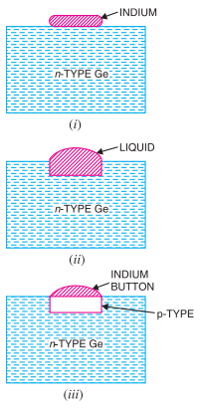
Formation of P-N junction
A pn junction is fabricated by special techniques. One common method of making pn junction is called alloying. In this method, a small block of indium (penta valent impurity) is placed on an n-type germanium slab as shown in Fig. 2 (i).
The system is then heated to a temperature of about 500ºC. The indium and some of the germanium melt to form a small puddle of molten germanium-indium mixture as shown in Fig. 2 (ii).
When all germanium has been redeposited, the remaining material appears as indium button which is frozen on to the outer surface of the crystallised portion as shown in Fig. 2 (iii)
Figure 2: Formation of pn junction
(Source: V K Mehta , Rohit Mehta "Principles of Electronics" 12/e , S. Chand Publishing)

Slide 16
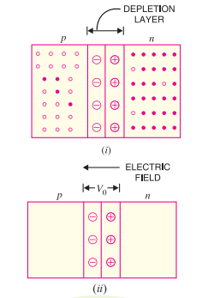
Properties of P-N Junction
At the instant of P-N -junction formation, the free electrons near the junction in the n region begin to diffuse across the junction into the p region where they combine with holes near the junction. The result is that n region loses free electrons as they diffuse into the junction. This creates a layer of positive charges (pentavalent ions) near the junction.
As the electrons move across the junction, the p region loses holes as the electrons and holes combine. The result is that there is a layer of negative charges (trivalent ions) near the junction. These two layers of positive and negative charges form the depletion region (or depletion layer).
Figure 3: Formation of depletion and electric field
(Source: V K Mehta , Rohit Mehta "Principles of Electronics" 12/e , S. Chand Publishing)

Slide 17
Properties of P-N Junction
The term depletion is due to the fact that near the junction, the region is depleted (i.e. emptied) of charge carries (free electrons and holes) due to diffusion across the junction. It may be noted that depletion layer is formed very quickly and is very thin compared to the n region and the p region.
Once pn junction is formed and depletion layer created, the diffusion of free electrons stops. In other words, the depletion region acts as a barrier to the further movement of free electrons across the junction. The positive and negative charges set up an electric field.

Slide 18
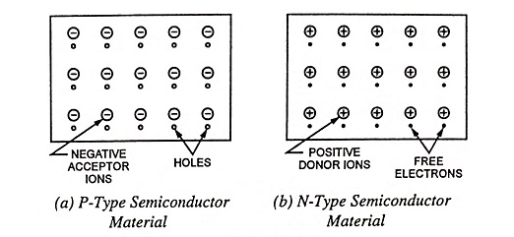
Basic Structure of P-N Junction
A P-N junction is an interface or a boundary between two semiconductor material types, namely the p-type and the n-type, inside a semiconductor.
In a semiconductor, the P-N junction is created by the method of doping. The p-side or the positive side of the semiconductor has an excess of holes, and the n-side or the negative side has an excess of electrons.

Slide 19
P-N Junction Diode
The formula used in the P-N junction depends upon the built-in potential difference created by the electric field is given as:
E₀ is the zero bias junction voltage
V_{T} is the thermal voltage of 26mV at room temperature
N_{D} and N_{A} are the impurity concentrations
n_{i} is the intrinsic concentration.

Slide 20
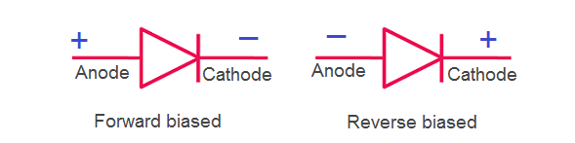
Symbol of P-N Junction Diode
When a p-n junction is formed, the electrons diffuse across the junction from n-type to p-type crystal. Similarly, holes diffuse from p-type to n-type crystals. As a result, the n-type crystal acquires a positive potential and the p-type crystal acquires a negative potential. The potential difference created across the p-n junction due to the diffusion of electrons and holes; is called a potential barrier. Then, a thin layer is formed on both the sides of the p-n junction where the mobile charge carriers have been diffused away. This is the depletion layer.

Slide 21
Summary
Introduction to Semiconductor
Energy band for semiconductor device
Introduction to n-type semiconductor
Introduction to p-type semiconductor

Slide 22
Frequently Asked Questions
Define the semiconductor material.
Define energy band for semiconductor device.
Explain n-type semiconductor.
Explain p-type semiconductor

Slide 23

LEARNING OUTCOMES
To make students understand
Energy band for semiconductor device
Fundamentals of n-type and p-type semiconductor.

Slide 24
References
Text Books:
Microelectronics Circuits, Adel S. Sedra and Kenneth Carless Smith, Oxford University Press.
Millman’s Integrated Electronics, Jacob Millman, Christos Halkias, Chetan Parikh, McGraw Hill Education.
Digital Logic & Computer Design, M. Morris Mano, Pearson
Reference Books:
Principles of Electronics, V K Mehta , Rohit Mehta, 12/e , S. Chand Publishing
Solid State Electronic Devices,6th Edition, Ben Streetman, Sanjay Banerjee
Electronic Principle, Albert Paul Malvino.
Electronics Circuits:Discrete & Integrated, D Schilling C BeloveTApelewiczRSaccardi.
Microelectronics, Jacob Millman, Arvin Grabel.
Electronics Devices &Circuits,S. Salivahanan, N. Suresh Kumar,A. Vallavaraj
Electronic Devices & Circuit Theory, 11th Edition, Robert L. Boylestad,LouisNashelsky

Slide 25
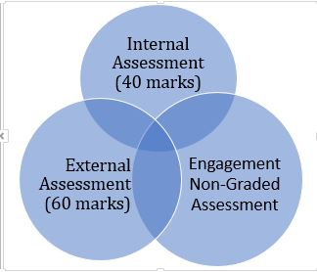

Assessment Pattern

Slide 26
Thank You
navjeetkaur.ee@cumail.in

