Slide 1

INSTITUTE UIE
DEPARTMENT ACADEMIC UNIT-1
Bachelor of Engineering (Computer Science & Engineering)
Subject Name Semi Conductor Physics
Subject Code 23SPH-143
Prepared By
Navjeet Kaur
Lecture-1.1.3
Baising of P-N Junction
DISCOVER . LEARN . EMPOWER

Slide 2
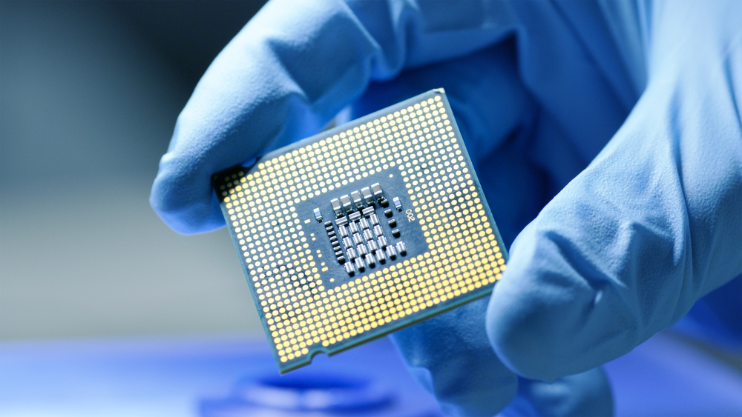
Course Objectives
S. No. | Objectives
1 | To understand the basic materials and properties of semiconductors.
2 | Understand the basic of semiconductor and components like diode, transistor, FET, MOSFET and Energy Sources.
3 | To give knowledge about semiconductor physics and discus working and applications of basic devices, including p-n junctions, BJTs and FETs.
https://www.iqsdirectory.com/resources/everything-you-ever-wanted-to-know-about-semiconductors/

Slide 3
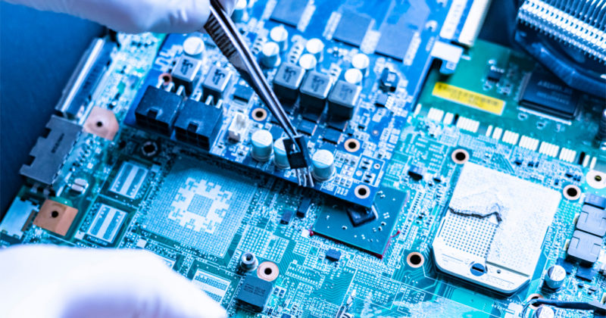
Course Outcomes
S.NO | Description | Blooms’ Taxonomy Level
CO1 | To apply the knowledge of basic semiconductor material physics and understand fabrication processes. | EASY
CO2 | To understand the characteristics of different electronic devices such as diodes, transistors. | MEDIUM
CO3 | To derive the relationships between the parameters in diode, FET, configurations of Transistor and MOSFETs. | MEDIUM
CO4 | To describe the working and design considerations for the various photonic devices like photo detectors, solar-cells and LEDs. | HARD
CO5 | To provide problem solving experience and learning of concepts through it in semiconductor physics. | HARD
https://lot.dhl.com/5-things-the-current-semiconductor-slowdown-tells-us-about-the-global-economy/

Slide 4


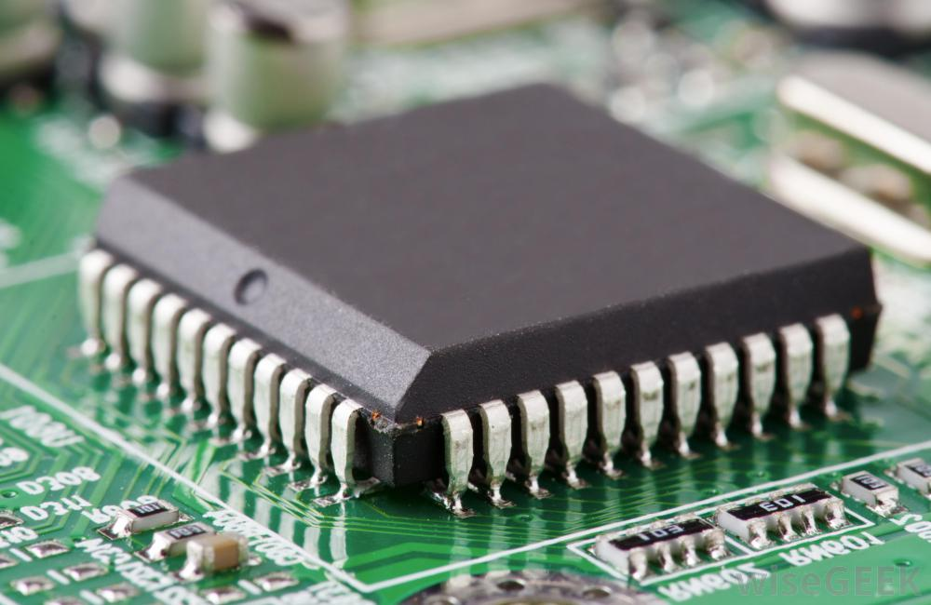
UNIT-1
SEMICONDUCTOR PHYSICS
PN JUNCTION DIODE

Slide 5
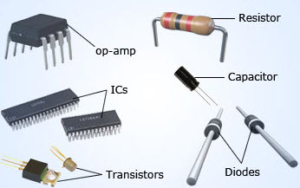
CONTENTS
Introduction of pn junction diode
Application of pn junction diode
Formation of pn junction diode
Summary

Slide 6
LEARNING OBJECTIVES
Develop an understanding of the PN junction diode and its behavior.
Develop an ability to analyze diode circuits
Demonstrate current flow in a pn junction in forward and reverse bias.

Slide 7
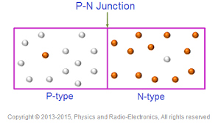
PN JUNCTION
A p-n junction is a boundary or interface between two types of semiconductor materials, p-type and n-type inside a single crystal of semiconductor(fig1).
A PN junction cannot be produced by simply pushing two pieces together or by welding etc…. Because it gives rise to discontinuities across the crystal structure.
Fig 1: p-n junction[1]

Slide 8
PN JUNCTION DIODE
A PN junction is a device formed by joining p-type (doped with B, Al) with n-type (doped with P, As, Sb) semiconductors and separated by a thin junction is called PN Junction diode.
A PN junction diode is one of the simplest semiconductor devices around and has characteristic of passing current in one direction(Fig2) .
Fig 2 :Symbol of PN diode[2]

Slide 9
FORMATION OF P-N JUNCTION
Step -1
S
DIFFUSION
Step -3
POTENTIAL BARRIER
Step -2
DEPLETION
REGION

Slide 10
DIFFUSION IN P-N JUNCTION
The N-type semiconductor and P-type semiconductor materials are first joined together a very large density gradient exists between both sides of the PN junction.
The free electrons from the donor impurity atoms begin to migrate across this newly formed junction to fill up the holes in the P-type material producing negative ions.
Electrons have moved across the PN junction from the N-type silicon to the P-type silicon, they leave behind positively charged donor ions ( Nd ) on the negative side.

Slide 11
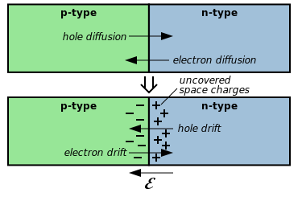
DIFFUSION IN P-N JUNCTION
4. The charge density of the P-type along the junction is filled with negatively charged acceptor ions (Na), and the charge density of the N-type along the junction becomes positive. This charge transfer of electrons and holes across the PN junction is known as diffusion.(fig 3)
Fig3:Diffusion in p-n junction[3]

Slide 12
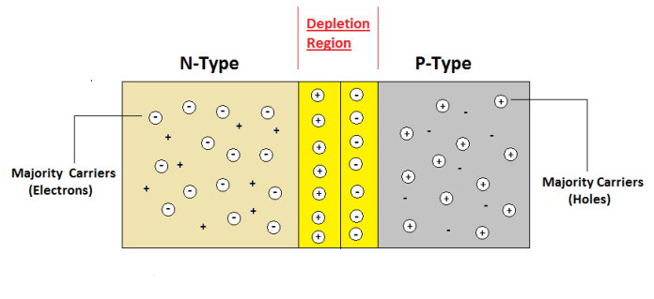
DEPLETION REGION
The width of these P and N layers depends on how heavily each side is doped with acceptor density NA, and donor density ND, respectively.
This area around the PN Junction is now called the Depletion Layer (fig 4).
Fig4 : Formation of depletion region[4]

Slide 13
POTENTIAL BARRIER
The total charge on each side of a PN Junction must be equal and opposite to maintain a neutral charge condition around the junction.
The depletion layer region has a distance D, it therefore must therefore penetrate into the silicon by a distance of Dp for the positive side, and a distance of Dn for the negative side giving a relationship between the two of: Dp*NA = Dn*ND in order to maintain charge neutrality also called equilibrium.
This electric field created by the diffusion process has created a “built-in potential difference” across the junction called POTENTIAL BARRIER (fig5).

Slide 14
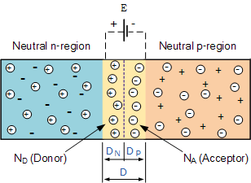
POTENTIAL BARRIER
Fig5: Potential barrier in pn junction[5]

Slide 15
Three Possible Biasing Conditions
Reverse biasing
No biasing
Forward biasing

Slide 16
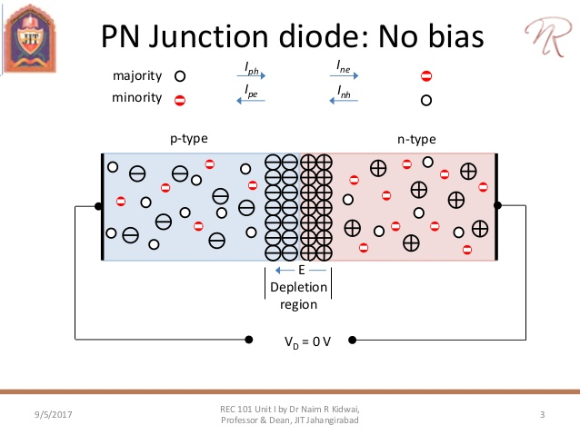
NO BIASING
No external voltage potential is applied to the PN junction diode(fig6).
The potential barrier helps minority carriers (few free electrons in the P-region and few holes in the N-region) to drift across the junction. Equilibrium” or balance will be established.
Fig 6: No external voltage[6]

Slide 17
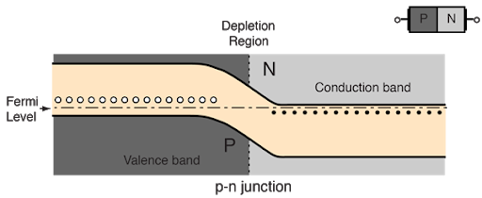
ENERGY LEVEL DIAGRAM OF UNBIASED PN JUNCTION
Fig 7: Unbiased energy level diagram[7]

Slide 18
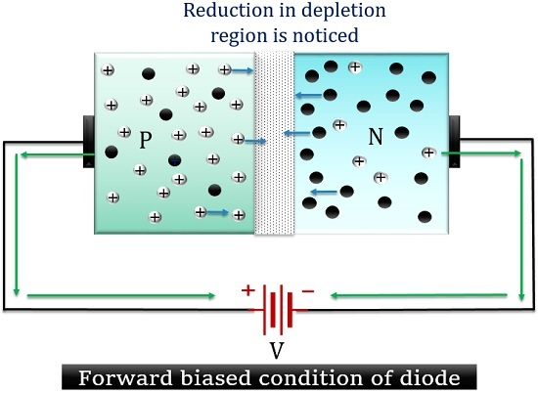
FORWARD BIASING
Pn–junction is forward biased when the n–type is more negative than the p–type. In forward bias mode and when VF >barrier potential the pn–junction begins to conduct.
The majority carriers, for example, electrons, from n side cross the pn–junction and move into the p side with little opposition and conduction occurs. The depletion region becomes narrower(fig8).
Fig 8: Forward biasing[8]

Slide 19
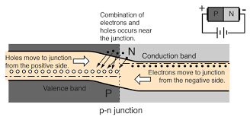
ENERGY LEVEL DIAGRAM OF FORWARD BIASING
Fig 9 : Forward biasing energy level diagram[9]

Slide 20
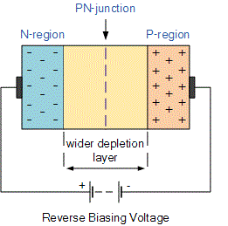
REVERSE BIASING
A pn–junction is reverse biased when the n–type is more positive than the p–type . Electrons in the n–type will head toward the positive terminal of the source. This will further deplete the electrons in the n–type near the junction. The same principle applies to the holes in p–type. The depletion layer is then widened(fig10). This increases the resistance of the junction and conduction drops to near zero.
Fig 10 : Reverse biasing[10]

Slide 21
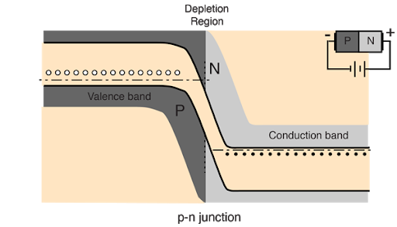
ENERGY LEVEL DIAGRAM OF REVERSE BIASING
Fig 11: Reverse biasing energy level diagram [11]

Slide 22
APPLICATIONS
RECTIFIER: Diode as rectifier converts AC signal into DC. There are many rectifier circuits. A) Half wave rectifier b) Full wave rectifier; bridge type and centre tapped. Practical rectifiers consist of: Transformer, Rectifier, Filter and regulator stage.
CLIPPERS: clippers are networks that employ diodes to clip away a portion of an input signal without distorting the remaining part of the applied waveform.
Clampers: clamping networks have capacitor connected in series with a diode and resistance in parallel.

Slide 23
SUMMARY
The junction region itself has no charge carriers and is known as the depletion region.
When a diode is Zero Biased no external energy source is applied and a natural Potential Barrier is developed across a depletion layer which is approximately 0.5 to 0.7v for silicon diodes and approximately 0.3 of a volt for germanium diodes.
When a junction diode is Forward Biased the thickness of the depletion region reduces and the diode acts like a short circuit allowing full current to flow.
When a junction diode is Reverse Biased the thickness of the depletion region increases and the diode acts like an open circuit blocking any current flow, (only a very small leakage current).

Slide 24
DISCUSSION FORUM
1.Difference between diffusion current density and drift current density
2. Discuss effect of temperature on depletion layer
3. Few examples of semiconductor devices

Slide 25
RELEVANT IMAGES
[1] https://images.app.goo.gl/1oN68pfnm3hE7E658
[2] https://images.app.goo.gl/3zwhabuHBraaz7my6
[3] https://images.app.goo.gl/55fSoHfhqBdKUuWu6
[4] https://images.app.goo.gl/nSFN1jMVDHtdsFMh7
[5] http://images.app.goo.gl/ikgGTJzBTdS4tdt17
[6] https://images.app.goo.gl/s2zTsVfyvCziTXt3A
[7] https://images.app.goo.gl/8VMbgSsjhhgrj1jY6
[8] https://images.app.goo.gl/dgUuLfWDYToG3VQV9
[9] https://images.app.goo.gl/WjQjuK8X82QVAH1C8
[10] https://images.app.goo.gl/dcZmvyzR5n9qWUWv6
[11] https://images.app.goo.gl/W5aH5EXpSWbJ9bePA

Slide 26
REFRENCE BOOKS AND VIDEOS
Semiconductor Devices, Physics and Technology, 3ed, ISV (WSE) https://www.amazon.in/dp/8126556757/ref=cm_sw_r_em_apa_i_gMS8Eb61QD3EW
Physics of Semiconductor Devices, 3ed https://www.amazon.in/dp/8126517026/ref=cm_sw_r_em_apa_i_vkT8EbV0892MJ
https://youtu.be/4SlfaocMfdA
https://youtu.be/YiDs8ZnpVD4

Slide 27
REFERENCE COURSES
https://nptel.ac.in/courses/117/107/117107095/
https://www.mooc-list.com/course/principle-semiconductor-devices-part-i-semiconductors-pn-junctions-and-bipolar-junction?__cf_chl_jschl_tk__=5d5c4e3011067563daec2c74c20afa4658689dfe-1593003362-0-AQjOCDclImzTEZv8nCNn0hGj8uiLGHTa_2EV64jJNRnwyuDNwHaCurIC5JqmGaBsGmglOA44WTCS-0teAwQHMMtxN8rKX0WvG9r9doj7Nf1VBi03205jYaaIw41ngyobLJUdWnqoEcsdhF95o0tyyR-r2ilOtbyObe7fac0wfepFeP8hTzsYXoBBd6IYNjQye91XQzXSJlEBoyRHIOugA1ABR4WiD2z-cqXwKpMQfCwuhKnvMTN9MPUjq7h6k3MgW_iyb5HCjsZDmrxCSAFlNVLqKaZSXqs7dvJjAO2XIJrCrTKU9zwk2JCW6tMx3r2JdCACTu9KWafAr2Alm6wJlZORka9PAZ8ynNylIyPto_SuTZMDxKOhLzXmJ5gvIoIbzCpq9nRMfBOMLmfuanwE3Jk

