Slide 1

INSTITUTE UIE
DEPARTMENT ACADEMIC UNIT-1
Bachelor of Engineering (Computer Science & Engineering)
Subject Name Semi Conductor Physics
Subject Code 23SPH-143
Prepared By
Navjeet Kaur
Lecture 1.1.4
Biasing of P-N Junction diode.
DISCOVER . LEARN . EMPOWER

Slide 2
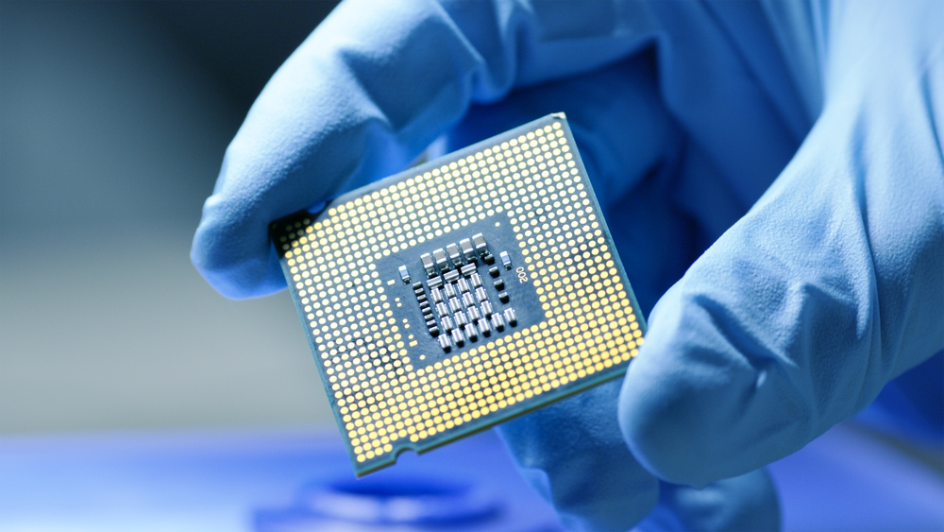
Course Objectives
S. No. | Objectives
1 | To understand the basic materials and properties of semiconductors.
2 | Understand the basic of semiconductor and components like diode, transistor, FET, MOSFET and Energy Sources.
3 | To give knowledge about semiconductor physics and discus working and applications of basic devices, including p-n junctions, BJTs and FETs.
https://www.iqsdirectory.com/resources/everything-you-ever-wanted-to-know-about-semiconductors/

Slide 3
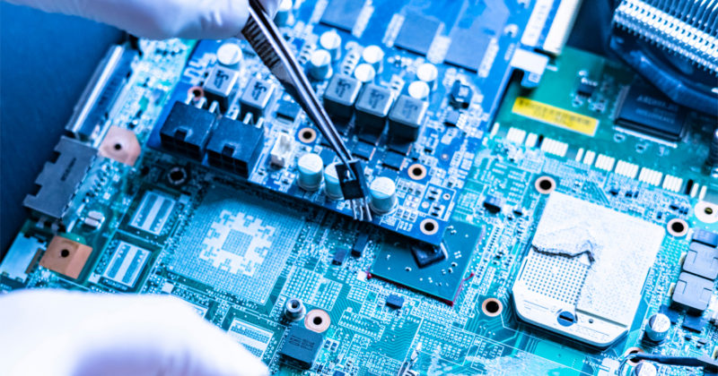
Course Outcomes
S.NO | Description | Blooms’ Taxonomy Level
CO1 | To apply the knowledge of basic semiconductor material physics and understand fabrication processes. | EASY
CO2 | To understand the characteristics of different electronic devices such as diodes, transistors. | MEDIUM
CO3 | To derive the relationships between the parameters in diode, FET, configurations of Transistor and MOSFETs. | MEDIUM
CO4 | To describe the working and design considerations for the various photonic devices like photo detectors, solar-cells and LEDs. | HARD
CO5 | To provide problem solving experience and learning of concepts through it in semiconductor physics. | HARD
https://lot.dhl.com/5-things-the-current-semiconductor-slowdown-tells-us-about-the-global-economy/

Slide 4
What is Electronics
Electronics is the science of how to control electric energy, energy which the electrons have a fundamental role.
Its also deals with electrical circuits that involve active electrical components such as vacuum tubes, transistors, diodes and integrated circuits, and associated passive electrical components and interconnection technologies.
You will work with a number of basic electronic components when building electronic circuits, including resistors, capacitors, diodes, transistors, and integrated circuits. Here is a brief overview of the functions of each of these basic electronic components.
Notes:
Fig-3

Slide 5
Content
Formation of depletion zone
Introduction to PN Junction diode
Forward biased PN junction diode
Reverse biased PN junction diode
Advantages & applications

Slide 6
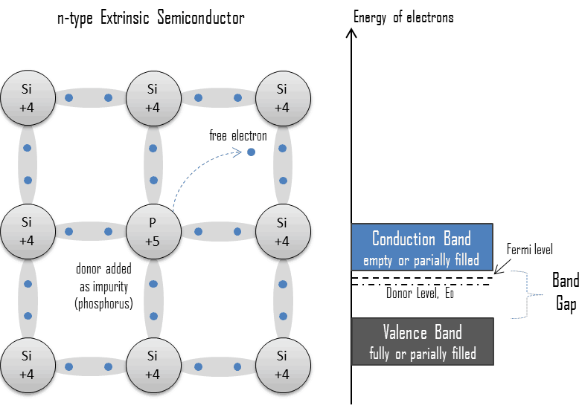
N-TYPE EXTRINSIC SEMICONDUCTOR
An extrinsic semiconductor which has been doped with electron donor atoms is called an n-type semiconductor, because the majority of charge carriers in the crystal are negative electrons.
Since silicon is a tetravalent element, the normal crystal structure contains 4 covalent bonds from four valence electrons.
Figure 1 N-type Extrinsic Semiconductor
(Source: https://www.nuclear-power.net/wp-content/uploads/2019/02/extrinsic-doped-semiconductor-n-type-donor.png)

Slide 7
N-TYPE EXTRINSIC SEMICONDUCTOR
In silicon, the most common dopants are group III and group V elements. Group V elements (pentavalent) have five valence electrons, which allows them to act as a donor.
That means, the addition of these pentavalent impurities such as arsenic, antimony or phosphorus contributes free electrons, greatly increasing the conductivity of the intrinsic semiconductor.
For example, a silicon crystal doped with boron (group III) creates a p-type semiconductor whereas a crystal doped with phosphorus (group V) results in an n-type semiconductor.

Slide 8
N-TYPE EXTRINSIC SEMICONDUCTOR
The conduction electrons are completely dominated by the number of donor electrons.
Therefore
The total number of conduction electrons is approximately equal to the number of donor sites, n≈ND.

Slide 9
Donor Level
From the energy gap viewpoint, such impurities “create” energy levels in the band gap close to conduction band so that electrons can be easily excited from these levels into the conduction band.
The electrons are said to be the “majority carriers” for current flow in an n-type semiconductor.
This shifts the effective Fermi level to a point about halfway between the donor levels and the conduction band.
Fermi level is the term used to describe the top of the collection of electron energy levels at absolute zero temperature.
The Fermi level is the surface of Fermi sea at absolute zero where no electrons will have enough energy to rise above the surface.
In pure semiconductors the position of the Fermi level is within the band gap, approximately in the middle of the band gap.

Slide 10
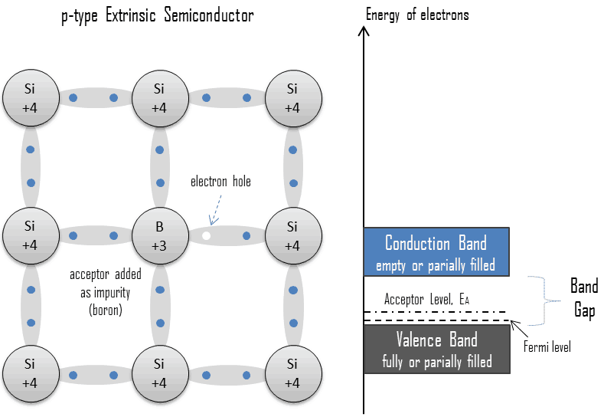
P-TYPE EXTRINSIC SEMICONDUCTOR
An extrinsic semiconductor which has been doped with electron acceptor atoms is called a p-type semiconductor, because the majority of charge carriers in the crystal are electron holes (positive charge carriers).
The pure semiconductor silicon is a tetravalent element, the normal crystal structure contains 4 covalent bonds from four valence electrons.
Figure 2 P-type Extrinsic Semiconductor
(Source: https://www.nuclear-power.net/wp-content/uploads/2019/02/extrinsic-doped-semiconductor-n-type-donor.png)

Slide 11
P-TYPE EXTRINSIC SEMICONDUCTOR
In silicon, the most common dopants are group III and group V elements. Group III elements (trivalent) all contain three valence electrons, causing them to function as acceptors when used to dope silicon.
When an acceptor atom replaces a tetravalent silicon atom in the crystal, a vacant state (an electron hole) is created.
An electron hole (often simply called a hole) is the lack of an electron at a position where one could exist in an atom or atomic lattice.

Slide 12
P-TYPE EXTRINSIC SEMICONDUCTOR
It is one of the two types of charge carriers that are responsible for creating electric current in semiconducting materials.
These positively charged holes can move from atom to atom in semiconducting materials as electrons leave their positions.
The addition of trivalent impurities such as boron, aluminum or gallium to an intrinsic semiconductor creates these positive electron holes in the structure.
Therefore
The total number of holes is approximately equal to the number of donor sites, p ≈ NA.

Slide 13
Acceptor Level
From the energy gap viewpoint, such impurities “create” energy levels within the band gap close to the valence band so that electrons can be easily excited from the valence band into these levels, leaving mobile holes in the valence band.
They create “shallow” levels, levels that are very close to the valence band, so the energy required to ionize the atom (accept the electron that fills the hole and creates another hole further from the substituted atom) is small.
This shifts the effective Fermi level to a point about halfway between the acceptor levels and the valence band.
Fermi level is the term used to describe the top of the collection of electron energy levels at absolute zero temperature.

Slide 14
Introduction to PN junction diode
When a p-type semiconductor is suitably joined to n-type semiconductor, the contact surface is called pn junction.
The p-n junction is also called a semiconductor diode.
In actual practice, the characteristic properties of pn junction will not be apparent if a p-type block is just brought in contact with n-type block.
In fact, pn junction is fabricated by special techniques. One common method of making pn junction is called alloying.

Slide 15
Properties of pn Junction
At the instant of pn-junction formation, the free electrons near the junction in the n region begin to diffuse across the junction into the p region where they combine with holes near the junction.
The result is that n region loses free electrons as they diffuse into the junction.
This creates a layer of positive charges (pentavalent ions) near the junction.
As the electrons move across the junction, the p region loses holes as the electrons and holes combine.
The result is that there is a layer of negative charges (trivalent ions) near the junction.

Slide 16
Properties of pn Junction
These two layers of positive and negative charges form the depletion region (or depletion layer).
The term depletion is due to the fact that near the junction, the region is depleted (i.e. emptied) of charge carries (free electrons and holes) due to diffusion across the junction

Slide 17
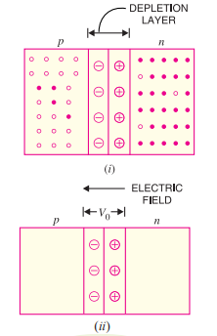
Properties of pn Junction
Once pn junction is formed and depletion layer created, the diffusion of free electrons stops.
In other words, the depletion region acts as a barrier to the further movement of free electrons across the junction.
The positive and negative charges set up an electric field
Figure 3 P-type Extrinsic Semiconductor
(Source: V K Mehta , Rohit Mehta "Principles of Electronics" 12/e , S. Chand Publishing)

Slide 18
Biasing of a PN junction diode
VI characteristics of P-N junction diodes is a curve between the voltage and current through the circuit. Voltage is taken along the x-axis while the current is taken along the y-axis. The above graph is the V-I characteristics curve of the P-N junction diode. With the help of the curve, we can understand that there are three regions in which the diode works, and they are:
Zero bias
Forward bias
Reverse bias

Slide 19
Zero bias
When the P-N junction diode is in zero bias condition, there is no external voltage applied and this means that the potential barrier at the junction does not allow the flow of current.

Slide 20
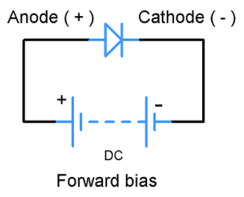
Function of a P-N junction diode in Forward Bias
The positive terminal of battery is connected to the P side (anode) and the negative terminal of battery is connected to the N side (cathode) of a diode, the holes in the p-type region and the electrons in the n-type region are pushed toward the junction and start to neutralize the depletion zone, reducing its width.
Figure 4: P-N junction diode in forward bias condition
(Source: https://www.gadgetronicx.com/diode-tutorial-construction-working-vi-characteristics/)

Slide 21
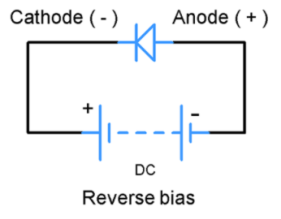
Function of a P-N junction diode in Reverse Bias
The positive terminal of battery is connected to the N side (cathode) and the negative terminal of battery is connected to the P side (anode) of a diode.
Therefore, very little current will flow until the diode breaks down.
Figure 5: P-N junction diode in Reverse bias condition
(Source: https://www.gadgetronicx.com/diode-tutorial-construction-working-vi-characteristics/)

Slide 22
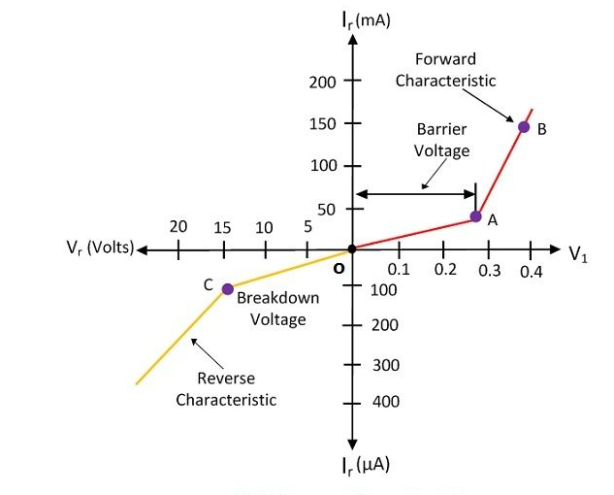
V-I Characteristics of P-N Junction Diode

Slide 23
ADVANTAGES
No filament is necessary
Occupies lesser space
Long life.
APPLICATIONS:
PN Junction diode used
as rectifiers to convert AC into DC.
As an switch in computer circuits.
As detectors in radios to detect audio signals
As LED to emit different colors.

Slide 24
Summary
Introduction to PN Junction diode.
Block diagram of PN junction diode
Forward and Reverse bias PN Junction diode.
Applications of PN junction diode.

Slide 25
Frequently Asked Questions
Explain Formation of depletion layer?
What is Reverse bias PN junction diode?
What is forward bias PN junction diode ?
What are the applications of PN junction diode?

Slide 26

LEARNING OUTCOMES
To make students understand
Concepts of pn junction diode
Formation of pn junction
Advantages and applications of pn junction diode.
Fundamentals of pn junction diode and their operation.

Slide 27
References
Text Books:
Microelectronics Circuits, Adel S. Sedra and Kenneth Carless Smith, Oxford University Press.
Millman’s Integrated Electronics, Jacob Millman, Christos Halkias, Chetan Parikh, McGraw Hill Education.
Digital Logic & Computer Design, M. Morris Mano, Pearson
Reference Books:
Principles of Electronics, V K Mehta , Rohit Mehta, 12/e , S. Chand Publishing
Solid State Electronic Devices,6th Edition, Ben Streetman, Sanjay Banerjee
Electronic Principle, Albert Paul Malvino.
Electronics Circuits:Discrete & Integrated, D Schilling C BeloveTApelewiczRSaccardi.
Microelectronics, Jacob Millman, Arvin Grabel.
Electronics Devices &Circuits,S. Salivahanan, N. Suresh Kumar,A. Vallavaraj
Electronic Devices & Circuit Theory, 11th Edition, Robert L. Boylestad,LouisNashelsky

Slide 28
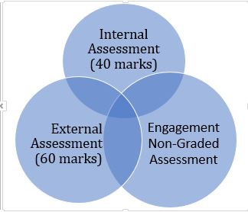

Assessment Pattern

