Slide 1

INSTITUTE UIE
DEPARTMENT ACADEMIC UNIT-1
Bachelor of Engineering (Computer Science & Engineering)
Subject Name Semi Conductor Physics
Subject Code 23SPH-143
Prepared By
Navjeet Kaur
Lecture-1.1.5
Introduction to Zener diode, Zener Breakdown & Avalanche Breakdown
DISCOVER . LEARN . EMPOWER

Slide 2
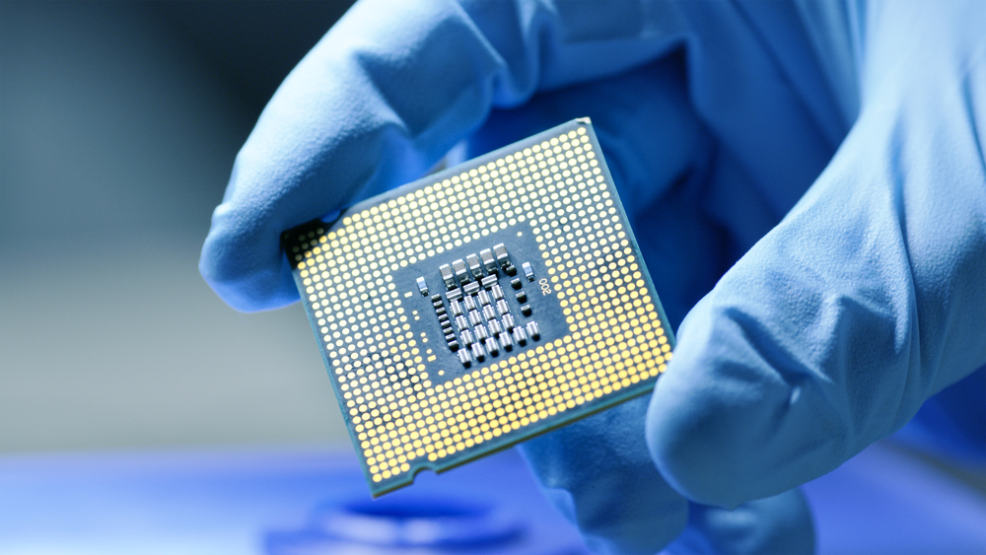
Course Objectives
S. No. | Objectives
1 | To understand the basic materials and properties of semiconductors.
2 | Understand the basic of semiconductor and components like diode, transistor, FET, MOSFET and Energy Sources.
3 | To give knowledge about semiconductor physics and discus working and applications of basic devices, including p-n junctions, BJTs and FETs.
https://www.iqsdirectory.com/resources/everything-you-ever-wanted-to-know-about-semiconductors/

Slide 3
Course Objectives
S. No. | Objectives
1 | To understand the basic materials and properties of semiconductors.
2 | Understand the basic of semiconductor and components like diode, transistor, FET, MOSFET and Energy Sources.
3 | To give knowledge about semiconductor physics and discus working and applications of basic devices, including p-n junctions, BJTs and FETs.
https://www.iqsdirectory.com/resources/everything-you-ever-wanted-to-know-about-semiconductors/

Slide 4
What is Electronics
Electronics is the science of how to control electric energy, energy which the electrons have a fundamental role.
Its also deals with electrical circuits that involve active electrical components such as vacuum tubes, transistors, diodes and integrated circuits, and associated passive electrical components and interconnection technologies.
You will work with a number of basic electronic components when building electronic circuits, including resistors, capacitors, diodes, transistors, and integrated circuits. Here is a brief overview of the functions of each of these basic electronic components.
Notes:
Fig-3

Slide 5
Content
Introduction to Zener diode
Zener breakdown
Avalanche breakdown
Working of a Zener diode
its reverse characteristics
Advantages & applications

Slide 6
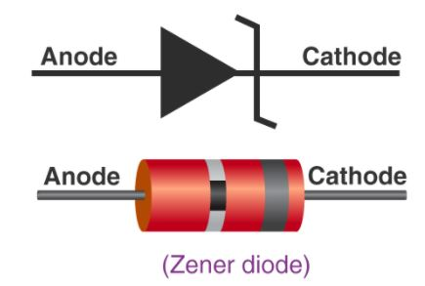
Introduction to Zener diode
A Zener diode is a heavily doped semiconductor device that is designed to operate in the reverse direction.
A Zener diode operates just like a normal diode when it is forward-biased.
Figure 1: Zener diode
(Source: https://byjus.com/physics/zener-diode/)

Slide 7
Introduction to Zener diode
A Zener diode, when connected in reverse biased mode, a small leakage current flows through the diode.
As the reverse voltage increases to the predetermined breakdown voltage (Vz), current starts flowing through the diode.
The current increases to a maximum, which is determined by the series resistor, after which it stabilizes and remains constant over a wide range of applied voltage.

Slide 8
Introduction to Zener diode
Zener diode is like a rectifying diode in that it allows current to flow in the forward direction.
In reverse-direction breakdown voltage is much lower than that of an ordinary rectifying diode.
The breakdown voltage of a Zener diode is set by carefully controlling the level during manufacture.
A Zener diode is always operated in its reverse biased condition.

Slide 9
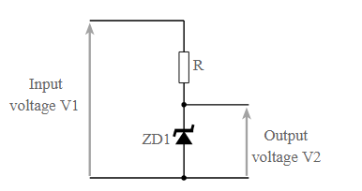
Introduction to Zener diode
The most basic Zener diode circuit consist of a single Zener diode and a resister.
The Zener diode provides the reference voltage.
A series resistor must be in place to limit the current into the diode otherwise a large amount of current would flow through it and it could be destroyed.
Figure 2: Zener diode circuit
(Source: https://www.evelta.com/6-2v-zener-diode-250mw)

Slide 10
Zener Diode -Theory
Avalanche Breakdown:
  There is a limit for the reverse voltage. Reverse voltage can increase until the diode breakdown voltage reaches. This point is called Avalanche Breakdown region. At this stage maximum current will flow through the zener diode. This breakdown point is referred as “Zener voltage”.
Zener Breakdown:
  The Zener diode is like a general-purpose signal diode. When biased in the forward direction it behaves just like a normal signal diode, but when a reverse voltage is applied to it, the voltage remains constant for a wide range of currents

Slide 11
Avalanche Breakdown
Avalanche breakdown occurs both in normal diode and Zener Diode at high reverse voltage.
When a high value of reverse voltage is applied to the PN junction, the free electrons gain sufficient energy and accelerate at high velocities.
These free electrons moving at high velocity collides other atoms and knocks off more electrons.

Slide 12
Avalanche Breakdown
Due to this continuous collision, a large number of free electrons are generated as a result of electric current in the diode rapidly increases.
This sudden increase in electric current may permanently destroy the normal diode, however, a Zener diode is designed to operate under avalanche breakdown and can sustain the sudden spike of current.
Avalanche breakdown occurs in Zener diodes with Zener voltage (Vz) greater than 6V.

Slide 13
Zener Breakdown
When the applied reverse bias voltage reaches closer to the Zener voltage, the electric field in the depletion region gets strong enough to pull electrons from their valence band.
The valence electrons that gain sufficient energy from the strong electric field of the depletion region break free from the parent atom.
At the Zener breakdown region, a small increase in the voltage results in the rapid increase of the electric current.

Slide 14
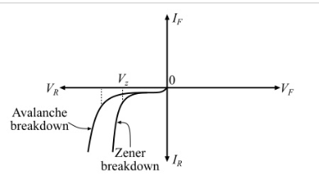
V-I Characteristics of Zener & Avalanche Breakdown in Diode

Slide 15
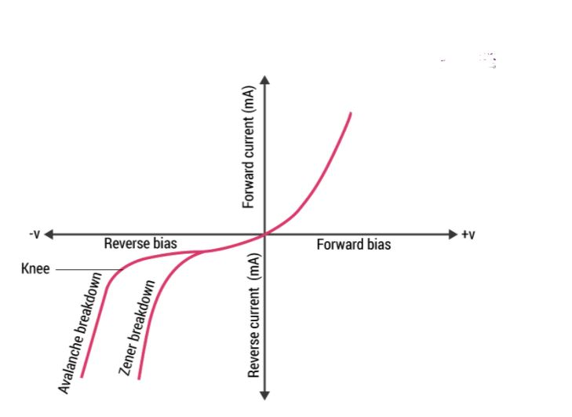
V-I characteristics of Zener diode
Figure 3: V-I characteristics of Zener diode
(Source: https://byjus.com/physics/zener-diode/)

Slide 16
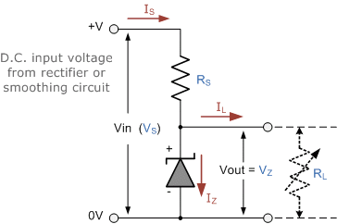
Zener Diode as Voltage Regulators
If there is no load resistance, shunt regulators can be used to dissipate total power through the series resistance and the Zener diode.
Shunt regulators have an inherent current limiting advantage under load fault conditions because the series resistor limits excess current.
Figure 3: Zener Diode as Voltage Regulators
(Source: https://www.electronics-tutorials.ws/diode/diode_7.html)

Slide 17
Zener Diode as Voltage Regulators
The voltage across the zener will remain steady at its break down voltage VZ for all the values of zener current IZ as long as the current remains in the break down region.
Hence a regulated DC output voltage V0 = VZ is obtained across RL ,whenever the input voltage remains within a minimum and maximum voltage

Slide 18
ADVANTAGES
Less expensive than other diodes.
Ability to shift voltage.
Easily compatible and obtainable across systems

Slide 19
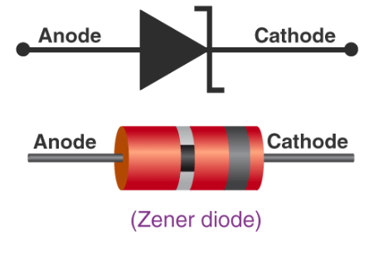
APPLICATIONS
Zener Regulator
Zener Comparator
Zener Limiters
Zener in Power Supplies

Slide 20
Summary
Introduction to Zener diode.
Avalanche Breakdown
Zener Breakdown
Zener Diode as Voltage Regulators.

Slide 21
Frequently Asked Questions
What is Zener diode.
Explain the Avalanche Breakdown
Explain the Zener Breakdown
How Zener Diode is used as Voltage Regulators.

Slide 22

LEARNING OUTCOMES
To make students understand
Introduction to Zener diode.
Avalanche Breakdown
Zener Breakdown
Zener Diode as Voltage Regulators.

Slide 23
References
Text Books:
Microelectronics Circuits, Adel S. Sedra and Kenneth Carless Smith, Oxford University Press.
Millman’s Integrated Electronics, Jacob Millman, Christos Halkias, Chetan Parikh, McGraw Hill Education.
Digital Logic & Computer Design, M. Morris Mano, Pearson
Reference Books:
Principles of Electronics, V K Mehta , Rohit Mehta, 12/e , S. Chand Publishing
Solid State Electronic Devices,6th Edition, Ben Streetman, Sanjay Banerjee
Electronic Principle, Albert Paul Malvino.
Electronics Circuits:Discrete & Integrated, D Schilling C BeloveTApelewiczRSaccardi.
Microelectronics, Jacob Millman, Arvin Grabel.
Electronics Devices &Circuits,S. Salivahanan, N. Suresh Kumar,A. Vallavaraj
Electronic Devices & Circuit Theory, 11th Edition, Robert L. Boylestad,LouisNashelsky

Slide 24
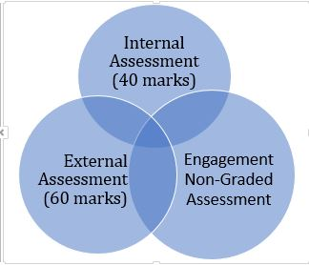

Assessment Pattern

