Slide 1

INSTITUTE UIE
DEPARTMENT ACADEMIC UNIT-1
Bachelor of Engineering (Computer Science & Engineering)
Subject Name Semi Conductor Physics
Subject Code 23SPH-143
Prepared By
Navjeet Kaur
Lecture-1.2.1
Carrier generation and recombination
DISCOVER . LEARN . EMPOWER

Slide 2
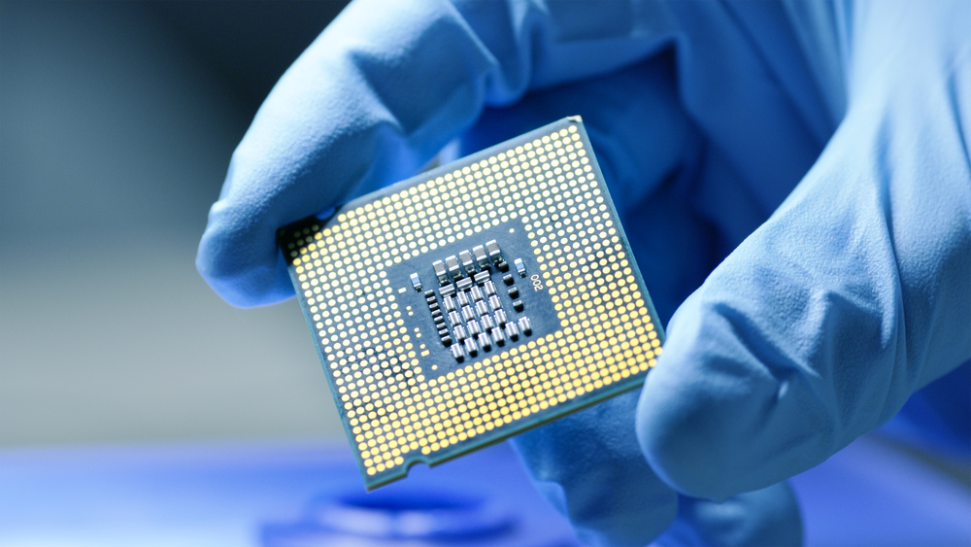
Course Objectives
S. No. | Objectives
1 | To understand the basic materials and properties of semiconductors.
2 | Understand the basic of semiconductor and components like diode, transistor, FET, MOSFET and Energy Sources.
3 | To give knowledge about semiconductor physics and discus working and applications of basic devices, including p-n junctions, BJTs and FETs.
https://www.iqsdirectory.com/resources/everything-you-ever-wanted-to-know-about-semiconductors/

Slide 3
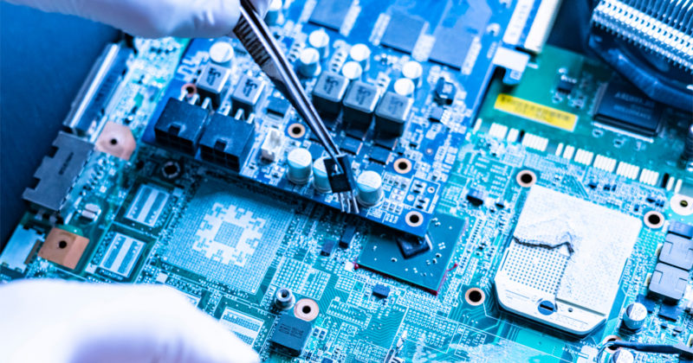
Course Outcomes
S.NO | Description | Blooms’ Taxonomy Level
CO1 | To apply the knowledge of basic semiconductor material physics and understand fabrication processes. | EASY
CO2 | To understand the characteristics of different electronic devices such as diodes, transistors. | MEDIUM
CO3 | To derive the relationships between the parameters in diode, FET, configurations of Transistor and MOSFETs. | MEDIUM
CO4 | To describe the working and design considerations for the various photonic devices like photo detectors, solar-cells and LEDs. | HARD
CO5 | To provide problem solving experience and learning of concepts through it in semiconductor physics. | HARD
https://lot.dhl.com/5-things-the-current-semiconductor-slowdown-tells-us-about-the-global-economy/

Slide 4
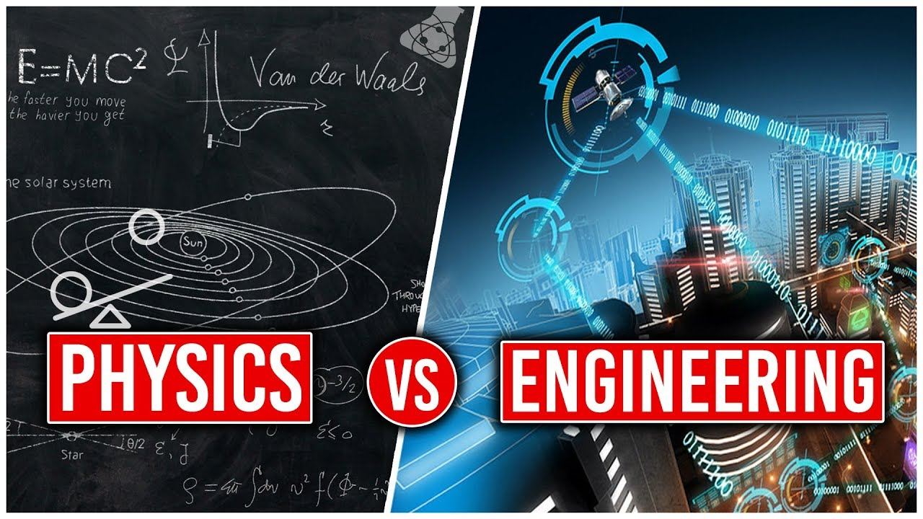
WHAT ROLE DOES PHYSICS PLAY IN ENGINEERING?
Engineering is concerned with figuring out how to design, build and use structures and machines. To do that requires physics because you have to take into account forces, fluid flow, heat transfer, and many other physics concepts. Engineering and technical applications of physics are numerous.
Figure.1.1 Physics vs Engineering[1]

Slide 5
LECTURE OBJECTIVES AND LECTURE OUTCOMES
LECTURE OBJECTIVES
To learn about the main factors upon which carrier generation and recombination depends in semiconductors.
LECTURE OUTCOMES
At the end of this lesson, student would gain knowledge about generation and recombination of charges in semiconductors .
Also, student would be able to explain the basic concepts of semiconductor physics, use its principles in design of semiconductor devices and its applications.

Slide 6
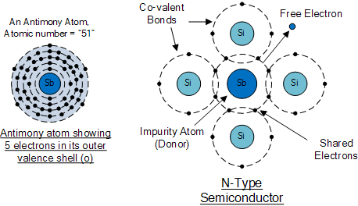
CONTENTS
Introduction: Basics and importance of Semiconductors.
Definition of Semiconductors.
Carrier Generation and Recombination in semiconductors.
Semiconductor Devices.
Applications of Semiconductor Devices.
Figure.1.2 Semiconductor Structure[2]
Notes:
Computer in the diagram is 3rd generation computer. The period of third generation was from 1965-1971. The computers of third generation used Integrated Circuits (ICs) in place of transistors. A single IC has many transistors, resistors, and capacitors along with the associated circuitry. The main features of third generation are −
IC used
More reliable in comparison to previous two generations
Smaller size
Generated less heat
Faster
Lesser maintenance
Costly
AC required
Consumed lesser electricity
Supported high-level language

Slide 7
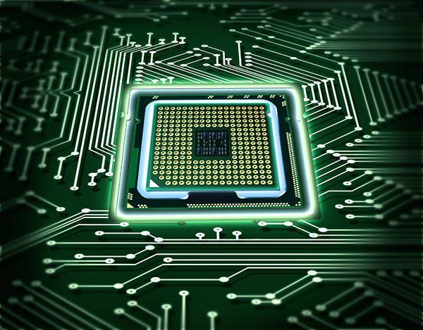
WHY TO STUDY SEMICONDUCTORS
Semiconductors are the foundation of modern day electronics such as radio, computers and mobile phones. Semiconductor material is used in the manufacturing of electrical components and used in electronic devices such as transistors and diodes.
Semiconductors are especially important as varying conditions like temperature and impurity content can easily change their conductivity. The combination of various semiconductor types together generates devices with special electrical properties, which allow control of electrical signals.
Imagine a world without electronics if these materials were not discovered. Despite the fact that vacuum tubes can be used to replace them, using semiconductors has made electronics faster, reliable and a lot smaller in size.
Also, they have allowed for creation of electrical devices with special capabilities which can be used for various purposes.

Slide 8
SEMICONDUCTORS
Semiconductors are materials that have electrical conductivity between conductors such as most metals and nonconductors and insulators like ceramics. How much electricity a semiconductor can conduct depends upon material and its mixture content.
Semiconductors can be insulators at low temperature and conductor at high temperature.
As they are used in the fabrication of electronic devices, semiconductors play an important role in our lives.

Slide 9
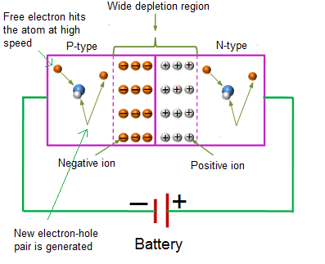
CARRIER GENERATION AND RECOMBINATION IN SEMICONDUCTORS
With the application of external energy source charge carriers are generated in the respective regions and combination of charge carriers also take place in depletion region.
Figure.1.4 Depletion Region[4]

Slide 10
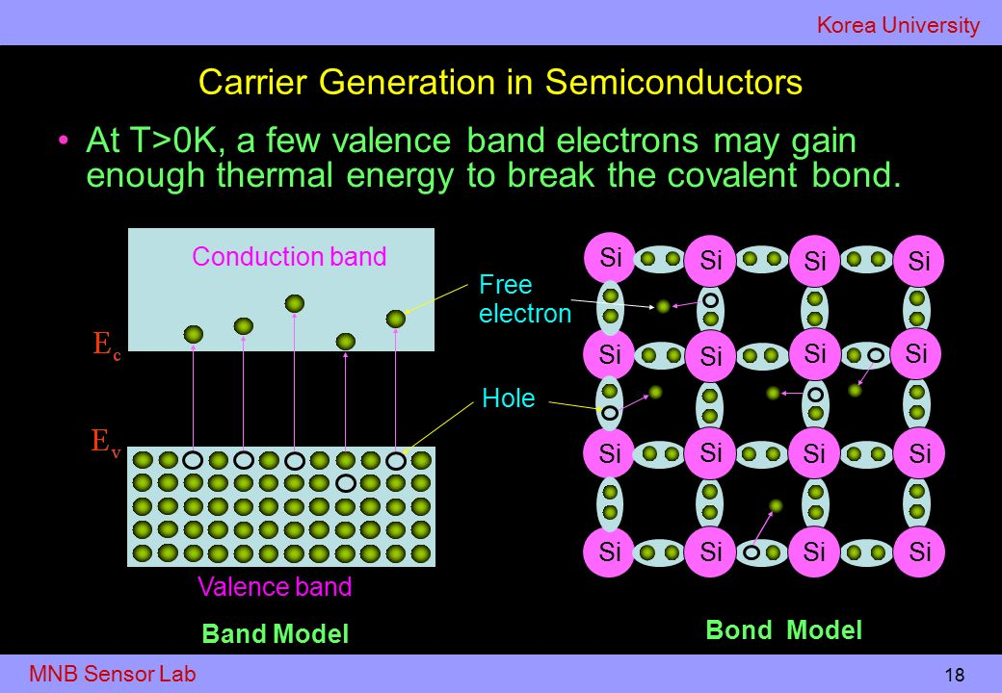
Carrier Generation in Semiconductors
When a semiconductor is in a non equilibrium state, electron and hole concentrations will change. As light illuminates a portion of the substrate, several electrons gain energy and jump to the conduction band, leaving an equal number of holes behind in the valence band. This is known as carrier generation (Figure-1.5).
We will denote the generation rates of electrons and holes, respectively, by Gn and Gp, which have units of carrier concentration per unit time.
Figure.1.5 Carrier Generation in Semiconductors[5]

Slide 11
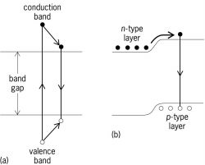
CARRIER RECOMBINATION IN SEMICONDUCTORS
Generation and Recombination occurs when electrons make transition from valence band to conduction band in semiconductor and due to thermal agitation electrons and holes continue to generate in nature of random movements. Merging of free electrons and holes occurs which is called recombination as a hole vacancy created by electron.
Figure.1.6 Carrier Recombination in Semiconductors[6]

Slide 12
CARRIER CONCENTRATION IN N-TYPE AND P-TYPE SEMICONDUCTORS
The free electron and hole concentrations are related by the Law of Electrical Neutrality i.e. Total positive charge density is equal to the total negative charge density
Let N_{D} = Concentration of donor atoms = no. of positive charges/m³
contributed by donor ions.
p = hole concentration
N_{A}=Concentration of acceptor atoms
n = electron concentration
By the law of electrical neutrality N_{D} + p = N_{A} + n

Slide 13
FOR N-TYPE SEMICONDUCTOR
N_{A} = 0 i.e. Concentration of acceptor atoms And n>>p,
then N_{D} + 0 = 0 + n
N_{D} = n
i.e. in N-type, concentration of donor atoms is equal to the concentration of free electrons.
According to Mass Action Law
n * p = n_{i}²
p = n_{i}² / n = n_{i}² / N_{D}

Slide 14
FOR P-TYPE SEMICONDUCTOR
N_{A} = 0 i.e. Concentration of donor atoms And p>>n,
then N_{A} + 0 = 0 + p
N_{A} = p
i.e. in P-type, concentration of acceptor atoms is equal to the concentration of free holes.
According to Mass Action Law
n * p = n_{i}²
n = n_{i}² / p = n_{i}² / N_{A}

Slide 15
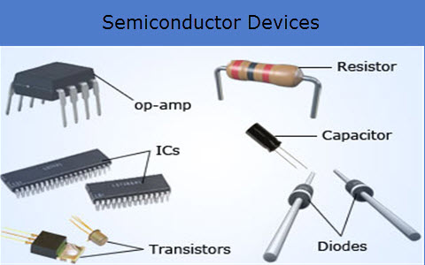
SEMICONDUCTOR DEVICES
Semiconductors are engrossed in the manufacture of various kinds of electronic devices, including diodes, transistors, and integrated circuits as shown in figure -1.7.
Such devices have found wide application because of their compactness, reliability, power efficiency, and low cost.
Figure.1.7 Semiconductors Devices[7]

Slide 16
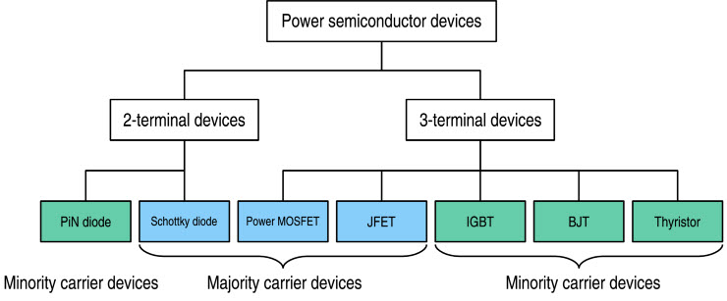
APPLICATIONS OF SEMICONDUCTOR DEVICES
Figure.1.8 Applications of Semiconductors Devices[7]

Slide 17
CONTINUE
All types of transistor can be used as the building blocks of logic gates, which is useful to design of digital circuits. In digital circuits like as microprocessors, transistors so which is acting as a switch (on-off); in the MOSFET.
Diodes optimized to take the advantage of conductivity is known as photodiodes. Compound semiconductor diodes are being used to generate light, light emitting diodes and laser diodes.
As semiconductor devices have no filaments, hence no power is needed to heat them to cause the emission of electrons.
Semiconductor devices require low voltage operation as compared to vacuum tubes.
Semiconductor diodes are used as a clipper and clamper circuits as well as a switch.
Owing to their small sizes, the circuits involving semiconductor devices are very compact.

Slide 18
MOST FREQUENTLY ASKED QUESTIONS
Q1: Explain recombination in semiconductors
Answer: There is a continuous transition of electrons between the two bands. When an electron falls from the conduction band into the valence band, into a hole, a recombination process occurs and an electron hole pair disappears..
Q2: Analyze how are charge carriers produced in intrinsic semiconductors.
Answer: In the intrinsic semiconductor the number of electrons in the conduction band equals to the number of holes in the valence band. Charge carriers appear as a result of charge carrier generation. Positive holes attract negative electrons. If an electron is drawn into the bond, it recombines with a hole.

Slide 19
MOST FREQUENTLY ASKED QUESTIONS
Q3: Justify use of semiconductors in electronic devices
Answer: Semiconductors are used in many electrical circuits because we can control the flow of electrons in this material, for example, with a controlling current.
Semiconductors are also used for other special properties. In fact, a solar cell is made of semiconductors which are sensitive to light energy.
Q4: Explain semiconductor material in terms of conductivity.
Answer: A semiconductor is a substance, usually a solid chemical element or compound, that can conduct electricity under some conditions but not others, making it a good medium for the control of electrical current. In a semiconductor material, the flow of holes occurs in a direction opposite to the flow of electrons.

Slide 20
SUMMARY
In this tutorial, we studied the main definitions of semiconductor and their devices with characteristic properties.
Responsible factors on which the rate of generation and recombination depends in semiconductors.
We also looked at that carrier concentration in n-type and p-type semiconductors.
We also looked at that carrier recombination rate is proportional to the product of electron and hole concentrations.
In the end, we discussed some applications of the semiconductor devices in the different fields.

Slide 21
ASSESSMENT PATTERN
Section- A
1. All questions are mandatory. Each question carry 2 marks each
Explain “carrier Generation in semiconductors”
Why the we prefer mostly semiconductor devices based technology ?
Section- B
Following questions carry 10 marks each
2. Explain
a) Illustrate carrier concentration in n-type semiconductor.
b) Tabulate the main factors which affects carrier generation and recombination
3. Express your views on the various applications of semiconductor devices like diodes, transistors etc

Slide 22
QUIZ- BUCKET
1.Q: Electron-hole pairs are produced by
Recombination
Thermal Energy
c) Ionization
d) Doping.
2.Q: Which of the following statements is not diode application in semiconductor?
Diode as voltage regulator
Diode as amplifier
Diode as rectifier
Diode as solar cell

Slide 23
QUIZ- BUCKET
3.Q: The most widely used semi-conductive material in electronic devices
a) Germanium
b) Carbon
c) Silicon
d) Copper
4.Q: The random motion of holes and electrons due to thermal agitation is called
a) Ionization
b) Pressure
c) Diffusion
d) None of above

Slide 24

REFERENCES
Websites & Books:
https://slideplayer.com/slide/11412380/
file:///C:Physics_of_Semiconductor_Devices.pdf
http://engineering.nyu.edu/gk12/amps-cbri/pdf/Basic%20Electronics.pdf
https://ecee.colorado.edu/~bart/book/book/chapter7/ch7_1.htm
https://www2.mvcc.edu/users/faculty/jfiore/Linear/SemiconductorDevices.pdf
Sze S.M., K. Ng Kwok., Physics of SemiconductorDevices, Edition 3rd , (2011), Wiley India.
KasapS.O.,Principles of Electronicand materials and devices,Edition 1st, (2007), Tata McGraw-Hill, Noida
Garcia N., Damask A., Physics forcomputer science, students,Edition1st, (1991), Springer-Verlag, NewYork.

Slide 25
REFERENCES
Images
https://fortune.com/2020/06/30/america-tech-semiconductor-manufacturing-investment/
https://www.cbronline.com/what-is/what-is-a-semiconductor-4946084/
https://www.elprocus.com/vi-characteristics-of-pn-junction-diode/
https://www.physics-and-radio-electronics.com/electronic-devices-and-circuits/semiconductor-diodes/pnjunctionsemiconductordiode.html
https://physics.stackexchange.com/questions/400321/reverse-biasing-of-pn-junction-diode?rq=1
https://electricalstudy.sarutech.com/p-n-junction-diode/index.html
https://slideplayer.com/slide/7245886/
https://www.slideshare.net/chinkitkit/chapter-4b
https://circuitglobe.com/zener-diode.html
https://www.electronics-tutorials.ws/diode/diode_7.html
https://www.miniphysics.com/uy1-hall-effect.html
https://www.elprocus.com/semiconductor-devices-types-and-applications

Slide 26
THANK YOU
For queries
Email: navjeetkaur.ee@cumail.in

