Slide 1

INSTITUTE UIE
DEPARTMENT ACADEMIC UNIT-1
Bachelor of Engineering (Computer Science & Engineering)
Subject Name Semi Conductor Physics
Subject Code 23SPH-143
Prepared By
Navjeet Kaur
Lecture-1.2.2
Carrier transport: diffusion and drift of carriers,
DISCOVER . LEARN . EMPOWER

Slide 2
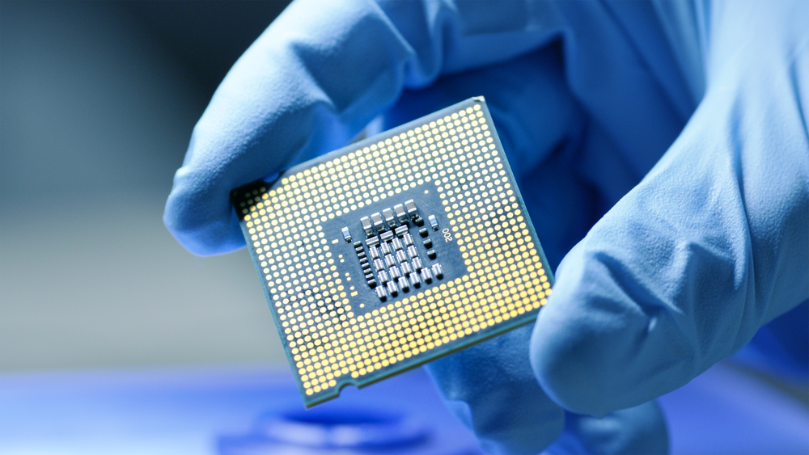
Course Objectives
S. No. | Objectives
1 | To understand the basic materials and properties of semiconductors.
2 | Understand the basic of semiconductor and components like diode, transistor, FET, MOSFET and Energy Sources.
3 | To give knowledge about semiconductor physics and discus working and applications of basic devices, including p-n junctions, BJTs and FETs.
https://www.iqsdirectory.com/resources/everything-you-ever-wanted-to-know-about-semiconductors/

Slide 3
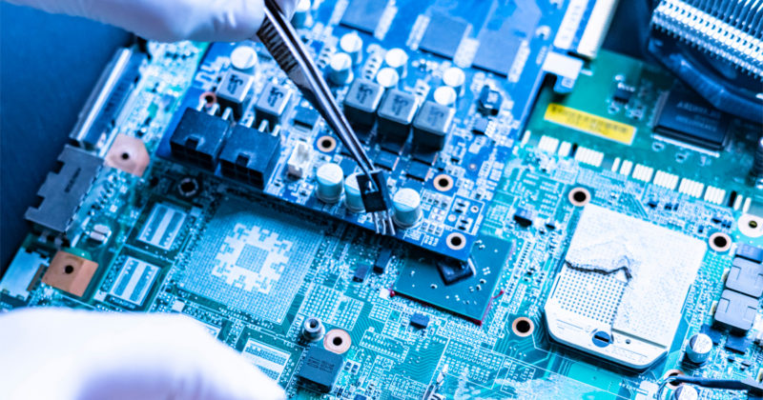
Course Outcomes
S.NO | Description | Blooms’ Taxonomy Level
CO1 | To apply the knowledge of basic semiconductor material physics and understand fabrication processes. | EASY
CO2 | To understand the characteristics of different electronic devices such as diodes, transistors. | MEDIUM
CO3 | To derive the relationships between the parameters in diode, FET, configurations of Transistor and MOSFETs. | MEDIUM
CO4 | To describe the working and design considerations for the various photonic devices like photo detectors, solar-cells and LEDs. | HARD
CO5 | To provide problem solving experience and learning of concepts through it in semiconductor physics. | HARD
https://lot.dhl.com/5-things-the-current-semiconductor-slowdown-tells-us-about-the-global-economy/

Slide 4
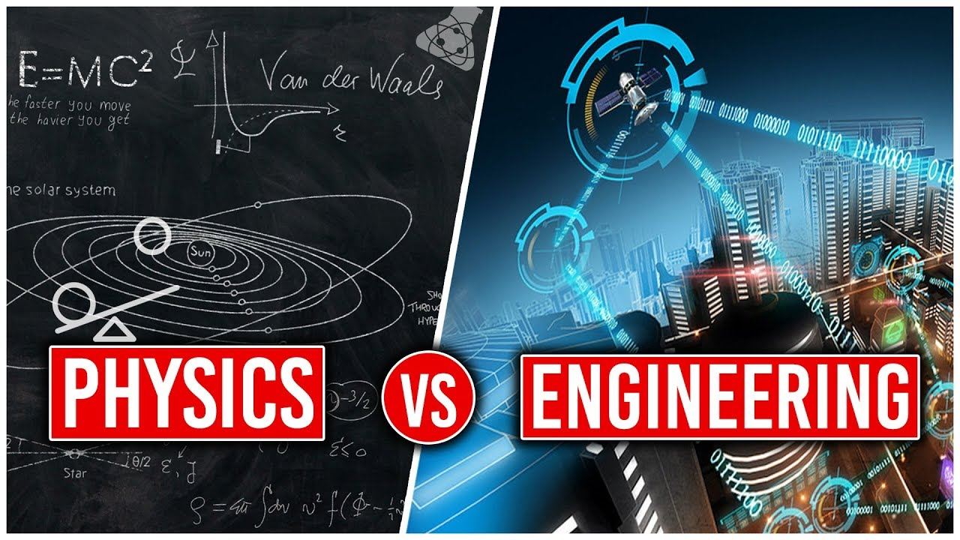
WHAT ROLE DOES PHYSICS PLAY IN ENGINEERING?
Engineering is concerned with figuring out how to design, build and use structures and machines. To do that requires physics because you have to take into account forces, fluid flow, heat transfer, and many other physics concepts. Engineering and technical applications of physics are numerous.
Figure.1.1 Physics vs Engineering[1]

Slide 5
LECTURE OBJECTIVES AND LECTURE OUTCOMES
LECTURE OBJECTIVES
To learn about the main factors upon which carrier generation and recombination depends in semiconductors.
LECTURE OUTCOMES
At the end of this lesson, student would gain knowledge about generation and recombination of charges in semiconductors .
Also, student would be able to explain the basic concepts of semiconductor physics, use its principles in design of semiconductor devices and its applications.

Slide 6
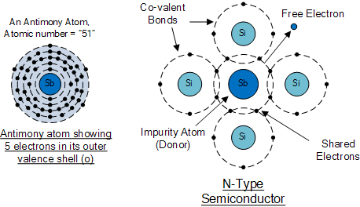
CONTENTS
Introduction: Basics and importance of Semiconductors.
Definition of Semiconductors.
Carrier Generation and Recombination in semiconductors.
Semiconductor Devices.
Applications of Semiconductor Devices.
Figure.1.2 Semiconductor Structure[2]
Notes:
Computer in the diagram is 3rd generation computer. The period of third generation was from 1965-1971. The computers of third generation used Integrated Circuits (ICs) in place of transistors. A single IC has many transistors, resistors, and capacitors along with the associated circuitry. The main features of third generation are −
IC used
More reliable in comparison to previous two generations
Smaller size
Generated less heat
Faster
Lesser maintenance
Costly
AC required
Consumed lesser electricity
Supported high-level language

Slide 7
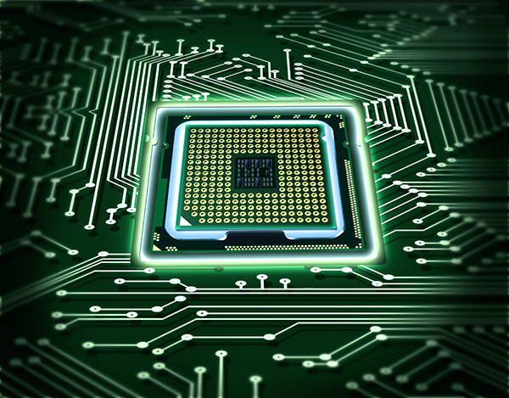
WHY TO STUDY SEMICONDUCTORS
Semiconductors are the foundation of modern day electronics such as radio, computers and mobile phones. Semiconductor material is used in the manufacturing of electrical components and used in electronic devices such as transistors and diodes.
Semiconductors are especially important as varying conditions like temperature and impurity content can easily change their conductivity. The combination of various semiconductor types together generates devices with special electrical properties, which allow control of electrical signals.
Imagine a world without electronics if these materials were not discovered. Despite the fact that vacuum tubes can be used to replace them, using semiconductors has made electronics faster, reliable and a lot smaller in size.
Also, they have allowed for creation of electrical devices with special capabilities which can be used for various purposes.

Slide 8
SEMICONDUCTORS
Semiconductors are materials that have electrical conductivity between conductors such as most metals and nonconductors and insulators like ceramics. How much electricity a semiconductor can conduct depends upon material and its mixture content.
Semiconductors can be insulators at low temperature and conductor at high temperature.
As they are used in the fabrication of electronic devices, semiconductors play an important role in our lives.

Slide 9
Carrier Transport
The net flow of the ‘electron and holes’ in a semiconductor generates the Current. The process through which these charged particles move is called transport.
Two basic modes of transport namely :
Drift & Diffusion.
The carrier transport phenomena are the foundation for finally determining the current-voltage characteristics of semiconductor devices.
I. Carrier Drift
II. Carrier Diffusion

Slide 10
Drift Current
Drift current can be defined as the charge carrier’s moves in a semiconductor because of the electric field. There are two kinds of charge carriers in a semiconductor like holes and electrons. Once the voltage is applied to a semiconductor, then electrons move toward the +Ve terminal of a battery whereas the holes travel toward the –Ve terminal of a battery.

Slide 11
Diffusion Current
The diffusion current can be defined as the flow of charge carriers within a semiconductor travels from a higher concentration region to a lower concentration region. A higher concentration region is nothing but where the number of electrons present in the semiconductor. Similarly, a lower concentration region is where the less number of electrons present in the semiconductor. The process of diffusion mainly occurs when a semiconductor is doped non-uniformly.
In an N-type semiconductor, when it is doped non-uniformly then a higher concentration region can be formed at the left side whereas the lower concentration region can be formed at the right side. The electrons in the higher concentration region are more in the semiconductor so they will experience a repulsive force from each other.

Slide 12
Drift Current Equation
The average velocity that an electron or hole achieved due to the applied voltage or electric field is called drift velocity.
The drift velocity of electrons is given by Vn = µnE T
he drift velocity of holes is given by Vp = µpE
Where vn = drift velocity of electrons
vp = drift velocity of holes
µn = mobility of electrons
µp = mobility of holes
E = applied electric field The drift current density due to free electrons is given by J n = enµn E

Slide 13
Drift Current Equation
and the drift current density due to holes is given by
J p = epµp E Where
Jn = drift current density due to electrons
Jp = drift current density due to holes e = charge of an electron = 1.602 × 10-19 Coulombs (C).
n = number of electrons
p = number of holes Then the total drift current density is
J = J n + J p = enµn E + epµp E
J = e (nµn + pµp ) E

Slide 14
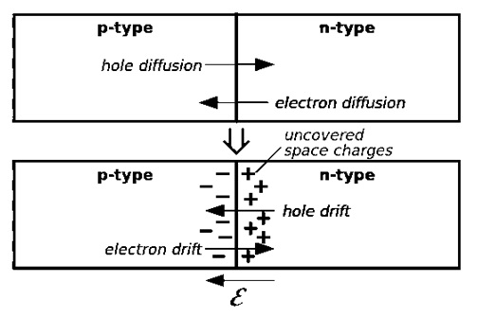
Drift and Diffusion Current

Slide 15
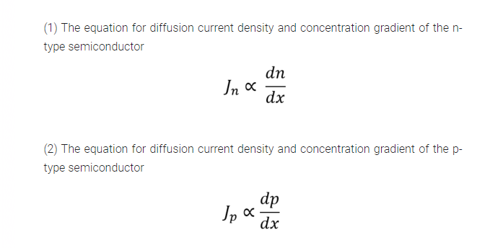
Diffusion Current Density Equation

Slide 16
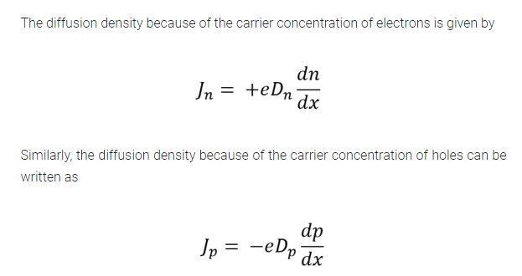
Diffusion current density

Slide 17
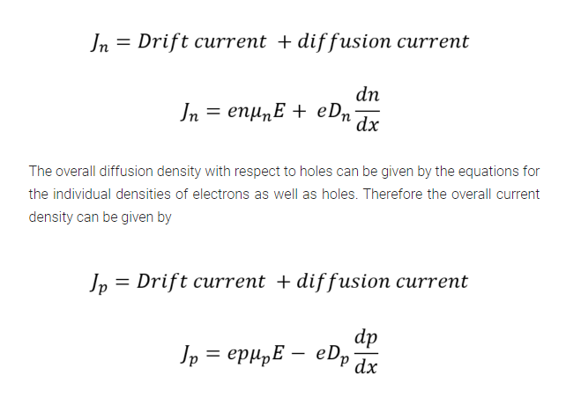
Diffusion current density
The overall diffusion density with respect to electrons can be given as

Slide 18
Difference Between Drift & Diffusion Current
S.No | Drift Current | Diffusion Current
1. | The movement of charge carriers is because of the applied electric field is known as drift current. | The diffusion current can be occurred because of the diffusion in charge carriers.
2. | It requires electrical energy for the process of drift current. | Some amount of external energy is enough for the process of diffusion current.
3. | This current obeys Ohm’s Law. | This current obeys Fick’s Law.
4. | The direction of charge carriers in the semiconductor is reverse to each other. | For charge carriers, the densities of diffusion are reverse in symbol to each other.

Slide 19
Difference Between Drift & Diffusion Current
S.No | Drift Current | Diffusion Current
5. | The direction of the drift current, as well as the electric field, will be the same. | The direction of this current can be decided by the concentration of the carrier slope.
6. | It depends on the permittivity | It is independent of permittivity
7. | The direction of this current mainly depends on the polarity of the applied electric field. | The direction of this current mainly depends on the charge within the concentrations of carrier

Slide 20
SUMMARY
In this tutorial, we studied the main definitions of semiconductor and their devices with characteristic properties.
Responsible factors on which the rate of generation and recombination depends in semiconductors.
We also looked at that carrier concentration in n-type and p-type semiconductors.
We also looked at that carrier recombination rate is proportional to the product of electron and hole concentrations.
In the end, we discussed some applications of the semiconductor devices in the different fields.

Slide 21
ASSESSMENT PATTERN
Section- A
1. All questions are mandatory. Each question carry 2 marks each
Explain “carrier Generation in semiconductors”
Why the we prefer mostly semiconductor devices based technology ?
Section- B
Following questions carry 10 marks each
2. Explain
a) Illustrate carrier concentration in n-type semiconductor.
b) Tabulate the main factors which affects carrier generation and recombination
3. Express your views on the various applications of semiconductor devices like diodes, transistors etc

Slide 22
QUIZ- BUCKET
1.Q: Electron-hole pairs are produced by
Recombination
Thermal Energy
c) Ionization
d) Doping.
2.Q: Which of the following statements is not diode application in semiconductor?
Diode as voltage regulator
Diode as amplifier
Diode as rectifier
Diode as solar cell

Slide 23
QUIZ- BUCKET
3.Q: The most widely used semi-conductive material in electronic devices
a) Germanium
b) Carbon
c) Silicon
d) Copper
4.Q: The random motion of holes and electrons due to thermal agitation is called
a) Ionization
b) Pressure
c) Diffusion
d) None of above

Slide 24

REFERENCES
Websites & Books:
https://slideplayer.com/slide/11412380/
file:///C:Physics_of_Semiconductor_Devices.pdf
http://engineering.nyu.edu/gk12/amps-cbri/pdf/Basic%20Electronics.pdf
https://ecee.colorado.edu/~bart/book/book/chapter7/ch7_1.htm
https://www2.mvcc.edu/users/faculty/jfiore/Linear/SemiconductorDevices.pdf
Sze S.M., K. Ng Kwok., Physics of SemiconductorDevices, Edition 3rd , (2011), Wiley India.
KasapS.O.,Principles of Electronicand materials and devices,Edition 1st, (2007), Tata McGraw-Hill, Noida
Garcia N., Damask A., Physics forcomputer science, students,Edition1st, (1991), Springer-Verlag, NewYork.

Slide 25
REFERENCES
Images
https://fortune.com/2020/06/30/america-tech-semiconductor-manufacturing-investment/
https://www.cbronline.com/what-is/what-is-a-semiconductor-4946084/
https://www.elprocus.com/vi-characteristics-of-pn-junction-diode/
https://www.physics-and-radio-electronics.com/electronic-devices-and-circuits/semiconductor-diodes/pnjunctionsemiconductordiode.html
https://physics.stackexchange.com/questions/400321/reverse-biasing-of-pn-junction-diode?rq=1
https://electricalstudy.sarutech.com/p-n-junction-diode/index.html
https://slideplayer.com/slide/7245886/
https://www.slideshare.net/chinkitkit/chapter-4b
https://circuitglobe.com/zener-diode.html
https://www.electronics-tutorials.ws/diode/diode_7.html
https://www.miniphysics.com/uy1-hall-effect.html
https://www.elprocus.com/semiconductor-devices-types-and-applications

Slide 26
THANK YOU
For queries
Email: navjeetkaur.ee@cumail.in

