Slide 1

INSTITUTE UIE
DEPARTMENT ACADEMIC UNIT-1
Bachelor of Engineering (Computer Science & Engineering)
Subject Name Semi Conductor Physics
Subject Code 23SPH-143
Prepared By
Dr. Sandeep Kaur
Lecture-2.2.2
Introduction to Photo Resistor & Photo Conductor with Applications.
DISCOVER . LEARN . EMPOWER

Slide 2
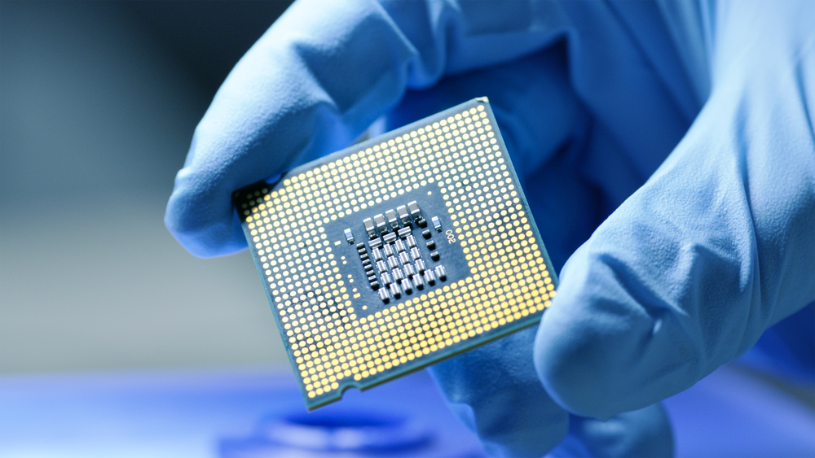
Course Objectives
S. No. | Objectives
1 | To understand the basic materials and properties of semiconductors.
2 | Understand the basic of semiconductor and components like diode, transistor, FET, MOSFET and Energy Sources.
3 | To give knowledge about semiconductor physics and discus working and applications of basic devices, including p-n junctions, BJTs and FETs.
https://www.iqsdirectory.com/resources/everything-you-ever-wanted-to-know-about-semiconductors/

Slide 3
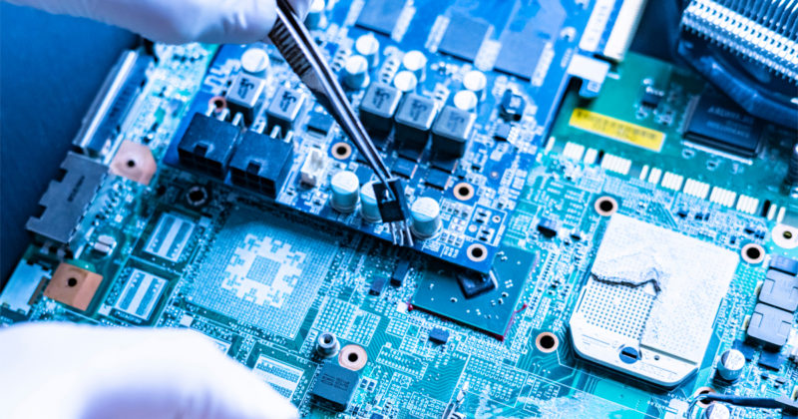
Course Outcomes
S.NO | Description | Blooms’ Taxonomy Level
CO1 | To apply the knowledge of basic semiconductor material physics and understand fabrication processes. | EASY
CO2 | To understand the characteristics of different electronic devices such as diodes, transistors. | MEDIUM
CO3 | To derive the relationships between the parameters in diode, FET, configurations of Transistor and MOSFETs. | MEDIUM
CO4 | To describe the working and design considerations for the various photonic devices like photo detectors, solar-cells and LEDs. | HARD
CO5 | To provide problem solving experience and learning of concepts through it in semiconductor physics. | HARD
https://lot.dhl.com/5-things-the-current-semiconductor-slowdown-tells-us-about-the-global-economy/

Slide 4
Content
Introduction to Photoconductor
Photoconductor Construction & Working Principle
Photoconductor Working
Advantages and Disadvantages
What is the use of a Photoconductor?
Introduction to Photo resistor
How photo resistor works?
Photo resistors classification .
Applications of photo resistors
Advantages and disadvantages of photo resistor

Slide 5
What is a Photoconductor
A photoconductor or Photoconductivity is an electrical & optical phenomenon where a material turns into conductive more electrically because of the electromagnetic radiation absorption like infrared light, ultraviolet light, visible light, or gamma radiation.
Once a semiconductor material absorbs light, then the number of charge carriers & also its electrical conductivity will be increased.

Slide 6
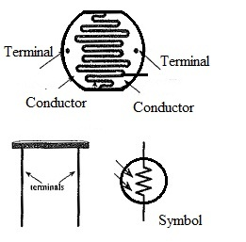
Photoconductor Construction
The photoconductor includes a light-sensitive material that is arranged in a long strip zigzag form across a base that is in a disc shape. The connecting terminals are fixed to the conducting material on every side of the strip. So, the light-sensitive material is a wide strip in between the two conductors and a transparent plastic cover is used for its protection.
Fig.1 photoconductor

Slide 7
Photoconductor Working
Once the light ray strikes the surface of a photoconductive material then it provides enough energy to cause electrons in the material to move away from their atoms.
Therefore, free charge carriers like holes & electrons can be created within the material, its resistance will be decreased. So this is called the Photoconductive effect.

Slide 8
Advantages
The advantages of a photoconductor include the following.
It mainly depends on the light, so its resistance will be decreased once light drops on it & enhances in the dark.
These are cheap & available in different sizes & shapes
They need less power & voltage for their operation.
These are used to make simple circuits

Slide 9
Disadvantages
These are less responsive as compared to phototransistors or photodiodes.
When the Cadmium sulfide (CdS) is used in the construction of a photoresistor, then it is dangerous to the atmosphere. Therefore they are accessible simply in preferred countries.
Once applied voltage increases the maximum voltage then it will cause damage to the photoconductor.
Its response time is very slow like 10sec or 100 milliseconds.
It is sensitive to temperature
These characteristics are nonlinear

Slide 10
What is the use of a Photoconductor?
Photoconductors are used in some practical applications like the following.
Photo-diode
Photoresistor
Photoconductors are used for X-Ray image detectors
These are used for relay control
These are used to switch on & off transistors.
These can be used with an op-amp-based Schmitt trigger circuit.
These are used to control the level of current flow within an LED.

Slide 11
Introduction to Photo resistor
The name photo resistor is the combination of words: photon (light particles) and resistor. A photo resistor is a type of resistor whose resistance decreases when the intensity of light increases. In other words, the flow of electric current through the photo resistor increases when the intensity of light increases.
Photo resistors are also sometimes referred as LDR (Light Dependent Resistor), semiconductor photo resistor, photoconductor, or photocell. Photo resistor changes its resistance only when it is exposed to light.

Slide 12
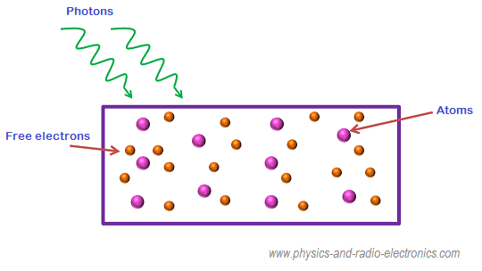
How photo resistor works?
When the light falls on the photo resistor, some of the valence electrons absorbs energy from the light and breaks the bonding with the atoms. The valence electrons, which break the bonding with the atoms, are called free electrons.
Fig.1 photoresistor

Slide 13
Types of Photo resistors
Photo resistors are classified into two types based on the material used to construct them:
Intrinsic photo resistor
Extrinsic photo resistor
Intrinsic photo resistor

Slide 14
Advantages and disadvantages of photoresistor
Advantages of photoresistor
Small in size
Low cost
It is easy to carry from one place to another place.
Disadvantages of photoresistor
The accuracy of photoresistor is very low.

