Slide 1

UNIVERSITY INSTITUTE OF ENGINEERING
DEPARTMENT OF ACADEMIC UNIT-1
Bachelor of Engineering (CSE)
SUBJECT NAME: Introduction to Electrical & Electronics Engineering-IEEE
SUBJECT CODE : 23ECH-101
By
Dr. Shikha
Unit-3 Chapter-1
EFFICIENCY & VOLTAGE REGULATION
Lecture No.3.1.3
DISCOVER . LEARN . EMPOWER

Slide 2
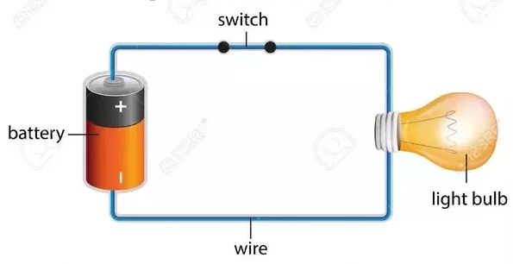
Lecture Objectives
S. No. | Objectives
1 | To make student aware about losses in transformer
2 | To aware about efficiency of transformer
3 | To provide knowledge about voltage regulation of transformer
4 | To aware about all day efficiency of transformer
5 | To give applications of transformer
https://www.quora.com/What-are-the-differences-between-a-circuit-and-an-electric-circuit

Slide 3
Course Objectives
S. No. | Objectives
1 | Understand Electrical & Electronics Engineering Fundamentals
2 | To prepare students to perform the analysis and design of various Electrical & digital electronic circuits.
https://www.quora.com/What-are-the-differences-between-a-circuit-and-an-electric-circuit

Slide 4
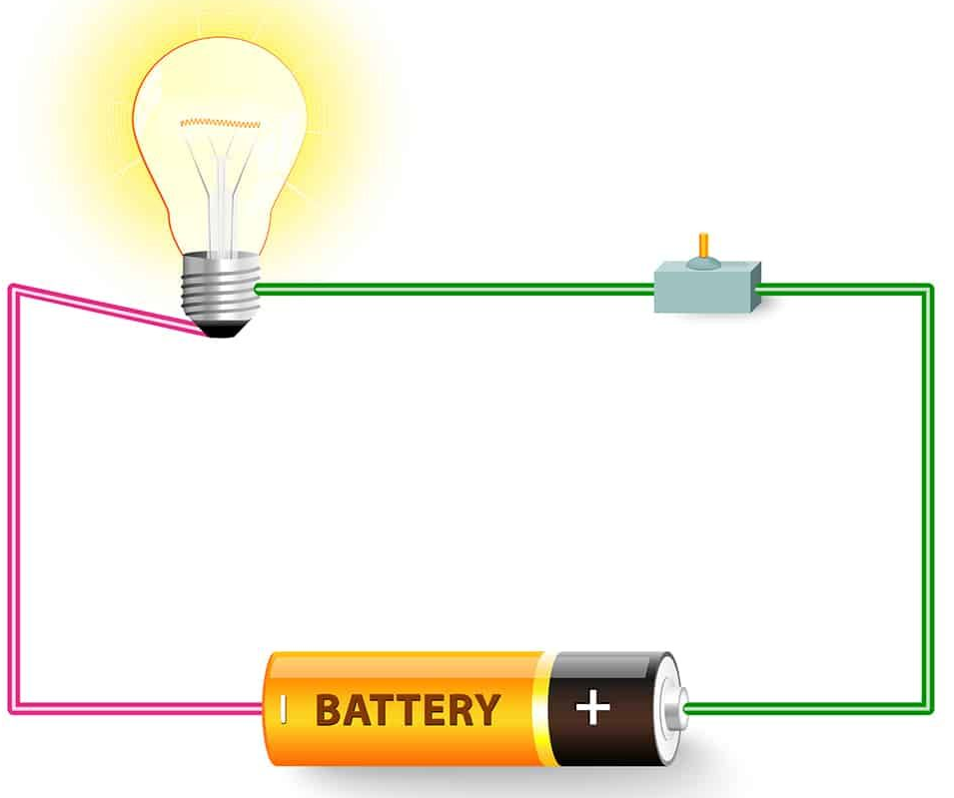
Course Outcomes
CO Number | Title | Level
CO1 | To identify the different types of electrical elements and the basic op-amp circuit elements and to illustrate the various types of motors, transducers. | Remember
CO2 | To understand basic principles of transformers, transducers, op-amps, DC and AC motors and to compare the different methods for analysing electrical and magnetic circuits. | Understand
CO3 | To derive the relationships between parameters in electric and magnetic circuits and motors and to determine specifications of op-amps. | Analyze
CO4 | To solve the basic problems related to electric circuits, magnetic circuits and motors and to assess the characteristics of different configurations of op-amps. | Evaluate
CO5 | To design the different applications of transducers, motors as well as the op-amps like adders, subtractor and comparators. | Create
https://in.pinterest.com/pin/240661173823316229/

Slide 5
Importance of Basic Electrical & Electronics Engineering
Use from home appliances to industrial plants.
Usage in communication and satellite navigation system.
Handles in electronics equipment and computers.
Deals with the problem of power transmission and motor control.
Control and monitor the medical appliances in hospitals.
High voltage applications with heavy current.
Robotics applications.
Product designing and development.

Slide 6
Contents
Various types of losses
Why is a transformer rated in KVA but not in KW?
Transformer Efficiency
Condition for maximum efficiency of transformer
All Day Efficiency of a Transformer
Voltage Regulation
Expression of Voltage Regulation of Transformer
Applications of transformer
Frequently asked questions
Summary

Slide 7
Various Types of Losses
Iron Losses
Hysteresis Loss
Eddy Current Loss
Copper Loss Or Ohmic Loss
Stray Loss
Dielectric Loss
Notes:
Computer in the diagram is 3rd generation computer. The period of third generation was from 1965-1971. The computers of third generation used Integrated Circuits (ICs) in place of transistors. A single IC has many transistors, resistors, and capacitors along with the associated circuitry. The main features of third generation are −
IC used
More reliable in comparison to previous two generations
Smaller size
Generated less heat
Faster
Lesser maintenance
Costly
AC required
Consumed lesser electricity
Supported high-level language

Slide 8
Rating of Transformer
KVA stands for kilo-volt-ampere, which basically is the unit of electric power. While calculating kVA of any piece of equipment the power factor is not taken into account.
(i.e.) Power in kVA = Voltage x Current.
This means kVA is the unit of measurement for that equipment in which the output power is independent of power factor.
For example Rating of Alternators, Transformers, and UPS etc.
Iron loss and copper loss occurring in the transformer are also independent of the power factor.
Moreover, the output power factor of the transformer purely depends on the connected load. The transformer does not alter the power factor of its output power.

Slide 9
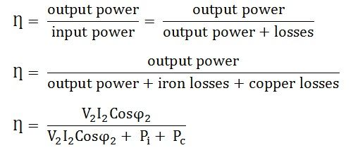

Transformer Efficiency
The Efficiency of the transformer is defined as the ratio of useful output power to the input power.
The input and output power are measured in the same unit. Its unit is either in Watts (W) or KW. Transformer efficiency is denoted by Ƞ.

Slide 10
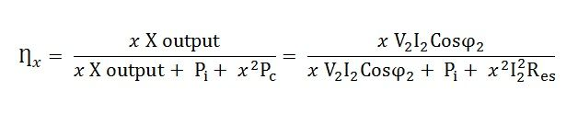
Transformer Efficiency
Where,
V₂ – Secondary terminal voltage
I₂ – Full load secondary current
Cosϕ₂ – power factor of the load
P_{i} – Iron losses = hysteresis losses + eddy current losses
P_{c} – Full load copper losses = I₂²R_{es}
Consider, the x is the fraction of the full load. The efficiency of the transformer regarding x is expressed as

Slide 11
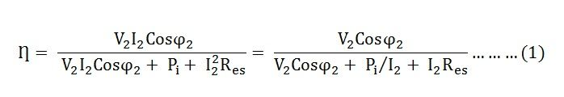
Condition for maximum efficiency of transformer?
The efficiency of the transformer along with the load and the power factor is expressed by the given relation:
The value of the terminal voltage V₂ is approximately constant. Thus, for a given power factor the Transformer efficiency depends upon the load current I₂.
In equation (1), the numerator is constant and the transformer efficiency will be maximum if the denominator with respect to the variable I₂ is equated to zero.

Slide 12
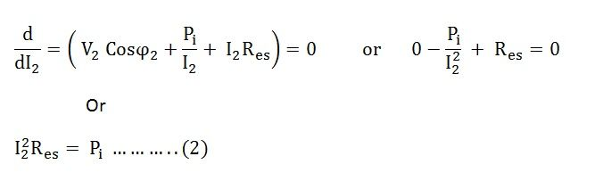
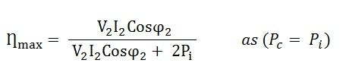
Condition for maximum efficiency of transformer?
i.e Copper losses = Iron losses
Thus, the transformer will give the maximum efficiency when their copper loss is equal to the iron loss.

Slide 13

Condition for maximum efficiency of transformer?
From equation (2) the value of output current I₂ at which the transformer efficiency will be maximum is given as
If x is the fraction of full load KVA at which the efficiency of the transformer is maximum then,
Copper losses = x²P_{c} (where P_{c} is the full load copper losses)
Iron losses = P_{i}
So iron loss must be equal to copper loss.

Slide 14
Voltage Regulation
Voltage regulation is a measure of change in the voltage magnitude between the sending and receiving end of a component.
It is commonly used in power engineering to describe the percentage voltage difference between no load and full load voltages distribution lines, transmission lines and transformers.

Slide 15
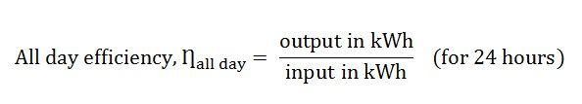
All Day Efficiency of a Transformer
Definition: All day efficiency means the power consumed by the transformer throughout the day.
It is defined as the ratio of output power to the input power in kWh or wh of the transformer over 24 hours.

Slide 16
Expression of Voltage Regulation of Transformer
The equation for the voltage regulation of transformer, represented in percentage, is
Voltage Regulation= change in output voltage/No-load output voltage
Voltage Regulation= V(no load)-V(full load)/V(no load)
In percentage we can write:
Voltage Regulation= V(no load)-V(full load)/V(no load) X 100
So when the secondary winding of transformer is connected with the load its output voltage can be changed and it can be expressed in terms of ratio or percentage.

Slide 17
Applications of Transformer
It can rise or lower the level of level of Voltage or Current ( when voltage increases, current decreases and vice versa because P =V x I, and Power is same ) in an AC Circuit.
It can increase or decrease the value of capacitor, an inductor or resistance in an AC circuit. It can thus act as an impedance transferring device.
It can be used to prevent DC from passing from one circuit to the other.
it can isolate two circuits electrically.

Slide 18
Frequently Asked Questions
1.) What is the condition for maximum efficiency of transformer
Answer:- iron losses =cu losses
2.) Define voltage regulation?
Answer:- Voltage regulation is a measure of change in the voltage magnitude between the sending and receiving end of a component.

Slide 19
Frequently Asked Questions
3.) Why the transformer rating is in kVA?
Answer:- KVA because iron loss is in voltage form and copper loss is in current form hence the rating of transformer rating is in kVA.
4.) What are the applications of transformer?
Answer:- Transformer performs functions such as:
Increase or decrease the value of voltage
Used to prevent DC passing from one circuit to the other.

Slide 20
Summary
Through this PPT , the students have learned and understood
Efficiency of transformer
Condition for maximum efficiency
Voltage regulation of transformer
Expression for voltage regulation of transformer
Applications of transformer

Slide 21
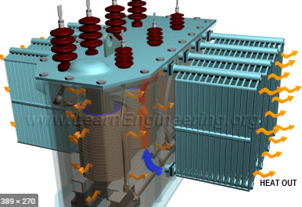
Learning Outcomes
To make students understand the
Concept of transformer efficiency.
Condition for maximum efficiency.
Voltage regulation of transformer.
Expression for voltage regulation.
Applications of transformer.
https://www.google.com/search?q=transformer+working+and+construction&source=lnms&tbm=isch&sa=X&ved=2ahUKEwjf7q2zo5XqAhXbb30KHcZ1A-MQ_AUoAnoECBEQBA&biw=1366&bih=608#imgrc=Hz4hgKww9splRM&imgdii=-GHifX4ZDm1raM

Slide 22
Assessment Pattern
A Assignment (each assignment) | B Time Bound Surprise Test (each test) | C Quiz (each quiz) | D Mid Semester Test(one per test) | E Homework | F Discussion Forums | G Attendance and engagement Score on BB
10 | 12 | 4 | 20 | NA | NA | 2

Slide 23

REFERENCES
https://circuitglobe.com/what-is-transformer-efficiency.html
https://iopscience.iop.org/book/978-0-7503-2084-9/chapter/bk978-0-7503-2084-9ch1
https://www.forgottenbooks.com/en/books/TheMagneticCircuit_10037141
https://cnx.org/contents/FOAgj46E@1.1:CF55C3SF@1/chapter-1-Magnetic-Circuits-and-Magnetic-Materials
https://www.sciencedirect.com/topics/engineering/magnetic-circuits

Slide 24
THANK YOU
For queries
Email:shikha.e12701@cumail.in

