Slide 1

UNIVERSITY INSTITUTE ENGINEERING
DEPARTMENT ACADEMIC UNIT-1
Bachelor of Engineering (Computer Science Engineering)
SUBJECT NAME: INTRODUCTION TO ELECTRICAL & ELECTRONICS ENGINEERING
SUBJECT CODE : 23ECH-101
By
Dr. Shikha
Unit-3, Chapter-1
Lecture No. 3.1.4
DC MACHINES
DISCOVER . LEARN . EMPOWER

Slide 2

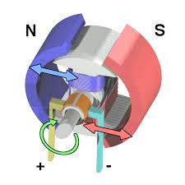
LECTURE OBJECTIVES
S. No. | Objectives
1 | To make student aware about the basic construction of DC Machine.
2 | To aware about the working principal of DC Machine.
3 | To provide knowledge about the load characteristics of DC machines.
4 | To make familiar with speed control of DC Machines.
5 | To give knowledge about EMF equation of DC Machine.
https://en.wikipedia.org/wiki/DC_motor

Slide 3
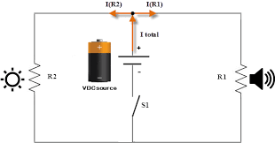
Course Objectives
S. No. | Objectives
1 | Understand Electrical & Electronics Engineering Fundamentals
2 | To prepare students to perform the analysis and design of various Electrical & digital electronic circuits.
https://library.automationdirect.com/basic-electrical-theory/

Slide 4
Course Outcomes
CO Number | Title | Level
CO1 | To identify the different types of electrical elements and the basic op-amp circuit elements and to illustrate the various types of motors, transducers. | Remember
CO2 | To understand basic principles of transformers, transducers, op-amps, DC and AC motors and to compare the different methods for analysing electrical and magnetic circuits. | Understand
CO3 | To derive the relationships between parameters in electric and magnetic circuits and motors and to determine specifications of op-amps. | Analyze
CO4 | To solve the basic problems related to electric circuits, magnetic circuits and motors and to assess the characteristics of different configurations of op-amps. | Evaluate
CO5 | To design the different applications of transducers, motors as well as the op-amps like adders, subtractor and comparators. | Create
https://library.automationdirect.com/basic-electrical-theory/

Slide 5
CONTENTS
Introduction of DC Motor
Constructional Parts of DC Motor.
Function of Commutator in DC Motor
Function of Armature Winding.
Types of Armature Windings
Function of Brushes in DC Motor.
Working of DC Motor.

Slide 6
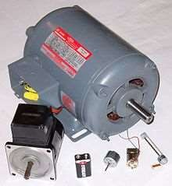
UNIT-2 DC MOTOR
https://www.electrical4u.com/dc-motor-or-direct-current-motor/
Fig: 1. Pictorial View of DC Motor

Slide 7
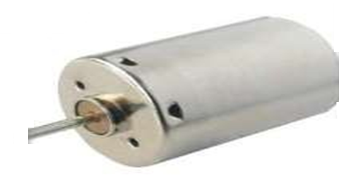
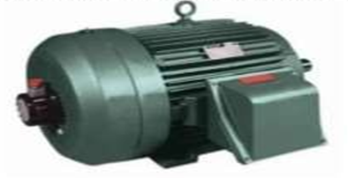
DC MOTOR
A DC Motor or Direct Current Motor converts electrical energy in to mechanical energy.
A Direct Current (DC) motor is fairly simple electric motor that uses electricity and a magnetic field to produce torque, which turns the rotor and hence give mechanical work.
Fig: 2. Small Size DC Motor
Fig: 3. Large Size DC Motor
https://en.wikipedia.org/wiki/DC_motor

Slide 8
CONSTRUCTIONAL PARTS OF DC MACHINE
Magnetic Frame or yoke
Pole core & Pole shoes.
Magnetic field or Exciting coils
Armature core
Armature winding
a) Lap Winding
b) Wave Winding
6) Commutator
7) Brushes.
8) Bearing
9) End ring
10) Shaft.

Slide 9
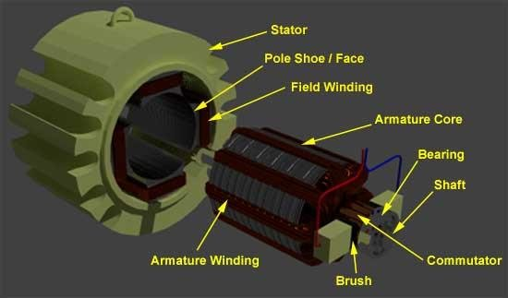
CONSTRUCTIONAL VIEW OF DC MACHINE
Fig: 4. Constructional View of DC Machine
https://www.electrical4u.com/construction-of-dc-motor-yoke-poles-armature-field-winding-commutator-brushes-of-dc-motor/

Slide 10
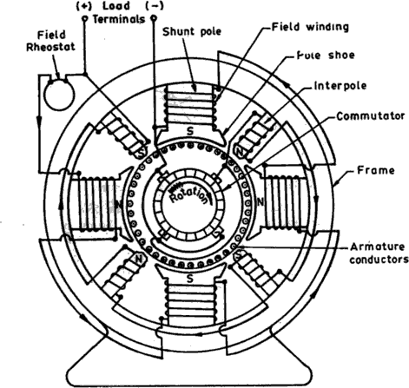
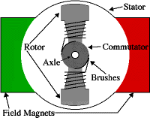
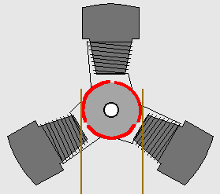
OVERVIEW OF DC MACHINE
Fig:5. Overview of DC Machine
https://blog.oureducation.in/construction-of-dc-motor/

Slide 11
MAGNETIC FRAME OR YOKE
The outer hollow cylindrical frame to which main poles and inter-poles are fixed and by means of which the machine is fixed to the foundation is known as Yoke.
The two main purposes of the yoke are as follows:-
It supports the pole cores and provides mechanical protection to the inner parts of the machines.
It provides a low reluctance path for the magnetic flux.

Slide 12
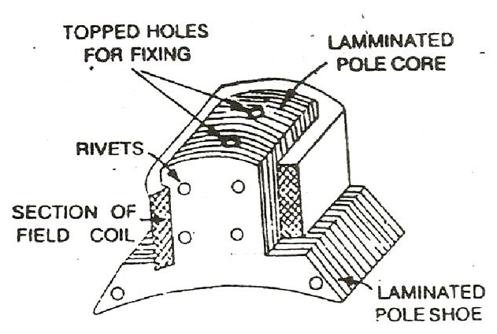
POLE CORE & POLE SHOES
The Pole Core and Pole Shoes are fixed to the magnetic frame or yoke by bolts.
The pole core and shoes are made of thin cast steel or wrought iron laminations.
It supports the field or exciting coils.
They spread out the magnetic flux over the armature periphery more uniformly.
It increases the cross-sectional area of the magnetic circuit, as a result, the reluctance of the magnetic path is reduced.
Fig:6. Pole Core & Pole Shoes
https://circuitglobe.com/construction-of-dc-generator.html

Slide 13
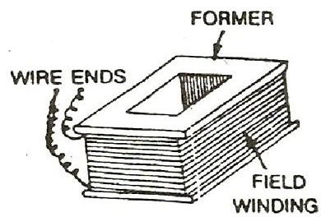
FIELD or EXCITING COILS
The enameled copper wire is used for the construction of field or exciting coils.
The field coils of all the poles are connected in series in such a way that when current flows through them, the adjacent poles attain opposite polarity.
Fig:7. Field or Exciting Coils
https://circuitglobe.com/construction-of-dc-generator.html

Slide 14
ARMATURE WINDING
The insulated conductors are placed in the slots of the armature core.
The armature winding is the heart of the DC Machine.
Armature winding is a place where conversion of power takes place.
windings are classified into two types named as Lap Winding and Wave Winding.
Lap Winding
In lap winding, the conductors are connected in such a way that the number of parallel paths are equal to the number of poles.
Wave Winding
In wave winding, the conductors are so connected that they are divided into two parallel paths irrespective of the number of poles of the machine.

Slide 15
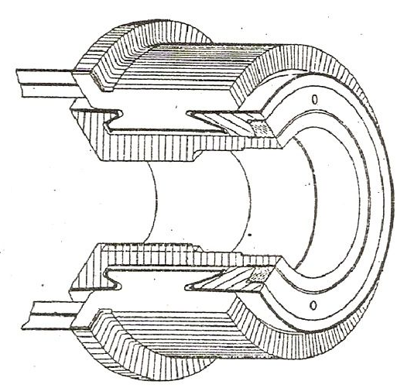
COMMUTATOR
The commutator which rotates with the armature, is cylindrical in shape.
It connects the rotating armature conductors to the stationary external circuit through brushes.
It converts the induced alternating current in the armature conductor into unidirectional current in the external load circuit in DC Generator action, whereas it converts the alternating torque into unidirectional (continuous) torque produced in the armature in motor action.
Fig:8. Commutator
https://circuitglobe.com/construction-of-dc-generator.html

Slide 16
BRUSHES
The brushes are pressed upon the Commutator and form the connecting link between the armature winding and the external circuit.
The pressure exerted by the brushes on the Commutator can be adjusted and is maintained at a constant value by means of springs.
It can be used to provide a lubricating effect on Commutator surface.
END HOUSINGS
End housings are attached to the ends of the Mainframe and provide support to the bearings.
BEARINGS
The ball or roller bearings are fitted in the end housings. The function of the bearings is to reduce friction between the rotating and stationary parts of the machine

Slide 17
SHAFT
The shaft is made of mild steel with a maximum breaking strength. The shaft is used to transfer mechanical power from or to the machine.

Slide 18
WORKING PRINCIPLE OF DC MOTOR
A machine that converts DC electrical power into mechanical power is known as a Direct Current motor.
DC motor working is based on the principle that when a current carrying conductor is placed in a magnetic field, the conductor experiences a mechanical force.
The direction of this force is given by Fleming’s left-hand rule and magnitude is given by;
F = BIL Newton’s
According to Fleming’s left-hand rule when an electric current passes through a coil in a magnetic field, the magnetic force produces a torque that turns the DC motor. The direction of this force is perpendicular to both the wire and the magnetic field.

Slide 19
SUMMARY
Introduction to DC Motor & its constructions.
Working Principle of DC Motor
Function of Commutator in DC motor
Types of Armature Windings.

Slide 20
FREQUENTLY ASKED QUESTIONS
What is the principle operation of DC Motors?
What is the function of Commutator in DC Motor.
What is the function of Brushes in DC Motor.
What is Lap Winding & Wave Winding.

Slide 21
LEARNING OUTCOMES
To Guide the students about basic knowledge of DC motor & it’s working principle.
To aware about constructional part of DC motor.
To make the students aware about concept of type of armature windings.
To make the students about function of Commutator in DC Motor.

Slide 22
Course Outcome to Program Outcome Relationship
 |  | (21ELH-101) BEEE
PO→
CO↓ | PO1 | PO2 | PO3 | PO4 | PO5 | PO6 | PO7 | PO8 | PO9 | PO10 | PO11 | PO12 | PSO1 | PSO2 | PSO3
CO1 | 3 | 2 |  |  |  |  |  |  |  |  |  |  | 3
CO2 | 3 | 2 |  |  |  |  |  |  |  |  |  |  | 3
CO3 | 3 | 2 |  |  |  |  |  |  |  |  |  |  | 3
CO4 | 3 | 2 |  |  |  |  |  |  |  |  |  |  | 3
CO5 | 3 | 2 |  |  |  |  |  |  |  |  |  |  | 3

Slide 23
ASSESSMENT PATTERN
A Assignment (each assignment) | B Time Bound Surprise Test (each test) | C Quiz (each quiz) | D Mid Semester Test(one per test) | E Homework | F Discussion Forums | G Attendance and engagement Score on BB
10 | 12 | 4 | 20 | NA | NA | 2

Slide 24
REFERENCES FOR FURTHER HIGHER LEARNING
https://www.usna.edu/EE/ee301/supplements/Rotating%20DC%20Motors%20Supplement%20I.pdf.
https://www.usna.edu/EE/ee301/supplements/Linear%20Motors%20Supplement.pdf.

Slide 25
REFERENCES
Books:
[1] Basic of Electrical Engineering, T. K. Nagsarkar and M. S.Sukhija,2013 ,2nd edition
[2]Theory and problems of Basic Electrical Engineering, J. Nagrath and Kothari, 2012, 2nd edition
[3] A Textbook of Electrical Technology, B.L Theraja,2010,Vol 1
[4] Fundamentals of Electrical and Electronics Engineering, Smarjith Ghosh,2013,1st edition
E-Books:
[1] http://www.freeengineeringbooks.com/Electrical/DC-Motors-Books.php
[2] http://pemclab.cn.nctu.edu.tw/W3lib/books/ElectroCraft85/ch2.dcmotor.pdf
Websites:
[1] https://en.wikipedia.org/wiki/DC_motor
[2] https://www.electrical4u.com/dc-motor-or-direct-current-motor/
[3] https://nptel.ac.in/content/storage2/courses/108105053/pdf/L-39(TB)(ET)%20((EE)NPTEL).pdf
[4] https://www.slideshare.net/saaz1425/dc-motor-23906628
Videos:
[1] https://www.youtube.com/watch?v=6MnmcMYbsfQ
[2] https://www.youtube.com/watch?v=ASnDSEeWADk
[3] https://www.youtube.com/watch?v=xsWNGcZ-jds

Slide 26
THANK YOU
For queries
Email: shikha.e12701@cumail.in

