Slide 1

UNIVERSITY INSTITUTE ENGINEERING
DEPARTMENT ACADEMIC UNIT-1
Bachelor of Engineering (Computer Science Engineering)
SUBJECT NAME: INTRODUCTION TO ELECTRICAL & ELECTRONICS ENGINEERING
SUBJECT CODE : 23ECH-101
By
Dr. Shikha
Unit-3, Chapter-2
Lecture No. 3.1.5
CHARACTERISTICS OF DC MOTOR
DISCOVER . LEARN . EMPOWER

Slide 2
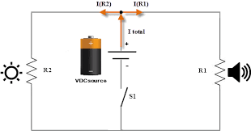
LECTURE OBJECTIVES
S. No. | Objectives
1 | To make student aware about the characteristics of DC motor
2 | To aware about torque- armature current, speed - armature current and speed-torque characteristics of DC shunt motor
3 | To aware about torque- armature current, speed - armature current and speed-torque characteristics of DC series motor
4 | To aware about torque- armature current, speed - armature current and speed-torque characteristics of DC compound motor
5 | To give brief knowledge about applications of DC motor
https://library.automationdirect.com/basic-electrical-theory/

Slide 3
Course Objectives
S. No. | Objectives
1 | Understand Electrical & Electronics Engineering Fundamentals
2 | To prepare students to perform the analysis and design of various Electrical & digital electronic circuits.
https://library.automationdirect.com/basic-electrical-theory/

Slide 4
Course Outcomes
CO Number | Title | Level
CO1 | To identify the different types of electrical elements and the basic op-amp circuit elements and to illustrate the various types of motors, transducers. | Remember
CO2 | To understand basic principles of transformers, transducers, op-amps, DC and AC motors and to compare the different methods for analysing electrical and magnetic circuits. | Understand
CO3 | To derive the relationships between parameters in electric and magnetic circuits and motors and to determine specifications of op-amps. | Analyze
CO4 | To solve the basic problems related to electric circuits, magnetic circuits and motors and to assess the characteristics of different configurations of op-amps. | Evaluate
CO5 | To design the different applications of transducers, motors as well as the op-amps like adders, subtractor and comparators. | Create
https://library.automationdirect.com/basic-electrical-theory/

Slide 5

IMPORTANCE OF COURSE[BEEE]
Use in communication and satellite navigation system.
Handles in electronics equipment and computers.
Deals with the problem of power transmission and motor control.
Handles with robotics applications.
https://images.app.goo.gl/JY2jmAuASfpDUENZ8

Slide 6
CONTENTS
Various types of characteristics of DC motor.
Torque- armature current, speed - armature current and speed-torque characteristics of DC shunt motor.
Torque- armature current, speed - armature current and speed-torque characteristics of DC series motor.
Torque- armature current, speed - armature current and speed-torque characteristics of DC compound motor.
Applications of DC motors.

Slide 7
TYPES OF CHARACTERISTICS OF DC MOTOR
Three characteristic curves are there for DC Motors given below
Torque-armature current
Speed- armature current
Speed- torque

Slide 8
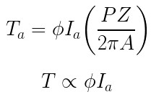
TORQUE- SPEED EQUATION OF DC MOTOR
For a d.c. motor, Torque is directly proportional to the product of Armature current and Main flux.
Now is the flux produced by the field winding and is proportional to the current passing through the field winding.

Slide 9
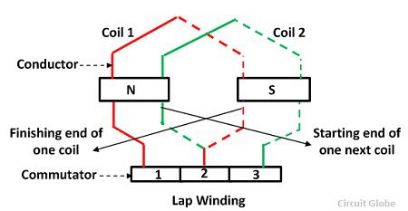
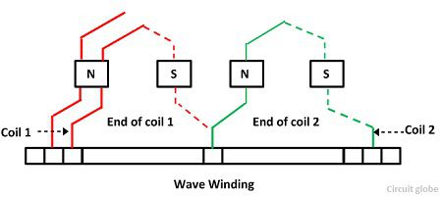

Slide 10

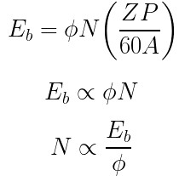
TORQUE- SPEED EQUATION OF DC MOTOR
For a d.c. motor, Torque is directly proportional to the product of armature current and main flux.
Similarly the back emf produced in the armature is given by

Slide 11
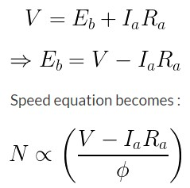
TORQUE- SPEED EQUATION OF DC MOTOR
These relations play an important role in understanding the various characteristics of different types of motors.

Slide 12

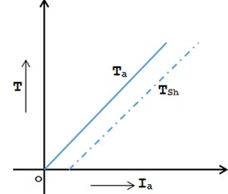

TORQUE- ARMATURE CURRENT CHARACTERISTICS OF DC SHUNT MOTOR
For a constant values of and supply voltage is also constant and hence flux is also constant.
Fig.1 torque-armature current curve for DC shunt motor
http://www.mytech-info.com/2014/12/characteristics-of-dc-shunt-motor.html

Slide 13
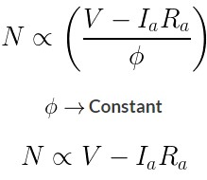
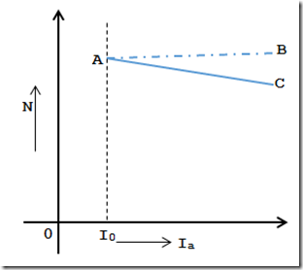
SPEED- ARMATURE CURRENT CHARACTERISTICS OF DC SHUNT MOTOR
So as load increases >> The armature current increases and hence drop also increases.
Fig.2 speed-armature current curve for DC shunt motor
http://www.mytech-info.com/2014/12/characteristics-of-dc-shunt-motor.html

Slide 14
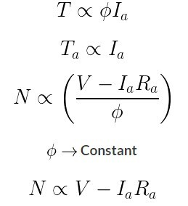
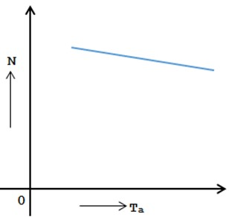
SPEED- TORQUE CHARACTERISTICS OF DC SHUNT MOTOR
So from these 2 equations, we can conclude that Speed and Torque both has a linear relationship.
Fig.3 speed-torque curve for DC shunt motor
http://www.mytech-info.com/2014/12/characteristics-of-dc-shunt-motor.html

Slide 15
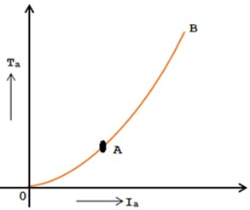

TORQUE- ARMATURE CURRENT CHARACTERISTICS OF DC SERIES MOTOR
In the case of a series motor, the series field winding is carrying the entire armature current. So flux produced is proportional to the armature current.
Fig.4 torque-armature current curve for DC series motor
http://www.mytech-info.com/2014/12/characteristic-of-dc-series-motor.html

Slide 16
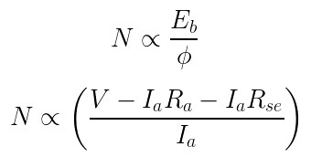
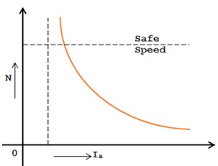

SPEED- ARMATURE CURRENT CHARACTERISTICS OF DC SERIES MOTOR
Hence in the speed equation, E_{b} ≈ V and can be assumed constant. So speed equation reduces
Fig.5 speed-armature current curve for DC series motor
http://www.mytech-info.com/2014/12/characteristic-of-dc-series-motor.html

Slide 17
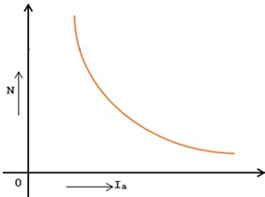
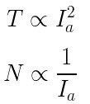

SPEED- TORQUE CHARACTERISTICS OF DC SERIES MOTOR
In case of series motors
Hence we can write
Thus as torque increases when load increases, the speed decreases.
Fig.6 speed-torque curve for DC series motor
http://www.mytech-info.com/2014/12/characteristic-of-dc-series-motor.html

Slide 18

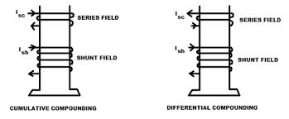
CHARACTERISTICS OF DC COMPOUND MOTOR
A compound motor has both shunt and series field winding .The shunt field winding always stronger then series field winding.
Two types of the compound motor
(1) Cumulative compound motor
(current direction is same in series and
shunt)
(2) Differentially compound motor
( current is in opposite direction in
series and shunt winding)
Fig:7 DC Compound Motor (Cumulative & Differential Compound)
https://top-ee.com/dc-compound-motor/

Slide 19
CUMULATIVE COMPOUND MOTOR
In this series and shunt both characteristics are required
The load is likely to be removed completely.
Series winding takes care of the heavy load.
The shunt winding prevents the motor from running at dangerously high speed.
These motors have generally employed a flywheel, where sudden and temporary loads are applied like in rolling mills.

Slide 20
DIFFERENTIALLY COMPOUND MOTOR
Series flux opposes shunt flux, the total flux decreases with increase in load.
Thus the machine runs at a higher speed with increase in the load.
This property is dangerous as on full load, the motor may try to run with dangerously high speed.
So differential compound motor is generally not used in practice.

Slide 21
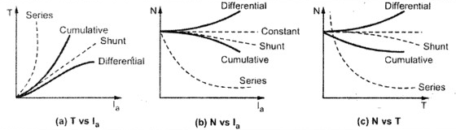
CHARACTERISTICS OF DC COMPOUND MOTOR
Fig:8 T-Ia Characteristics
Fig: 9 N-Ia Characteristics
Fig:10 N-T Characteristics
https://eeebooks4u.wordpress.com/2017/05/23/characteristics-of-dc-motors/

Slide 22
APPLICATIONS OF DC MOTORS
Blower
Fans
Lathe machine
Machine tool
Drilling machines
Punches
Elevators

Slide 23
SUMMARY
Types of characteristics of DC motor.
Torque- armature current, speed - armature current and speed-torque characteristics of DC shunt motor.
Torque- armature current, speed - armature current and speed-torque characteristics of DC series motor.
Torque- armature current, speed - armature current and speed-torque characteristics of DC compound motor.
Applications of DC motors.

Slide 24
FREQUENTLY ASKED QUESTIONS
Give the classification of characteristics of DC motors
Draw the torque speed curve for DC series motor.
Design the torque armature current curve for DC shunt motor.
Write the applications of DC motors.

Slide 25

LEARNING OUTCOMES
To make students understand
Types of characteristics of DC motors
Torque-armature current, speed-armature current and speed-torque curve for DC motors
Applications of DC motors

Slide 26
Course Outcome to Program Outcome Relationship
 |  | (21ELH-101) BEEE
PO→
CO↓ | PO1 | PO2 | PO3 | PO4 | PO5 | PO6 | PO7 | PO8 | PO9 | PO10 | PO11 | PO12 | PSO1 | PSO2 | PSO3
CO1 | 3 | 2 |  |  |  |  |  |  |  |  |  |  | 3
CO2 | 3 | 2 |  |  |  |  |  |  |  |  |  |  | 3
CO3 | 3 | 2 |  |  |  |  |  |  |  |  |  |  | 3
CO4 | 3 | 2 |  |  |  |  |  |  |  |  |  |  | 3
CO5 | 3 | 2 |  |  |  |  |  |  |  |  |  |  | 3

Slide 27
ASSESSMENT PATTERN
A Assignment (each assignment) | B Time Bound Surprise Test (each test) | C Quiz (each quiz) | D Mid Semester Test(one per test) | E Homework | F Discussion Forums | G Attendance and engagement Score on BB
10 | 12 | 4 | 20 | NA | NA | 2

Slide 28
REFERENCES FOR FURTHER HIGHER LEARNING
https://www.sciencedirect.com/topics/computer-science/electrical-network
https://www.electricaltechnology.org/2014/01/important-terms-related-to-electric-circuits-and-networks.html

Slide 29
REFERENCES
Books: [1]Basic of Electrical Engineering, T. K. Nagsarkar and M. S.Sukhija,2013 ,2nd edition
[2]Theory and problems of Basic Electrical Engineering, J. Nagrath and Kothari, 2012, 2nd edition
[3] A Textbook of Electrical Technology, B.L Theraja,2010,Vol 1
[4] Fundamentals of Electrical and Electronics Engineering, Smarjith Ghosh,2013,1st edition
E-Books: [1] file:///C:/Users/user/Desktop/BLACK%20BOARD%20MATERIAL%20PEE/UNIT-2%20PEE/Lecture%203%20&%204/doku.pub_basic-electrical-engineering-vkmehta-e-schand.pdf
[2] file:///C:/Users/user/Desktop/BLACK%20BOARD%20MATERIAL%20PEE/UNIT-2%20PEE/Lecture%203%20&%204/Elements%20Of%20Electrical%20Engineering%20By%20V.%20U.%20Bakshi%20and%20U.%20A.%20Bakshi.pdf
Websites: [1] https://www.electrical4u.com/dc-motor-or-direct-current-motor/
[2] http://www.mytech-info.com/2014/12/characteristic-of-dc-series-motor.html
[3] https://nptel.ac.in/content/storage2/courses/108105053/pdf/L-39(TB)(ET)%20((EE)NPTEL).pdf
[4] https://www.slideshare.net/saaz1425/dc-motor-23906628
Videos: [1] https://www.youtube.com/watch?v=6MnmcMYbsfQ
[2] https://youtu.be/Fbw1Rcm3E68
[3] https://youtu.be/SP98tDcH3sE

Slide 30
THANK YOU
For queries
Email: shikha.e12701@cumail.in

