Slide 1

UNIVERSITY INSTITUTE ENGINEERING
DEPARTMENT ACADEMIC UNIT-1
Bachelor of Engineering (Computer Science Engineering)
SUBJECT NAME: INTRODUCTION TO ELECTRICAL & ELECTRONICS ENGINEERING
SUBJECT CODE : 23ECH-101
By
Dr. Shikha
Unit-3, Chapter-1
Lecture No. 3.1.6
BLDC MOTOR
DISCOVER . LEARN . EMPOWER

Slide 2
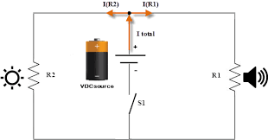
Lecture Objectives
S. No. | Objectives
1 | To make student aware about BLDC motor
2 | To aware about construction of BLDC motor
3 | To provide knowledge about working of BLDC motor
4 | To aware about applications of BLDC motor
https://library.automationdirect.com/basic-electrical-theory/

Slide 3
Course Objectives
S. No. | Objectives
1 | Understand Electrical & Electronics Engineering Fundamentals
2 | To prepare students to perform the analysis and design of various Electrical & digital electronic circuits.
https://library.automationdirect.com/basic-electrical-theory/

Slide 4
Course Outcomes
CO Number | Title | Level
CO1 | To identify the different types of electrical elements and the basic op-amp circuit elements and to illustrate the various types of motors, transducers. | Remember
CO2 | To understand basic principles of transformers, transducers, op-amps, DC and AC motors and to compare the different methods for analysing electrical and magnetic circuits. | Understand
CO3 | To derive the relationships between parameters in electric and magnetic circuits and motors and to determine specifications of op-amps. | Analyze
CO4 | To solve the basic problems related to electric circuits, magnetic circuits and motors and to assess the characteristics of different configurations of op-amps. | Evaluate
CO5 | To design the different applications of transducers, motors as well as the op-amps like adders, subtractor and comparators. | Create
https://library.automationdirect.com/basic-electrical-theory/

Slide 5
CONTENTS
Introduction of BLDCM
Main parts of brushed motor
Classification brushed motor
Working principle of BLDCM
Applications of BLDCM

Slide 6
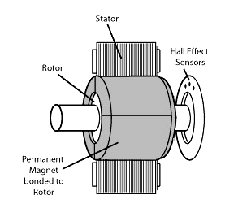
BRUSHLESS DC MOTOR
Permanent magnet (PM) brushless DC motors (BLDCM) are generated by virtually inverting the stator and rotor of PM DC motors.
These motors are actually fed by rectangular AC waveform.
The advantage is the removal of brushes, leading to eliminate many problems associated with brushes.
Fig.2 BLDC motor
https://www.elprocus.com/brushless-dc-motor-advantages-applications-and-control/

Slide 7
BRUSHLESS DC MOTOR
Classical DC motors are no doubt good and simple but inefficient in some ways.
Although dc motors possess good control characteristics and ruggedness, their performance and applications are inhibited due to sparking and commutation problems.
The Permanent Magnet Brushless DC (PMBLDC) motor is able to overcome the limitations mentioned above and satisfy the requirements of a variable speed drive.

Slide 8
MAIN PARTS OF BRUSHED MOTOR
Commutator -Facilitate collection of current from the armature conductors . Facilitate collection of current from the armature conductors.
Brush -Collects current from the commutator.

Slide 9
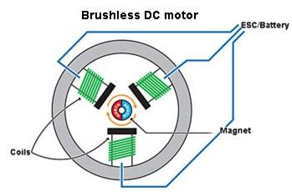
BLDC MOTOR
Has no brushes and commutators.
Rotation of the rotor depends on the accurate position with stator.
Detected by Hall Sensor, mounted on rotor, shifted at 60º or 120º phase shift.
Electronic commutation used to vary the PWM duty-cycle for speed control, using software..
Fig-3(BLDCM)
https://images.app.goo.gl/2nFyQSrPrgkfo7FL8

Slide 10
WORKING OF BLDCM
As there is no commutator ,the current direction of the conductor on the stator controlled electronically.
Rotor consists the permanent magnet where as stator consist a no. of windings. Current through winding produces magnetic field and force.
Hall sensor used to determine the position during commutation. Brushless DC motor requires external commutation circuit to rotate rotor.
Rotor position is very important.
HALL SENSOR senses the position of the coil accurately..

Slide 11
APPLICATIONS
PMBLDC motors are increasingly being used in a wide spectrum of applications:
domestic equipments
automobiles information technology equipment
industries
public life appliances
transportation
aerospace, defence equipments, power tools, toys, vision and sound equipments
medical and health care equipment ranging from microwatts to megawatts

Slide 12
PRACTICE QUESTIONS
Explain the operation of geared motor.
Explain the operation of brushless motor.
What are the different types of brushless motor?
Notes:
12

Slide 13

LEARNING OUTCOMES
To make students understand
Concept of BLDC motor
Different types of brushless motor
Applications of BLDC motor

Slide 14
Course Outcome to Program Outcome Relationship
 |  | (21ELH-101) BEEE
PO→
CO↓ | PO1 | PO2 | PO3 | PO4 | PO5 | PO6 | PO7 | PO8 | PO9 | PO10 | PO11 | PO12 | PSO1 | PSO2 | PSO3
CO1 | 3 | 2 |  |  |  |  |  |  |  |  |  |  | 3
CO2 | 3 | 2 |  |  |  |  |  |  |  |  |  |  | 3
CO3 | 3 | 2 |  |  |  |  |  |  |  |  |  |  | 3
CO4 | 3 | 2 |  |  |  |  |  |  |  |  |  |  | 3
CO5 | 3 | 2 |  |  |  |  |  |  |  |  |  |  | 3

Slide 15
ASSESSMENT PATTERN
A Assignment (each assignment) | B Time Bound Surprise Test (each test) | C Quiz (each quiz) | D Mid Semester Test(one per test) | E Homework | F Discussion Forums | G Attendance and engagement Score on BB
10 | 12 | 4 | 20 | NA | NA | 2

Slide 16
REFERENCES
Text Books:
Basic Electrical Engineering, Nagrath, 2001, McGraw-Hill Education (India) PvtLimited
Basic Electrical and Electronics Engineering, Bhattacharya, S.K., 2011, Pearson
Reference Books:
Electric Circuits, Charles K. Alexander & Matthew N. O. Sadiku, 4th edition,McGraw-Hill. Publication
Electrical Engineering Fundamentals, Vincent Del Toro, 2nd edition, Prentice Hall of India.
Websites:
http://en.wikipedia.org/wiki/Alternator
http://en.wikipedia.org/wiki/Electric_motor
http://www.basler.com

Slide 17
THANK YOU
For queries
Email:shikha.e12701@cumail.in

