Slide 1

UNIVERSITY INSTITUTE ENGINEERING
DEPARTMENT ACADEMIC UNIT-1
Bachelor of Engineering (Computer Science Engineering)
SUBJECT NAME: INTRODUCTION TO ELECTRICAL & ELECTRONICS ENGINEERING
SUBJECT CODE : 23ECH-101
By
Dr. Shikha
Unit-3, chapter 2
Lecture No. 3.1.8
GEAR MOTOR, SERVO MOTOR, STEPPER MOTOR & LINEAR MOTOR
DISCOVER . LEARN . EMPOWER

Slide 2
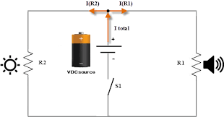
Lecture Objectives
S. No. | Objectives
1 | To make student aware about gear motor
2 | To aware about need of servo and stepper motor
3 | To provide knowledge about difference between servo and stepper motor
4 | To give various applications of stepper and servo motor
5 | To aware about linear motor with its construction and working
https://library.automationdirect.com/basic-electrical-theory/

Slide 3
Course Objectives
S. No. | Objectives
1 | Understand Electrical & Electronics Engineering Fundamentals
2 | To prepare students to perform the analysis and design of various Electrical & digital electronic circuits.
https://library.automationdirect.com/basic-electrical-theory/

Slide 4
Course Outcomes
CO Number | Title | Level
CO1 | To identify the different types of electrical elements and the basic op-amp circuit elements and to illustrate the various types of motors, transducers. | Remember
CO2 | To understand basic principles of transformers, transducers, op-amps, DC and AC motors and to compare the different methods for analysing electrical and magnetic circuits. | Understand
CO3 | To derive the relationships between parameters in electric and magnetic circuits and motors and to determine specifications of op-amps. | Analyze
CO4 | To solve the basic problems related to electric circuits, magnetic circuits and motors and to assess the characteristics of different configurations of op-amps. | Evaluate
CO5 | To design the different applications of transducers, motors as well as the op-amps like adders, subtractor and comparators. | Create
https://library.automationdirect.com/basic-electrical-theory/

Slide 5
CONTENTS
Introduction to Gear motor with its construction and working.
Introduction of servo motor.
Construction of servo motor.
Working principle of DC servomotor.
Advantages disadvantages,and applications of servo motor.
Stepper Motor with its working and types.
Advantages ,disadvantages and applications of stepper motor.
Linear motor with its construction and working.

Slide 6
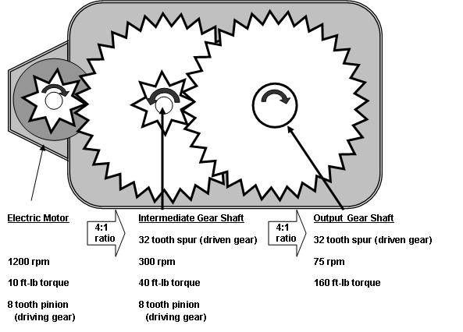
WHAT IS A GEAR MOTOR?
Gear motors are complete motive force systems consisting of an electric motor and a reduction gear train integrated into one easy-to-mount and –configure package.
This greatly reduces the complexity and cost of designing and constructing power tools, machines and appliances calling for high torque at relatively low shaft speed or RPM.
Fig-1-(geared motor)
https://in.pinterest.com/pin/422845852485215270/

Slide 7
OPERATING PRINCIPLE OF GEAR MOTOR
Most synchronous AC electric motors have output ranges of from 1,200 to 3,600 revolutions per minute. They also have both normal speed and stall-speed torque specifications.
The reduction gear trains used in gear motors are designed to reduce the output speed while increasing the torque. The increase in torque is inversely proportional to the reduction in speed. Reduction gearing allows small electric motors to move large driven loads, although more slowly than larger electric motors.
Reduction gears consist of a small gear driving a larger gear. There may be several sets of these reduction gear sets in a reduction gear box.

Slide 8
TYPES OF GEAR MOTORS
Helical gear motor
Shaft mounted gear motor
Bevel-geared motor
Worm geared motor.

Slide 9
FEATURES OF GEAR MOTORS
Some of the salient features that geared motors possess are:
Available in standard gear mechanism
Available in non lubricated metal bearing gear mechanism Also, available in planetary gear mechanism
Provides speed reduction by the means of a gear box Increases the torque ratio

Slide 10
FEATURES OF GEAR MOTORS
Provides protection against overload and locked rotor
Used as precautions for instantaneous reversing and dynamic braking
Used in speed detection and control

Slide 11
MAIN AIM OF USING GEAR MOTORS
The main aim of using gear motors are:
• Everything in one box
• Easy to Control
• Wide range of sizes, speeds and options
• Mounting
• Durability

Slide 12
APPLICATIONS OF GEAR MOTOR
Garage door openers
Stair lifts
Timer cycle knobs on washing machines
Power drills
Cake mixers
Electromechanical clocks

Slide 13
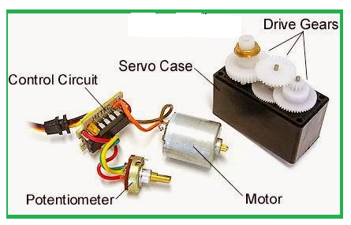
WHAT IS THE MEANING OF SERVO?
In modern usage the term servo or servo-mechanism is restricted to a feedback control system in which the controlled variable is mechanical position or time derivatives of position such as velocity and acceleration.
A servo is a device, electrical, mechanical or electro mechanical, that upon receipt of a input will employ feedback for velocity and/or position control, creating a closed loop.
Fig-1 (Servo Motor)
http://eee-resetsg.blogspot.com/2016/01/construction-of-simple-servo-motor.html

Slide 14
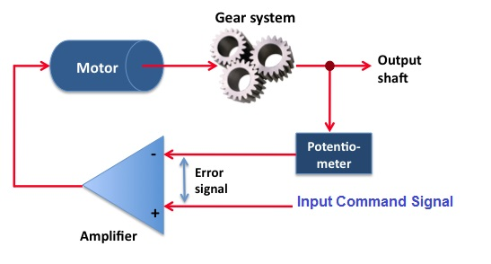
CONSTRUCTION OF SERVO MOTOR
Fig-2(construction of servo motor)
https://electricalbaba.com/basics-of-servomechanism-and-servo-motor/

Slide 15
Working principle of Servomotor
It is having three major parts:
Controlled device
Feedback system
Output sensor
The servo motor works on the phenomenon of the automatic closed-loop system. The controller is required for this closed-loop system.
This controller is composed of a comparator and a feedback path. It has one output and two inputs.
In this, for producing an output signal, the comparator is used to compare the required reference signal and this output signal is sensed by the sensor. The input signal for the motor is termed as a feedback signal.
On the basis of the feedback signal, the motor starts working. Comparator signal is called a logic signal of the motor.
The motor would be ON for the desired time when the logical difference is higher and the motor would be OFF for the desired time when the logical difference is lower.
Basically, a comparator is used to decide that motor would be ON or OFF. Proper functioning of the motor can be done with the help of a good controller.

Slide 16
ADVANTAGES
High output power relative to motor size and weight.
Encoder determines accuracy and resolution.
High efficiency. It can approach 90% at light loads.
High torque to inertia ratio. It can rapidly accelerate loads.
Has "reserve" power. 2-3 times continuous power for short periods.
Has "reserve" torque. 5-10 times rated torque for short periods.
Motor stays cool. Current draw proportional to load.

Slide 17
DISADVANTAGES
Requires "tuning" to stabilize feedback loop.
Motor "runs away" when something breaks. Safety circuits are required.
Brush wear out limits life to 2,000 hrs. Service is then required.
Peak torque is limited to a 1% duty cycle.
Motor can be damaged by sustained overload.
Bewildering choice of motors, encoders, and servo-drives.
Power supply current 10 times average to use peak torque.
Motor develops peak power at higher speeds. Gearing often required.
Poor motor cooling. Ventilated motors are easily contaminated.

Slide 18
APPLICATIONS
They play an important role in robotics information of robot because of their smooth switching on or off and accurate positioning.
They are used in hydraulic systems to maintain hydraulic fluid in the aerospace industry.
In radio controlled toys these are also used.
They are used to extend or replay the disc trays in electronic devices such as DVDs or Blue-ray Disc players.
They are used to maintain the speed of vehicles in the automobile industries.

Slide 19
STEPPER MOTOR
A stepper motor is an electromechanical device which converts train of pulses into discrete mechanical movements.
The shaft of motor rotates through a fixed angle for each discrete pulse. This rotation can be linear or angular.
When a train of pulses is applied, it gets turned through a certain angle.
The angle through which the stepper motor shaft turns for each pulse is referred as step angle.

Slide 20
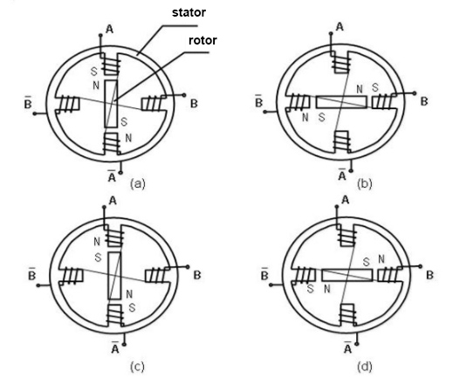
WORKING OF STEPPER MOTOR
Fig-3(stepper motor)
https://images.app.goo.gl/PsZMXpQW5ZgWaqZi6

Slide 21
OPERATION OF STEPPER MOTOR
Each of those slight rotations is called a step, with an integer number of steps making a full rotation.
In that way, the motor can be turned by a precise.
Stepper motor doesn’t rotate continuously, they rotate in steps.
There are 4 coils with 90 deg angle between each other fixed on the stator.
The stepper motor connections are determined by the way the coils are interconnected.
In stepper motor, the coils are not connected together.
The motor has 90deg rotation step with the coils being energized in a cyclic order.

Slide 22
WORKING OF STEPPER MOTOR
The stepper motor rotor is a permanent magnet, when the current flows through the stator winding, the stator winding to produce a vector magnetic field.
The magnetic field drives the rotor to rotate by an angle so that the pair of magnetic fields of the rotor and the magnetic field direction of the stator are consistent.
When the stator's vector magnetic field is rotated by an angle, the rotor also rotates with the magnetic field at an angle.
Each time an electrical pulse is input, the motor rotates one degree further. The angular displacement it outputs is proportional to the number of pulses input and the speed is proportional to the pulse frequency.
it can control the rotation of the stepping motor by controlling the number of pulses, the frequency and the electrical sequence of each phase winding of the motor.

Slide 23
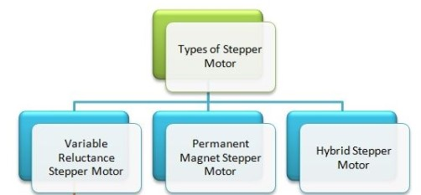
TYPES OF STEPPER MOTOR
Fig-4(types of stepper motor)
https://circuitglobe.com/stepper-motor.html

Slide 24
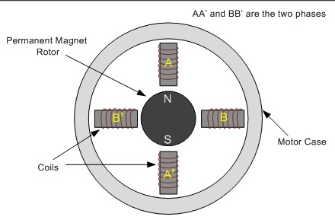
PERMANENT MAGNET STEPPER MOTOR
Permanent magnet motors use a permanent magnet (PM) in the rotor.
It operate on the attraction or repulsion between the rotor PM and the stator electromagnets.
When the stator windings are excited with DC supply, it produces magnetic flux and establishes north poles and south poles.
Due to force of attraction and repulsion between PM rotor poles and stator poles, the rotor starts moving upto the position for which pulses are given to the stator.
Fig.5 Permanent magnet stepper motor
https://www.engineersgarage.com/article_page/stepper-motor-basics-types-and-working/

Slide 25
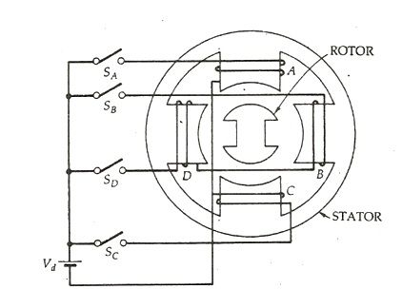
VARIABLE RELUCTANCE STEPPER MOTOR
Variable reluctance (VR) motors have a plain iron rotor and operate based on the principle that minimum reluctance occurs with minimum gap, hence the rotor points are attracted toward the stator magnet poles.
All the stator poles are aligned in a Multi-Stack motor. But the rotor poles are displaced by 1/m of the pole pitch angle from each other.
Fig.6 variable stepper motor
https://circuitglobe.com/variable-reluctance-stepper-motor.html

Slide 26
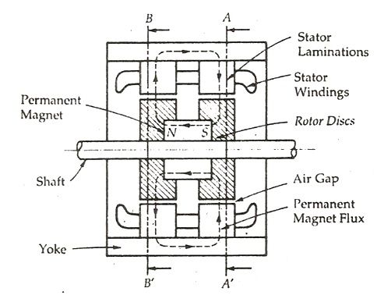
HYBRID STEPPER MOTOR
Hybrid stepper motors are named because they use a combination of permanent magnet (PM) and variable reluctance (VR) techniques to achieve maximum power in a small package size.
The Hybrid Stepper Motor is a combination of the features of the variable reluctance motor and permanent magnet stepper motor.
Fig.7 hybrid stepper motor
https://circuitglobe.com/hybrid-stepper-motor.html

Slide 27
STEPPER MOTOR ADVANTAGES
The rotation angle of the motor is proportional to the input pulse.
The motor has full torque at standstill.
Excellent response to starting, stopping and reversing.
Very reliable since there are no contact brushes in the motor. Therefore the life of the motor is simply dependant on the life of the bearing.
The motors response to digital input pulses provides open-loop control, making the motor simpler and less costly to control.
It is possible to achieve very low speed synchronous rotation with a load that is directly coupled to the shaft.

Slide 28
STEPPER MOTOR DISADVANTAGES
Resonances can occur if not properly controlled.
Not easy to operate at extremely high speeds

Slide 29
STEPPER MOTOR APPLICATIONS
Industrial Machines – Stepper motors are used in automotive gauges and machine tooling automated production equipment's.
Security – new surveillance products for the security industry.
Medical – Stepper motors are used inside medical scanners, samplers, and also found inside digital dental photography, fluid pumps, respirators and blood analysis machinery.
Consumer Electronics – Stepper motors in cameras for automatic digital camera focus and zoom functions.

Slide 30
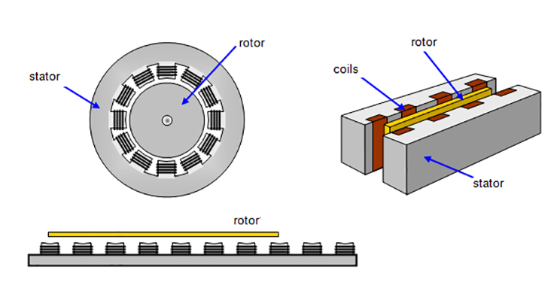
LINEAR INDUCTION MOTOR
A Linear Induction Motor (or LIM) is a special type of induction motor used to achieve rectilinear motion rather than rotational motion as in the case of conventional motors.
Linear induction motors are quite an engineering marvel, to convert a general motor for a special purpose with more or less similar working principle, thus enhancing its versatility of operation.
Fig.1 linear induction motor
https://www.linearmotiontips.com/what-are-linear-induction-motors/

Slide 31
CONSTRUCTION OF LINEAR INDUCTION MOTOR
The basic design and construction of a linear induction motor is similar to a three phase induction motor, although it does not look like a conventional induction motor. If we cut the stator of a polyphase induction motor and lay on a flat surface, it forms the primary of the linear induction motor system.
Similarly, after cutting the rotor of the induction motor and making it flat, we get the secondary of the system.
There is another variant of LIM also being used for increasing efficiency known as the Double Sided Linear Induction Motor or DLIM, as shown in the figure below. It has primary on either side of the secondary, for more effective utilization of the flux from both sides.

Slide 32
WORKING PRINCIPLE OF LINEAR INDUCTION MOTOR
When the primary of a LIM gets excited by a balanced three-phase power supply, a flux starts traveling along the entire length of the primary.
This linearly traveling magnetic field is equivalent to the rotating magnetic field in the stator of a three phase induction motor or a synchronous motor. Electric current gets induced in the conductors of the secondary due to the relative motion between the traveling flux and the conductors.
Then the induced current interacts with the traveling flux wave to produce linear force or thrust.

Slide 33

WORKING PRINCIPLE OF LINEAR INDUCTION MOTOR
If the primary is fixed and the secondary is free to move, the force will pull the secondary in the direction of the force and will result in the required rectilinear motion.
When we give supply to the system the developed field will result in a linear travelling field, the velocity of which is given by the equation,
Where f_{s} is the supply frequency in Hz, V_{s} is the velocity of the linear traveling field in meter per second, and t is the linear pole pitch i.e. pole to pole linear distance in meter.

Slide 34
APPLICATION OF LINEAR INDUCTION MOTOR
Automatic sliding doors in electric trains.
Mechanical handling equipment, such as propulsion of a train of tubs along a certain route.
Metallic conveyor belts.
Pumping of liquid metal, material handling in cranes, etc.

Slide 35
FREQUENTLY ASKED QUESTIONS
Why servo motor is used for feedback system?
What are the different types of dc servo motor?
Discuss applications of servo motor.
What are the difference between variable and hybrid type stepper motor?
Discuss applications of stepper motor.

Slide 36
PRACTICE QUESTIONS
Explain the operation of servo motor.
Explain the operation of stepper motor.
What are the different types of servo motor?
Notes:
36

Slide 37

LEARNING OUTCOMES
To make students understand
Concept of gear motor
operation of servo motor
Different types of servo motor
Working of stepper motor
Concept of linear motor

Slide 38
ASSESSMENT PATTERN
A Assignment (each assignment) | B Time Bound Surprise Test (each test) | C Quiz (each quiz) | D Mid Semester Test(one per test) | E Homework | F Discussion Forums | G Attendance and engagement Score on BB
10 | 12 | 4 | 20 | NA | NA | 2

Slide 39
REFERENCES
Text Books:
Basic Electrical Engineering, Nagrath, 2001, McGraw-Hill Education (India) PvtLimited
Basic Electrical and Electronics Engineering, Bhattacharya, S.K., 2011, Pearson
Reference Books:
Electric Circuits, Charles K. Alexander & Matthew N. O. Sadiku, 4th edition,McGraw-Hill. Publication
Electrical Engineering Fundamentals, Vincent Del Toro, 2nd edition, Prentice Hall of India.
Websites:
http://www.learnengineering.org/2014/10/Brushless-DC-motor.html
http://www.electricaltechnology.org/2016/05/bldc-brushless-dc-motor-construction-working-principle.html
https://www.engineersgarage.com/insight/how-geared-dc-motor-works
https://www.tsukasa-d.co.jp/en/data_download/english_catalogue.pdf
http://circuitglobe.com/linear-induction-motor.html
http://www.explainthatstuff.com/linearmotor.html
http://www.globalspec.com/learnmore/motion_controls/motors/ac_servo_motors
http://www.engineerlive.com/content/21559
http://www.electricaleasy.com/2014/07/characteristics-of-dc-motors.html

Slide 40
THANK YOU
For queries
Email: shikha.e12701@cumail.in

