Slide 1

INSTITUTE : UIE
DEPARTMENT : CSE
Bachelor of Engineering (Computer Science & Engineering)
Object Oriented Programming using Java
(23CSP-202 )
TOPIC OF PRESENTATION:
Java Fundamentals
Prepared by: Bhavneet Kaur
Master Subject Coordinator
DISCOVER . LEARN . EMPOWER

Slide 2
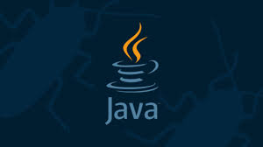
Course Outcomes
CO1
Recall and understand the various fundamental concepts of Object Oriented Programming Language.
CO2
Define and demonstrate the numerous paradigms of OOPs and exception handling in Java.
CO3
Illustrate and classify the java concepts such as IOStream and Multithreading.
CO4
Outline and apply the concept of GUI and JDBC.
CO5
Analyze and relate the various functionalities of Applet and Swings.

Slide 3
Lecture Objectives
In this lecture, we will discuss:
Java programming language , its features and evolution of Java and forces that shaped it
Java Architecture along with JVM Concepts

Slide 4

PROBLEM STATEMENT
Design and implement a Student Course Registration System in which:
Classes are organized logically+Implicit memory management+Exception Handling+Multithreading
Can you identify the language that can do all directly in a code

Slide 5
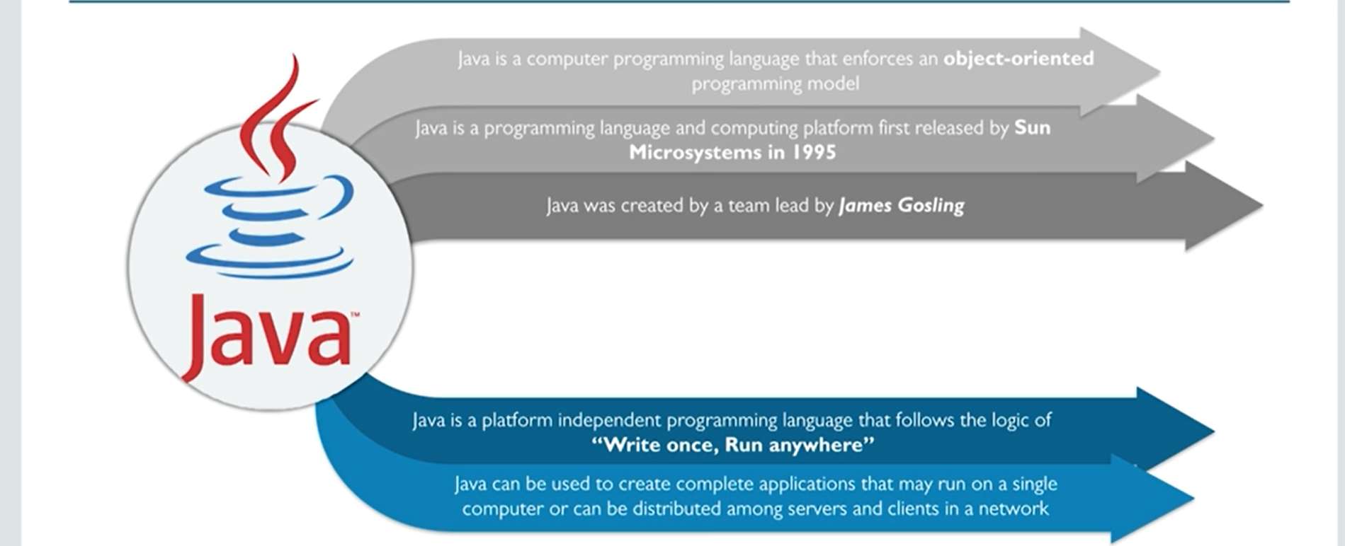
What is Java

Slide 6

What is Java?
Follows Object Oriented model
Platform independent(Write Once Run Anywhere)
Programming language that is used to design applications for a variety of purposes
JAVA
Runs on many devices worldwide
6

Slide 7
Why JAVA?
Java Applets
Security
Portability
Bytecode

Slide 8
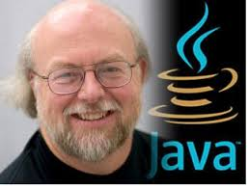
Evolution of Java
James Gosling, Mike Sheridan, and Patrick Naughton initiated the Java language project in June 1991. The small team of sun engineers called Green Team
The origin of Java can be traced back to the fall of 1992, and was
initially called Oak
Oak was renamed as Java in 1995
Java was originally meant to be a platform-neutral
language for embedded software in devices

Slide 9
Features of java
Secure
Portable
Architecture-neutral
Simple
Interpreted
Object-oriented
Multithreaded
FEATURES
Dynamic

Slide 10
Java versus C/C++
C Uses header Files but java uses Packages
C Uses Pointers but java doesn’t supports pointers
Java doesn’t supports storage classes like auto, external etc.
The Code of C Language is Converted into the Machine code after Compilation But in Java Code First Converted into the Bytes Codes then after it is converted into the Machine Code
C++ supports Operator Overloading but java doesn’t Supports Operator Overloading
In C++ Multiple Inheritance is Possible but in java the Concept of Multiple Inheritances is Introduced in the Form of Interfaces .
Java Uses import statement for including the contents of screen instead of #include .
Java Doesn’t uses goto.
Java Doesn’t have Destructor.
Java Doesn’t have Structure Union , enum data types

Slide 11

Why pointer concept is not use in java?
Memory access via pointer arithmetic:
Java has a robust security model and disallows pointer arithmetic for the same reason.
It would be impossible for the Virtual Machine to ensure that code containing pointer arithmetic is safe without expensive runtime checks.
Security:
By not allowing pointers, Java effectively provides another level of abstraction to the developer.
No pointer support make Java more secure because they point to memory location or used for memory management that loses the security as we use them directly.

Slide 12
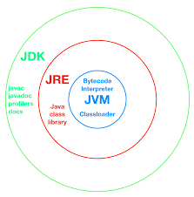
JAVA ARCHITECTURE

Slide 13
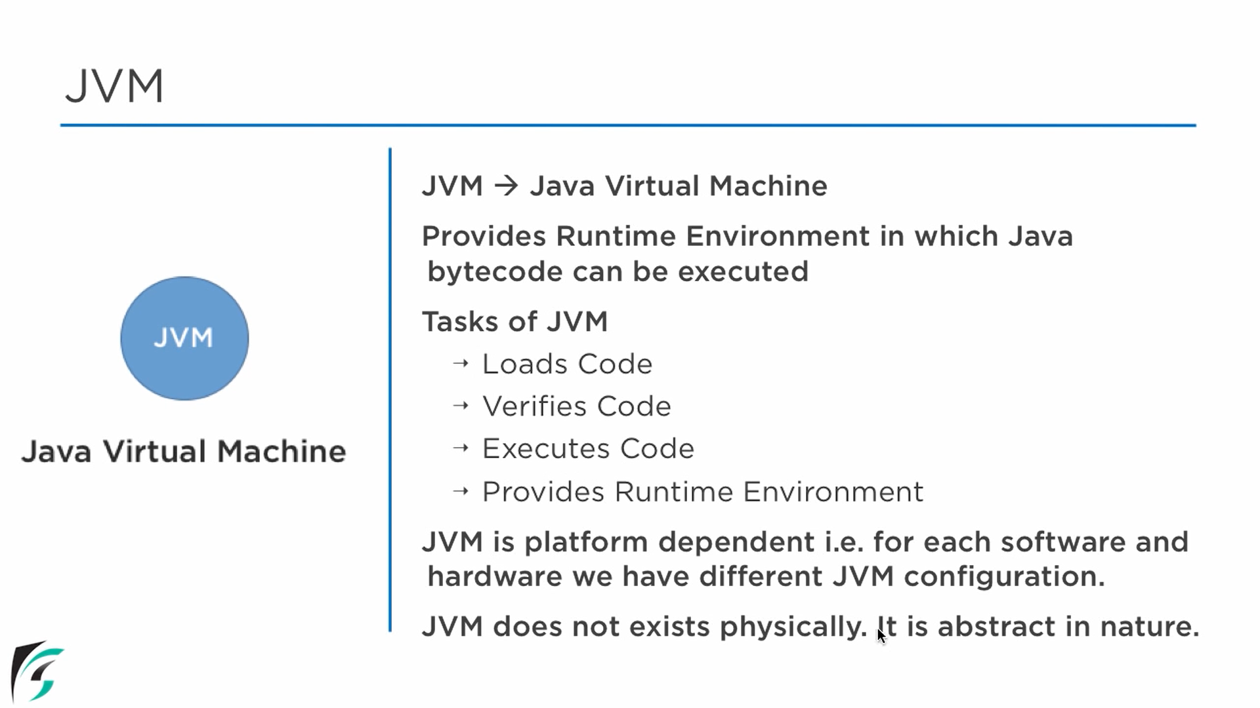
JVM : JAVA VIRTUAL MACHINE

Slide 14
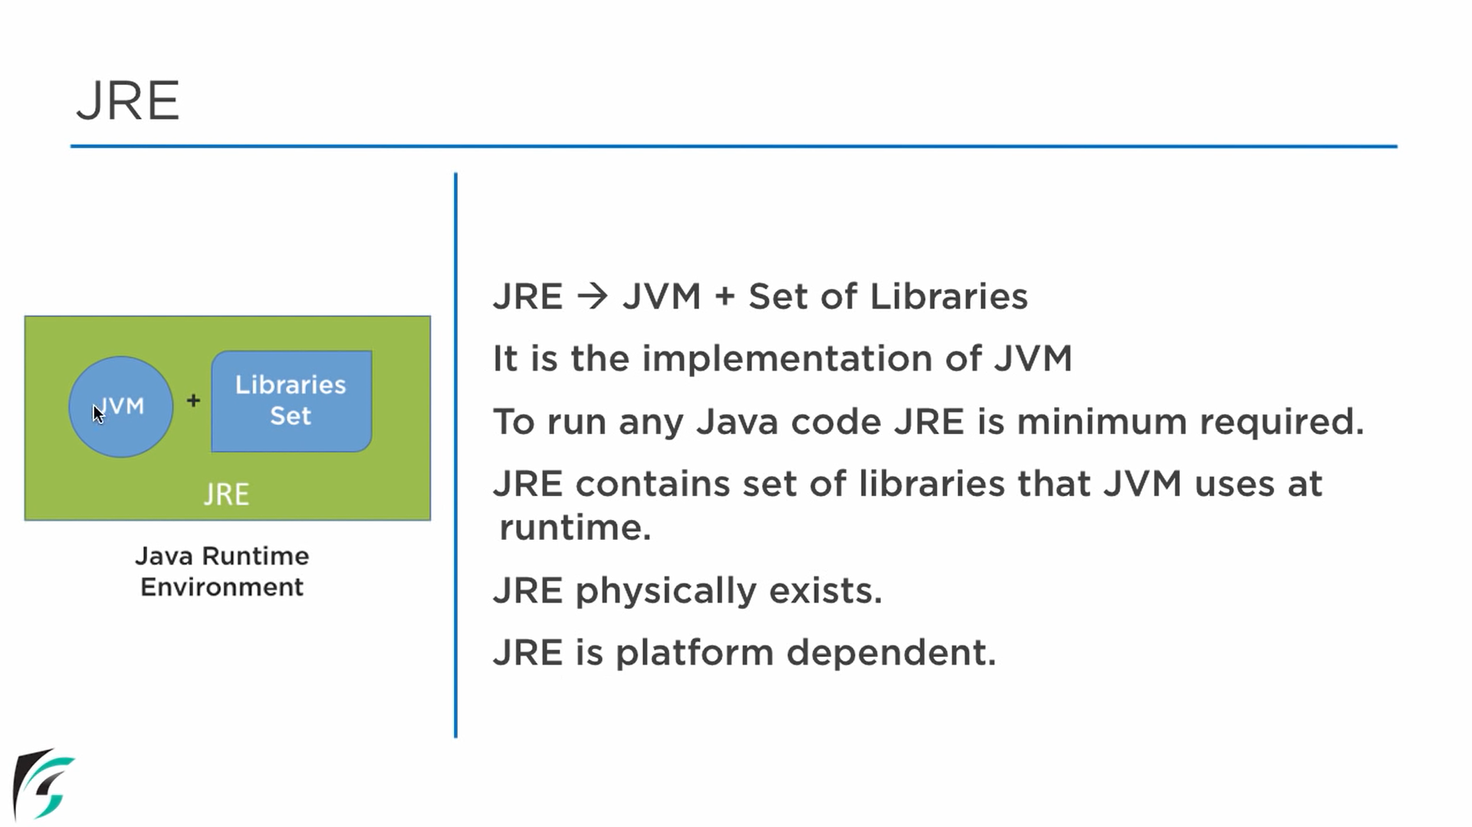
JRE : JAVA RUNTIME ENVIRONMENT

Slide 15
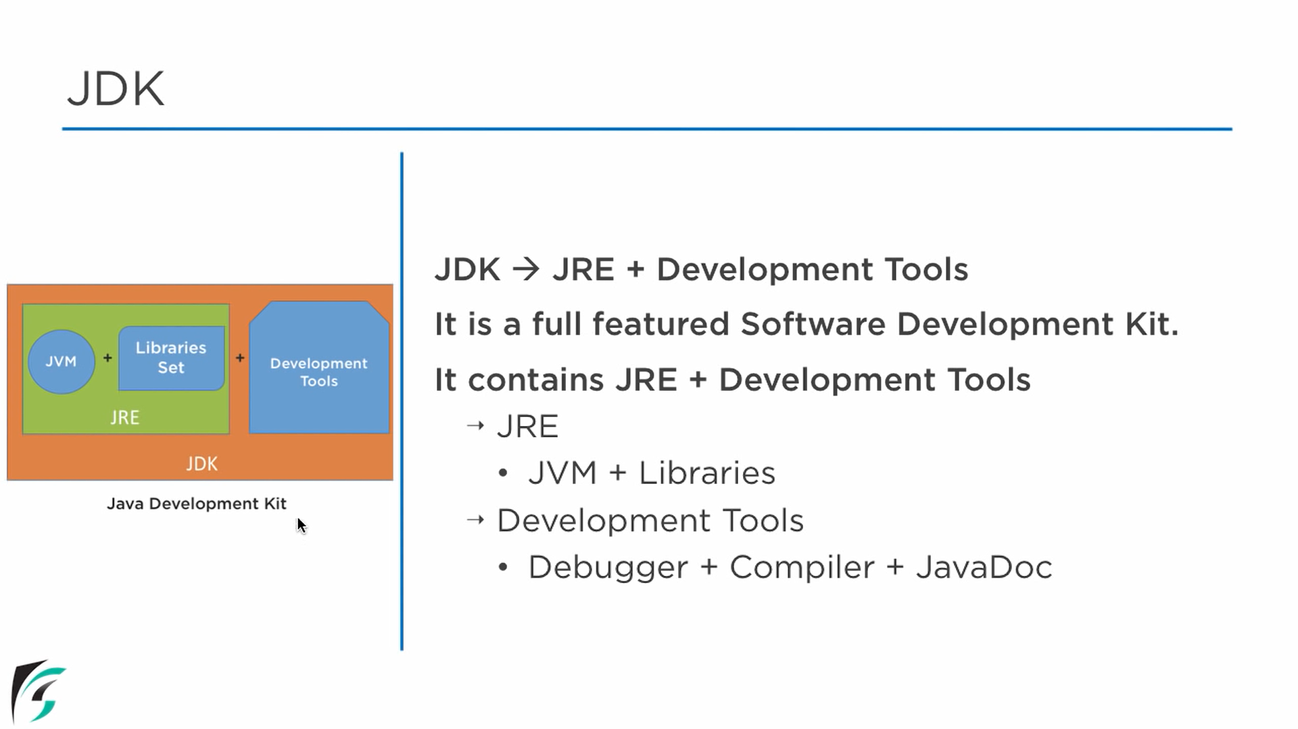
JDK: JAVA DEVELOPMENT KIT

Slide 16
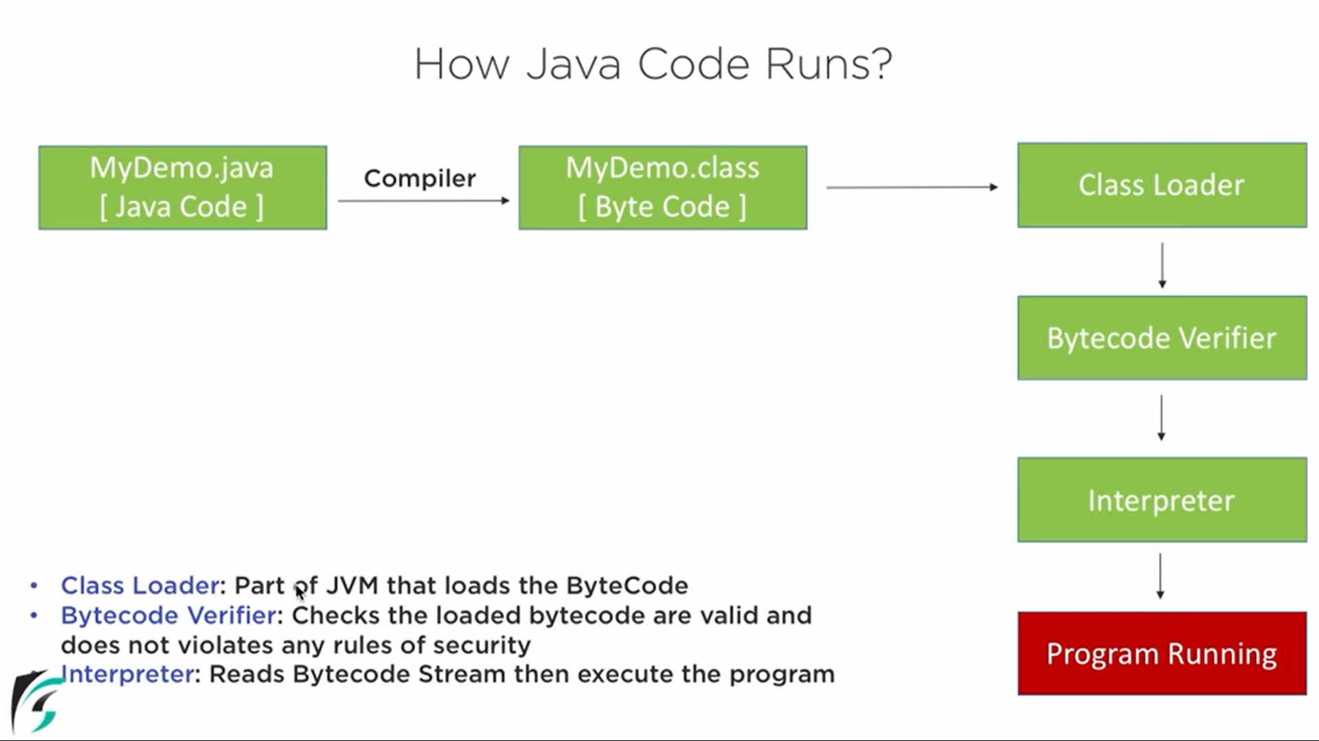
PHASES OF JAVA PROGRAM

Slide 17
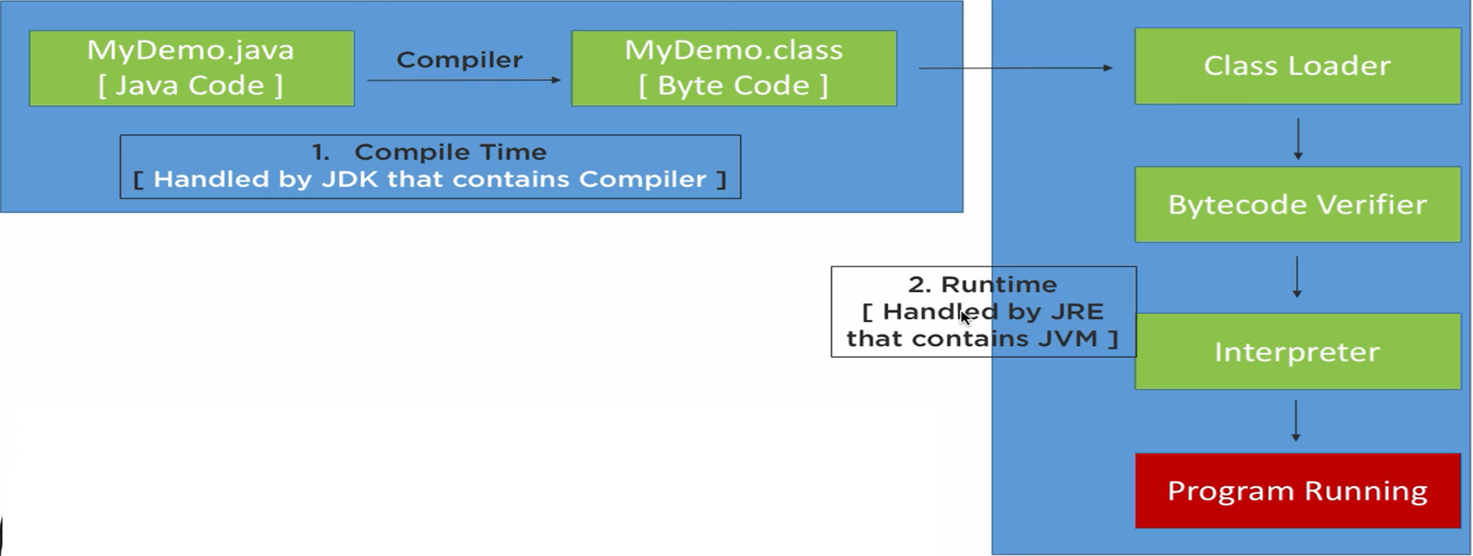
PHASES OF JAVA PROGRAM
Class Loader: Part of JVM that loads Byte Code.
Byte code verifier: Checks the validity of loaded byte code according to the defined rules.
Interpreter: Reads byte code stream and then executes the program.

Slide 18
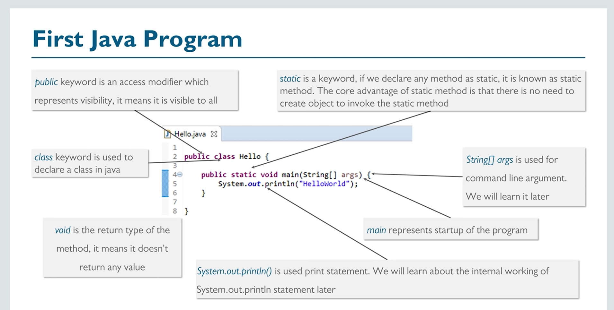
FIRST JAVA PROGRAM

Slide 19
Questions based on JAVA architecture
Write the correct order of the Java program execution
A. Class Loader
B. Interpretation
C. Compilation
D. Byte Code Verification
E. Java Source Code
F. Execution

Slide 20
QUIZ:
Which of the following is used to load a .class file?
A. Class Loader
B. Byte Code Verifier
C. JIT Compiler
D. Interpreter

Slide 21
Summary:
In this session, you were able to :
• Learn about Java , its features and evolution of Java and forces that shaped it
• Understand Java Architecture along with JVM
Concepts

Slide 22
References:
Books:
1. Balaguruswamy, Java.
2. A Primer, E.Balaguruswamy, Programming with Java, Tata McGraw Hill Companies
3. John P. Flynt Thomson, Java Programming.
Video Lectures :
https://www.youtube.com/watch?v=hBh_CC5y8-s&t=32122s
E-book :
https://www.learnjavaonline.org/

Slide 23
THANK YOU

