Slide 1

INSTITUTE : UIE
DEPARTMENT : CSE
Bachelor of Engineering (Computer Science & Engineering)
Object Oriented Programming using Java
(23CSP-202 )
TOPIC OF PRESENTATION:
Java Fundamentals
Prepared by: Bhavneet Kaur
Master Subject Coordinator
DISCOVER . LEARN . EMPOWER

Slide 2

Lecture Objectives
In this lecture, we will discuss:
About various java API’s
Various java keywords
Identifiers and data types are discussed along with their programs.
Operators

Slide 3
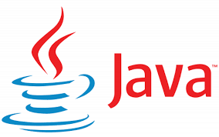
JAVA API
Java application programming interface (API) is a list of all classes that are part of the Java development kit (JDK).
It includes all Java packages, classes, and interfaces, along with their methods, fields, and constructors.
These prewritten classes provide a tremendous amount of Built-in Packages.
The Java API is a library of prewritten classes which contains components for managing input, database programming.
The library is divided into packages and classes i.e you can either import a single class or a whole package that contain all the classes that belong to the specified package.
To use a class or a package from the library, you need to use the import keyword.

Slide 4
Understanding of .class file concept
Sample.java file contains class A, B and C.
How many .class files will be created after compiling Sample.java?
Sample.java
class A {
void m1() { }
}
class B {
void m2() { }
}
class C {
void m3() { }
}
What is your observation?

Slide 5
Difference between class, object, methods, and instance variables?
Object - Objects have states and behaviors. Example: A dog has states - color, name, breed as well as behavior such as wagging their tail, barking, eating. An object is an instance of a class.
Class - A class can be defined as a template/blueprint that describes the behavior/state that the object of its type supports.
Methods - A method is basically a behavior. A class can contain many methods. It is in methods where the logics are written, data is manipulated and all the actions are executed
Instance - Each object has its unique set of instance variables. An object's state is created by the values assigned to these instance variables.

Slide 6

Analyze the below program and answer
What will be the result if you try to compile and execute the following program ?
Sample.java
class Sample {
public static void main() {
System.out.println(“Welcome”);
}
}
a. Compilation Error
b. Runtime Error
c. The program compiles and executes successfully but prints
nothing.
d. It will print “Welcome”

Slide 7
Accessing numeric command line arguments
class Simple {
static public void main(String[] args) {
int i1 = Integer.parseInt(args[0]);
int i2 = Integer.parseInt(args[1]);
System.out.println(i1+i2);
}
}
When we compile the above code successfully and execute it as Java Simple 10 20, the output will be 30.
A Java application can accept any number of arguments from the command line.
Command-line arguments allow the user to affect the operation of an application for one invocation.
If your program needs to support a numeric command-line argument, it must convert a String argument that represents a number, such as "34", to a number.

Slide 8
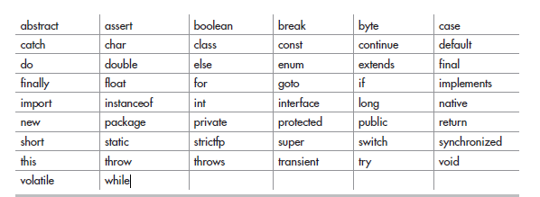
Java Keywords
Java has a set of keywords that are reserved words that cannot be used as variables, methods, classes, or any other identifiers.
Example break, abstract, byte, Boolean etc
True, false, and null are not keywords, but they are literals and reserved words that cannot be used as identifiers.

Slide 9
Which statement is true?
(a) new and delete are keywords in the Java language.
(b) try, catch, and thrown are keywords in the Java language.
(c) static, unsigned, and long are keywords in the Java language.
(d) exit, class, and while are keywords in the Java language.
(e) return, goto, and default are keywords in the Java language.
(f) for, while, and next are keywords in the Java language.

Slide 10
Java Operators
An operator is a symbol that tells the compiler to perform a specific mathematical or logical manipulation.
Arithmetic
Bitwise
Relational
Logical
Classes of Operators

Slide 11
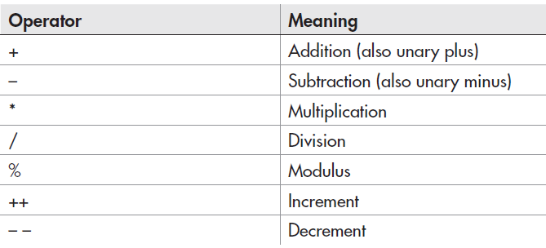
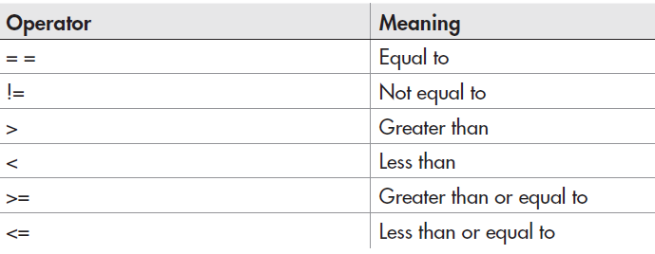
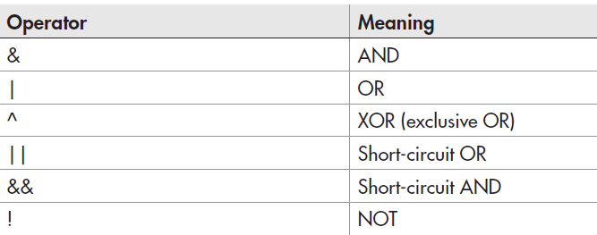
ARITHMATIC OPERATORS
RELATIONAL OPERATORS
LOGICAL OPERATORS

Slide 12
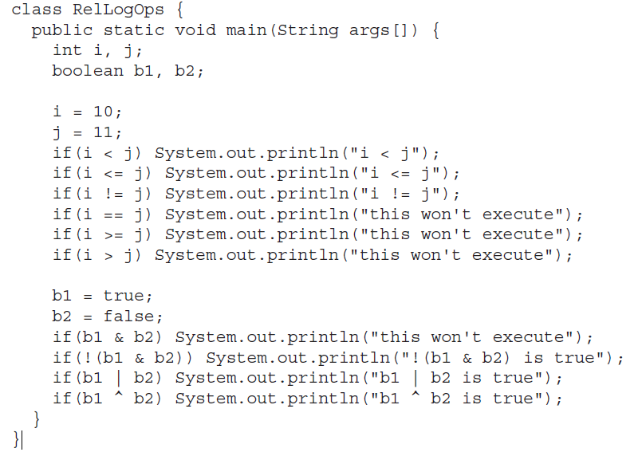
Can you identify the output for the below code?
Source:
Java™
A Beginner’s Guide
Sixth Edition ,
Herbert Schildt

Slide 13
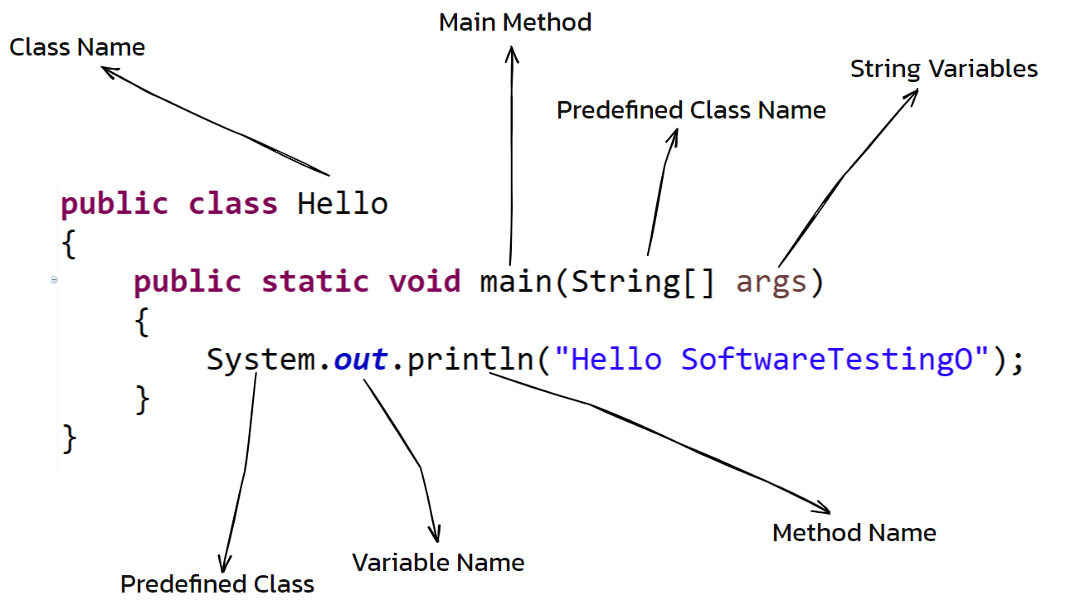
Identifiers in java
In programming languages, identifiers are used for identification purpose.
In Java, an identifier can be a class name, method name, variable name or a label.
For example :public class Test { public static void main(String[] args) { int a = 20; } }
Which of the following can be used in a Java program as identifiers? Check all of the identifiers that are legal.
1. sum_of_data 2. AnnualSalary 3. _average 4. 42isThesolution 5. B4 6. ABC 7. for 8. println 9. "hello" 10. first-name
Answer:1 2 3 5 6 8

Slide 14
Lets Brief!
1. What is null in Java.
The null is not a keyword. null is a literal as true or false
2. Can a digit form the first character of an identifier?
No. Only characters are allowed. However, they may be used after the first character.
3. Explain var keyword in Java.
var keyword is introduced in Java 10 to enhance the Java Language to extend type inference to declarations of local variables with initializers.
var map = new HashMap<String, Integer>();

Slide 15
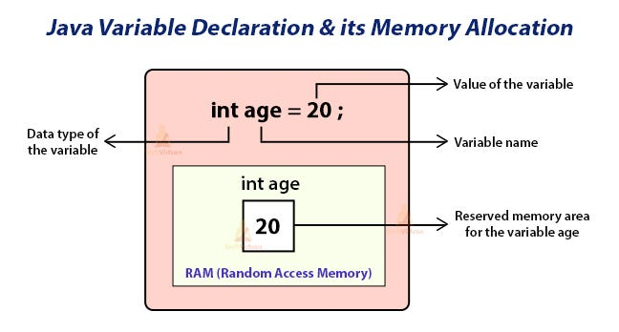
Difference between local, instance and static variable
Local Variables
Tied to a method
Instance Variables (Non-static)
Tied to an object
Static Variables
Tied to a class
Shared by all instances of a class
Scope of an instance variable is the whole class
Scope of a local variable is within the method

Slide 16
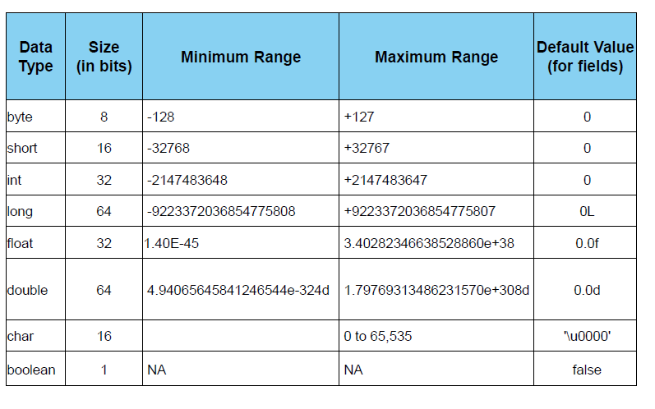
Data Types

Slide 17
Understanding of data type concepts
What will be the result, if we try to compile and execute the following??
code?
class Test {
public static void main(String [ ] ar) {
byte b=128;
System.out.println(b);
}
}

Slide 18
QUIZ
1. Which of the following do not denote a primitive data value in Java? Select the two correct answers.
(a) "t"
(b) 'k‘
(c) 50.5F
(d) "hello"
(e) false 2.5

Slide 19
QUIZ
2. Which of the following primitive data types are not integer types? Select the three correct answers.
(a) boolean
(b) byte
(c) float
(d) short
(e) double

Slide 20
Summary:
In this session, you were able to :
Learn about Java API’S, its features
Understand Java keywords, identifiers.
Various data types are also discussed

Slide 21
References:
Books:
1. Balaguruswamy, Java.
2. A Primer, E.Balaguruswamy, Programming with Java, Tata McGraw Hill Companies
3. John P. Flynt Thomson, Java Programming.
Video Lectures :
https://www.youtube.com/watch?v=0MFC_Vw9NxY
E-book :
https://www.learnjavaonline.org/

Slide 22
THANK YOU

