Slide 1

INSTITUTE : UIE
DEPARTMENT : CSE
Bachelor of Engineering (Computer Science & Engineering)
Object Oriented Programming using Java
(23CSP-202 )
TOPIC OF PRESENTATION:
Java Fundamentals
Prepared by: Bhavneet Kaur
Master Subject Coordinator
DISCOVER . LEARN . EMPOWER
DISCOVER . LEARN . EMPOWER

Slide 2

Lecture Objectives
In this lecture, we will discuss:
About classes and objects, Encapsulation / Abstraction
About inheritance and polymorphism.

Slide 3
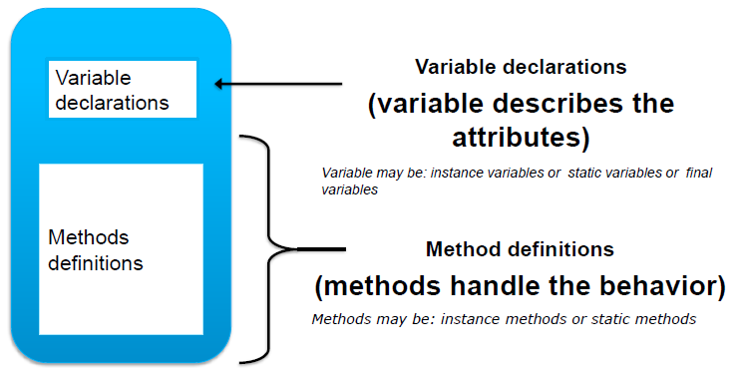
Classes
A class contains variable declarations and method definitions. It provides a sort of template for an object that serves to define its properties.

Slide 4
Object
An entity that has state and behavior is known as an object e.g., chair, bike, marker, pen, table, car, etc. It can be physical or logical (tangible and intangible). The example of an intangible object is the banking system.
An object has three characteristics:
State: represents the data (value) of an object.
Behavior: represents the behavior (functionality) of an object such as deposit, withdraw, etc.
Identity: An object identity is typically implemented via a unique ID. The value of the ID is not visible to the external user. However, it is used internally by the JVM to identify each object uniquely.

Slide 5

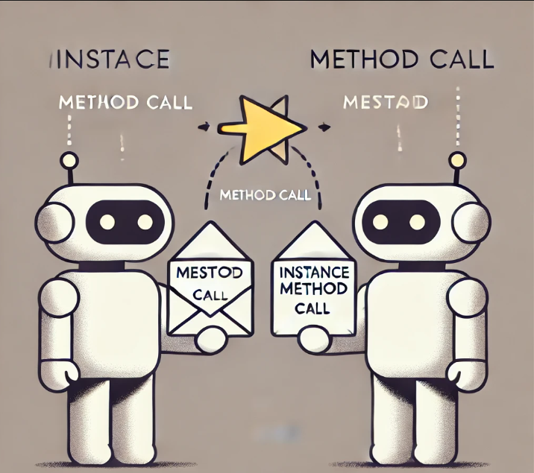
Object
How do objects communicate in Java?
Select the one correct answer.
(a) They communicate by modifying each other’s fields.
(b) They communicate by modifying the static variables of each other’s classes.
(c) They communicate by calling each other’s instance methods.
(d) They communicate by calling static methods of each other’s classes.
Hint

Slide 6
The correct answer is:
(c) They communicate by calling each other’s instance methods.
In Java, objects communicate with each other by invoking each other’s instance methods. This is part of the object-oriented programming paradigm where objects interact by sending messages (method calls) to each other. Through these methods, data can be processed or exchanged without directly accessing or modifying each other's fields.
Option (a): Modifying fields directly breaks encapsulation, which is not recommended.
Option (b): Static variables are shared across all instances of a class and are not typically used for communication between objects.
Option (d): Static methods are associated with the class itself, not with specific instances (objects), so they are not suitable for object-to-object communication.
HOW??????????

Slide 7
How to declare a class in java??
class Rectangle
{ int length, width;
void getData(int x, int y)
{ length= x; width= y;
}
int rectArea()
{ int area=length*width;
Return (area);
}
}
CLASS DEDCLARATION
INSTANCE VARIABLES BELONGING TO THE OBJECT OF THIS CLASS
PARAMETERIZED FUNCTION
PARAMETERIZED FUNCTION
RETURN THE VALUE OF THE METHOD

Slide 8
EXAMPLE 2
Class RectArea
{
public static void main(String args[])
{
int area1;
Rectangle rect1= new Rectangle();
rect1.getData(20,12);
area1= rect1.rectArea();
System.out.println (“Area = ”+area1);
}
}

Slide 9
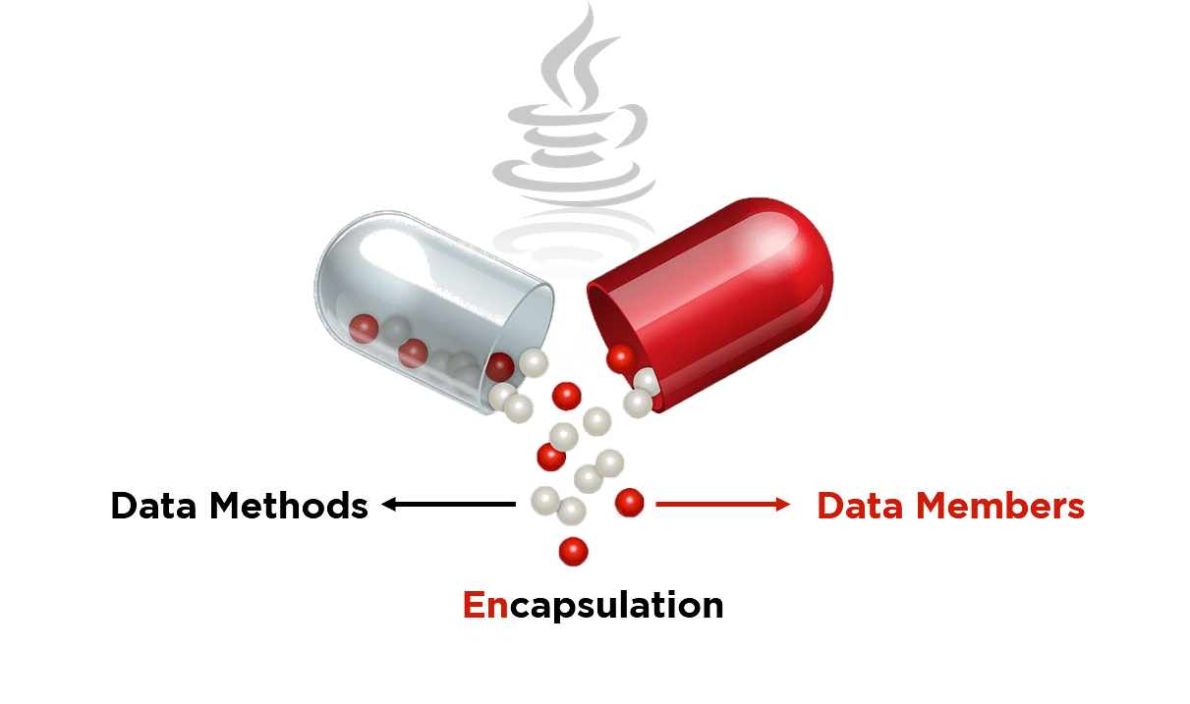
Java Encapsulation
The meaning of Encapsulation, is to make sure that "sensitive" data is hidden from users.
To achieve this, you must:
Declare class variables/attributes as private provide public get and set methods to access and update the value of a private variable
Get and Set
You have learned that private variables can only be accessed within the same class (an outside class has no access to it).
However, it is possible to access them if we provide public get and set methods.
The get method returns the variable value, and the set method sets the value.
Syntax for both is that they start with either get or set, followed by the name of the variable, with the first letter in upper case

Slide 10
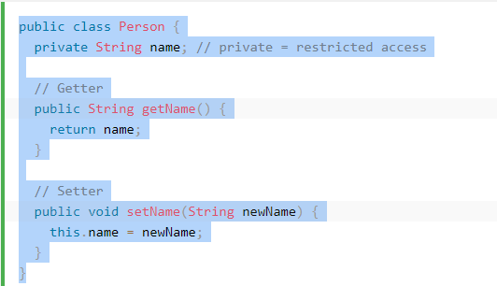
Example of Encapsulation

Slide 11

Abstraction
The process of hiding certain details and showing only essential information to the user.
Abstraction can be achieved with either abstract classes or interfaces (which you will learn more about in the next chapter).
The abstract keyword is a non-access modifier, used for classes and methods:
Abstract class: is a restricted class that cannot be used to create objects (to access it, it must be inherited from another class).
Abstract method: can only be used in an abstract class, and it does not have a body. The body is provided by the subclass (inherited from).

Slide 12
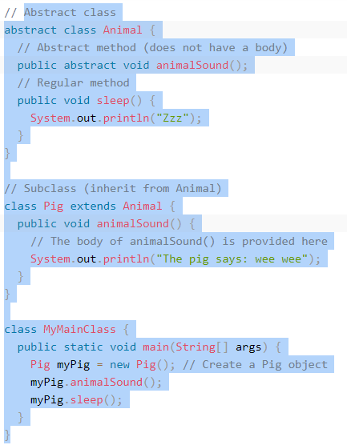
Example of abstraction

Slide 13
Creating reference to abstract class
abstract class Bike{
abstract void run();
}
class Honda4 extends Bike{
void run()
{
System.out.println("running safely");
}
public static void main(String args[]){
Bike obj = new Honda4();
obj.run();
}
}

Slide 14
Points to Remember
An abstract class must be declared with an abstract keyword.
It can have abstract and non-abstract methods.
It cannot be instantiated.
It can have constructors and static methods also.
It can have final methods which will force the subclass not to change the body of the method.

Slide 15
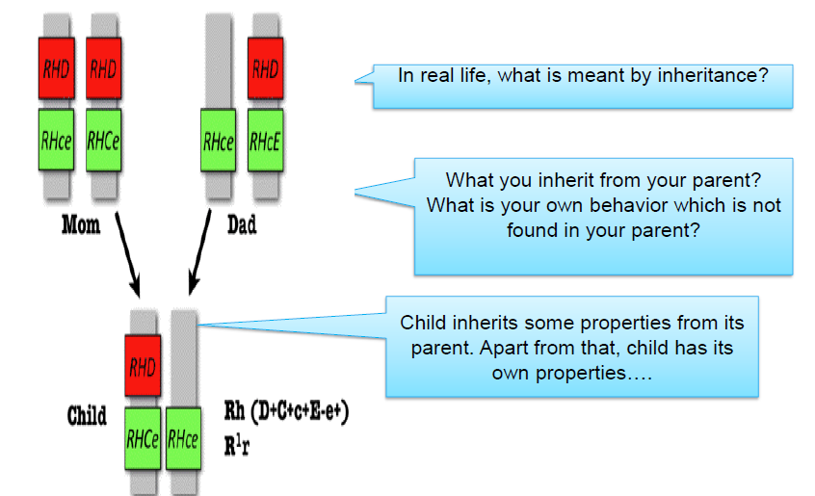
Inheritance in real World

Slide 16
Example of inheritance
// Parent class
class Animal {
String name;
// Constructor for the parent class
Animal(String name) {
this.name = name;
}
// Parent class method
void sound() {
System.out.println("Animals make sounds");
}
}
// Child class inheriting from Parent class
class Dog extends Animal {
String breed;
// Constructor for the child class
Dog(String name, String breed) {
super(name); // Calling the parent class constructor
this.breed = breed;
}
// Overriding the parent class method
@Override
void sound() {
System.out.println(name + " says: Bark! Bark!");
}
}
; // Output: Whiskers says: Meow! Meow!
}
}
// Another child class
class Cat extends Animal {
// Constructor for the child class
Cat(String name) {
super(name);
}
// Overriding the parent class method
@Override
void sound() {
System.out.println(name + " says: Meow! Meow!");
}
}
// Main class to test the program
public class InheritanceExample {
public static void main(String[] args) {
Dog dog = new Dog("Buddy", "Golden Retriever");
Cat cat = new Cat("Whiskers");
// Calling methods
dog.sound(); // Output: Buddy says: Bark! Bark!
cat.sound()

Slide 17
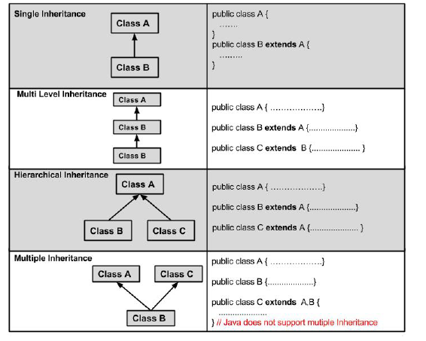
Types Of Inheritance

Slide 18
Predict the output??
class Animal{
String color="white";
}
class Dog extends Animal{
String color="black";
void printColor(){
System.out.println(color);//prints color of Dog class
System.out.println(super.color);//prints color of Animal class
}
}
class TestSuper1{
public static void main(String args[]){
Dog d=new Dog();
d.printColor();
}}
Output: black white

Slide 19
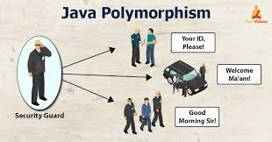
POLYMORPHISM
Polymorphism is one of the OOPs feature that allows us to perform a single action in different ways.
Polymorphism is the capability of a method to do different things based on the object that it is acting upon.
It allows you define one interface and have multiple implementations.

Slide 20
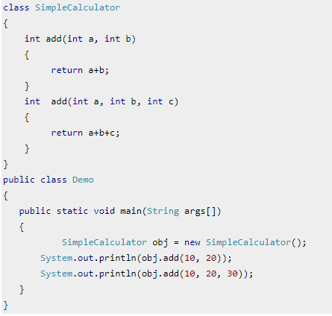
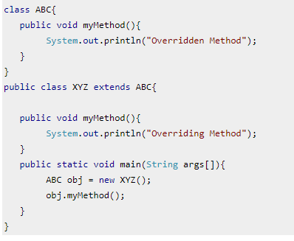
Difference between Static and runtime polymorphism
Static polymorphism
Runtime polymorphism

Slide 21
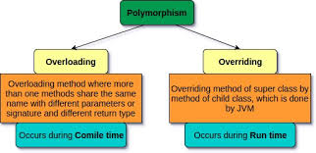

Slide 22
Advantages of Method Overloading in Java
Method overloading increases the readability of the program.
There are two ways to overload the method in java
By changing number of arguments
By changing the data type
In java, Method Overloading is not possible by changing the returntype of the method only.
**Can we overload main method???

Slide 23
Access Modifiers in Java
The access modifiers in Java specifies the accessibility or scope of a field, method, constructor, or class. We can change the access level of fields, constructors, methods, and class by applying the access modifier on it.
Private: The access level of a private modifier is only within the class. It cannot be accessed from outside the class.
Default: The access level of a default modifier is only within the package. It cannot be accessed from outside the package. If you do not specify any access level, it will be the default.
Protected: The access level of a protected modifier is within the package and outside the package through child class. If you do not make the child class, it cannot be accessed from outside the package.
Public: The access level of a public modifier is everywhere. It can be accessed from within the class, outside the class, within the package and outside the package.

Slide 24
Demonstrating Access Modifiers
}
// Subclass in the same package
class Child extends Parent {
public void display() {
System.out.println("Accessing fields from Child class:");
System.out.println("Public Field: " + publicField); // Allowed
System.out.println("Protected Field: " + protectedField); // Allowed
System.out.println("Default Field: " + defaultField); // Allowed
// System.out.println("Private Field: " + privateField); // Not allowed - Compile-time error
}
}
// Class in the same package
public class AccessModifiersExample {
public static void main(String[] args) {
Parent parent = new Parent();
// Accessing fields from the Parent class
System.out.println("Accessing fields from Main class:");
System.out.println("Public Field: " + parent.publicField); // Allowed
System.out.println("Protected Field: " + parent.protectedField); // Allowed
System.out.println("Default Field: " + parent.defaultField); // Allowed
// System.out.println("Private Field: " + parent.privateField); // Not allowed - Compile-time error
parent.accessPrivate(); // Accessing private field/method through a public method
// Creating Child object
Child child = new Child();
child.display(); // Access fields through Child class
}
}
// Parent class
class Parent {
public String publicField = "Public Field"; // Accessible everywhere
protected String protectedField = "Protected Field"; // Accessible within the package and subclasses
String defaultField = "Default Field"; // Accessible within the package
private String privateField = "Private Field"; // Accessible only within this class
// Method to demonstrate private access
private void privateMethod() {
System.out.println("This is a private method");
}
// Public method to access private field and method
public void accessPrivate() {
System.out.println("Accessing: " + privateField);
privateMethod();
}

Slide 25
Non-access modifiers
Java provides a number of non-access modifiers to achieve many other functionalities.
The static modifier for creating class methods and variables.
The final modifier for finalizing the implementations of classes, methods, and variables.
The abstract modifier for creating abstract classes and methods.
The synchronized and volatile modifiers, which are used for threads

Slide 26
References:
Books:
Balaguruswamy, Java.
Modern Java in Action by Raoul-Gabriel Urma, Mario Fusco, and Alan Mycroft
3. A Primer, E.Balaguruswamy, Programming with Java, Tata McGraw Hill Companies,John P. Flynt Thomson, Java Programming.
Video Lectures :
https://www.youtube.com/watch?v=-HafzawNlUo
https://www.youtube.com/watch?v=7GwptabrYyk&t=45s

Slide 27
THANK YOU

