Slide 1

INSTITUTE : UIE
DEPARTMENT : CSE
Bachelor of Engineering (Computer Science & Engineering)
Object Oriented Programming using Java
(23CSP-202 )
TOPIC OF PRESENTATION:
Java Fundamentals
Prepared by: Bhavneet Kaur
Master Subject Coordinator
DISCOVER . LEARN . EMPOWER

Slide 2
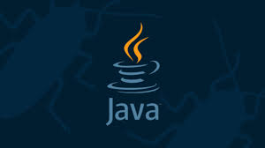
Lecture Objectives
In this lecture, we will discuss:
About flow control statements in java.
Various concepts of array will be part of this ppt.

Slide 3
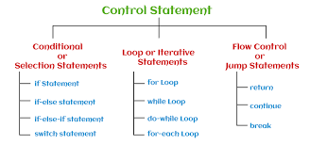
Control Flow Statements In Java
Control flow statements, change or break the flow of execution by implementing decision making, looping, and branching your program to execute particular blocks of code based on the conditions.
Types of control flow statements:
Decision-making statements : if-then, if-then-else, switch
Looping statements : for, while, do-while
Branching statements : break, continue, return

Slide 4
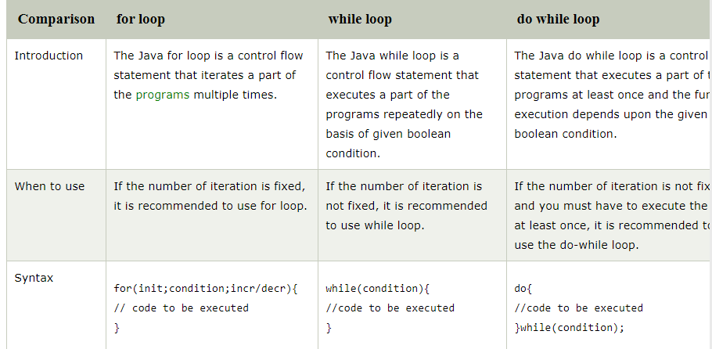
Comparison of for while and do while

Slide 5

Predict the output?
What will be the result, if we try to compile and execute the following code?
class Sample{
public static void main(String[]args) {
boolean b = true;
if(b){
System.out.println(" if block ");
}
else {
System.out.println(“ else block ");
}
}
}

Slide 6
Java program to demonstrate the use of infinite for loop which prints a statement
public class ForExample {
public static void main(String[] args) {
//Using no condition in for loop
for(;;){
System.out.println("infinitive loop");
}
}
}

Slide 7
Predict the output -while loop
What will be the result, if we try to compile and execute the following code snippets
1.
class Sample {
public static void main(String[] args) {
while(false)
System.out.println("while loop");
}
}
2.
class Sample {
public static void main(String[] args) {
for( ; ; )
System.out.println("For loop");
}
}

Slide 8
Concept of enhanced for loop
.
Iterate through elements of arrays.
Also known as for each or enhanced loop in java.
public class Sample {
public static void main(String[] args) {
int [] numbers = {10, 20, 30, 40, 50};
for(int i : numbers ) {
System.out.println( "i: "+i );
}
}
}
The loop automatically iterates over all elements in the numbers collection without requiring explicit index handling
Output:
i:10
i:20
i: 30
i:40
i:50
numbers is a collection (like a list, set, or array) of integers
int i is a variable that holds the current element from the numbers collection during each iteration.

Slide 9
Break Statement
Predict the output ?
class BreakDemo { public static void main(String args[]) { int arr[] = {5,10,15,20,25,30}; int n ; int search = 15; boolean b = false; for(n = 0; n < arr.length; n++) { if(arr[n] == search) { b = true; break; } } if(b) System.out.println("Number found " +search+" at index of "+n); else System.out.println("Element is not found"); } }
Output:
Number found 15 at index of 2

Slide 10
Continue statement
Predict the output? class ContinueDemo { public static void main(String []args) { for (int j = 1; j <= 10; j++) { System.out.print(j+" "); if (j % 2 != 0) continue; System.out.println(" "); } } }
Output: 1 2 3 4 5 6 7 8 9 10
Continue Statement
Continue statement is used to skip the current iteration of while, for or do-while loop.
It causes the immediate jump to next iteration of loop.

Slide 11
Program for Continue statement
Predict the output class ContinueDemo { public static void main(String []args) { for (int j = 1; j <= 10; j++) { System.out.print(j+" "); if (j % 2 != 0) continue; System.out.println(" "); } } }
Output: 1 2 3 4 5 6 7 8 9 10

Slide 12
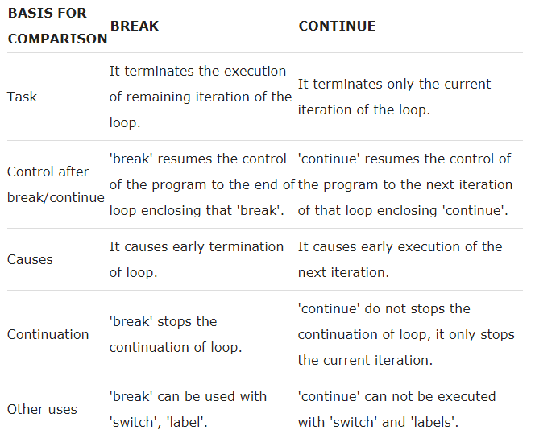
Comparison of Break and continue

Slide 13
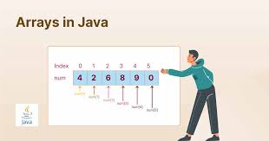
Arrays in Java
In Java all arrays are dynamically allocated.
Since arrays are objects in Java, we can find their length using member length.
To find length of Array, sizeof is used.
A Java array variable can also be declared like other variables with [] after the data type.
The variables in the array are ordered and each have an index beginning from 0.
Java array can be also be used as a static field, a local variable or a method parameter.
The size of an array must be specified by an int value and not long or short.
The direct superclass of an array type is Object.
Every array type implements the interfaces Cloneable and java.io.Serializable.

Slide 14
Cloning of array
Cloning of an array means creating a new array that is a copy of the original array.
In Java, you can clone an array using the clone() method, which creates a shallow copy of the array.
When an array is cloned using the clone() method, a new array is created with the same elements as the original array.
If the array contains primitive types (e.g., int, double), the actual values are copied.
If the array contains reference types (e.g., objects), only the references are copied, not the objects themselves.
Syntax of Cloning:
int[] originalArray = {1, 2, 3, 4, 5};
// Cloning the array
int[] clonedArray = originalArray.clone();

Slide 15
Demonstrating cloning of array objects
public class ArrayCloneDemo
{
public static void main(String[] args)
{
int ai[] = {1, 2, 3, 4, 5};
int aic[] = ai;
aic[2] = -9;
System.out.println(aic[2]);
System.out.println(ai[2]);
aic = ai.clone();
aic[1] = -15;
System.out.println(aic[1]);
System.out.println(ai[1]);
}
}
OUTPUT:
9
-9
---
-15
2

Slide 16
Is an array a primitive type or an object in Java?
An array in Java is an object.
class Test
{
public static void main(String[] args)
{ int[] ia = new int[3];
System.out.println(ia.getClass());
System.out.println(ia.getClass().getSuperclass()); } }
}
}
OUTPUT:
class [I class java.lang.Object where the string "[I" is the run-time type signature for the class object "array with component type int".

Slide 17
ArrayStoreException
Arrays have the property that an array of one type is assignable to an array of its supertype, it is possible to play games with the compiler and try to trick it into storing the wrong kind of object in an array.
Java may not be able to check the types of all objects that you place into arrays at compile time.
In those cases, it’s possible to receive an ArrayStoreException at runtime if you try to assign the wrong type of object to an array element.
For example:
String [] strings = new String [10];
Object [] objects = strings; // alias String [] as Object []
objects[0] = new Date(); // Runtime ArrayStoreException!

Slide 18
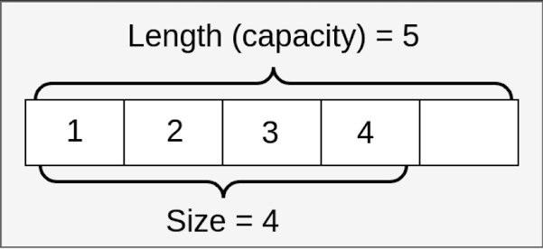
Anonymous Array in Java
Java supports the feature of an anonymous array, so you don't need to declare the array while passing an array to the method.
//Java Program to demonstrate the way of passing an anonymous array
//to method.
public class TestAnonymousArray{
//creating a method which receives an array as a parameter
static void printArray(int arr[]){
for(int i=0;i<arr.length;i++)
System.out.println(arr[i]);
}
public static void main(String args[]){
printArray(new int[]{10,22,44,66}); //passing anonymous array to method
}}

Slide 19
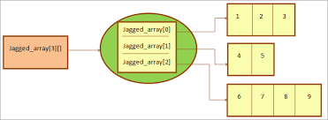
JAGGED ARRAY
Jagged arrays in java are arrays containing arrays of different length. Jagged arrays are also multidimensional arrays.
Jagged arrays in java sometimes are also called as ragged arrays.
public class JaggedArraysInJava
{
public static void main(String[] args)
{
//One Dimensional Array of length 3
int[] OneDimensionalArray1 = {1, 2, 3};
//One Dimensional Array of length 4
int[] oneDimensionalArray2 = {4, 5, 6, 7};
//One Dimensional Array of length 5
int[] oneDimensionalArray3 = {8, 9, 10, 11, 12};

Slide 20
JAGGED ARRAY (cont…)
//Jagged Two-Dimensional Array
int[][] twoDimensionalArray = {OneDimensionalArray1, oneDimensionalArray2, oneDimensionalArray3};
//Printing elements of Two Dimensional Array
for (int i = 0; i < twoDimensionalArray.length; i++)
{
for (int j = 0; j < twoDimensionalArray[i].length; j++)
{
System.out.print(twoDimensionalArray[i][j]+"\t");
}
System.out.println();
}
}
}

Slide 21
QUIZ
Q1. Select which of the following are valid array definition
1. int[] a;
a = new int[5];
2. int a[] = new int[5]
3. int a[5] = new int[5];
4. int a[] = {1,2,3};
5. int[] a = new int[]{1,2,3};
6. int[] a = new int[5]{1,2,3,4};

Slide 22
QUIZ
Q2. What will be the result, if we try to compile and execute the following
codes
class Sample {
public static void main(String[] args) {
int[] a = new int[5]{1,2,3};
for(int i : a)
System.out.println(i);
}
}

