Slide 1

INSTITUTE : UIE
DEPARTMENT : CSE
Bachelor of Engineering (Computer Science & Engineering)
Object Oriented Programming using Java
(23CSP-202 )
TOPIC OF PRESENTATION:
Java Classes
Prepared by: Bhavneet Kaur
Master Subject Coordinator
DISCOVER . LEARN . EMPOWER
DISCOVER . LEARN . EMPOWER

Slide 2

Lecture Objectives
In this lecture, we will discuss:
Abstract Class
Static Class

Slide 3
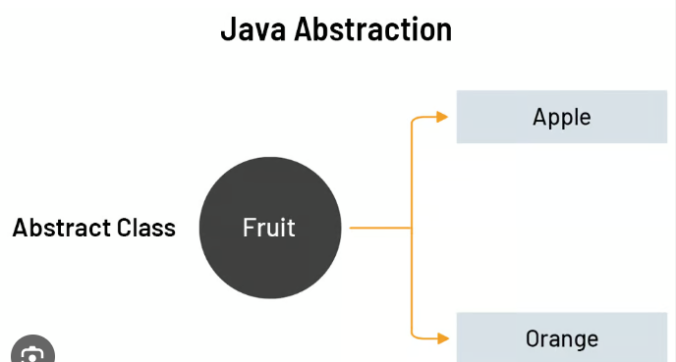
Abstract Class
Abstraction is a process of hiding the implementation details and showing only functionality to the user.
A class which is declared with the abstract keyword is known as an abstract class in Java.
It can have abstract and non-abstract methods.
The abstract keyword is a non-access modifier, used for classes and methods:
Abstract class: is a restricted class that cannot be used to create objects (to access it, it must be inherited from another class).
Abstract method: can only be used in an abstract class, and it does not have a body. The body is provided by the subclass (inherited from).

Slide 4
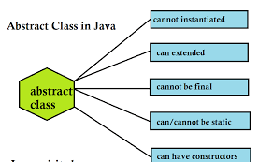
Abstract Class
Any class containing an abstract method is an abstract class
You must declare the class with the keyword abstract:
abstract class MyClass {...}
An abstract class is incomplete as it has “missing” method bodies.
EXAMPLE:
abstract class Animal {
public abstract void animalSound();
public void sleep() {
System.out.println("Zzz");
}
}

Slide 5
Ways to achieve Abstraction:
There are two ways to achieve abstraction in java:
a) Abstract class (0 to 100%)
b) Interface (100%)

Slide 6
Example:
abstract class Bank{
abstract int getRateOfInterest();
}
class SBI extends Bank{
int getRateOfInterest(){return 7;}
}
class PNB extends Bank{
int getRateOfInterest(){return 8;}
}
class TestBank{
public static void main(String args[]){
Bank b;
b=new SBI();
System.out.println("Rate of Interest is: "+b.getRateOfInterest()+" %");
b=new PNB();
System.out.println("Rate of Interest is: "+b.getRateOfInterest()+" %");
}}

Slide 7
Java static keyword
The static keyword in Java is used for memory management mainly. We can apply static keyword with variables, methods, blocks and nested classes. The static keyword belongs to the class than an instance of the class.
The static can be:
Variable (also known as a class variable)
Method (also known as a class method)
Block
Nested class

Slide 8
Java static variable
If you declare any variable as static, it is known as a static variable.
The static variable can be used to refer to the common property of all objects (which is not unique for each object), for example, the company name of employees, college name of students, etc.
The static variable gets memory only once in the class area at the time of class loading.
Advantages of static variable
It makes your program memory efficient (i.e., it saves memory).

Slide 9
Java static method
If you apply static keyword with any method, it is known as static method.
A static method belongs to the class rather than the object of a class.
A static method can be invoked without the need for creating an instance of a class.
A static method can access static data member and can change the value of it.
Java static block
Is used to initialize the static data member.
It is executed before the main method at the time of classloading.

Slide 10
Can a class be static in Java?
The answer is yes, some classes can be made static in Java.
Java allows a class to be defined within another class. These are called Nested Classes.
The class in which the nested class is defined is known as the Outer Class.
Unlike top level classes, Inner classes can be Static.

Slide 11
STATIC METHOD
Example:
class SimpleStaticExample
{
// This is a static method
static void myMethod()
{
System.out.println("myMethod");
}
public static void main(String[] args)
{
/* You can see that we are calling this
* method without creating any object.
*/
myMethod();
}
}

Slide 12
Differences between static and non-static nested classes?
The following are major differences between static nested classes and inner classes.
A static nested class may be instantiated without instantiating its outer class.
Inner classes can access both static and non-static members of the outer class. A static class can access only the static members of the outer class

Slide 13
JAVA STATIC VARIABLES
A static variable is common to all the instances of the class because it is a class level variable.
A single copy of static variable is created and shared among all the instances of the class.
Memory allocation for such variables only happens once when the class is loaded in the memory.
Static variables are also known as Class Variables.
Unlike non-static variables, such variables can be accessed directly in static and non-static methods.

Slide 14
JAVA STATIC VARIABLES
class JavaExample3{
static int var1;
static String var2;
//This is a Static Method
static void disp(){
System.out.println("Var1 is: "+var1);
System.out.println("Var2 is: "+var2);
}
public static void main(String args[])
{
disp();
}
}

Slide 15
Java static nested class example with static method
If you have the static member inside static nested class, you don't need to create instance of static nested class.
class TestOuter2{
static int data=30;
static class Inner{
static void msg(){System.out.println("data is "+data);}
}
public static void main(String args[]){
TestOuter2.Inner.msg();//no need to create the instance of static nested class
}
}

Slide 16
QUIZ:
Q1: Which of the following statements are incorrect?
a) static methods can call other static methods only
b) static methods must only access static data
c) static methods can not refer to this or super in any way
d) when object of class is declared, each object contains its own copy of static variables

Slide 17
QUIZ:
Q2: Which of the following classes fail to compile:
abstract class X { abstract void method(); }
abstract class Y extends X { }
class Z extends Y {
void method() {
System.out.println("Class Z");
}
}
X,Y
Y,Z
X,Y,Z
All classes compile

Slide 18
Summary:
In this session, you were able to :
• Learn about Abstract classes and static classes
• Understand abstraction with example

Slide 19
References:
Books:
1. Balaguruswamy, Java.
2. A Primer, E.Balaguruswamy, Programming with Java, Tata McGraw Hill Companies
3. John P. Flynt Thomson, Java Programming.
Video Lectures :
https://www.youtube.com/watch?v=RcIsb9iFKH8

Slide 20
THANK YOU

