Slide 1

INSTITUTE : UIE
DEPARTMENT : CSE
Bachelor of Engineering (Computer Science & Engineering)
Java Programming (20CST-218)
TOPIC OF PRESENTATION:
Java Classes
DISCOVER . LEARN . EMPOWER

Slide 2

Lecture Objectives
In this lecture, we will discuss:
Constructors
This and super keyword
Access Control

Slide 3
Constructors
A constructor in Java is a special method that is used to initialize objects. The constructor is called when an object of a class is created.
Constructor is automatically invoked whenever an object of the class is created.
At the time of calling the constructor, memory for the object is allocated in the memory.
Rules to define a constructor
A constructor has the same name as the class name
A constructor should not have a return type
Constructors are called only once at the time of Object creation while method(s) can be called any number of times.
A class can contain more than one constructor, So it can be overloaded.

Slide 4
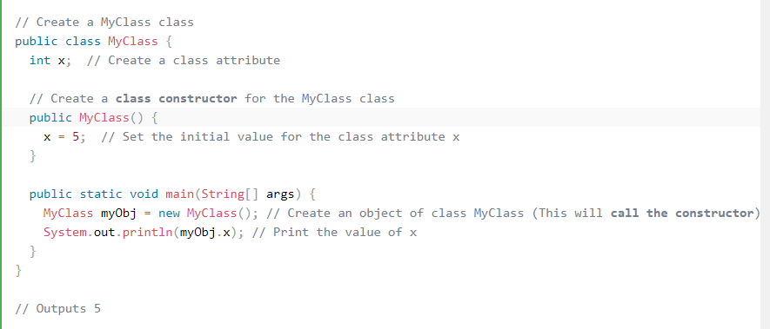
Example of constructor

Slide 5
Two types of constructors in java:
No-argument constructor (Default constructor):
If we don’t define a constructor in a class, then the compiler creates a default constructor(with no arguments) for the class. And if we write a constructor with arguments or no arguments then the compiler does not create a default constructor.
Parameterized Constructor:
A constructor that has parameters is known as parameterized constructor. If we want to initialize fields of the class with our own values, then use a parameterized constructor.

Slide 6
//Default constructor
import java.io.*;
class Geek {
int num;
String name;
Geek() { System.out.println("Constructor called"); }
}
class GFG {
public static void main(String[] args) {
Geek geek1 = new Geek();
System.out.println(geek1.name);
System.out.println(geek1.num);
} }
OUTPUT:
Constructor called
null
0
// Parameterised constructor
import java.io.*;
class Geek {
String name;
int id;
Geek(String name, int id) {
this.name = name;
this.id = id;
}}
class GFG {
// main driver method
public static void main(String[] args)
{
Geek geek1 = new Geek("adam", 1);
System.out.println("GeekName :" + geek1.name
+ " and GeekId :" + geek1.id);
}}
OUTPUT:
GeekName :adam and GeekId :1

Slide 7
super keyword
The super keyword in java is a reference variable that is used to refer parent class objects.
The keyword “super” came into the picture with the concept of Inheritance.
The use of super keyword
1) To access the data members of parent class when both parent and child class have member with same name 2) To explicitly call the no-arg and parameterized constructor of parent class 3) To access the method of parent class when child class has overridden that method.

Slide 8
this keyword
The this keyword refers to the current object in a method or constructor.
The most common use of the this keyword is to eliminate the confusion between class attributes and parameters with the same name.
this can also be used to:
Invoke current class constructor
Invoke current class method
Return the current class object
Pass an argument in the method call
Pass an argument in the constructor call

Slide 9
this keyword
Using ‘this’ keyword to refer current class instance variables.
class Test {
int a, b;
Test(int a, int b) {
this.a = a;
this.b = b; }
void display() {
System.out.println("a = " + a + " b = " + b); }
public static void main(String[] args) {
Test object = new Test(10, 20);
object.display();
} }

Slide 10
this keyword
Using this() to invoke current class constructor
class Test {
int a,b;
Test() {
this(10, 20);
System.out.println("Inside default constructor \n"); }
Test(int a, int b) {
this.a = a;
this.b = b;
System.out.println("Inside parameterized constructor"); }
public static void main(String[] args) {
Test object = new Test(); } }

Slide 11
this keyword
Using ‘this’ keyword to invoke current class method
class Test {
void display() {
this.show();
System.out.println("Inside display function"); }
void show() {
System.out.println("Inside show funcion"); }
public static void main(String args[]) {
Test t1 = new Test();
t1.display();
} }

Slide 12
super keyword
Use of super with variables:
class Vehicle {
int maxSpeed = 120; }
class Car extends Vehicle {
int maxSpeed = 180;
void display() {
/* print maxSpeed of base class (vehicle) */
System.out.println("Maximum Speed: " + super.maxSpeed); } }
class Test {
public static void main(String[] args) {
Car small = new Car();
small.display(); } }

Slide 13
super keyword
Use of super with methods:
class Person {
void message() {
System.out.println("This is person class"); } }
class Student extends Person {
void message() {
System.out.println("This is student class"); }
void display() {
message();
// will invoke or call parent class message() method
super.message(); } }
class Test {
public static void main(String args[]) {
Student s = new Student();
s.display(); } }

Slide 14

ACCESS CONTROL
Problem Statement
Design a secure banking application.
The system should include BankAccount Class:Define attributes such as accountNumber, accountHolderName, balance, and pin.
accountNumber: Should be publicly accessible for identification purposes.
accountHolderName: Should be protected so it can be accessed by derived classes.
balance: Should be private to ensure it cannot be accessed or modified directly from outside the class.
pin: Should be private to ensure confidentiality.
CAN YOU THINK OF APPROPRIATE APPROACH HERE?????

Slide 15
ACCESS CONTROL
Access modifiers define the scope of the class and its members (data and methods).
There are four categories, provided by Java regarding the visibility of the class members between classes and packages:
Subclasses in the same package
Non-subclasses in the same package
Subclasses in different packages
Classes that are neither in the same package nor subclasses

Slide 16
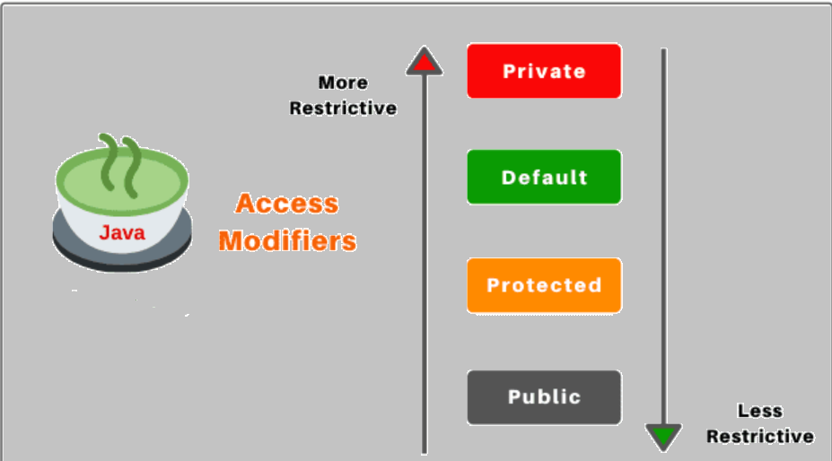
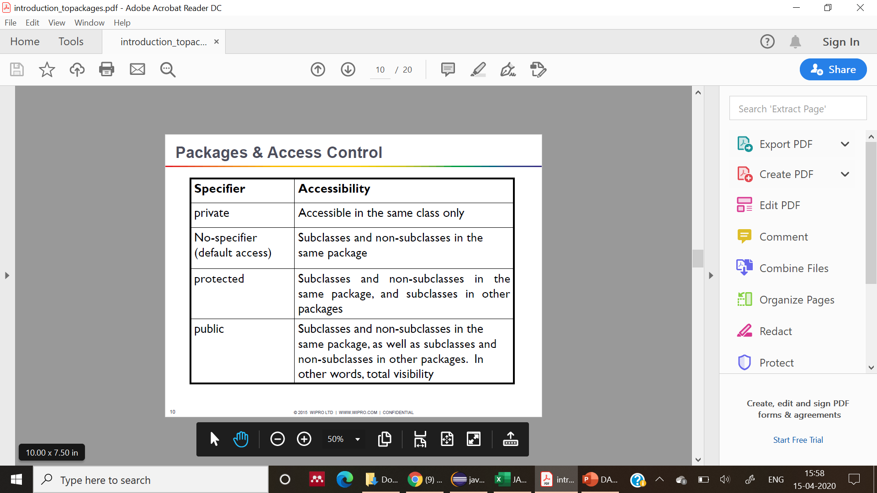
ACCESS CONTROL:

Slide 17
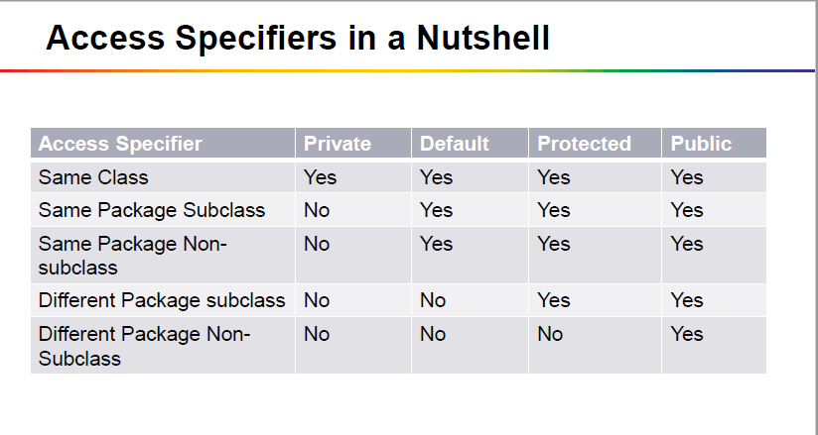
ACCESS CONTROL:

Slide 18
QUIZ:
Which of these is used as a default for a member of a class if no access specifier is used for it? a) private b) public c) public, within its own package d) protected

Slide 19
QUIZ:
Q2:
“this" keyword can not be used in ---?
Constructors
Static blocks and methods
Non static methods

Slide 20
Summary:
In this session, you were able to :
• Learn about this and super keyword
• Understand access controls

Slide 21
References:
Books:
1. Balaguruswamy, Java.
2. A Primer, E.Balaguruswamy, Programming with Java, Tata McGraw Hill Companies
3. John P. Flynt Thomson, Java Programming.
Video Lectures : https://www.youtube.com/watch?v=eKoJiCUFEls
https://www.youtube.com/watch?v=1ZDApgnufSI

Slide 22
THANK YOU

