Slide 1

INSTITUTE : UIE
DEPARTMENT : CSE
Bachelor of Engineering (Computer Science & Engineering)
Object Oriented Programming using Java
(23CSP-202 )
TOPIC OF PRESENTATION:
Java Exceptions
Prepared by: Bhavneet Kaur
Master Subject Coordinator
DISCOVER . LEARN . EMPOWER

Slide 2

Lecture Objectives
In this lecture, we will discuss:
Exception Handling
Exception Heirarchy

Slide 3
JAVA - EXCEPTIONS
An exception (or exceptional event) is a problem that arises during the execution of a program.
When an Exception occurs the normal flow of the program is disrupted and the program/Application terminates abnormally, which is not recommended, therefore, these exceptions are to be handled.
An exception can occur for many different reasons. Following are some scenarios where an exception occurs.
A user has entered an invalid data.
A file that needs to be opened cannot be found.
A network connection has been lost in the middle of communications or the JVM has run out of memory.
Some of these exceptions are caused by user error, others by programmer error, and others by physical resources that have failed in some manner.

Slide 4
Error v/s Exception
Error: An Error indicates serious problem that a reasonable application should not try to catch.
Exception: Exception indicates conditions that a reasonable application might try to catch.
Exception Hierarchy :
All exception and errors types are subclasses of class Throwable, which is base class of hierarchy.
One branch is headed by Exception. This class is used for exceptional conditions that user programs should catch.
NullPointerException is an example of such an exception.
There is an important subclass of Exception, called RuntimeException.
Exceptions of this type are automatically defined for the programs that you write and include things such as division by zero and invalid array indexing.

Slide 5
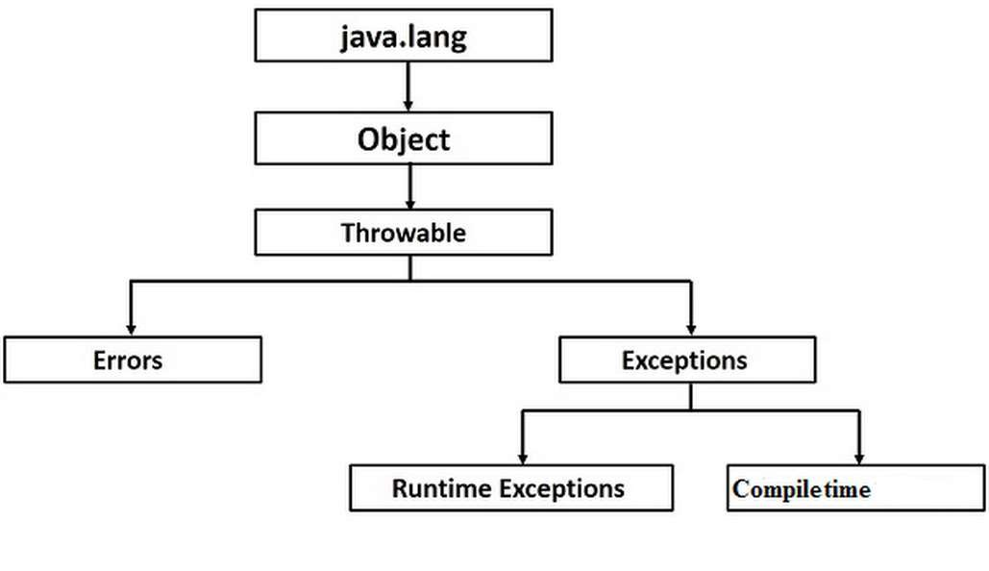
Exception Hierarchy
Another branch,Error which defines exceptions that are not expected to be
caught under normal circumstances by your program ,
Errors are used by the Java run-time system(JVM) to indicate errors having to do with the run-time environment itself(JRE). StackOverflowError is an example of such an error.

Slide 6
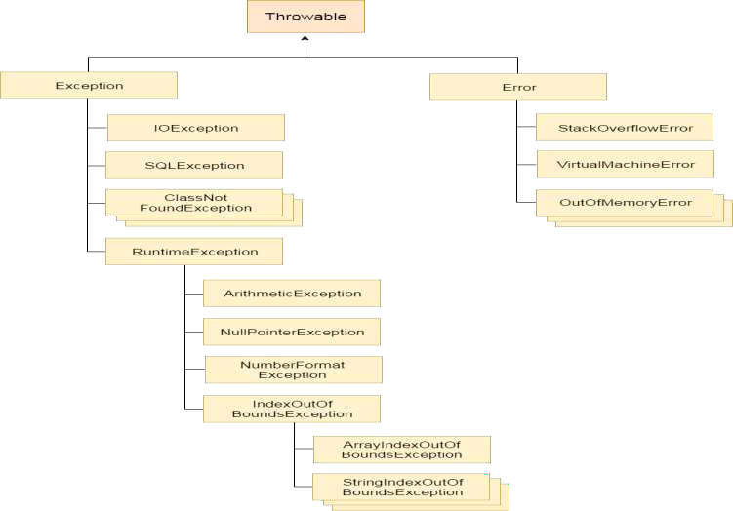
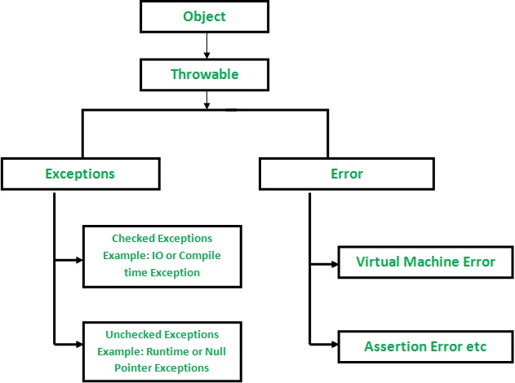
Exception Hierarchy

Slide 7
EXCEPTION : Types
Java’s exceptions can be categorized into two types:
Checked exceptions
Unchecked exceptions
Checked exceptions −
A checked exception is an exception that occurs at the compile time.
These are also called as compile time exceptions.
These exceptions cannot simply be ignored at the time of compilation, the programmer should take care of (handle) these exceptions.
checked exceptions are subject to the catch or specify a requirement, which means they require catching or declaration. This requirement is optional for unchecked exceptions.
Code that uses a checked exception will not compile if the catch or specify rule is not followed.

Slide 8
EXCEPTION : Types
All Java exceptions are checked exceptions except those of the Error and RuntimeException classes and their subclasses.
For example, if you use FileReader class in your program to read data from a file, if the file specified in its constructor doesn't exist, then a FileNotFoundException occurs, and the compiler prompts the programmer to handle the exception.
Since the methods read() and close() of FileReader class throws IOException, you can observe that the compiler notifies to handle IOException, along with FileNotFoundException.

Slide 9
EXCEPTION : Types
Unchecked exceptions − An unchecked exception is an exception that occurs at the time of execution.
These are also called as Runtime Exceptions.
These include programming bugs, such as logic errors or improper use of an API. Runtime exceptions are ignored at the time of compilation.
For example, if you have declared an array of size 5 in your program, and trying to call the 6th element of the array then an ArrayIndexOutOfBoundsExceptionexception occurs.
Errors − These are not exceptions at all, but problems that arise beyond the control of the user or the programmer.
Errors are typically ignored in your code because you can rarely do anything about an error.
For example, if a stack overflow occurs, an error will arise. They are also ignored at the time of compilation.

Slide 10
Exception Handling
statement 1;
statement 2;
statement 3;
statement 4;
statement 5;//exception occurs
statement 6;
statement 7;
statement 8;
statement 9;
statement 10;
Suppose there is 10 statements in your program and there occurs an exception at statement 5, rest of the code will not be executed i.e. statement 6 to 10 will not run. If we perform exception handling, rest of the statement will be executed. That is why we use exception handling in java.

Slide 11
How JVM handle an Exception?
Default Exception Handling : Whenever inside a method, if an exception has occurred, the method creates an Object known as Exception Object and hands it off to the run-time system(JVM).
The exception object contains name and description of the exception, and current state of the program where exception has occurred.
Creating the Exception Object and handling it to the run-time system is called
throwing an Exception.
There might be the list of the methods that had been called to get to the method where exception was occurred. This ordered list of the methods is called Call Stack.
Now the following procedure will happen.
The run-time system searches the call stack to find the method that contains block of code that can handle the occurred exception. The block of the code is called Exception handler.

Slide 12
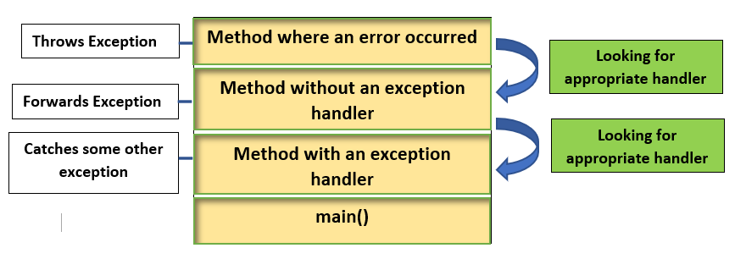
How JVM handle an Exception?
The run-time system starts searching from the method in which exception occurred, proceeds through call stack in the reverse order in which methods were called.
If it finds appropriate handler then it passes the occurred exception to it. Appropriate handler means the type of the exception object thrown matches the type of the exception object it can handle.
If run-time system searches all the methods on call stack and couldn’t have found the appropriate handler then run-time system handover the Exception Object to default exception handler , which is part of run-time system. This handler prints the exception information in the following format and terminates program abnormally.

Slide 13
QUIZ:
Which of these keywords is used to manually throw an exception?
A. try
B. finally
C. throw
D. catch

Slide 14
QUIZ:
Q2:
Exception and Error are direct subclasses of? A.BaseException B.Throwable C.Object D.RuntimeException

Slide 15
Summary:
In this session, you were able to :
• Learn about this and super keyword
• Understand access controls

Slide 16
References:
Books:
1. Balaguruswamy, Java.
2. A Primer, E.Balaguruswamy, Programming with Java, Tata McGraw Hill Companies
3. John P. Flynt Thomson, Java Programming.
Video Lectures : https://youtu.be/VIbZRUjh2d0?list=PLHuIqV4DwPicArdMjI2YI5Hu5c2TnMgvV

Slide 17
THANK YOU

