Slide 1

Academic Session 2025-26
EVEN Semester Jan-Jun 2026
UNIVERSITY INSTITUTE OF ENGINEERING
DEPARTMENT NAME-UIE
PROGRAM NAME:-Bachelor of Engineering
SPECIALIZATION/ SEMESTER-6th
SUBJECT NAME:-Principles of Artificial Intelligence
(SUBJECT CODE-23CST-306)
Unit No.2 Chapter No.3 Lecture No.20
Topic :Graph Theory and Search Strategies in Artificial Intelligence
Faculty Name-Er.Parveen kumar saini and E_Code -13339 Designation-AP

Slide 2
1
Learning Objectives
Understand the working principles of Breadth First Search (BFS) and Depth First Search (DFS) algorithms.
Differentiate between BFS and DFS based on traversal strategy, data structures, and applications.
Understanding BFS and DFS to solve graph problems such as shortest path, cycle detection, and connected components.
Understand and analyze heuristic search techniques and their role in efficient problem solving in Artificial Intelligence.

Slide 3
2
Recap of Previous Lecture
Graph Theory and
Search Strategies in Artificial Intelligence

Slide 4
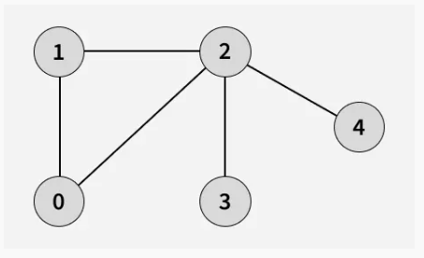
3
Breadth First Search or BFS for a Graph
Breadth First Search (BFS) is a graph traversal algorithm that starts from a source node and explores the graph level by level. First, it visits all nodes directly adjacent to the source. Then, it moves on to visit the adjacent nodes of those nodes, and this process continues until all reachable nodes are visited.
BFS is different from DFS in a way that closest vertices are visited before others. We mainly traverse vertices level by level.
Popular graph algorithms like Dijkstra's shortest path, Kahn's Algorithm, and Prim's algorithm are based on BFS.
BFS itself can be used to detect cycle in a directed and undirected graph, find shortest path in an unweighted graph and many more problems.
Figure-1 : BFS Graph
Additional / Recommended Readings:
https://www.geeksforgeeks.org/dsa/breadth-first-search-or-bfs-for-a-graph/

Slide 5
4
Breadth First Search or BFS for a Graph
Examples:
Input: adj[][] = [[1, 2], [0, 2], [0, 1, 3, 4], [2], [2]]
Output: [0, 1, 2, 3, 4] Explanation: Starting from 0, the BFS traversal proceeds as follows: Visit 0 - Print: 0 Visit 1 (neighbor of 0) - Print: 1 Visit 2 (next neighbor of 0) - Print: 2 Visit 3 (first neighbor of 2 that hasn't been visited yet) - Print: 3 Visit 4 (next neighbor of 2) - Print: 4
Input: adj[][] = [[2, 3], [2], [0, 1], [0], [5], [4]]
Figure-1 : BFS Graph
Additional / Recommended Readings:
https://www.geeksforgeeks.org/dsa/breadth-first-search-or-bfs-for-a-graph/

Slide 6
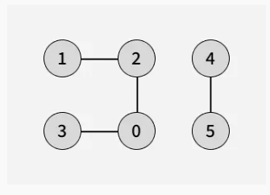
5
Breadth First Search or BFS for a Graph
Output: [0, 2, 3, 1, 4, 5] Explanation: Starting from 0, the BFS traversal proceeds as follows: Visit 0 - Print: 0 Visit 2 (first neighbor of 0) - Print: 2 Visit 3 (next neighbor of 0) - Print: 3 Visit 1 (neighbor of 2 that hasn't been visited yet) - Print: 1
Start another BFS traversal with source as 4:
Visit 4 - Print: 4 Visit 5 (neighbor of 4) - Print: 5
Figure-2 : BFS Graph
Additional / Recommended Readings:
https://www.geeksforgeeks.org/dsa/breadth-first-search-or-bfs-for-a-graph/

Slide 7
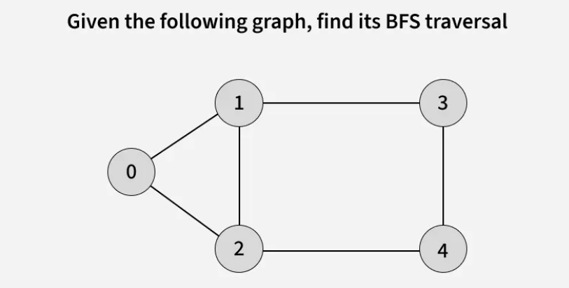
6
BFS from a Given Source in an Undirected Graph:
The algorithm starts from a given source vertex and explores all vertices reachable from that source, visiting nodes in increasing order of their distance from the source, level by level using a queue. Since graphs may contain cycles, a vertex could be visited multiple times.
To prevent revisiting a vertex, a visited array is used.
Let us understand the working of Breadth First Search with the help of the following Illustration:
Figure-3 : BFS Graph

Slide 8
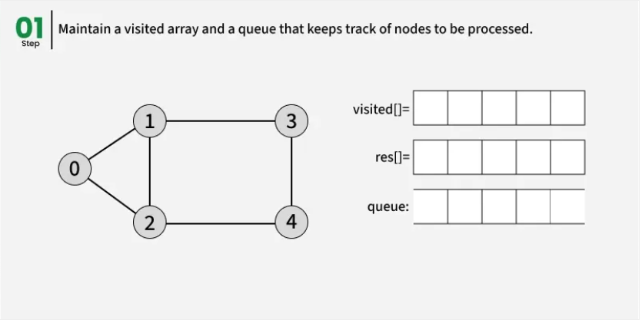
7
Figure-4 : Working of Breadth First Search

Slide 9
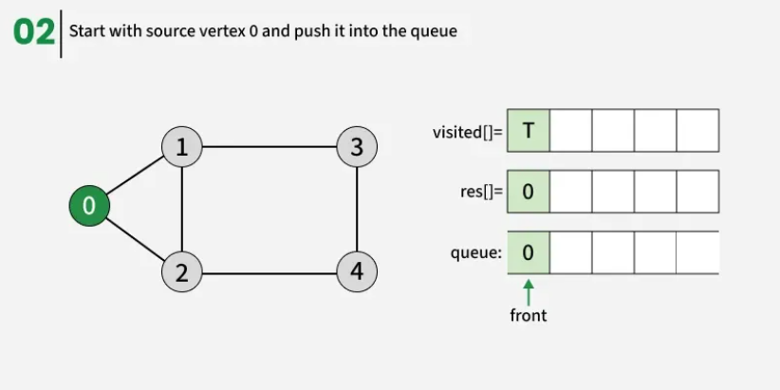
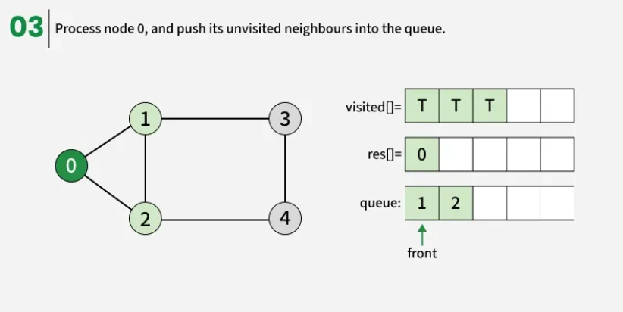
8
Figure-5 : Working of Breadth First Search
Figure-6 : Working of Breadth First Search

Slide 10
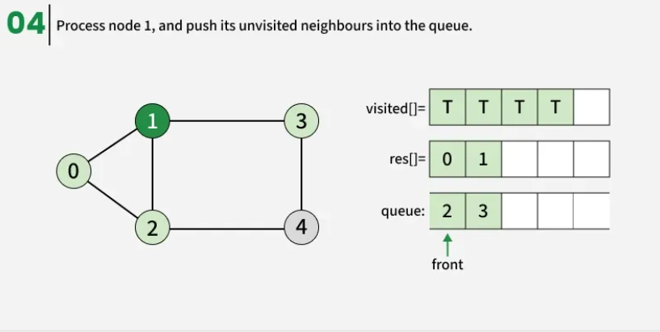
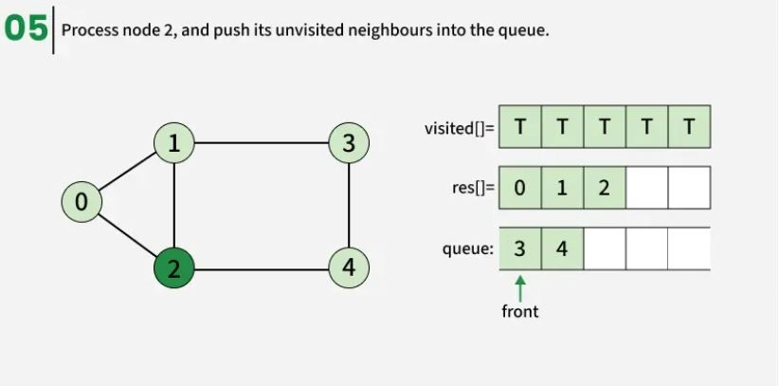
9
Figure-7 : Working of Breadth First Search
Figure-8 : Working of Breadth First Search

Slide 11
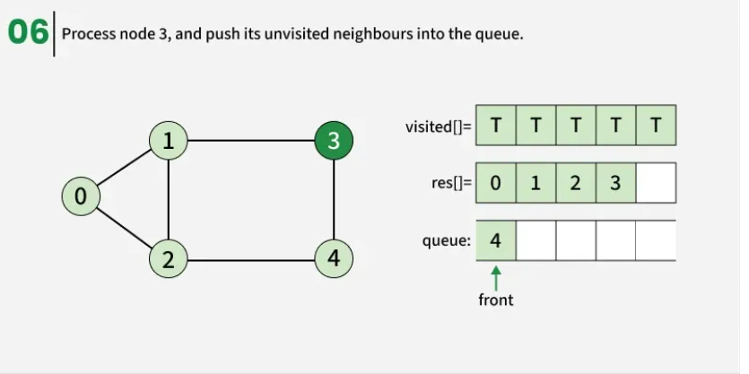
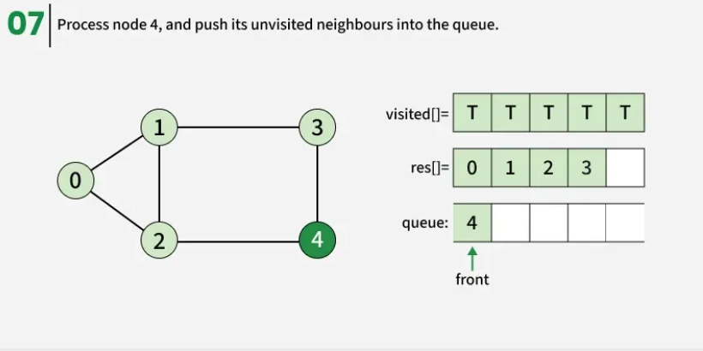
10
Figure-9 : Working of Breadth First Search
Figure-8 : Working of Breadth First Search

Slide 12
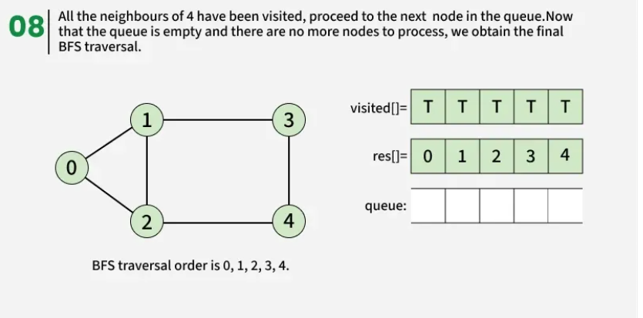
11
Figure-9 : Working of Breadth First Search

Slide 13
Applications of BFS in Graphs
12
BFS has various applications in graph theory and computer science, including:
Shortest Path Finding
Cycle Detection
Connected Components
Network Routing

Slide 14
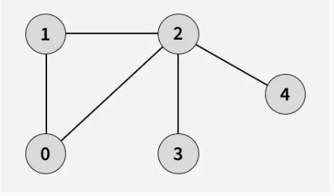
Depth First Search or DFS for a Graph
13
Given a graph, traverse the graph using Depth First Search and find the order in which nodes are visited.
Depth First Search (DFS) is a graph traversal method that starts from a source vertex and explores each path completely before backtracking and exploring other paths. To avoid revisiting nodes in graphs with cycles, a visited array is used to track visited vertices.
Note: There can be multiple DFS traversals of a graph according to the order in which we pick adjacent vertices. Here we pick vertices as per the insertion order.
Figure-10 : DFS Graph

Slide 15
Depth First Search or DFS for a Graph
14
Example:
Input: adj[][] = [[1, 2], [0, 2], [0, 1, 3, 4], [2], [2]]
Output: [0, 1, 2, 3, 4] Explanation: The source vertex is 0. We visit it first, then we visit its adjacent. Start at 0: Mark as visited. Print 0. Move to 1: Mark as visited. Print 1. Move to 2: Mark as visited. Print 2. Move to 3: Mark as visited. Print 3.(backtrack to 2) Move to 4: Mark as visited. Print 4(backtrack to 2, then backtrack to 1, then to 0).
Note that there can be more than one DFS Traversals of a Graph. For example, after 1, we may pick adjacent 2 instead of 0 and get a different DFS.
Figure-10 : DFS Graph

Slide 16
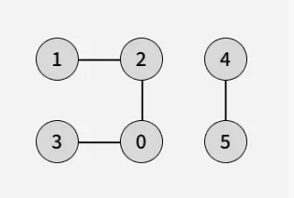
Depth First Search or DFS for a Graph
15
Example:
Input: adj[][] = [[2, 3], [2], [0, 1], [0], [5], [4]]
Output: [0, 2, 1, 3, 4, 5] Explanation: DFS Steps:
Start at 0: Mark as visited. Print 0. Move to 2: Mark as visited. Print 2. Move to 1: Mark as visited. Print 1 (backtrack to 2, then backtrack to 0). Move to 3: Mark as visited. Print 3 (backtrack to 0). Start with 4. Start at 4: Mark as visited. Print 4. Move to 5: Mark as visited. Print 5. (backtrack to 4)
Figure-11 : DFS Graph

Slide 17
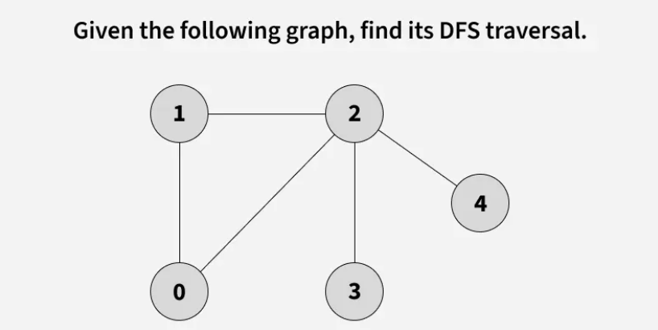
DFS from a Given Source of Graph:
16
Depth First Search (DFS) starts from a given source vertex and explores one path as deeply as possible. When it reaches a vertex with no unvisited neighbors, it backtracks to the previous vertex to explore other unvisited paths. This continues until all vertices reachable from the source are visited. In a graph, there might be loops. So we use an extra visited array to make sure that we do not process a vertex again.
Let us understand the working of Depth First Search with the help of the following Illustration:
Figure-12 : DFS Graph

Slide 18
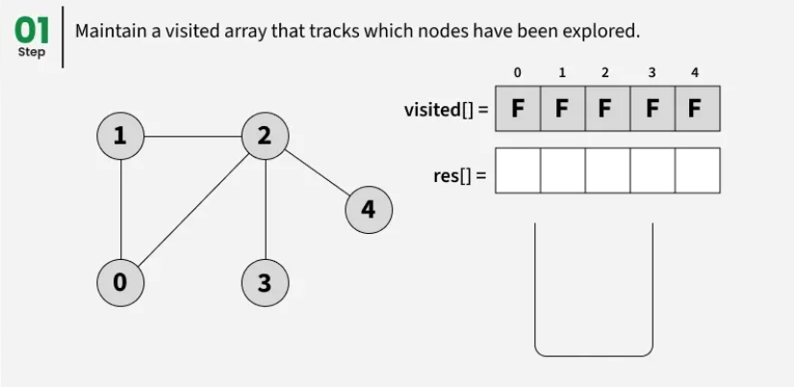
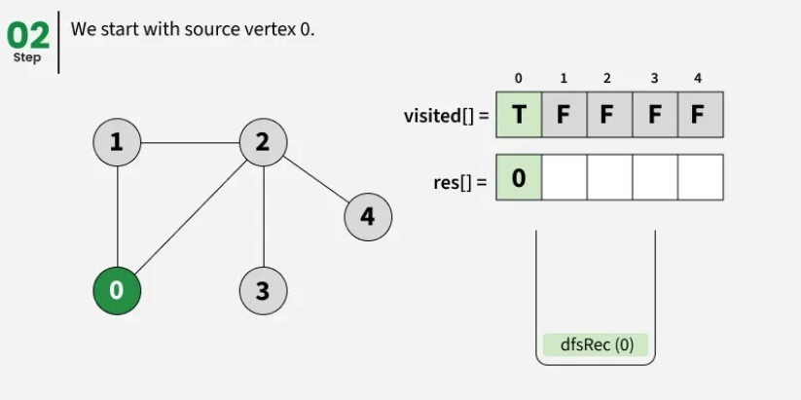
17
Figure-13 : Working of Depth First Search (DFS)
Figure-14 : Working of Depth First Search (DFS)

Slide 19
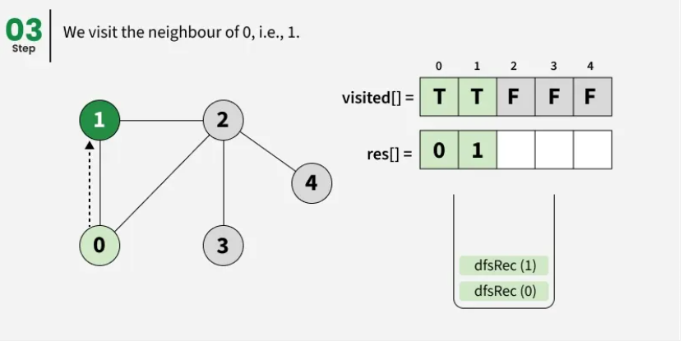
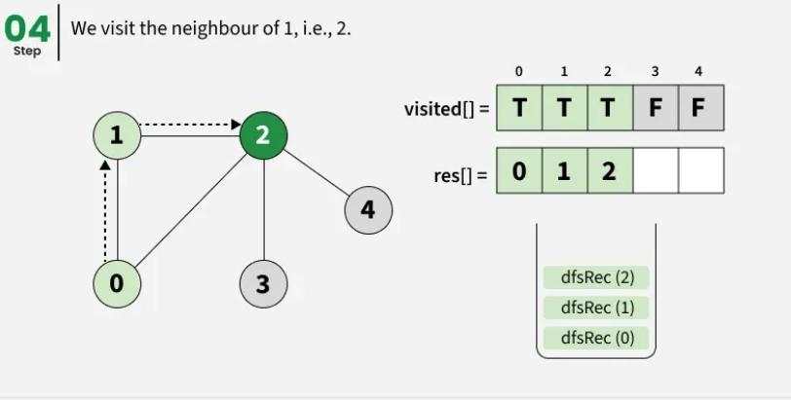
18
Figure-15 : Working of Depth First Search (DFS)
Figure-16 : Working of Depth First Search (DFS)

Slide 20
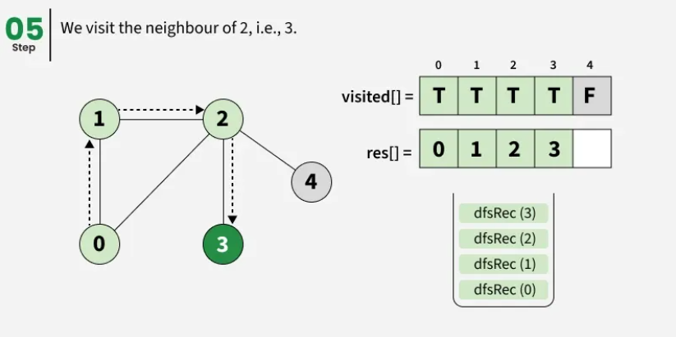
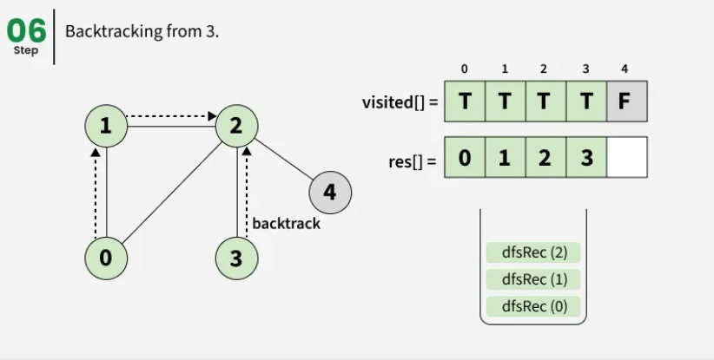
19
Figure-17 : Working of Depth First Search (DFS)
Figure-18 : Working of Depth First Search (DFS)

Slide 21
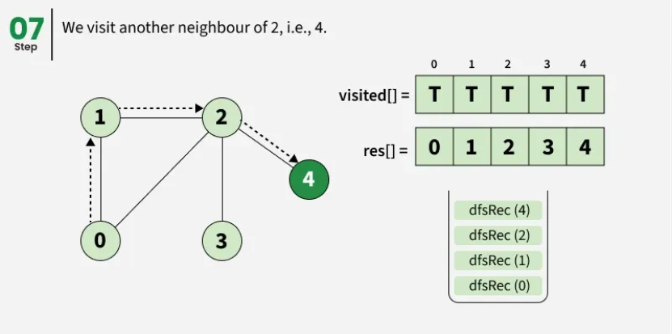
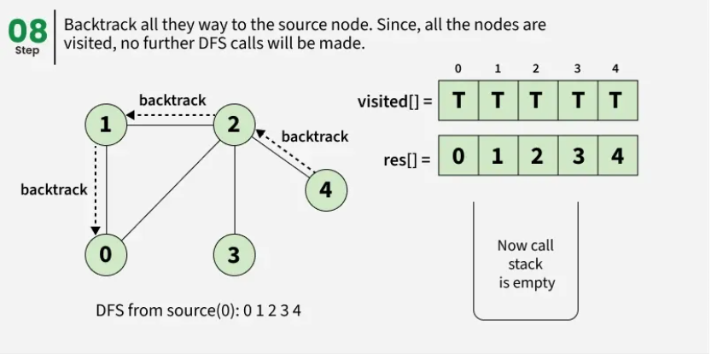
20
Figure-19 : Working of Depth First Search (DFS)
Figure-20 : Working of Depth First Search (DFS)

Slide 22
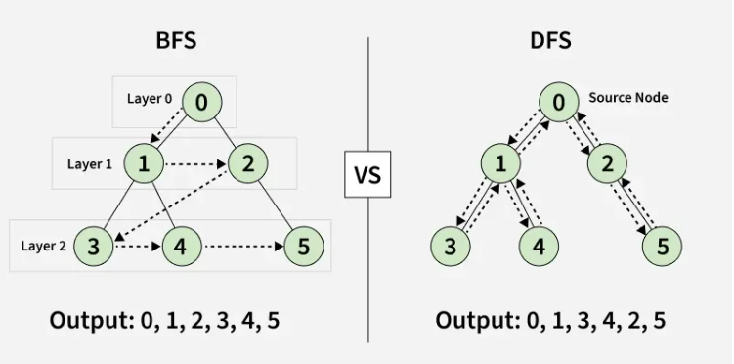
Difference between BFS and DFS
21
Breadth-First Search (BFS) and Depth-First Search (DFS) are two fundamental algorithms used for traversing or searching graphs and trees.
Figure-21 : Difference between BFS and DFS

Slide 23
Difference between BFS and DFS
22
Parameters | BFS | DFS
Stands for | BFS stands for Breadth First Search. | DFS stands for Depth First Search.
Data Structure | BFS(Breadth First Search) uses Queue data structure for finding the shortest path. | DFS(Depth First Search) uses Stack data structure.
Definition | BFS is a traversal approach in which we first walk through all nodes on the same level before moving on to the next level. | DFS is also a traversal approach in which the traverse begins at the root node and proceeds through the nodes as far as possible until we reach the node with no unvisited nearby nodes.
Conceptual Difference | BFS builds the tree level by level. | DFS builds the tree sub-tree by sub-tree.

Slide 24
Difference between BFS and DFS
23
Parameters | BFS | DFS
Approach used | It works on the concept of FIFO (First In First Out). | It works on the concept of LIFO (Last In First Out).
Suitable for | BFS is more suitable for searching vertices closer to the given source. | DFS is more suitable when there are solutions away from source.
Applications | BFS is used in various applications such as bipartite graphs, shortest paths, etc. If weight of every edge is same, then BFS gives shortest path from source to every other vertex. | DFS is used in various applications such as acyclic graphs and finding strongly connected components etc. There are many applications where both BFS and DFS can be used like Topological Sorting, Cycle Detection, etc.
Approach used | It works on the concept of FIFO (First In First Out). | It works on the concept of LIFO (Last In First Out).

Slide 25
Heuristic Search Techniques in AI and Significance of Heuristic Search in AI
24
Heuristic Search Techniques in AI
Heuristic search techniques are used for problem-solving in AI systems. These techniques help find the most efficient path from a starting point to a goal, making them essential for applications such as navigation systems, game playing, and optimization problems.
Heuristic search operates within the search space of a problem to find the best or near-optimal solution using systematic algorithms.
Unlike brute-force methods, which exhaustively evaluate all possible solutions, heuristic search leverages heuristic information to guide the search toward more promising paths.
In this context, heuristics refer to a set of criteria or rules of thumb that provide an estimate of the most viable solution. By balancing exploration (searching new possibilities) and exploitation (refining known solutions), heuristic algorithms efficiently solve complex problems that would otherwise be computationally expensive.
Significance of Heuristic Search in AI
The advantage of heuristic search techniques in AI is their ability to efficiently navigate large search spaces. By prioritizing the most promising paths, heuristics significantly reduce the number of possibilities that need to be explored.
This not only accelerates the search process but also enables AI systems to solve complex problems that would be impractical for exact algorithms.

Slide 26
Components of Heuristic Search
25
Components of Heuristic Search
Heuristic search algorithms typically comprise several essential components:
1.State Space: This implies that the totality of all possible states or settings, which is considered to be the solution for the given problem.
2.Initial State: The instance in the search tree of the highest level with no null values, serving as the initial state of the problem at hand.
3.Goal Test: The exploration phase ensures whether the present state is a terminal or consenting state in which the problem is solved.
4.Successor Function: This create a situation where individual states supplant the current state which represent the possible moves or solutions in the problem space.
5.Heuristic Function: The function of a heuristic is to estimate the value or distance from a given state to the target state. It helps to focus the process on regions or states that has prospect of achieving the goal.

Slide 27
Types of Heuristic Search Techniques
26
Over the history of heuristic search algorithms, there have been a lot of techniques created to improve them further and attend different problem domains. Some prominent techniques include:
1. A* Search Algorithm:- A* Search Algorithm is perhaps the most well-known heuristic search algorithm. It uses a best-first search and finds the least-cost path from a given initial node to a target node. It has a heuristic function, often denoted as f(n)=g(n)+h(n) , where g(n) is the cost from the start node to n, and h(n) is a heuristic that estimates the cost of the cheapest path from n to the goal. A* is widely used in pathfinding and graph traversal.
2. Greedy Best-First Search:- Greedy best-first search expands the node that is closest to the goal, as estimated by a heuristic function. Unlike A*, which considers both path cost and estimated remaining cost, greedy best-first search only prioritizes the estimated cost to the goal. While this makes it faster, it can be less optimal, often leading to sub optimal solutions.

Slide 28
Types of Heuristic Search Techniques
27
3. Hill Climbing:- Hill climbing is a heuristic search used for mathematical optimization problems. It is a variant of the gradient ascent method. It starts from a random initial point and iteratively moves toward higher values (local maxima) by choosing the best neighboring state. However, it can get stuck in local maxima, failing to find the global optimum.
4. Simulated Annealing:- Inspired by annealing in metallurgy, simulated annealing is a probabilistic technique for finding the global optimum. Unlike hill climbing, it allows the search to accept worse solutions temporarily to escape local optima. This probabilistic acceptance decreases over time, allowing it to converge toward the best solution.
5. Beam Searc:-Beam search is a graph-based search technique that explores only a limited number of promising nodes (a beam). The beam width, which limits the number of nodes stored in memory, plays a crucial role in the performance and accuracy of the search.

Slide 29
Applications of Heuristic Search
28
Heuristic search techniques are widely used in various real-world scenarios, including:
Pathfinding: Whether it's navigating a city or plotting a route in a game, heuristic search helps find the shortest or most efficient path between two points.
Optimization: From resource allocation to scheduling, heuristic methods help make the most of available resources while maximizing efficiency.
Game Playing: In strategy games like chess and Go, AI relies on heuristic search to evaluate possible moves and plan ahead.
Robotics: Autonomous robots use heuristic search to determine their movements, avoid obstacles, and complete tasks efficiently.
Natural Language Processing (NLP): Search algorithms play a key role in language processing tasks like parsing, semantic analysis, and text generation, helping AI understand and generate human language.

Slide 30
Advantages of Heuristic Search Techniques
29
Heuristic search techniques offer several advantages:
Efficiency: By focusing on the most promising paths, heuristic search significantly reduces the number of possibilities explored, saving both time and computational resources.
Optimality: When using admissible heuristics, certain algorithms like A* can guarantee an optimal solution, ensuring the best possible outcome.
Versatility: Heuristic methods are adaptable and can be applied to a wide range of problems, from pathfinding and optimization to game AI and robotics.

Slide 31
Limitations of Heuristic Search Techniques
30
Despite their advantages, heuristic search techniques also have some limitations:
Heuristic Quality: The effectiveness of heuristic search heavily depends on the quality of the heuristic function. Poorly designed heuristics can lead to inefficient or suboptimal solutions.
Space Complexity: Some heuristic algorithms require large amounts of memory, especially when dealing with extensive search spaces, making them less practical for resource-limited environments.
Domain-Specificity: Designing effective heuristics often requires domain-specific knowledge, which can make it difficult to create general-purpose heuristic approaches.

Slide 32
31
Summary of the Lecture
Graph Traversal and Heuristic Search Techniques
Breadth First Search (BFS) traverses graphs level by level using a queue, ensuring shortest paths in unweighted graphs.
Depth First Search (DFS) explores graphs depth-wise using a stack or recursion, ideal for cycle detection and connected components.
BFS is best when solutions are closer to the source, while DFS is effective when solutions are deep in the graph.
Heuristic Search improves efficiency by using problem-specific knowledge to guide the search.
Popular heuristic techniques include A*, Greedy Best-First Search, Hill Climbing, Simulated Annealing, and Beam Search.
Heuristic methods are widely used in pathfinding, game AI, robotics, and optimization problems.

Slide 33
32
Next Lecture
Introduction to Neural Networks,
Biological neuron vs. artificial neuron,
Importance & applications of neural networks

Slide 34
33
Quiz/ FAQ’s
1. What is the main difference between BFS and DFS traversal strategies?
2. Why does BFS guarantee the shortest path in an unweighted graph?
3. Which data structure is used in DFS and why?
4. Can BFS and DFS handle graphs with cycles? How?
5. Why can DFS produce different traversal orders for the same graph?
6. In which scenarios is DFS preferred over BFS?
7. What is a heuristic function and why is it important in AI search?
8. How does A* search differ from Greedy Best-First Search?
9. What are the limitations of heuristic search techniques?
10.Can BFS and DFS be applied to real-world problems? Give examples.

Slide 35
34
https://www.geeksforgeeks.org/dsa/breadth-first-search-or-bfs-for-a-graph/
https://www.geeksforgeeks.org/dsa/depth-first-search-or-dfs-for-a-graph/
https://www.geeksforgeeks.org/dsa/difference-between-bfs-and-dfs/
https://www.geeksforgeeks.org/artificial-intelligence/heuristic-search-techniques-in-ai/
References/ Articles

Slide 36
35
Faculty-curated videos, NPTEL, Coursera, LinkedIn, or other relevant learning resources
https://www.youtube.com/watch?v=SZ2a668G6vA
https://www.youtube.com/watch?v=dWpvK-8uAqM
https://www.youtube.com/watch?v=xaVTpt58bFI
https://www.youtube.com/watch?v=CnqMV_wXcBg

Slide 37

36
Class-Wise Feedback

Slide 38
37
Thank You
For queries
Email: parveen.e13339@cumail.in

