Slide 1
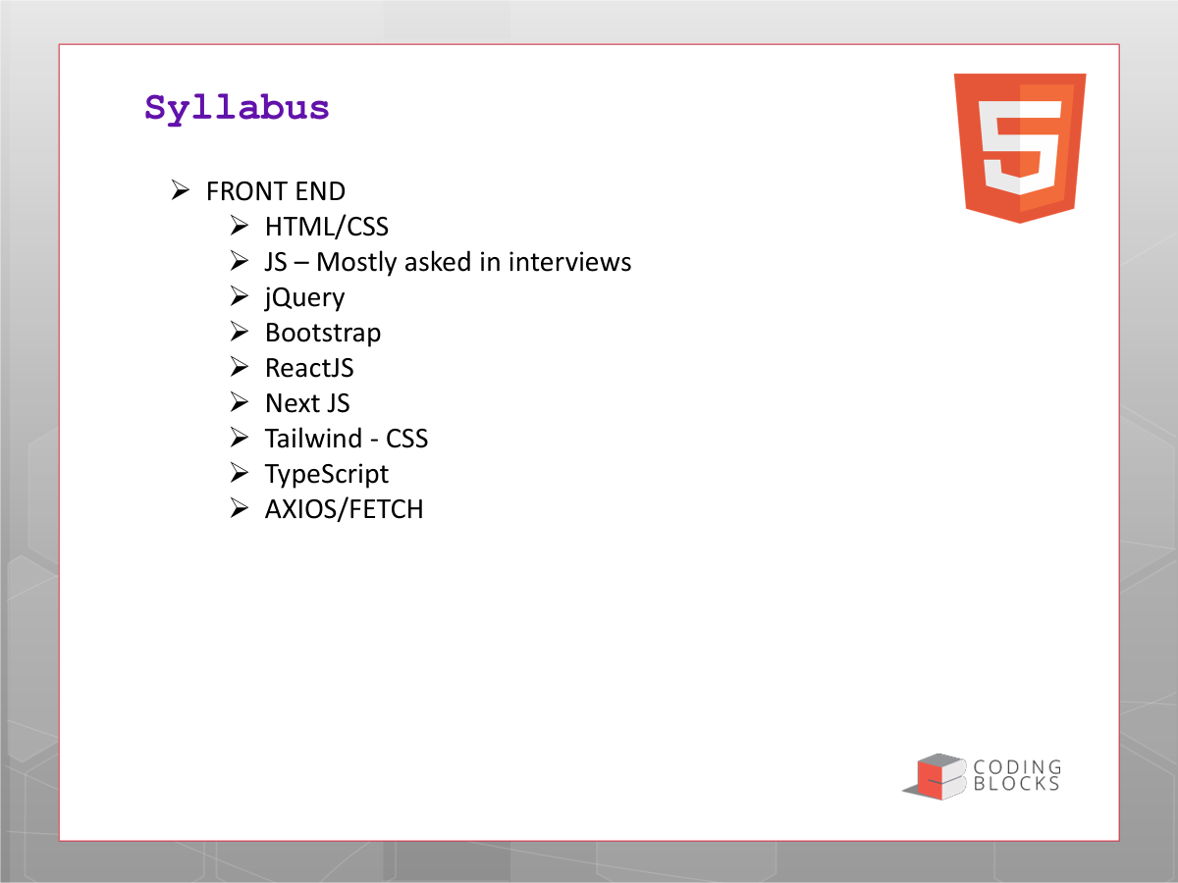


HTML Content Essentials
Practical HTML elements for media, embeds, symbols and forms
➤ Favicon and page-level browser details
➤ Marquee and tooltip concepts
➤ iframe, embed and external content
➤ Audio, video, maps and PDF files
➤ HTML symbols / character entities
➤ Forms and common input types
Goal: understand what each element does, when to use it, and its modern alternative.

Slide 2
Favicon
The small icon shown in the browser tab, bookmarks and browser UI
➤ A favicon gives your website a recognizable visual identity.
➤ Usually stored as favicon.ico, but PNG/SVG formats are also common.
➤ Place the <link> element inside <head>.
➤ Use a square image and keep the design simple at small sizes.
<head> <link rel="icon" href="/favicon.ico"> </head>
Tip: SVG favicons are useful when you want a scalable, crisp icon.

Slide 3
Marquee
Scrolling text/content across the page
➤ The <marquee> element creates scrolling content.
➤ It is easy to demonstrate, but it is obsolete/deprecated in modern HTML.
➤ It can create accessibility and usability problems because moving content is harder to read.
➤ Prefer CSS animations when movement is genuinely useful.
<marquee direction="left"> Welcome to our website! </marquee>
Interview point: know the tag, but also know that modern websites should use CSS instead.

Slide 4
Tooltip
Show helpful information when the user hovers over an element
➤ The simplest native tooltip uses the title attribute.
➤ It works on many elements such as links, buttons and images.
➤ For rich, styled or interactive tooltips, use CSS/JavaScript or an accessible component.
➤ Do not put essential information only inside a hover tooltip.
<button title="Save your changes"> Save </button>
Remember: title is a quick native tooltip, not a replacement for visible labels or instructions.

Slide 5
iframe & embed
Display content from another resource inside your page
IFRAME
➤ <iframe> embeds another HTML page or external resource.
➤ Common examples: maps, videos, dashboards and documentation.
➤ Always provide a meaningful title for accessibility.
<iframe src="https://example.com" title="Example content"></iframe>
EMBED
➤ <embed> can embed external resources such as PDFs.
➤ For modern applications, choose the element/API that best matches the content.
<embed src="guide.pdf" type="application/pdf">

Slide 6
Audio & Video
Native HTML5 media without third-party plugins
➤ <audio> plays sound files such as MP3, WAV or OGG.
➤ <video> displays video with controls, poster images and multiple source formats.
➤ controls lets the browser show play/pause, volume and progress controls.
➤ Use <source> when you want to provide fallback media formats.
<audio controls> <source src="song.mp3" type="audio/mpeg"> </audio>
<video controls width="480" poster="cover.jpg"> <source src="intro.mp4" type="video/mp4"> </video>
Accessibility: provide captions/subtitles for videos whenever applicable.

Slide 7
Embedding a Map
A map can be displayed using an iframe from a map provider
➤ Most map services provide a ready-to-use embed URL or iframe snippet.
➤ The map appears inside your page without building a map engine yourself.
➤ Use width/height responsively and give the iframe a useful title.
➤ For advanced map interactions, consider the provider's JavaScript Maps API.
<iframe src="MAP_EMBED_URL" width="100%" height="350" style="border:0" title="Office location"></iframe>
Practice: generate an embed link for a location and place it inside a responsive page.

Slide 8
Embedding a PDF
Let users view a PDF directly inside the browser
➤ A PDF can be displayed with <iframe>, <embed> or <object>.
➤ Always provide a normal download/open link as a fallback.
➤ Browser PDF support can vary, so do not assume every environment will render it.
<iframe\n src="docs/guide.pdf" width="100%" height="500" title="Product guide"></iframe>
<a href="docs/guide.pdf" download>Download PDF</a>
Best practice: give users both an in-browser preview and a clear download/open option.

Slide 9
HTML Symbols & Character Entities
Display reserved characters and useful symbols safely
➤ HTML uses character entities when a character has special meaning in markup.
➤ &lt; displays < and &gt; displays >.
➤ &amp; displays &, while &quot; displays a quotation mark.
➤ Named entities and numeric entities can represent many Unicode characters.
&copy; → ©&reg; → ®&trade; → ™&rarr; → →&hearts; → ♥&#8377; → ₹&lt; → <&gt; → >&amp;
Interview point: entities are especially important when displaying reserved HTML characters as text.

Slide 10
HTML Forms
Collect user input and send it for processing
➤ <form> groups controls and defines where/how the data is submitted.
➤ action specifies the destination URL; method is commonly GET or POST.
➤ <label> should be associated with its input using for + id.
➤ Use name attributes because they identify submitted form values.
<form action="/register" method="post">
<label for="email">Email</label>
<input id="email" name="email" type="email">
<button type="submit">Register</button>
</form>
Good form design = labels + correct input types + validation + clear submit action.

Slide 11
Common Input Types
Choose the input type that matches the data you need
➤ text — general short text
➤ email — email address
➤ password — masked password
➤ number — numeric value
➤ tel — telephone number
➤ url — web address
➤ search — search field
➤ date / time / datetime-local
➤ radio — one choice from a group
➤ checkbox — zero or more choices
➤ file — upload a file
➤ color — color picker
➤ range — slider value
➤ submit / reset / button
<input type="email">
<input type="date">
<input type="radio">
<input type="checkbox">
<input type="file">

Slide 12
Assignment: Build a Media Contact Page
Combine the concepts from this lesson in one small HTML page
➤ Add a favicon to the page.
➤ Create a tooltip on an important button or icon.
➤ Embed a map using an iframe.
➤ Add an audio player and a video player with controls.
➤ Show a PDF preview plus a download link.
➤ Create a contact form with name, email, phone, subject and message fields.
Challenge: make the page responsive and accessible, then validate the HTML.

