Slide 1
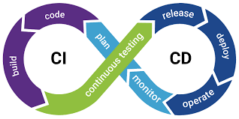
Continuous Integration (CI)
Developers frequently merge code into a shared repository
Automated builds and tests run on each change
Goal: detect bugs early
Continuous Delivery (CD)
Code changes are automatically prepared for release
Deployment is manual (approval step)

Slide 2
Why It Matters
Faster development cycles
Early bug detection
Improved collaboration
Reliable releases
Reduced manual errors

Slide 3
Traditional vs CI/CD Approach
Manual testing | Automated testing
Infrequent releases | Frequent releases
High risk | Low risk
Slow feedback | Fast feedback

Slide 4
Github Actions
GitHub Actions is a CI/CD tool built into GitHub.
Key Features:
Automate workflows
Run tests, builds, deployments
Event-driven execution
Supports multiple languages

Slide 5
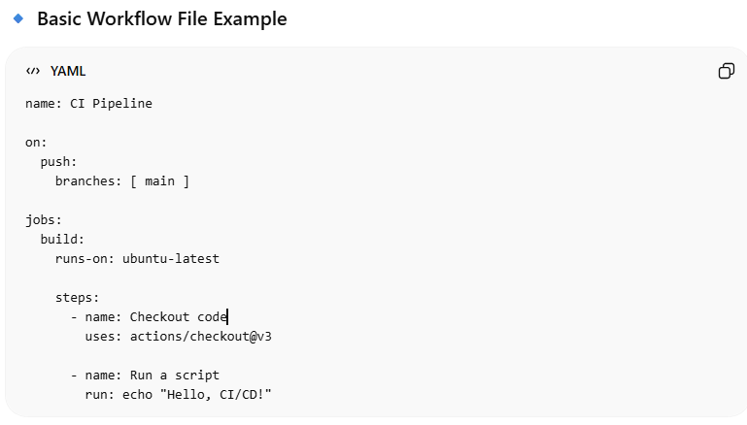
Workflow Syntax & Structure
take template to show
name: CI Pipeline
on:
push:
branches: [ main ]
jobs:
build:
runs-on: ubuntu-latest
steps:
- name: Checkout code
uses: actions/checkout@v3
- name: Run a script
run: echo "Hello, CI/CD!"

Slide 6
Workflow Keywords
Workflow Keywords
name → Workflow name
on → Trigger
jobs → Tasks ( grp of steps, can run parallel )
steps → Commands ( run sequentially )
Events (Triggers) : push , pull, workflow dispatch Runners: machine that executes jobs eg: ubuntu, window, mac, self-hosted runner

Slide 7
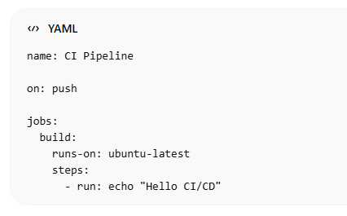
Practice Test
Workflow templates explain eg: Node.js
ENV: Repo → Settings → Secrets → Actions
Creating custom workflow in github action
name: CI Pipeline
on: push
jobs:
build:
runs-on: ubuntu-latest
steps:
- name: Say hello
run: echo "Hello CI/CD“

Slide 8
CI Pipeline Overview
Steps:
Checkout code
Install dependencies
Run tests
Build

