Slide 1
SQL
Installation
SQL Commands
SQL Constrains
Aggregate Function
Subquery
Joins
Interview Questions
ACID Property
SQL vs NoSQL, MongoDB vs CouchDB
Reference

Slide 2
Installation
https://youtu.be/hiS_mWZmmI0?si=S7_8rAssd1OZXEZv
db commads:
mysql –V
mysql –u root –p
Create|drop database db;
show databases;
use db;
show tables;
desc table_name;
exit

Slide 3
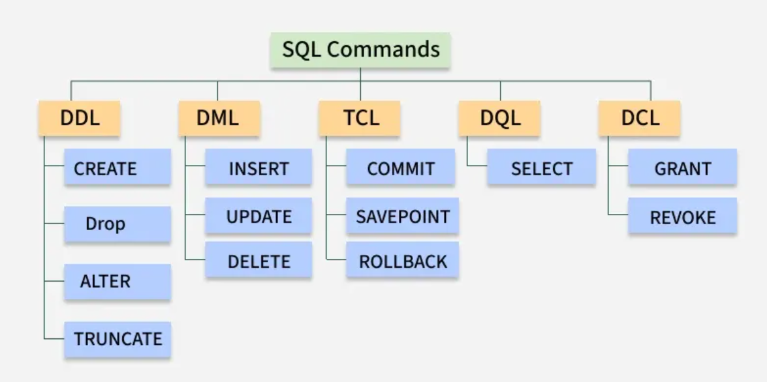

Slide 4
Alter Table
Add column
ALTER TABLE employees ADD email VARCHAR(100);
Modify column
ALTER TABLE employees MODIFY salary DECIMAL(10,2);
Rename column
ALTER TABLE employees CHANGE emp_name full_name VARCHAR(50);
Drop column
ALTER TABLE employees DROP email;

Slide 5
Aggregate Functions
SELECT COUNT(*) FROM employees;
SELECT AVG(salary) FROM employees;
SELECT SUM(salary) FROM employees;
SELECT MAX(salary) FROM employees;
SELECT MIN(salary) FROM employees;
// order by _ desc, limit, as, concat

Slide 6
Primary/Foreign key
CREATE TABLE departments (
dept_id INT PRIMARY KEY, //id INT AUTO_INCREMENT PRIMARY KEY,
dept_name VARCHAR(50) UNIQUE NOT NULL
);
CREATE TABLE employees (
emp_id INT PRIMARY KEY,
emp_name VARCHAR(50) NOT NULL,
age INT CHECK (age >= 18),
salary DECIMAL(10,2),
dept_id INT,
email VARCHAR(100) UNIQUE,
FOREIGN KEY (dept_id) REFERENCES departments(dept_id)
);

Slide 7
Seed Data
Insert Departments
INSERT INTO departments VALUES
(1, 'HR'),
(2, 'Engineering'),
(3, 'Sales');
Insert Employees
INSERT INTO employees VALUES
(101, 'Aman', 25, 40000, 2, 'aman@mail.com'),
(102, 'Riya', 28, 50000, 2, 'riya@mail.com'),
(103, 'Karan', 35, 60000, 1, 'karan@mail.com'),
(104, 'Sneha', 30, 45000, 3, 'sneha@mail.com'),
(105, 'Rohit', 26, 38000, NULL, 'rohit@mail.com');

Slide 8
Joins
Inner Join:
SELECT e.emp_name, d.dept_name
FROM employees e
INNER JOIN departments d
ON e.dept_id = d.dept_id;
Left Join: SELECT e.emp_name, d.dept_name
FROM employees e
LEFT JOIN departments d
ON e.dept_id = d.dept_id;
Right Join:
SELECT e.emp_name, d.dept_name
FROM employees e
RIGHT JOIN departments d
ON e.dept_id = d.dept_id;
Full Join: SELECT e.emp_name, d.dept_name
FROM employees e
LEFT JOIN departments d ON e.dept_id = d.dept_id
UNION
SELECT e.emp_name, d.dept_name
FROM employees e
RIGHT JOIN departments d ON e.dept_id = d.dept_id;

Slide 9
Interview Ques.
Q1 Average salary of employees in each department.
SELECT dept_id, AVG(salary) AS avg_salary
FROM employees
GROUP BY dept_id;
Q2 Employee names whose salaries are above than average salary of employee.
SELECT emp_name, salary
FROM employees
WHERE salary > (SELECT AVG(salary) FROM employees);
Q3 Second highest salary
SELECT MAX(salary)
FROM employees
WHERE salary < (SELECT MAX(salary) FROM employees);

Slide 10
SQL NoSQL MongoDB CouchDB
Feature | MongoDB | CouchDB
Schema | Schema-less | Schema-less
Performance | High performance | Moderate
Indexing | Advanced indexing | Limited indexing
Cost | Services | Free
Offline Support | Limited | Excellent
Conflict Handling | App-level | Built-in
Use Case | High-traffic apps | Offline-first apps
Popularity | Very high | Niche

Slide 11
Home Work
Views
Store Procedure
Normalization (1/2/3NF)
References
https://www.sql-practice.com/ ( sql practice platform )
https://youtu.be/SSKVgrwhzus?si=eqqmy054WtuonB-e ( sql tutorial )

