Slide 1
Exploratory Data Analysis (EDA)
Analysis of the Hotel Booking Dataset

Slide 2
Introduction
This presentation explores the dataset using statistical analysis and visualizations.
Key aspects covered include data structure, missing values, distributions, and correlations.

Slide 3
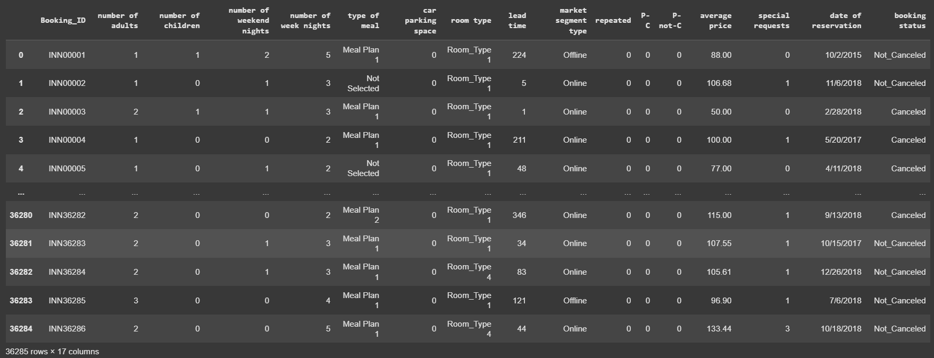
Dataset Overview
Total Rows: 36,285
Total Columns: 17
Key Features:
Booking details (lead time, number of nights, special requests)
Customer details (number of adults, children)
Pricing and cancellation status

Slide 4

Data Types & Missing Values
No missing values were found in the dataset.
The dataset contains:
Numerical columns: e.g., lead time, average price, special requests
Categorical columns: e.g., room type, booking status

Slide 5
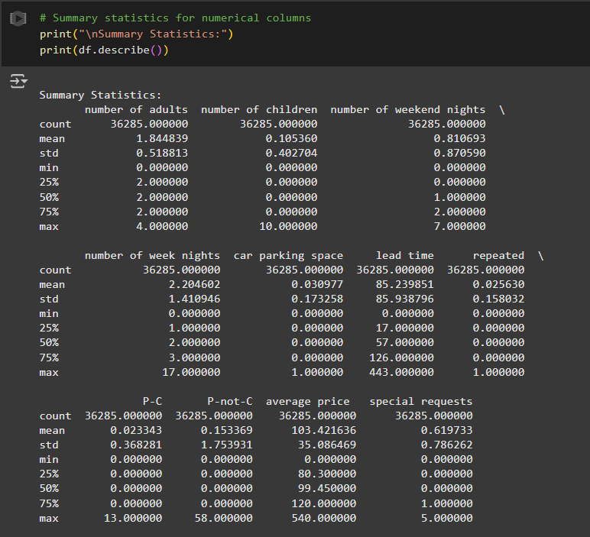
Summary Statistics
Lead Time:
Ranges from 0 to 443 days
Median lead time is 57 days
Average Price:
Mean price is $103
Maximum price is $540
Booking Trends:
Most bookings have 2 adults
Many bookings have 0 special requests

Slide 6
Booking Status Distribution
The dataset contains both canceled and non-canceled bookings.
A count plot reveals the proportion of each booking status.
Cancellation rates are influenced by factors like lead time and pricing.

Slide 7

Lead Time Analysis
A histogram shows most bookings are made within 0-150 days before check-in.
Bookings with long lead times are less frequent.
Price Distribution
The majority of bookings fall within the $80-$120 price range.
A few high-value outliers exist, reaching up to $540.

Slide 8
Correlation Insights
Lead time vs. Cancellation:
Longer lead times slightly increase the likelihood of cancellations.
Special Requests:
Have minimal impact on price and booking status.
Parking Space & Price:
No strong correlation between car parking space and total price.

Slide 9
Conclusion
EDA provides insights into booking behaviors, pricing, and cancellation trends.
The findings can help optimize pricing strategies and improve cancellation predictions.
Future analysis can focus on predictive modeling to forecast cancellations.

