Slide 1
Bengaluru Smart Mobility Intelligence
• Real Bengaluru traffic, weather, road-safety and enforcement data
• Forecasts, what-if estimates, hotspot and risk analytics, Streamlit app
• AI/ML capstone

Slide 2
Problem and data
• Two tasks: forecast tomorrow's congestion; estimate congestion under given conditions
• Traffic: 8,936 road-days, 16 roads, 2022-01-01 to 2024-08-09
• Weather = features; crashes and BTP enforcement = insight datasets
• Vision module (BMD-45 + YOLO) as an optional extension

Slide 3
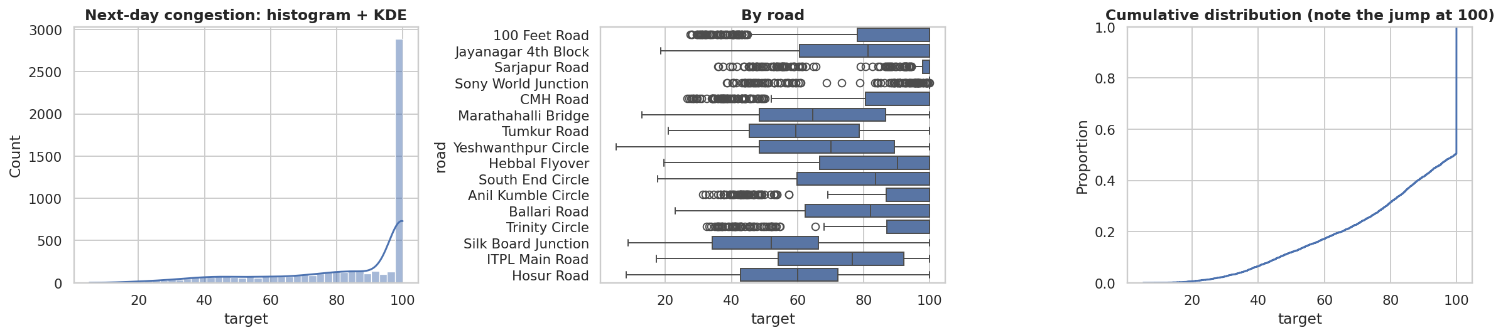
A data-leakage audit changed the results
• Old target: only 70% truly next-day; 50% at the ceiling of 100
• Interpolated 'today' rows leaked tomorrow's value (R² looked ~3x better)
• Random split replaced by chronological split
• Environmental Impact = duplicate of Traffic Volume

Slide 4
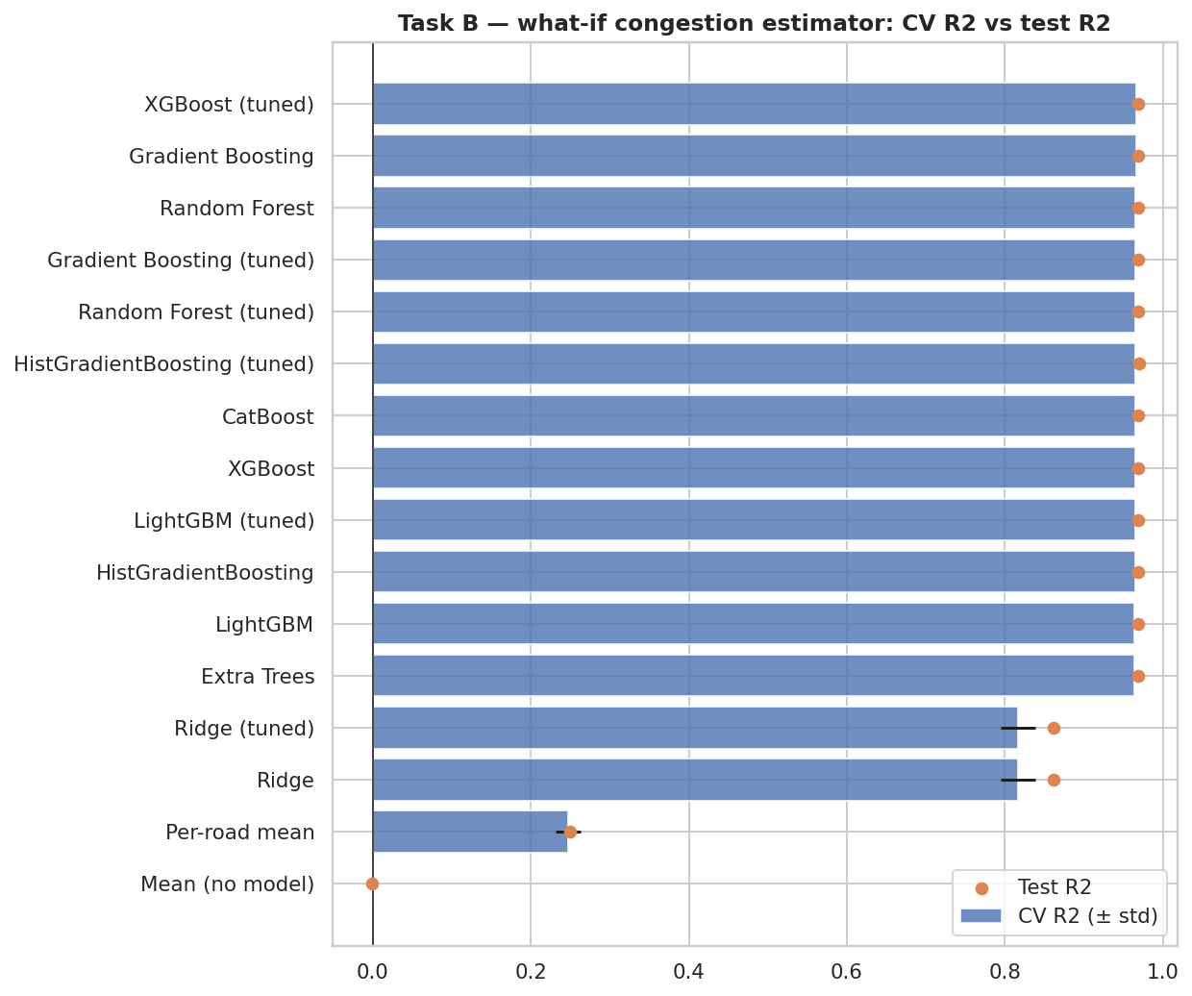
Model results
• What-if estimator (Random Forest): R² 0.969, MAE 2.8 (volume alone: 0.968)
• Tomorrow forecast (Ridge (tuned)): R² 0.179 vs road-average 0.179
• Severe-congestion alert: AUC 0.72
• 8 algorithms compared, tuned, time-series cross-validated; simplest model within 1 SE chosen

Slide 5
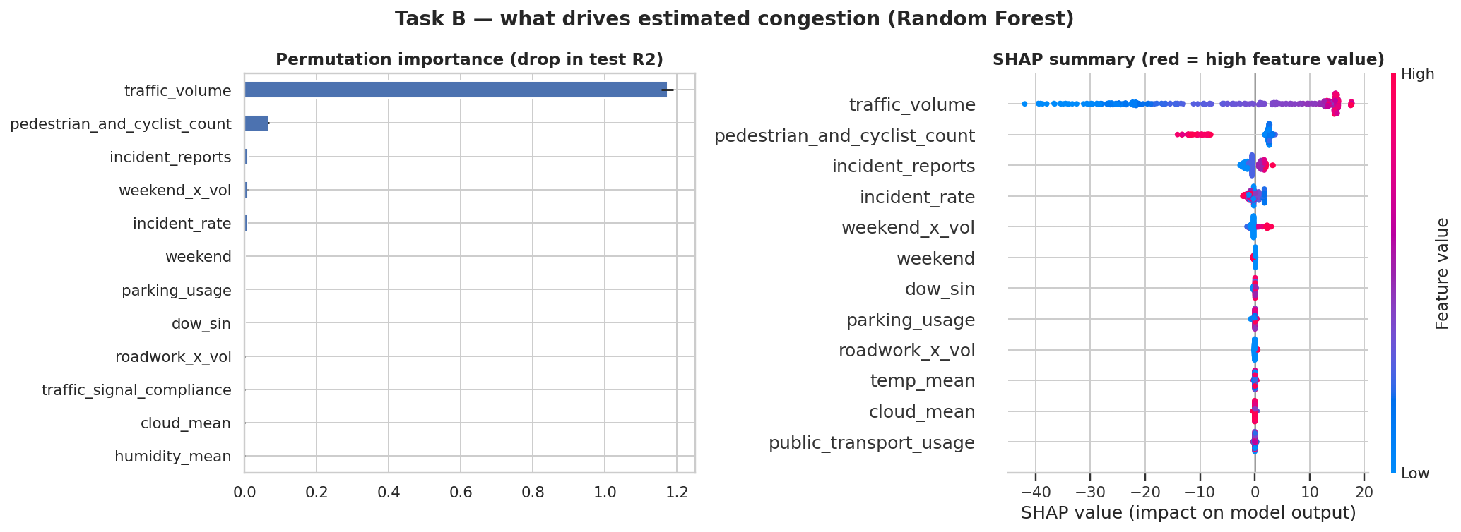
Explainable AI
• traffic_volume: a higher value increases predicted congestion (mean |SHAP| 15.79) — more vehicles on the road raise congestion
• pedestrian_and_cyclist_count: a higher value decreases predicted congestion (mean |SHAP| 3.75) — pedestrian-heavy streets are typically lower-vehicle streets, so the link can be negative
• incident_reports: a higher value increases predicted congestion (mean |SHAP| 1.36) — breakdowns and accidents block lanes and slow the whole corridor
• incident_rate: a higher value decreases predicted congestion (mean |SHAP| 0.78) — incidents per 10k vehicles (risk normalised for exposure)

Slide 6
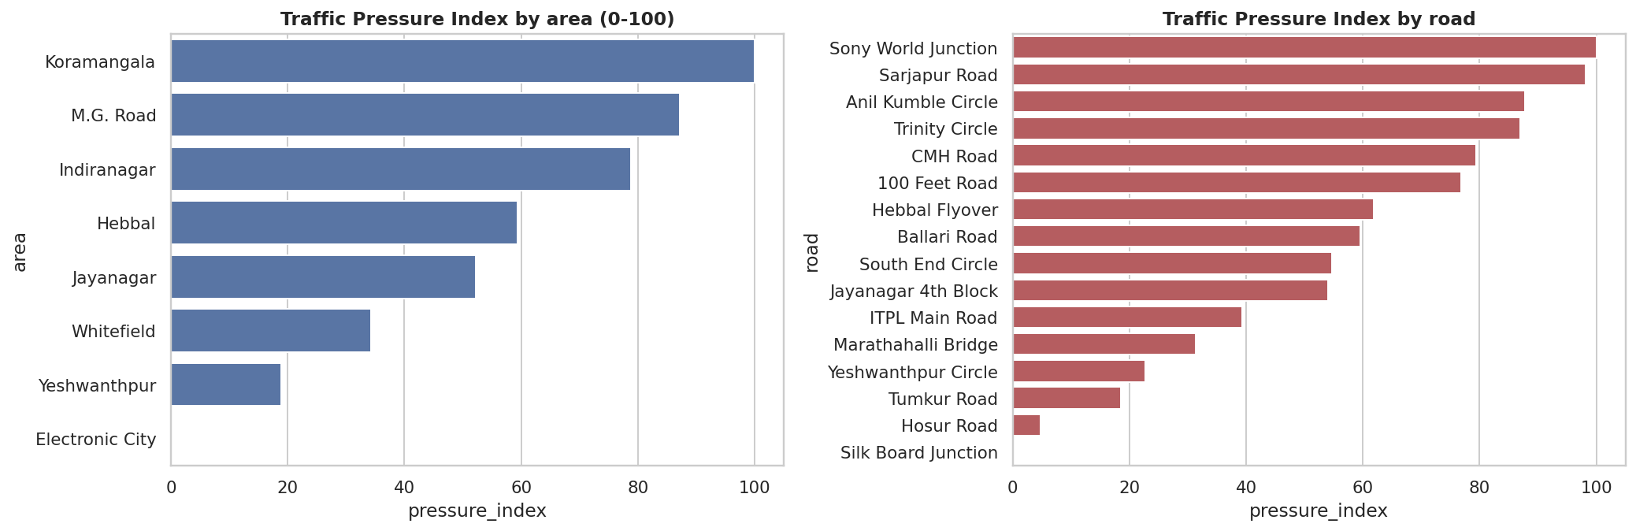
Mobility intelligence
• Highest traffic pressure: Koramangala (index 100/100) among areas; Sony World Junction (Koramangala) among roads (index 100).
• 44% of road-days sit at the congestion ceiling of 100; saturation ranges from 3% to 77% across roads — WHICH road it is explains 19% of next-day congestion variance.
• Time patterns: weekday differences are not detectable (p=0.90, range 1.1 pts); monthly not detectable (p=0.77); seasonal not detectable (p=0.50).
• Capacity utilisation and congestion move together (Spearman +0.80): congested roads are the ones that are already full.

Slide 7
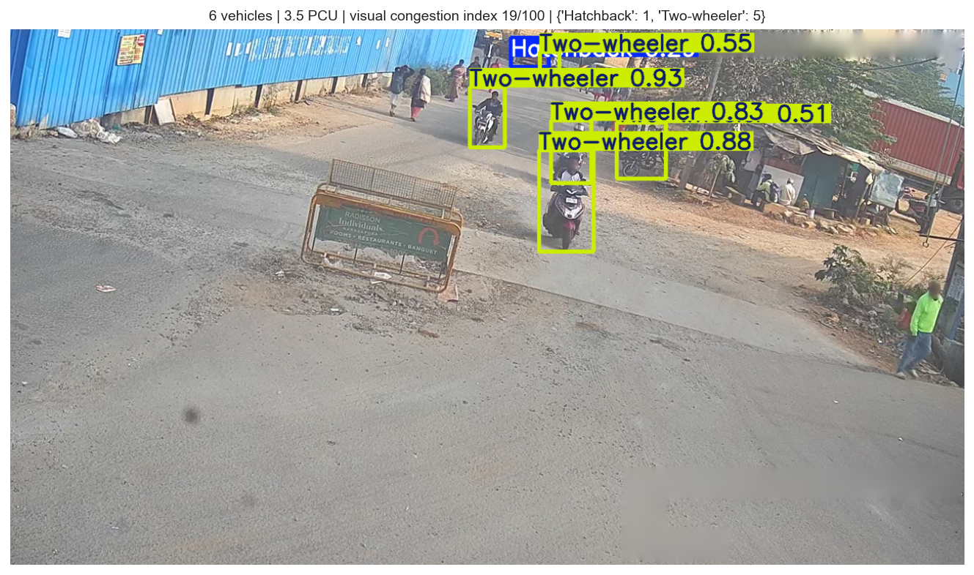
CCTV vehicle detection (YOLO + BMD-45)
• YOLO11n, 14 vehicle classes; mAP50 0.56, mAP50-95 0.45
• PCU load from detections tracks the annotated load (r = 0.93, MAE 2.3 PCU)
• PCU-weighted visual congestion index (0-100) per frame
• Streamlit CCTV tab: image upload, video clip, live stream URL; fused into the priority report

Slide 8
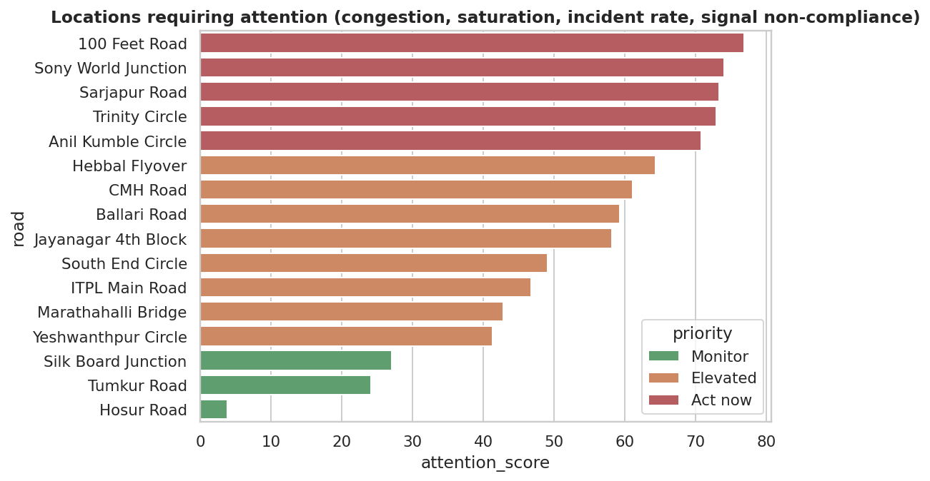
Hotspots and risk
• Highest attention: 100 Feet Road, Sony World Junction, Sarjapur Road
• Roadwork effect on congestion vs the road's own average: -0.8 pts (95% CI -2.2 to +0.7), not detectable.
• Road safety: 878 killed in 2025 vs peak 981 in 2007; fatality rate 17.9 killed per 100 crashes.
• Enforcement: 6.99 million cases in 2025, of which 88% automated; forecast 8.09 million next year.

Slide 9
Dashboard and deployment
• Interactive Plotly dashboard (5 sections) + standalone HTML
• Streamlit app: prediction, CCTV detection tab, analysis tabs, explainability
• Shared feature code prevents train/serve skew
• Deploy: Streamlit Community Cloud or Hugging Face Spaces

Slide 10
Limitations and next steps
• Tomorrow's congestion is mostly the road's usual level plus noise
• Congestion capped at 100; 16 roads; small yearly tables; associations not causation
• Next: more roads/years, live weather API, camera-based congestion index, per-road models

