Slide 1

HACKATHON
TEAM NO:03
ADAPTIVE PERSONALIZED CARDIOLOGY CARE
K MOHEDHAA SHRI-9923005209
V ASMITHA SHREE-9923005258

Slide 2
Problem Statement
Patients often lack access to:
Continuous monitoring of vital heart parameters
Real-time visual alerts during abnormal conditions
Simple and interactive dashboards for understanding heart health
Systems that interpret data like cholesterol, chest pain type, blood pressure, and heart rate
Hence, there is a need for a user-friendly system that monitors, visualizes, and alerts heart abnormalities in real time.

Slide 3
Objectives
To design a real-time heart monitoring dashboard using Python Tkinter
To visualize heart parameters like cholesterol, BP, chest pain, heart rate, FBS, ECG type.
To provide instant visual alerts for abnormal values
To enable easy interpretation through graphs, blinking indicators, and colors

Slide 4
Proposed Solution
Loads health data from heart.csv
✅ Provides real-time line graphs (Matplotlib)
✅ Offers health alerts using colors, text, sound, and icons
✅ Simple UI that runs on cloud (Replit/Colab/CodeSpaces)

Slide 5
Dashboard Features
Health Parameter Display
Chest pain type
Blood pressure
Cholesterol
Fasting blood sugar
Rest ECG
Maximum heart rate
Heart rate vs time
BP vs time
Cholesterol trend
High BP alert
High cholesterol alert
High/low heart rate alarm
Optional sound alert (winsound/beep)

Slide 6
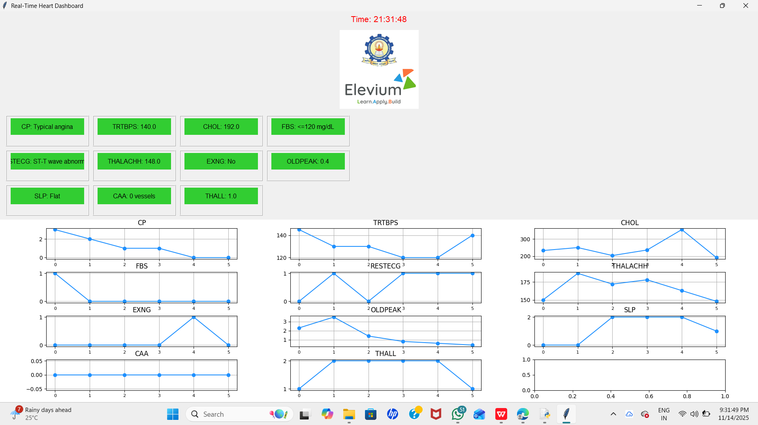

Slide 7
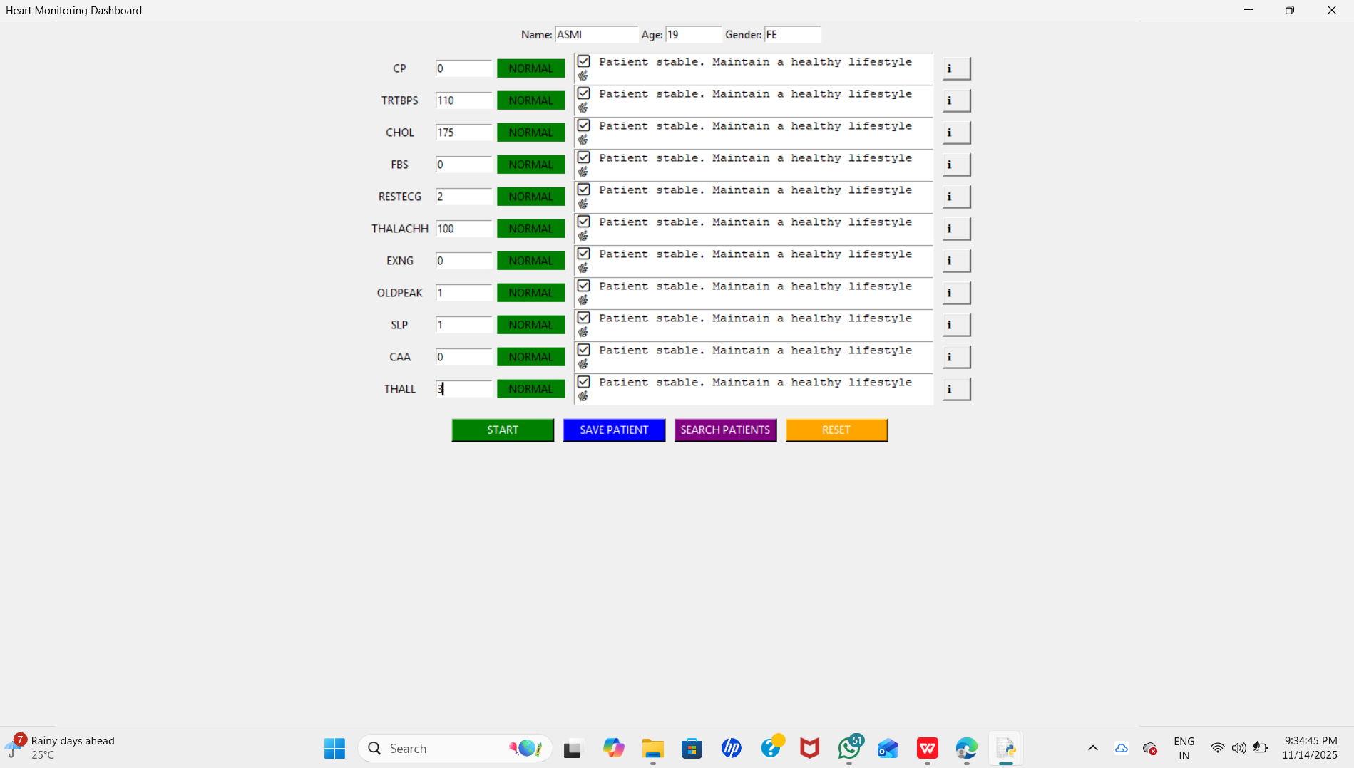

Slide 8
Advantages
Real-time Visualization –
Makes analysis easy
Intuitive and User-friendly dashboard
Medical data interpretation becomes simple
No special hardware required
GIF animation improves user engagement
Easy to deploy on cloud and offline
Helps early detection of abnormal cardiac patterns

Slide 9
Future Enhancements
Integration with wearable sensors (Smartwatch, ECG patch)
Live camera analysis for face color/oxygen detection
AI-based risk prediction using ML models
Cloud database for remote doctor monitoring
Mobile app version of the dashboard
Voice Alerts (“Warning: High Cholesterol”)

Slide 10
Github link
https://github.com/MohedhaaShri/Adaptive-cardiology-monitoring-

Slide 11
CONCLUSION
The developed system successfully demonstrates a digital heart monitoring dashboard that uses:
Real-time visualization
Data-driven alerts
Graphical health insights

