Slide 1
Time Frame Expansion
(Extended D-Algorithm)
Mohee Datta Gupta (2018112005)
Pawankumar Gururaj Yendigeri (2020702006)

Slide 2
Sequential ATPG
Sequential ATPGs are much more complex than Combinational ATPGs even though they give lower fault coverage
Worst case time complexity for a Sequential ATPG is
O(2^^{(no. Of PI)} * 9^^{(no. Of FF)})

Slide 3
Idea Behind Time Frame Expansion
Saving time complexity by using up memory
Using more memory in a clock cycle and saving total no. of clock cycles required for testing
We divide each state of the circuit into an individual “time frame”.
Assumptions:
We consider the faults to be present only in the Combinational Part of the circuit
We consider only Single Stuck-at-Faults
Controllability of Seq. Nodes are initialised with infinity contrary to Comb. circuits where it is 1

Slide 4
Different Approaches to Time Frame Expansion
Extended D-Algorithm Methods [ Kubo 68]
9-Valued D Algorithm [Muth 76]
EBT [Marlett 78] , BACK [ Cheng 88]

Slide 5
Extended D-Algorithm
Select a target fault
Create a copy of the Comb. logic and set is at stage 0 (time frame 0)
Try to propagate the fault (D or D’) to primary output
If not possible to propagate after ‘n’ time frames, declare “untestable”
If possible try continue justification from stage 0 to previous stages
If justification is not possible after ‘k’ stages, declare “untestable”
For our project we took n=2 and k=1

Slide 6
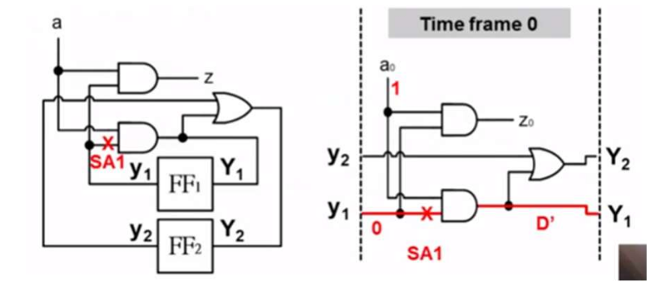

Example 1

Slide 7
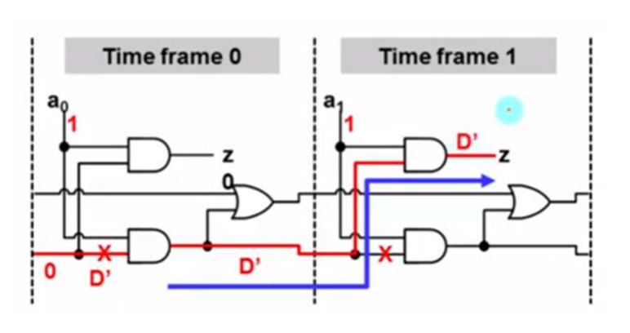

Slide 8
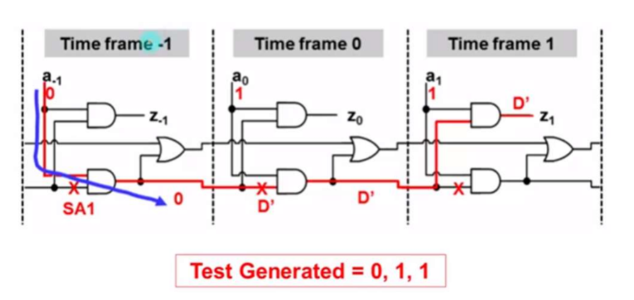

Slide 9
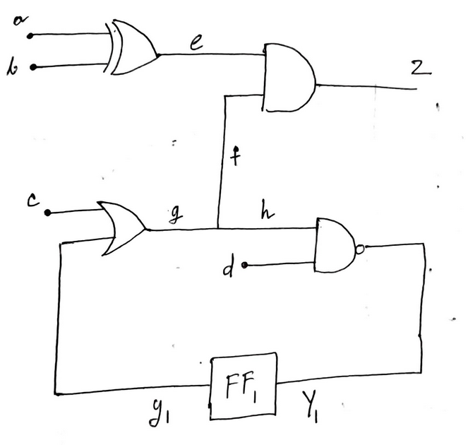
Example 2
h-SA0
X

Slide 10
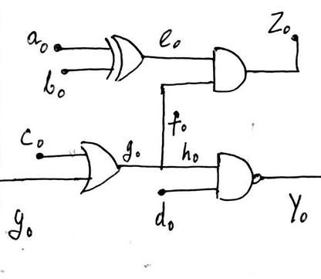
1
D
1
X
D’
1
a0b0c0d0=xx11

Slide 11
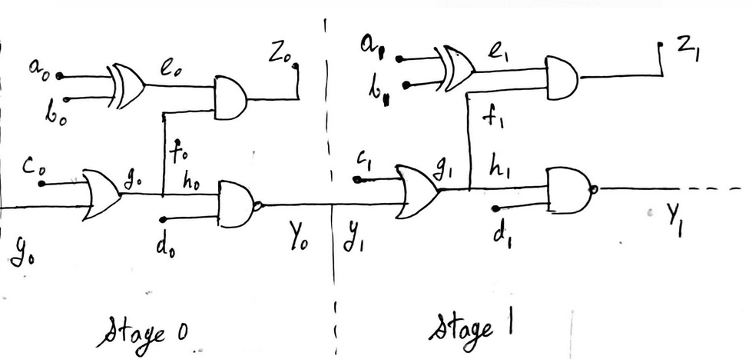
1
1
D’
0
D’
0
D’
D’
a1b1c1d1=100x

Slide 12
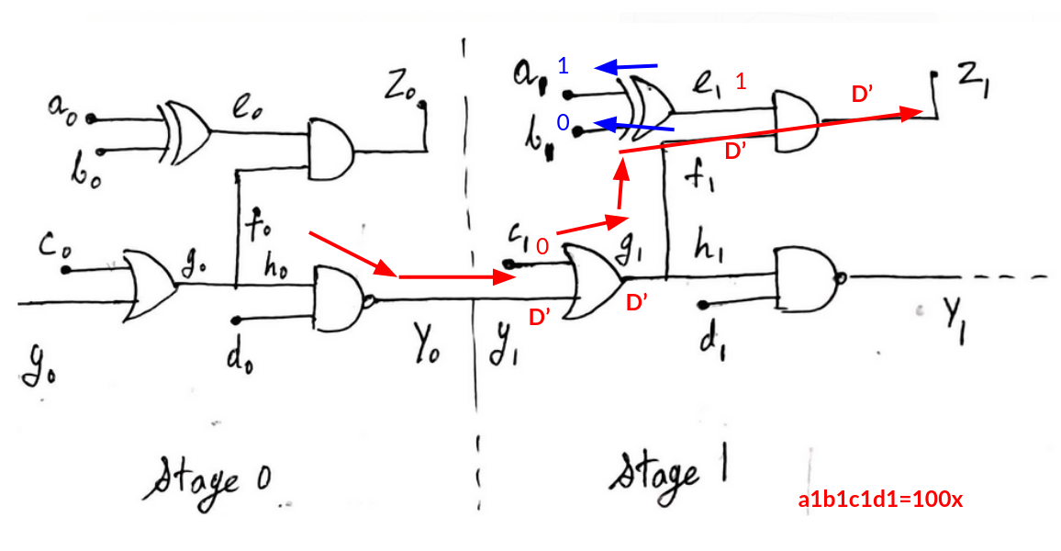
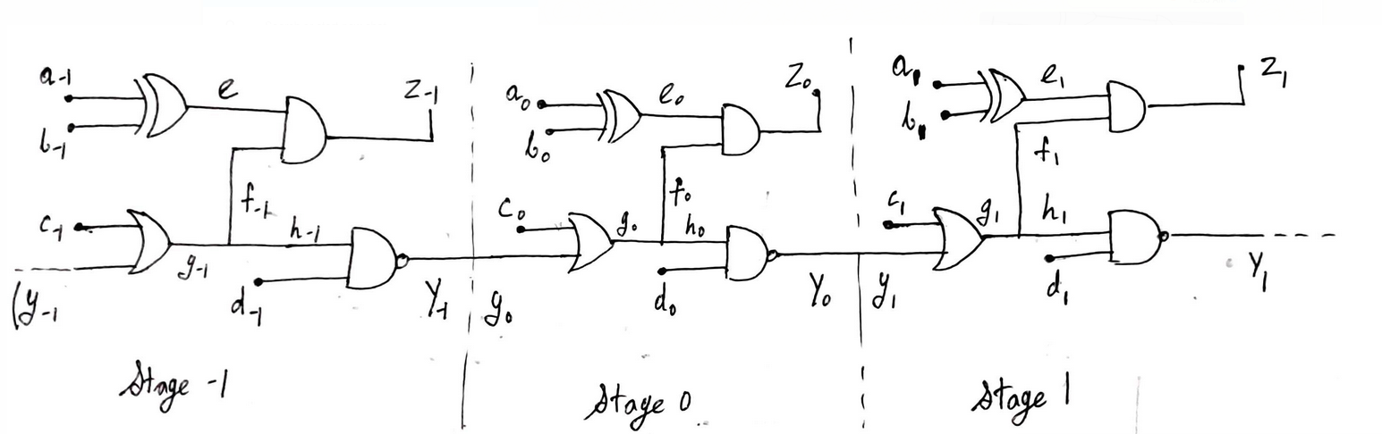
1
a0b0c0d0=xx11
Not required(already justified)
abcd = xx11 , 100x or xx11 , 010x detects h-SA0

Slide 14
Assumptions in Our Implementation
As each fault had to be forced to undergo S-A conditions, we had to stimulate conditions for each fault location manually.
Our code is circuit specific and does not work for any general circuit.

Slide 15
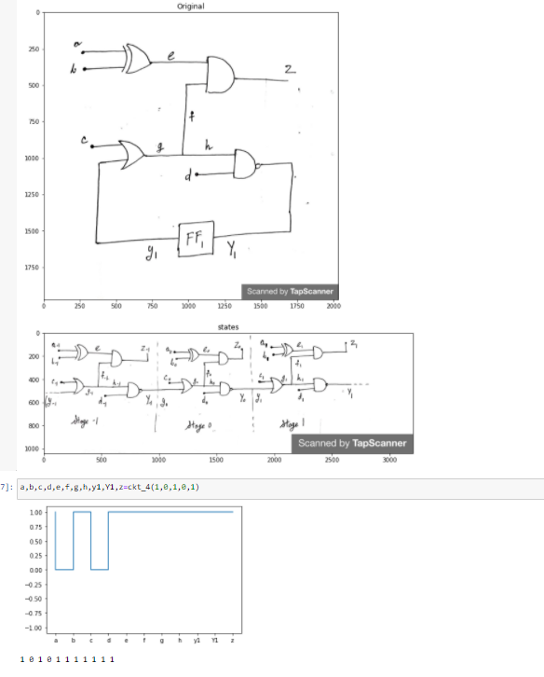
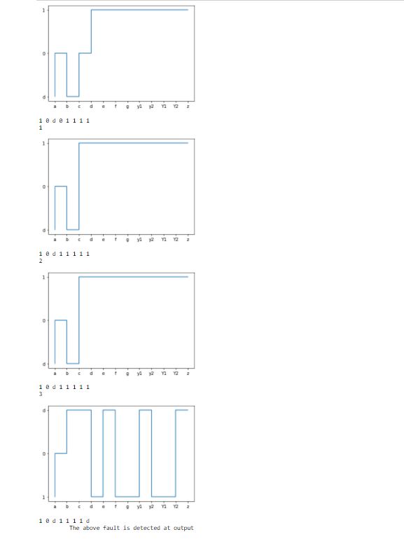

Slide 16
Future Scope
We can convert each circuit into graphs and apply a recursive algorithm on the graph to generate a more general ATPG
We can increase the “n” and “k”

Slide 17

Thank You!
GitHub repo:link

