Slide 1
Developing a Code Review Strategy Using LLMs and Acceptance Tests in Python
University of Echahid Hamma Lakhdar - EL Oued
Presented by :
- Mohieddine MATALLAH
Supervised by :
- Dr. Mohammed Mounir BOUHAMED
- Dr. Ahmed GHENABZIA
-Academic year: 2024/2025-

Slide 2





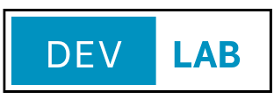
01
GENERAL PRESENTATION
PROJECT TITLE
Developing a Code Review Strategy Using LLMs and Acceptance Tests in Python
PROJECT LOGO

Slide 3
01
GENERAL PRESENTATION
CONTACT INFORMATION
Nom du responsable(01):
- Dr. BOUHAMED Mohammed Mounir
Fonction:
- Reseaux et Systemes Distribues
Email:
- bouhamed-mohammedmounir@univ-eloud.dz
Numéro de téléphone:
- 0676512199
Nom du responsable(02):
- Dr. GHNEBZIA Ahmed
Fonction:
- Intelligence artificielle
Email:
- a_ghenabzia@esi.dz
Numéro de téléphone:
- 0557100777

Slide 4
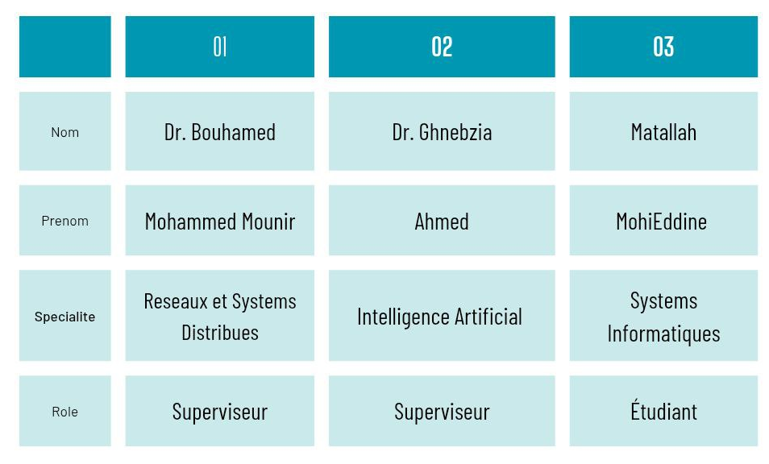
03
THE TEAM
PRESENTATION OF MEMBERS:

Slide 5
02
PROJECT SUMMARY
Problem: Within collaborative coding platforms, the lack of clear and effective code review strategies hinders code quality, slows integration, and can introduce vulnerabilities.
Solution: Our project aims to develop and integrate optimized code review strategies within these platforms. By equipping contributors with clear guidelines, decision-making tools, and collaborative processes, we facilitate faster, more thorough, and more constructive reviews.
Expected Impact: Significant improvement in code quality, reduction of errors and security risks, acceleration of development cycles and fostering a culture of collaboration and continuous learning within development teams.

Slide 6
04
TARGETED PROBLEM
THE PROBLEM IDENTIFIED: Optimizing Code Review and the Consequences of Ineffective Code Review
1- Time and Resources:
A Google study found that in-depth code reviews can consume up to 15% of total development time. Without an optimized strategy, this time can be wasted on unconstructive discussions or late identification of major issues.
According to an analysis by SmartBear, 56% of developers believe that code review is sometimes a "bottleneck" in their development process.

Slide 7
04
TARGETED PROBLEM
2- Code Quality and Bugs:
Research has shown that rigorous code review can reduce the number of bugs introduced into production by 20% to 30%. The lack of a clear strategy inevitably leads to an accumulation of technical debt and an increase in production incidents.
An internal case study at Microsoft showed that adopting systematic code review practices resulted in a 10% decrease in post-release bug fixes.
3- Collaboration and Knowledge:
A survey conducted by Atlassian indicated that only 43% of developers believe their current code review process actively promotes knowledge sharing within the team. A lack of a collaborative strategy hinders mutual learning and skill homogenization.

Slide 8
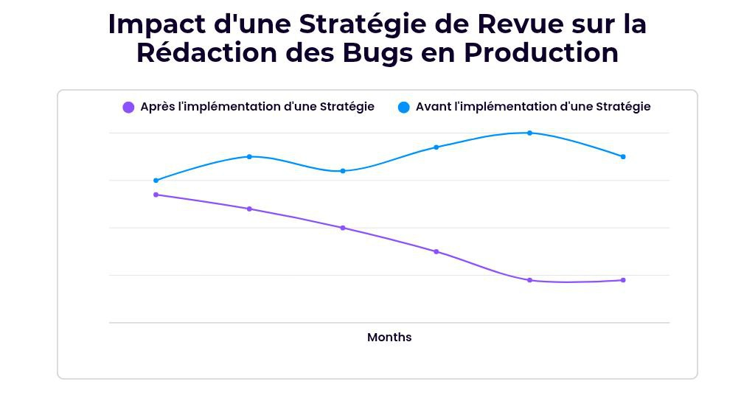
04
TARGETED PROBLEM
1- Linear Graph (Inspired by Google and Microsoft studies):
The studies mentioned (Google and Microsoft) observed similar trends after improving their code review processes.

Slide 9
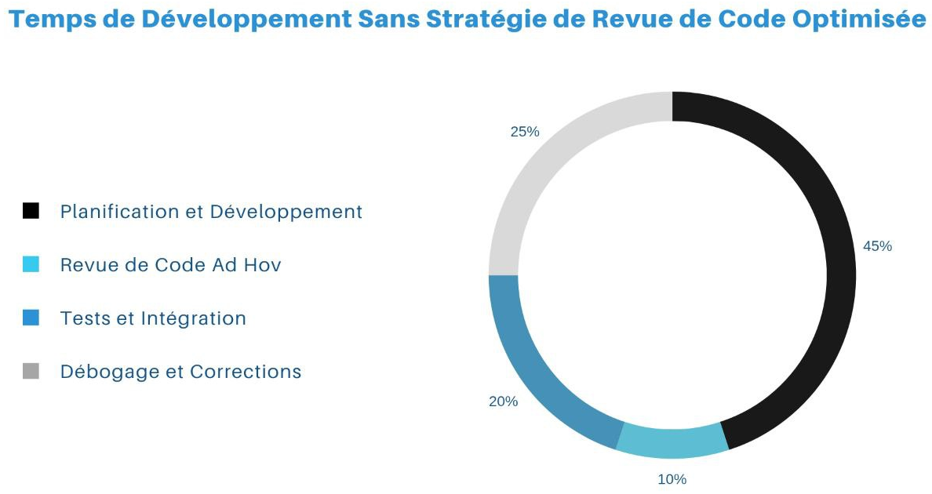
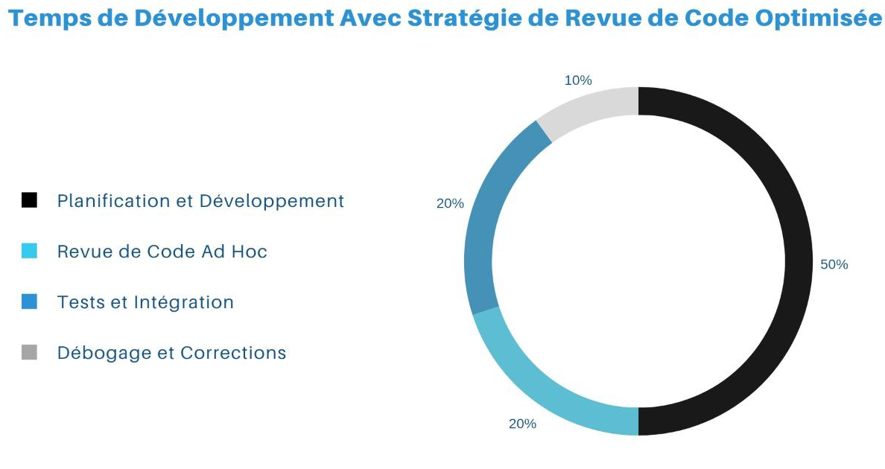
04
TARGETED PROBLEM
2- Pie Chart (Based on SmartBear analysis):
SmartBear's analysis of the perception of code review as a bottleneck suggests an imbalance in time allocation.

Slide 10
05
THE PROPOSED SOLUTION
Our Proposal: Revolutionize Collaborative Code Review with Artificial Intelligence.
We transform code review into a collaborative and intelligent experience that goes beyond simple inspection. Our platform integrates strategic intelligence that analyzes code in depth to provide contextual insights and relevant suggestions. Uniquely, it actively identifies testing needs and assists developers in creating effective test cases, fostering a culture of quality by design.
Our unique approach lies in this dual approach: context-enriched code review and intelligent test generation assistance. By analyzing code changes, our system can suggest relevant test types or even generate test skeletons to accelerate the adoption of TDD (Test-Driven Development) practices and ensure optimal test coverage.
This synergy between intelligent review and test generation helps detect critical issues earlier, reduce unproductive review time, and, most importantly, inherently improve the quality and reliability of delivered code. Seamless integration into existing platforms ensures rapid adoption and a measurable impact across the entire development lifecycle.

Slide 11
06
PRESENTATION OF THE PROTOTYPE
LINK TO THE PROJECT WEBSITE:
PROTOTYPE WEB SITE LINK
https://www.dev-lab.fun/
LINK TO PROJECT VIDEO:
PROTOTYPE VIDEO LINK
https://drive.google.com/drive/folders/1c4EzESEppUjTQG40YeAmk0G_vNeLXVBX?usp=drive_link

Slide 12
07
PATENTS, TRADEMARKS AND INTELLECTUAL PROPERTY RIGHTS
STATUS OF INTELLECTUAL PROPERTY
REGISTERED TRADEMARKS OR DESIGNS:
- Registration in progress
COPYRIGHT OR LICENSES:
- Copyright: The source code, user interface, documentation, and any other creative content developed by our team will be protected by copyright from the moment of creation. We will claim intellectual property rights to our platform.
- User License: We will distribute our software under a proprietary (commercial) license as part of our SaaS model. This license will define subscribers' rights to use our platform, usage restrictions (e.g., number of users, projects), and prohibit unauthorized reproduction, distribution, or modification of our software. The terms of this license will be specified in our terms of service and subscription agreements.
- Trademarks and Logos: Our project name, logo and any other distinctive elements will be protected by registered trademarks to strengthen our identity and avoid any confusion in the market.

Slide 13
08
ADDED VALUE
Our collaborative code review strategy solution is designed to generate significant and measurable value for our clients:
Significant Time Savings: By optimizing and structuring the review process, we significantly reduce the time spent identifying and correcting errors. Faster, more targeted reviews mean faster development cycles and faster time to market for your products and features.
Substantial Cost Savings: Reducing bugs in production reduces the costs of urgent fixes, downtime, and lost team productivity. Higher code quality from the start minimizes technical debt and future maintenance and refactoring expenses.
Accelerated Innovation: By freeing up time and resources through efficient code review, your teams can focus more on innovation and developing new, high-value features, strengthening your competitive advantage.
In summary, our collaborative code review strategy is a strategic investment that results in concrete gains in terms of time, money and innovation capacity for our clients.

Slide 14
09
COMPETITIVE ANALYSIS
Direct Competitors:
GitHub Reviews, GitLab Merge Requests, Bitbucket Pull Requests. These platforms have the advantage of being already integrated into developers' workflows. However, their primary focus remains version control, and their code review tools are often basic, focusing on presenting differences without much intelligent context.
Gerrit, Phabricator. These tools are more focused on code review and offer more advanced features than integrated platforms. However, they require separate installation and management, which can be a barrier to adoption for some teams. Additionally, they often lack the seamless integration with the overall project context found in version control platforms.

Slide 15
09
COMPETITIVE ANALYSIS
Indirect Competitors:
Tools like SonarQube or linters help identify code issues, but they don't replace human review for business logic and context. They can complement our solution.
Manual Approaches: Email or meeting reviews are time-consuming, inefficient, and difficult to track. Our solution offers a structured and integrated alternative.

Slide 16
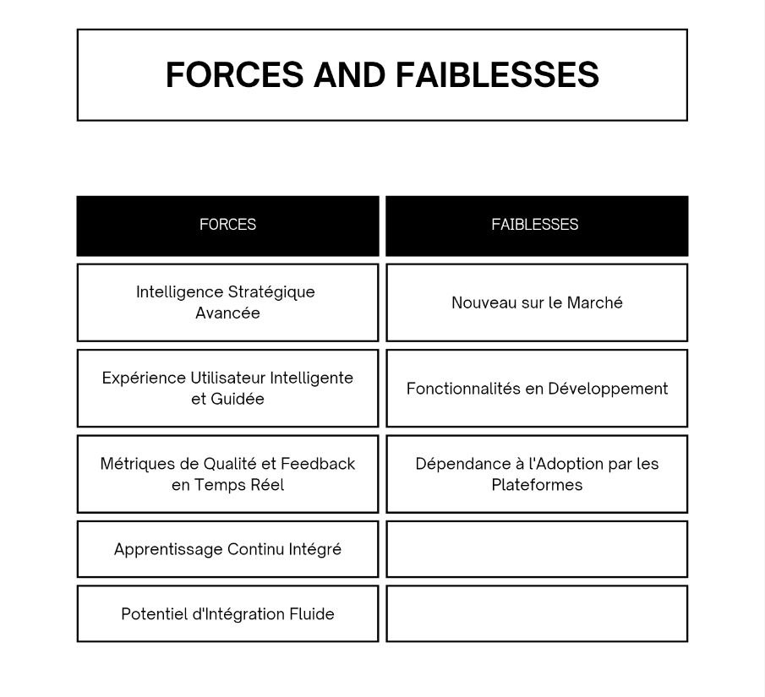
09
COMPETITIVE ANALYSIS
Our SWOT Analysis Against the Competition: Our Strengths, Our Challenges, Our Opportunities:
Strengths and Weaknesses:

Slide 17
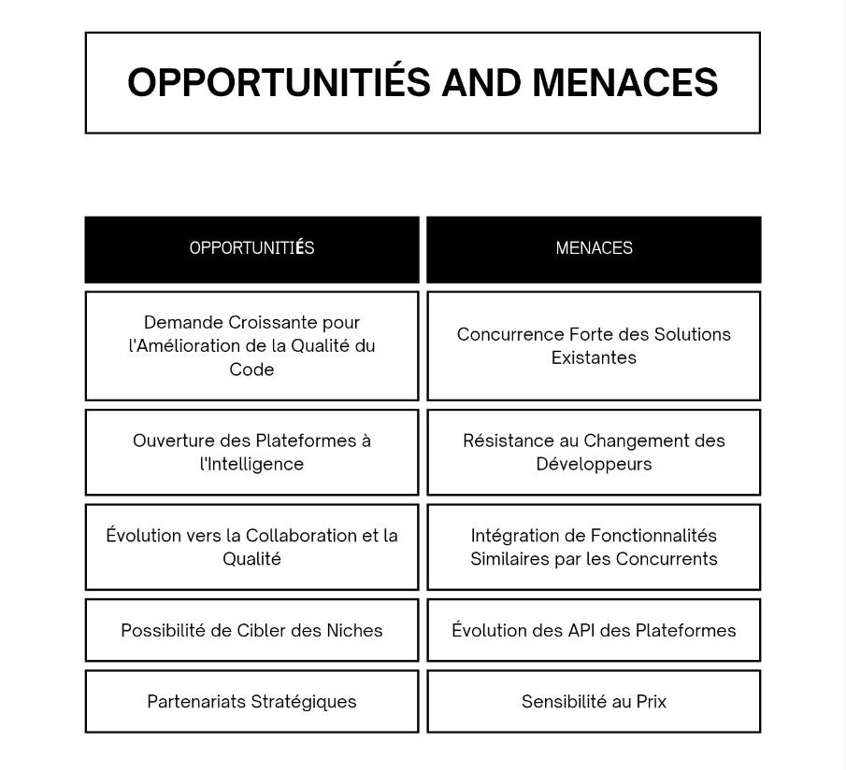
09
COMPETITIVE ANALYSIS
Our SWOT Analysis Against the Competition: Our Strengths, Our Challenges, Our Opportunities:
2. Opportunities AND Threats:

Slide 18
09
COMPETITIVE ANALYSIS
Our SWOT Analysis Against the Competition: Our Strengths, Our Challenges, Our Opportunities:
3. DIFFERENTIATION OF THE PROJECT:
Our solution stands out for its fundamentally intelligent approach to code review. Where existing tools simply show changes, we provide context, proactive suggestions, and continuous learning.
We're not just another tool; we're a smart partner for improving code quality. Our integration, designed for collaborative platforms, aims to make code review not a chore, but a constructive exchange and a learning engine for the entire team.
Our focus on user experience, making the review process more intuitive and guided, is also a key differentiator. We want developers to enjoy code review and see it as an integral and valuable part of their workflow.
In short, our integrated strategic intelligence, our focus on continuous learning, and our collaborative user experience are what make us unique and, I believe, superior to existing solutions. We don't just make reviewing easier; we fundamentally improve it.

Slide 19
10
TARGET MARKET ANALYSIS
MAIN TARGET: Software Development Teams within Companies.
Our primary target audience is software development teams operating within companies of all sizes, from innovative startups to established enterprises. These teams are directly responsible for the creation, maintenance, and evolution of software applications and systems.
Customers:
Software Engineering / R&D Departments: Managers in these departments are often the final decision-makers for adopting new tools and processes to improve development efficiency and quality. They are sensitive to metrics such as bug reduction, faster development cycles, and improved developer satisfaction.
Chief Technology Officers (CTOs) / Vice Presidents of Engineering: These technology leaders are responsible for the overall development strategy and are interested in solutions that can have a significant impact on productivity, quality and innovation across the organization.
Software Project Managers: These roles focus on team management and workflow optimization. They seek tools that can facilitate collaboration, improve transparency, and reduce friction within the development process, including code review.

Slide 20
10
TARGET MARKET ANALYSIS
2. Users:
Software Developers (of all levels): These are the direct users of our solution on a daily basis. Their experience and satisfaction are crucial to the adoption and success of our product. They are looking for a tool that makes code review easier, less time-consuming, and contributes to their professional growth through constructive feedback.
3. Beneficiaries:
The Enterprise as a Whole: Better code quality, faster development cycles, and increased innovation translate into significant business benefits for the entire organization, including improved customer satisfaction and increased competitiveness.

Slide 21
11
BUSINESS MODEL
REVENUE AND PROFITABILITY MODEL:
Our project will adopt a SaaS (Software as a Service) subscription-based revenue model with multiple pricing plans to meet the different needs of our customers:
Free Plan: Offers a basic 2-week trial. While it doesn't generate direct revenue, it serves as an entry point to attract users and allow them to discover the value of our solution, potentially encouraging them to upgrade to a paid plan.
Basic Plan: Billed at DA 2000 per month for 2 users and 50 credits. This plan is aimed at small teams or individual users with moderate needs. It provides recurring monthly revenue for each subscriber.
Teams Plan: Billed at DA 4000 per month for 10 users and 200 credits, including shared workspaces and priority support. This plan is designed for medium-sized teams and generates higher monthly revenue per subscriber.
Enterprise Plan: With "On Demand" pricing for a number of users tailored to needs, over 500 credits, Single Sign-On, customized deployment, and top-priority support. This plan targets large organizations with complex needs and a larger budget, generating significant revenue per contract.

Slide 22
11
BUSINESS MODEL
Profitability Strategy:
Our profitability strategy will be based on the following elements:
Free Trial: Encourage Free plan users to upgrade to a paid plan by demonstrating the added value of our advanced features and limiting usage in the free version.
Increased Value per Customer: Encourage existing customers to upgrade to higher plans (“Basic” to “Teams”, “Teams” to “Enterprise”) based on their team growth and needs.
Effective New Customer Acquisition: Use targeted marketing strategies to reach businesses that fit our pricing plans and optimize customer acquisition costs.
Strong Customer Retention: Provide a reliable platform and quality support to minimize churn and maximize customer lifetime value.

Slide 23
12
PROJECT ROADMAP AND DEVELOPMENT STRATEGY
KEY STEPS:
1. Initial Technical Development:
Development and testing of the basic functionalities of the collaborative code review platform.
Implemented initial strategic intelligence features for contextualization and basic suggestions.
Setting up the cloud infrastructure needed to host the platform.
2. Commercial Launch:
Launch of the beta version to a select group of testers (early adopters) to gather feedback and iterate on the product.
Development and launch of initial pricing plans.
Implementation of initial marketing and sales channels (website, content marketing, social media).

Slide 24
12
PROJECT ROADMAP AND DEVELOPMENT STRATEGY
3. Expansion et Amelioration Continue :
Development and deployment of advanced features based on user feedback and our vision (e.g. real-time quality metrics, deeper continuous learning, additional integrations).
TIME-SPECIFIC OBJECTIVES:
6 Months:
Successful launch of the beta version and obtaining the first significant user feedback.
Acquisition of an initial number of paying subscribers (“Basic” plan).
Establishing an online presence and basic content strategy.
Building a core functional team (development, marketing/sales, customer support).

Slide 25
12
PROJECT ROADMAP AND DEVELOPMENT STRATEGY
1 Year :
Reached a significant threshold of paying subscribers on the “Basic” and “Teams” plans.
Launch of the first advanced features based on strategic intelligence and user feedback.
Exploration and potential first strategic partnerships.
Team expansion to support growth.
3 Years:
Have a significant user base and stable, continuous revenue growth.
Deployment of advanced and differentiating strategic intelligence functionalities.
Possibility of expansion into new markets or diversification of the offer.
Building a strong and experienced team in all key areas.

Slide 26
12
PROJECT ROADMAP AND DEVELOPMENT STRATEGY
RESOURCES REQUIRED:
1. Humans :
Technical Development: Full-stack developers, artificial intelligence/machine learning experts, DevOps engineers.
Marketing and Sales: Digital marketing specialist, content creator, salesperson.
Customer Support: Customer support technician.
Project Management: Project Manager.
2. Financial:
Seed Capital: To cover initial development costs, cloud infrastructure, initial marketing, and founding team salaries.
Cash Flow: To support operations until subscription revenue becomes sufficient to cover expenses and ensure profitability.
Future investments: For team expansion, new feature development, and larger-scale marketing efforts.

Slide 27
12
PROJECT ROADMAP AND DEVELOPMENT STRATEGY
3. Techniques :
Cloud Infrastructure: Scalable and reliable hosting platform
Development Technology Stack: programming languages, frameworks and tools adapted to the needs of the project.
Marketing and Sales Tools: CRM, marketing automation tools, web analytics tools.

Slide 28
THANKS

