Slide 1
Decathlon
Mohibullah Kamran
Javel Williamson
Sudha Ramakrishnan
Shrestha Acharya
Bryan Mayfield

Slide 2
Data Exploration
Dataset contained ~44 variables for individuals who had loan applications funded
These variables included items you would expect to find on a credit report
Also contained job titles and length of employment

Slide 3
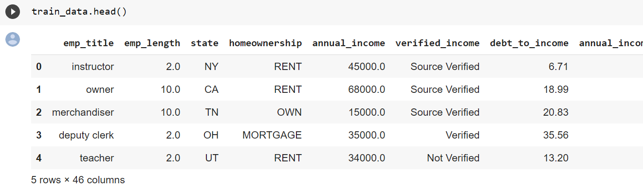
Data Exploration
visual exploration to understand what is in a dataset and the characteristics of the data
size or amount of data, completeness of the data, correctness of the data, possible relationships amongst data elements or files/tables in the data.

Slide 4
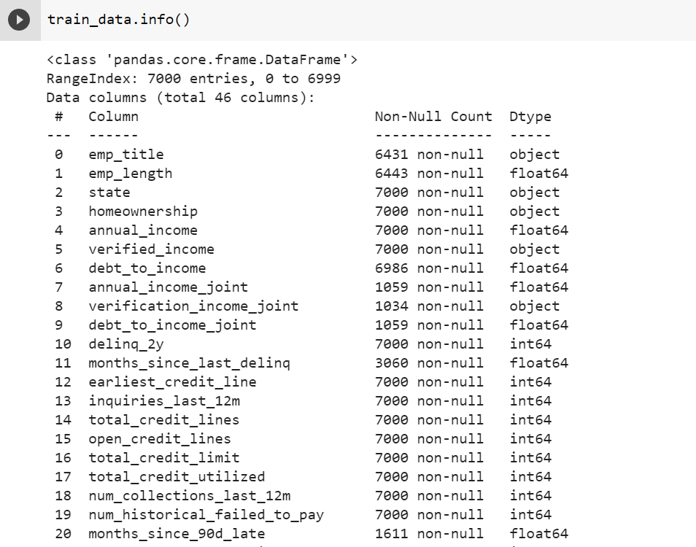
Data Exploration

Slide 5
Data Cleaning & Preprocessing
detecting and correcting (or removing) corrupt or inaccurate records from a record set, table, or database
identifying incomplete, incorrect, inaccurate or irrelevant parts of the data and then replacing, modifying, or deleting the dirty or coarse data

Slide 6
Data Cleaning & Preprocessing
There were a number of individuals that applied for their loans jointly
We dropped the columns associated with their joint income/debt measures (joint income, joint debt to income, and joint verification as there were many missing values given that only a small subset of people applied for loans jointly.
Next we looked at the missing values in the employed length column
We quickly noticed that the people who had missing values for length of time employed also had missing values for their job title. We assumed that these people were unemployed. Because we felt that this would also have an impact on their interest rate, we did not want to drop them. Instead, we imputed their missing values with the value -1 to essentially rank them lower than others in this category.
Although the job title data was interesting, there was nothing we could do with that text data in the short time we were given for the project, so we decided to drop the column

Slide 7
Data Cleaning & Preprocessing
Next we turned to the variables with the highest number of missing values
Number of months since last delinquency
Number of months since an account was 90 days late
Number of months since last credit inquiry
For all of these variables, a higher number of months would likely represent a better overall credit score and thus a lower interest rate
It seemed to us that those individuals with missing values had no delinquencies or recent credit inquiries, so we imputed a larger value for them to represent their higher credit-worthiness
We took the reverse approach when looking at the number of accounts greater than 120 days past due and imputed smaller value there to again indicated higher credit-worthiness for individuals with fewer delinquencies

Slide 8
Data Cleaning & Preprocessing
Beyond the steps on the previous slides, we also converted categorical variables into numeric data types
There was one additional variable with an incorrect data type, “earliest credit line.” This should have been a date (year). We dropped this variable since the model may be been misinterpreting the values. However, given more time, we would have liked to convert this to something representing to length of credit history as we know this is an extremely important variable when determining interest rates!

Slide 9
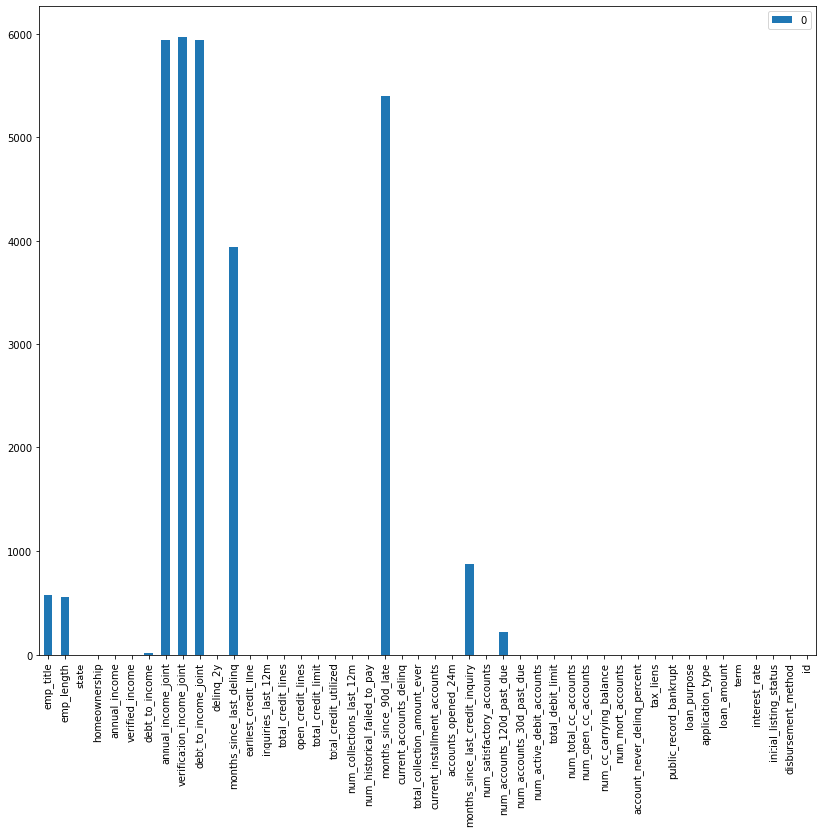
Data Visualization
A bar plot was plotted with the training dataset to identify the variables with highest number of missing values for further exploration.
We suspected that the variables ending in “_joint” had such high missing values because they were only populated for those people applying for a loan jointly.

Slide 10
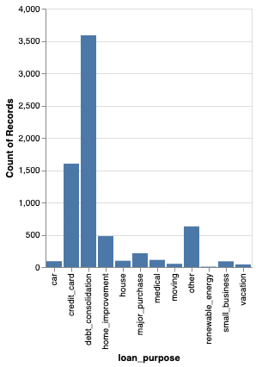
Bar Plot of Counts of Loan Purpose
The vast majority of loans were for debt consolidation, followed by “credit card”

Slide 11
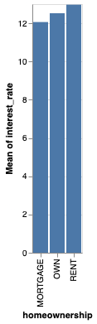
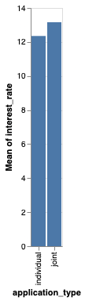
Bar Plots of Mean Interest Rate by Homeownership and Application Type
Interest rates seem to be systematically higher for those that rent instead of own their homes.
Interest rates appear to be systematically higher for those who applied jointly

Slide 12
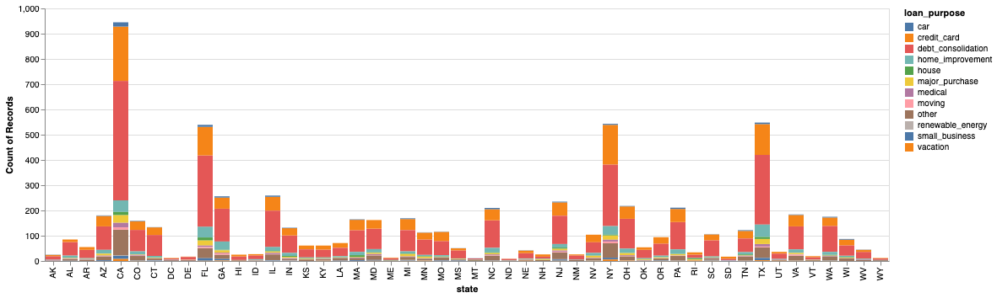
Bar Plot of Number of Loans per State + Loan Purpose
The number of loans follows what would be expected given the population of each state with California having the highest, followed by Texas, Florida, and New York.

Slide 13
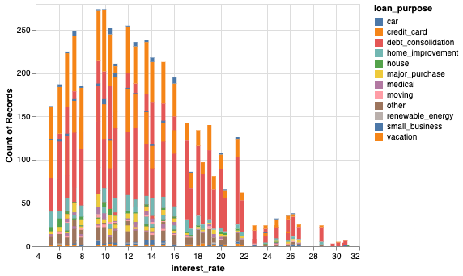
Distribution of Interest Rates Colored by Loan Purpose
Here it appears that the majority of interest rates are between 10 and 12 percent.
Home loans and home improvement loans seem to have some of the lowest interest rates (besides the “other” category)

Slide 14
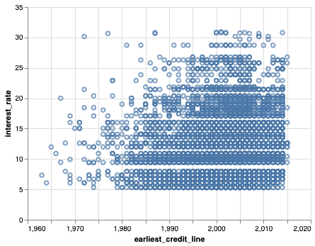
Relationship Between Length of Credit History and Interest Rates
Although it is difficult to see, it does appear that there is a general correlation between an applicant length of credit history and the interest rate they receive

Slide 15
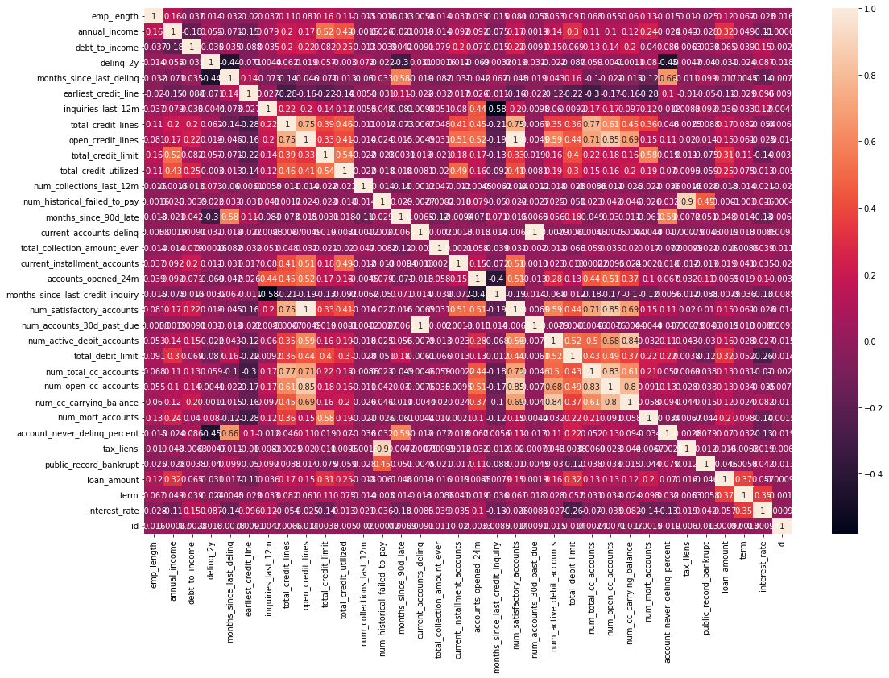

Slide 16
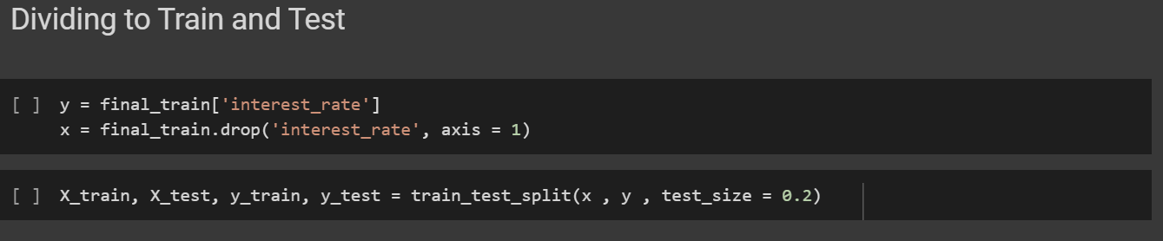
Encoding & Train-Test Split
Encoding Data for Subsequent Modelling
The training data set after all the data cleaning and preprocessing was divided into X and Y. After which a train test split was done.

Slide 17
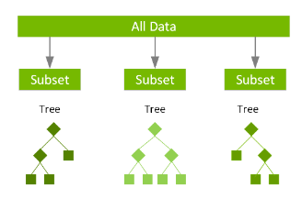
Modeling
Why did you choose this model?
We knew that we needed a regression model since we were aiming to predict numerical/continuous interest rates
Explanation of how the model works
Why this model worked the best?

Slide 18
Hyperparameter tuning
XGBoost - Gradient Boost
Max-Depth : 3
Number of Estimators : 250
Learning Rate : 0.01
Sub-Sample : 0.5
Col-Sample : 0.6

Slide 19
Accuracy report
Training Data
RMSLE 0.2633
Test Data
RMSLE 0.2847

Slide 20
Conclusion
Overall, we believe that we chose the best parameters we could given the time allotted. With more time, we do believe that we could have transformed some variables to make them more relevant and eliminated others to improve the model.
Ultimately, the lesson we have learned is that often the time allotted can determine the depth to which the data can be explored and, consequently, the complexity of the model.
Many factors seem to have an impact on the interest rate, but for some of them, the relationship is much clearer.

