Slide 1

V0.2 - A quick reference guide

Slide 2
Contents
Context & features
Requirements
Input files
Case setup and example
How to run a simulation
Outputs
Postprocessing

Slide 3
Context
MOHID Lagrangian is:
A unidirectional Lagrangian particle simulator
Made to easily extend the physical models acting on the particles
Made to support large scale modelling in both space and time
Made to support medium independent simulations
Made to support large tracer numbers
A cross platform, shared memory parallel tool

Slide 4
Features on V0.2
Define tracer sources in space and time using basic shapes and file defined polygons
Import currents data from .nc or .nc4 files, using CF conventions
Import 3D/2D/regular/irregular structured meshes – not curvilinear
Import data from a file series automatically
One domain per simulation – no fitted or overlaid domains
Provides 1st, 2nd and 4th order integrators
Physics kernels for Lagrangian kinematics
Automatic land, beaching and bed interaction masks (assuming CF compliant input files)

Slide 5
Features on V0.2
Basic litter modelling physics kernels (degradation)
Diffusion (random walk based on mixing length estimate)
Beaching behaviour
Windage and Stokes drift effects
Python based, postprocessor suite in order to interpolate solutions and cast them on NetCDF CF compliant grids, so they can be published and explored

Slide 6
Features on V23.01
Simulation of detritus type tracers with a degradation function dependent on bacterial growth over time
Improved routines for deposition of tracers in the bottom
Resuspension of particulate type tracers using currents, or currents+waves
Release of tracers near the bottom.
Import curvilinear grids
Export of different parameters into HDF format
WaterQuality type tracers for simulating biogeochemical processes, through a link to MOHID’s water quality module

Slide 7
Requirements
To compile
modern Fortran compiler - IFort 18+, GFortran 8+
Cmake
m4, autotools if using Linux
Visual Studio if using windows
to Run
python 3+ (with xarray, vtk and netcdf4 libs installed)
text editor...
To process outputs
Paraview

Slide 8
Input files
To set up a case:
Case definition file (.xml)
Tracer library file (optional, .xml)
Variable output control file (optional, .xml)
NetCDF variable library file (optional, .xml)
Input data (.nc or .nc4 file/s)

Slide 9
Input files – case definition
A case definition file contains several sections and typically has the following structure
Case
Execution
Parameters – dates, formats, numerical schemes, output frequency,…
Post processing cycles requests
Variable naming – file containing variable name correspondences in NetCDF files
Case definitions
Input data fields – directories were .nc files are present
Simulation parameters – spatial and temporal resolution, bounding box, …
Source definitions – defining the name, emission rates, resolution, lifespan and geometry of a tracer source
Source type properties – linking a source to a specific type (plastic, paper, oil, …)
Case constants –beaching level and intensity, diffusion coefficient, …

Slide 10
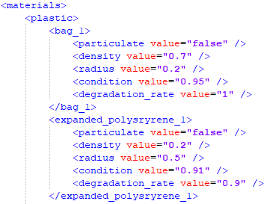
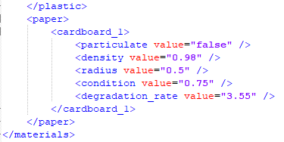
Input files – tracer library
A tracer library file is a simplified tracer type database. The idea is that users can add tracer types and subtypes, each with their parameters and coefficients, to that library and use them on any case and share with other users.
For v0.2, plastic and paper types are implemented, with simple, placeholder physical functions such as a degradation rate.

Slide 11
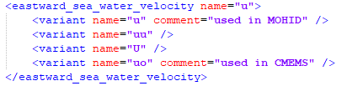
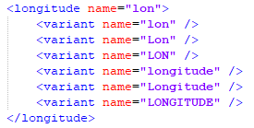
Input files – variable names library
A variable library file simply stores the match between the formal NetCDF CF name for a variable and the actual variants that different models write on their outputs. Any user can add to this file if they encounter outputs from different models, and as long as the output is CF compliant, no further pre-processing should be required.
The name of the section is the CF long name, and the name field in front of it determines the name of that variable inside our simulation and its outputs.
The variants are a list of possible names for a given variable, that if found in a NetCDF file are used to read the fields.

Slide 12
Input files – .nc or .nc4 files
MOHID Lagrangian V0.2 consumes NetCDF CF files with arbitrary dimension fields. These are checked for correctness and processed if necessary during the input stages. The vertical dimension needs to be well formed however – MOHID was made to model any medium, in natural coordinates – if your ocean data vertical coordinate is written indistinguishably from an atmospheric data set, it will be imported as such. Use NCO or other tools to correct this in your files directly if necessary.
MOHID Lagrangian supports reading an arbitrary number of fields. If you have a collection of time steps spread across different files, these are ordered internally and read as required, automatically.

Slide 13
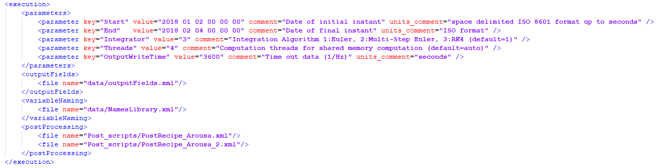
Case definition - example
Execution section of the Arousa2D test case configuration file
File listing variables to output
List of post processing recipes to run (add here recipies to run them in batch at simulation end)

Slide 14
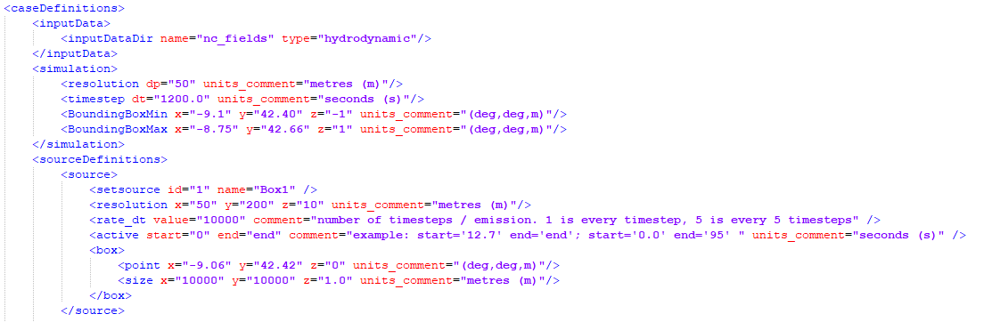
Case definition - example
Case definitions of the Arousa2D test case configuration file
Input data directory and type
Global initial resolution (uniform or not)
Global bounding box – any tracer crossing this will be excluded from the simulation

Slide 15
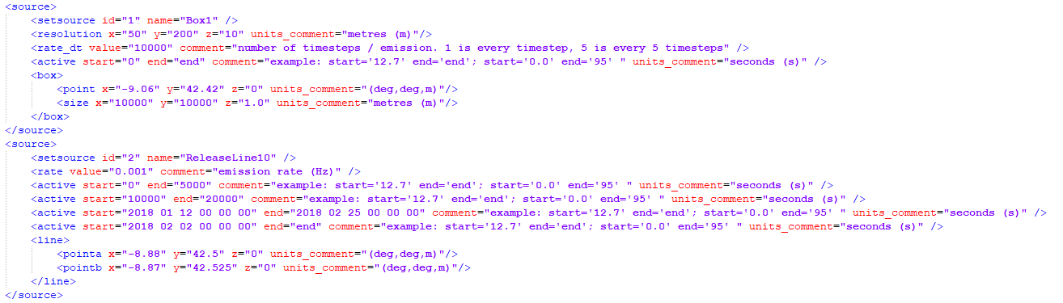
Case definition - example
Source definitions of the Arousa2D test case configuration file
Override of global resolution for this source
Distinct types of emission rate definitions
Series of on/off cycles for this source

Slide 16
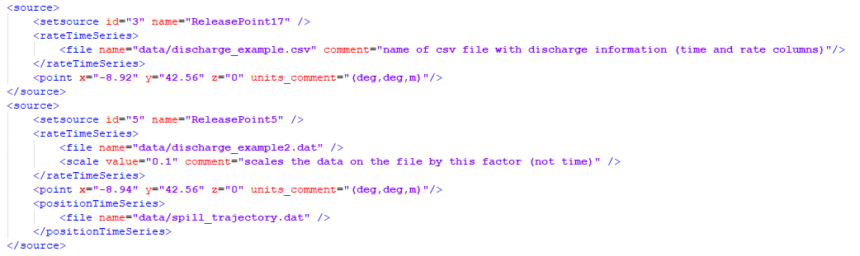
Case definition - example
Source definitions of the Arousa2D test case configuration file
Emission rate mediated by a csv file (time(s), rate(Hz)
Emission rate mediated by a MOHID time series file.
You can add the name of the variable you want to import as rate to the NamesLibrary.xml file
Optional scale to multiply the imported variable with (transforming river discharge into rate for example)
Position time series (either .csv or MOHID time series) for this source

Slide 17
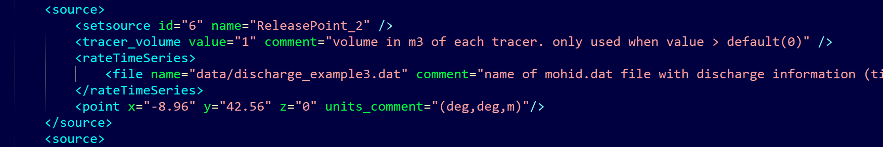
Case definition – example 2
Source definitions of the Arousa2D test case configuration file
Emission rate mediated by a MOHID time series file.
You can add the name of the variable you want to import as rate to the naming .xml file
Emission rate mediated by a mohidTimeseries file (time(s), rate(flow rate or Hz)
Specify tracer volume so the number of particles released become a function of a variable flow rate

Slide 18
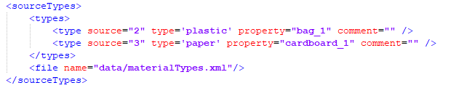
Case definition - example
Source type definitions of the Arousa2D test case configuration file – optional section
Source 3 will imprint on emitted tracers the properties of ‘bag_1’, of type ‘plastic’. This will lead to differentiated behavior with other types (different processes) and subtypes (different parameters)
Type library file

Slide 19
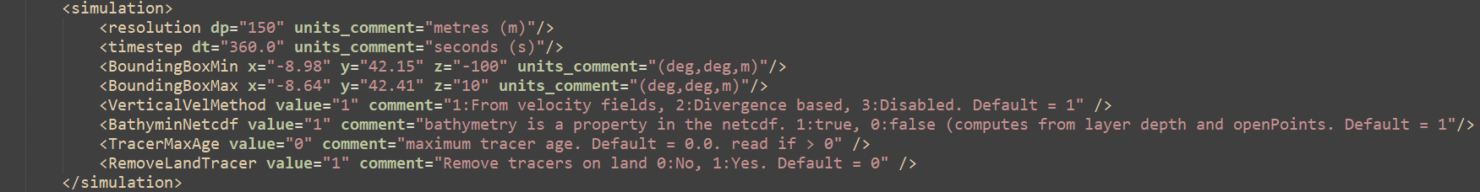
Case definition - example
Source type definitions of the Vigo3D test case configuration file
If the Netcdf has a bathymetry property the model will build the bathymetry from that input, if not, the model will build it using the vertical layers and the velocity gridded values as a guide for bottom and land points.
TracerMaxAge is a threshold for deleting old tracers

Slide 20
Case definition - example
Source type definitions of the Vigo3D test case configuration file
If the Netcdf has a bathymetry property the model will build the bathymetry from that input, if not, the model will build it using the vertical layers and the velocity gridded values as a guide for bottom and land points.
TracerMaxAge is a threshold for deleting old tracers

Slide 21
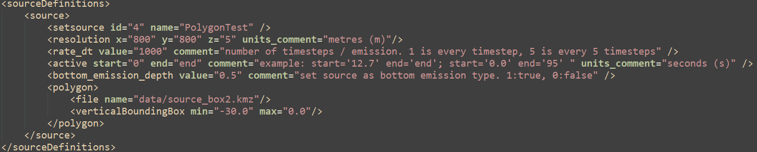
Case definition - example
Source type definitions of the Vigo3D test case configuration file
In case you want to release tracers close to the bottom, this is the Keyword you must use. Don’t use 0 but something close to it like 0.01, as 0.0 is the default value for not releasing near the bottom.

Slide 22
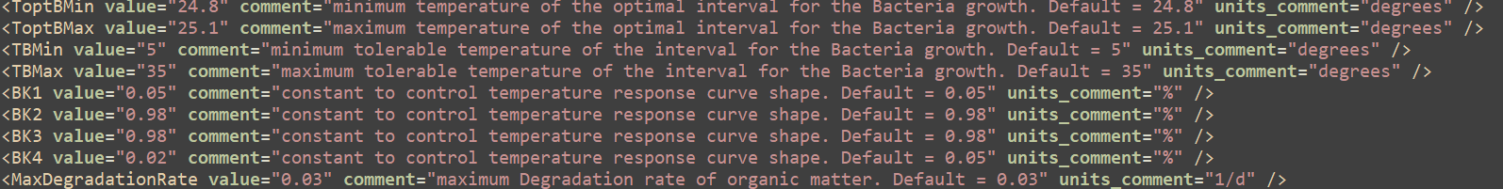
Case definition - example
Source type definitions of the Vigo3D test case configuration file
Resuspension processes use these 2 keywords, which, if not present will have the default value
Keywords used for detritus degradation due to microbial activity.

Slide 23
Case definition – useful pointers
File names and directories can be put in as absolute or relative paths
The naming conventions can be imported from several files, just add another to the section to append more options
If you get an error saying a .xml file doesn’t exist while running MOHID Lagrangian, it’s probably not correctly formatted. Make sure all sections are properly open and closed (</>)
Comments and units are there for user convenience, they don’t interact with the simulation

Slide 24
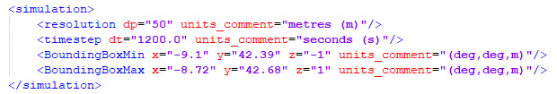
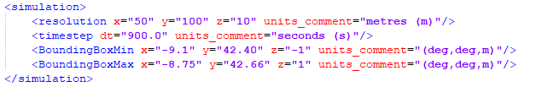
Case setup – workflow example
Create a directory to run your case – it will typically hold configuration, input and output files, but this is entirely up to the user. The examples directory in V0.2 is ‘RUN_Cases’. Create a ‘Test’ directory there.
Create a configuration .xml file inside ‘Test’. You can copy the one from ‘Arousa_2D’ and modify it:
Change spatial and temporal resolutions – notice resolution can vary by direction or be uniform

Slide 25
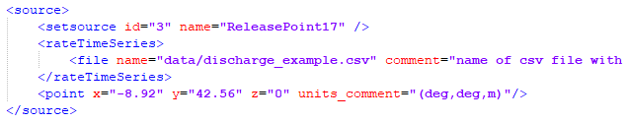
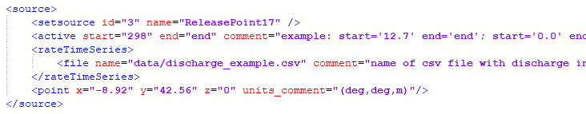
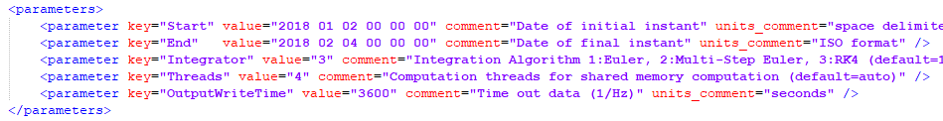
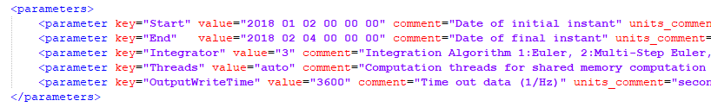
Case setup – workflow example
Make source id=3 active only after 298 seconds and change using 4 threads to automatic use of CPU cores

Slide 26
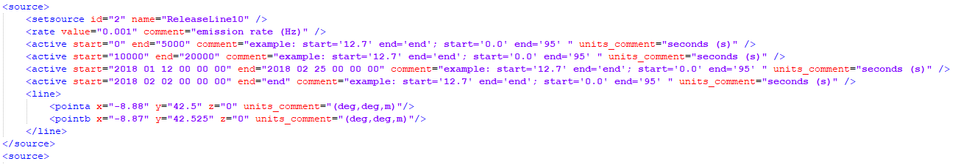
Case setup – workflow example
Notice you can set an arbitrary amount of active intervals, both is relative time (seconds from the beginning of the simulation) or absolute with dates

Slide 27

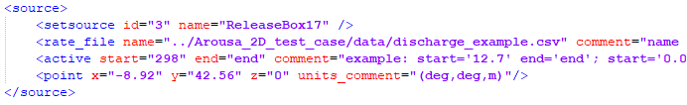
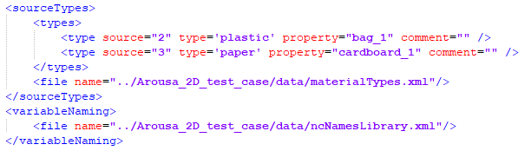
Case setup – workflow example
What about input files?
You can either copy all of the files to the new directory, or put the paths of where they already are in the configuration file.
Using relative paths to the old directory:

Slide 28
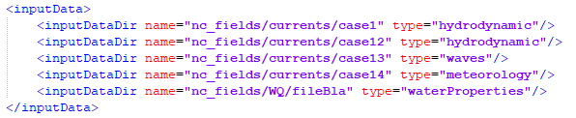
Case setup – workflow example
What about different input files?
You must tag the directory containing the files with the type – hydrodynamic, waves, meteorology, water properties…
This is so they are correctly imported and used accordingly. You can set an arbitrary number of input directories, of any type. All valid .nc or .nc4 files under those (or under subdirectories) will be listed for import and used if needed.
V0.2 does NOT support multiple domains (either fitted or overlapping). All files of the same type must be from the same mesh. You can use different spatial and temporal discretizations across file types (the hydrodynamic solution can be 3D full north Atlantic and the meteorology is 2D and cover only a section of it, for example).

Slide 29
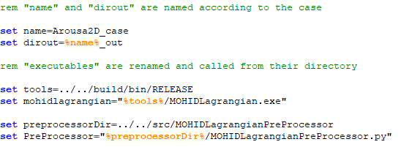
How to run a simulation
How do I now run MOHID Lagrangian?
The typical chain is data – setup – preprocessor – MOHID Lagrangian - postprocessor
In the examples there are windows (.bat) and unix (.sh) scripts to run the these steps for a given case, as well as separate ones to run post processing, that can be used while a simulation is running.
You need to make sure your configuration file name is correct and the directory to the executables are well set.
Name of the case and configuration file (the name of your main .xml file)
Path to the executables

Slide 30
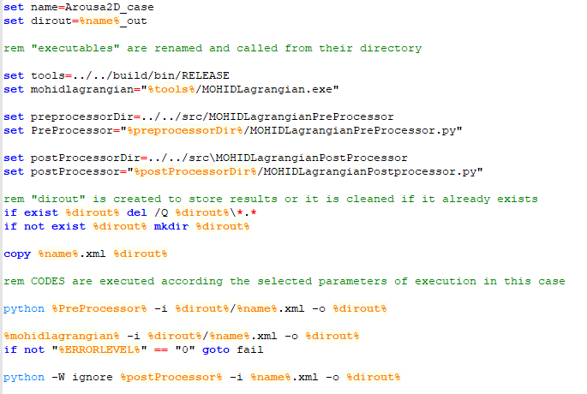
How to run a simulation
Name of the case and configuration file (the name of your main .xml file, all you need to change in this script to run another case)
Path to the executables – change this to point to the executables if you want to run your cases in some other directory tree
Creates the output directory – deletes old results if they are present!
Running pre processor, MOHID Lagrangian and post processor

Slide 31
Outputs
An output directory will be created (or emptied if it already exists), with the same name as the case, appended with ‘_out’.
In there several files will be created:
A copy of your case configuration file
A ‘casename’.log file with all of the console output
A preprocessor output called ‘casename’_inputs.xml
A Bounding box and blocks .vtu files (these are just for visualization)
A series of .vtu files with simulation heavy data (all the particles and variables)
A .pdv file, with simulation light data (indexes and time-stamps heavy data)
A directory for each post processing request, with processed data
This lists and sorts all of the input NetCDF files so MOHID Lagrangian know what to read. It also shows the dates of the files, so you can correct your configuration start and end dates based on this output.
You need Paraview to plot this

Slide 32
Outputs – Using Paraview
Plenty of Paraview tutorials exist online, it is a mature software and is used by many to view, post-process, explore and render scientific spatial data. It is useful in our context – it reads NetCDF CF files and can read our output files (.vtu) with millions of particles on screen.
Open .pdv file
yes
Open Paraview
Open Files
Simulation ended?
no
Open series of .vu files

Slide 33
Outputs – Using Paraview - tips
Paraview is coordinate system agnostic – This means that our horizontal units (degrees) are not compatible with our vertical units (m) – apply a transform filter and scale your data on the horizontal dimension so it looks appropriate.
At the moment animating currents and particles simultaneously (synchronized in time) is not trivial – Our time stamp is fixed (seconds since 1950-01-01) and the time stamp of the input NetCDF may be different, or with different units (hours instead of seconds). Use NCO to change the input to match or wait for further post-processing tools
Ploting the bathymetry in 3D (if available on a NetCDF file): read the file, set dimensions to the 2D plane (lon, lat typically), not as spherical coordinates. Use the warp by scalar filter to deform the bathymetry field using a given scale.

Slide 34
Post processing
At the moment, to explore raw data Paraview is the gate for post-processing. Explore the filters and settings, it is a very complete suite.
Paraview supports exporting data to other formats. Using routines you already have may require exporting particle data as a .csv file and using it with your other codes
Paraview supports python scripting: a suite of scripts is being prepared to simplify and automate typical workflows
V0.2 introduces our post processor
Interpolates raw data to a grid (Lagrangian to Eulerian results), both globally and by source
Produces cell averages of any output variable and creates synthetic variables (concentration, residence time)
Writes the data in OpenDAP, Thredds ready netCDF CF – results are immediately publishable and importable in any compliant framework
Converts raw data to MOHID formatted .hdf5 files

Slide 35
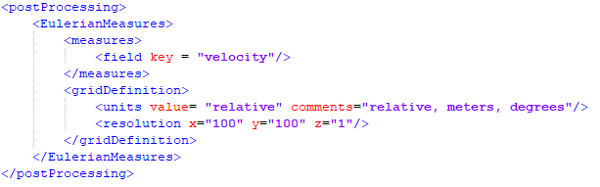
Post processing
Post processing works by ‘scripting’ a recipe to follow, and the user can design an arbitrary number of recipes and request them to be run automatically after the simulation. These can also be run during runtime, on the available files.
This is an example recipe file.
It interpolates velocity magnitudes, on a mesh defined by the bounding box of the simulation it is attached to, discretized in 100x100 cells.

Slide 36
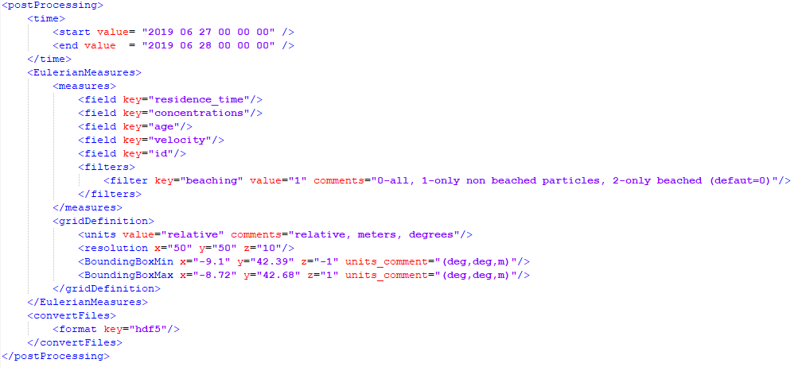
Post processing
Selecting a time interval to process
Selecting the variables to process
Filtering the results by beached status
Selecting a space interval to process
Converting all the files to MOHID .hdf5 Lagrangian format

