Slide 1
ABCOnlineStore
Introduction:
ABCOnlineStore is an online store built using Angular, offering a seamless shopping experience for mobiles and Laptops. It features product listing, filtering, a shopping cart, checkout, authentication, and route guards.
Presenter Details
Presenter: Mohideen Surakath S

Slide 2
Problem Statement
Product Selection: Finding the right mobile or laptop that meets specific needs and budget can be overwhelming.
Comparison & Decision-Making: Lack of easy product comparison makes it difficult for buyers to choose the best option.
User Experience: Many online stores have complex navigation and slow load times, affecting the shopping experience.
Secure Transactions: Ensuring safe and reliable payments is a major concern for online shoppers.

Slide 3
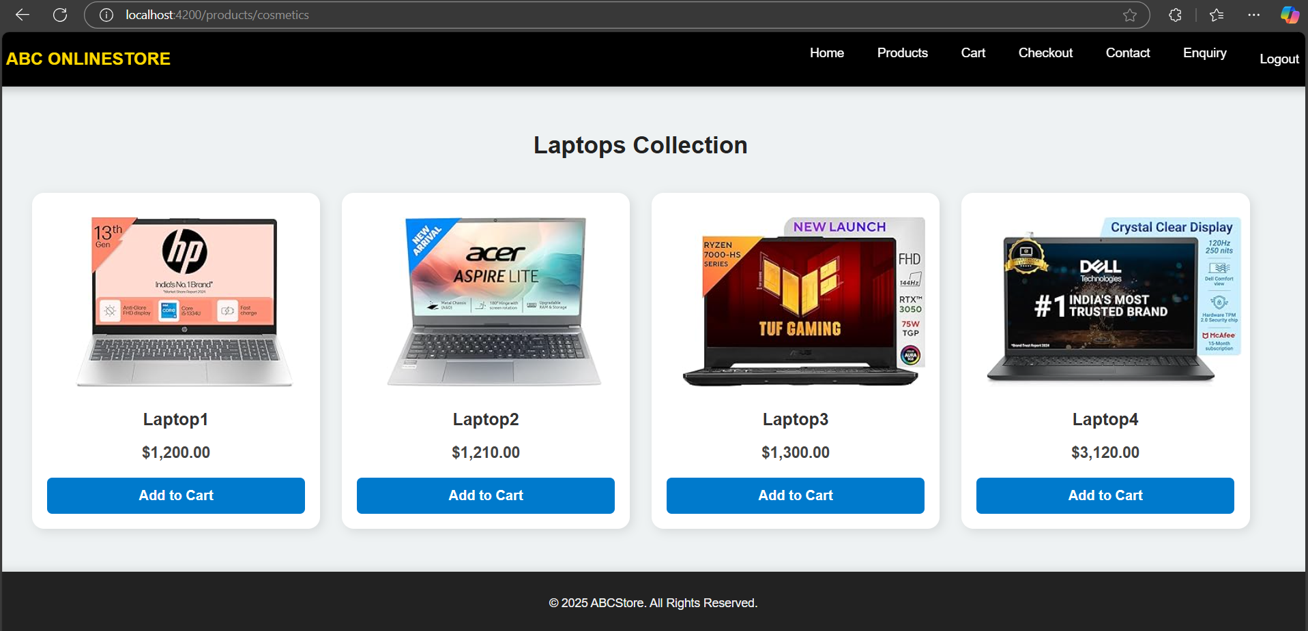
Project Overview
Secure Shopping & Checkout: A smooth and safe checkout process ensures a hassle-free purchase experience.
Browse & Explore Products: Users can discover a wide range of mobiles and laptops from various brands.
Compare & Filter Options: Advanced filtering and sorting help users find the best product based on their preferences.
User-Friendly Interface: The platform offers an intuitive and responsive design for easy navigation across devices.
ABCOnlineStore enhances the online shopping experience by making it efficient, convenient, and secure for customers.

Slide 4
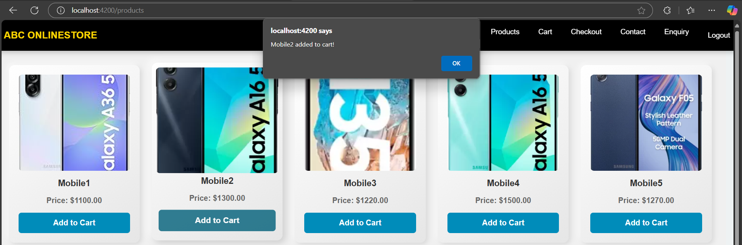
User Interaction Overview
Browse Products: Explore a wide range of mobiles and laptops with filtering and sorting options.
User Authentication: Log in or register to access personalized features like order history and saved items.
Add to Cart & Checkout: Select products, add them to the cart, and proceed with a secure checkout process.
Order Tracking & Support: View order status and get customer support for any inquiries.

Slide 5
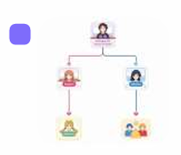
Tech Stack
Project Flow
● Frontend: Angular for a dynamic and responsive UI.
● Backend: JSON Server for easy data management.
● Image Hosting: Nginx for fast image loading.
● Storage: Local storage for user preferences.
ABCOnlineStore offers a wide range of mobiles and laptops with detailed product listings and comparison options. Users can search, filter, add items to their cart, and securely checkout. Registered users can log in to track orders and manage their purchases, ensuring a fast, responsive, and user-friendly shopping experience.

Slide 6
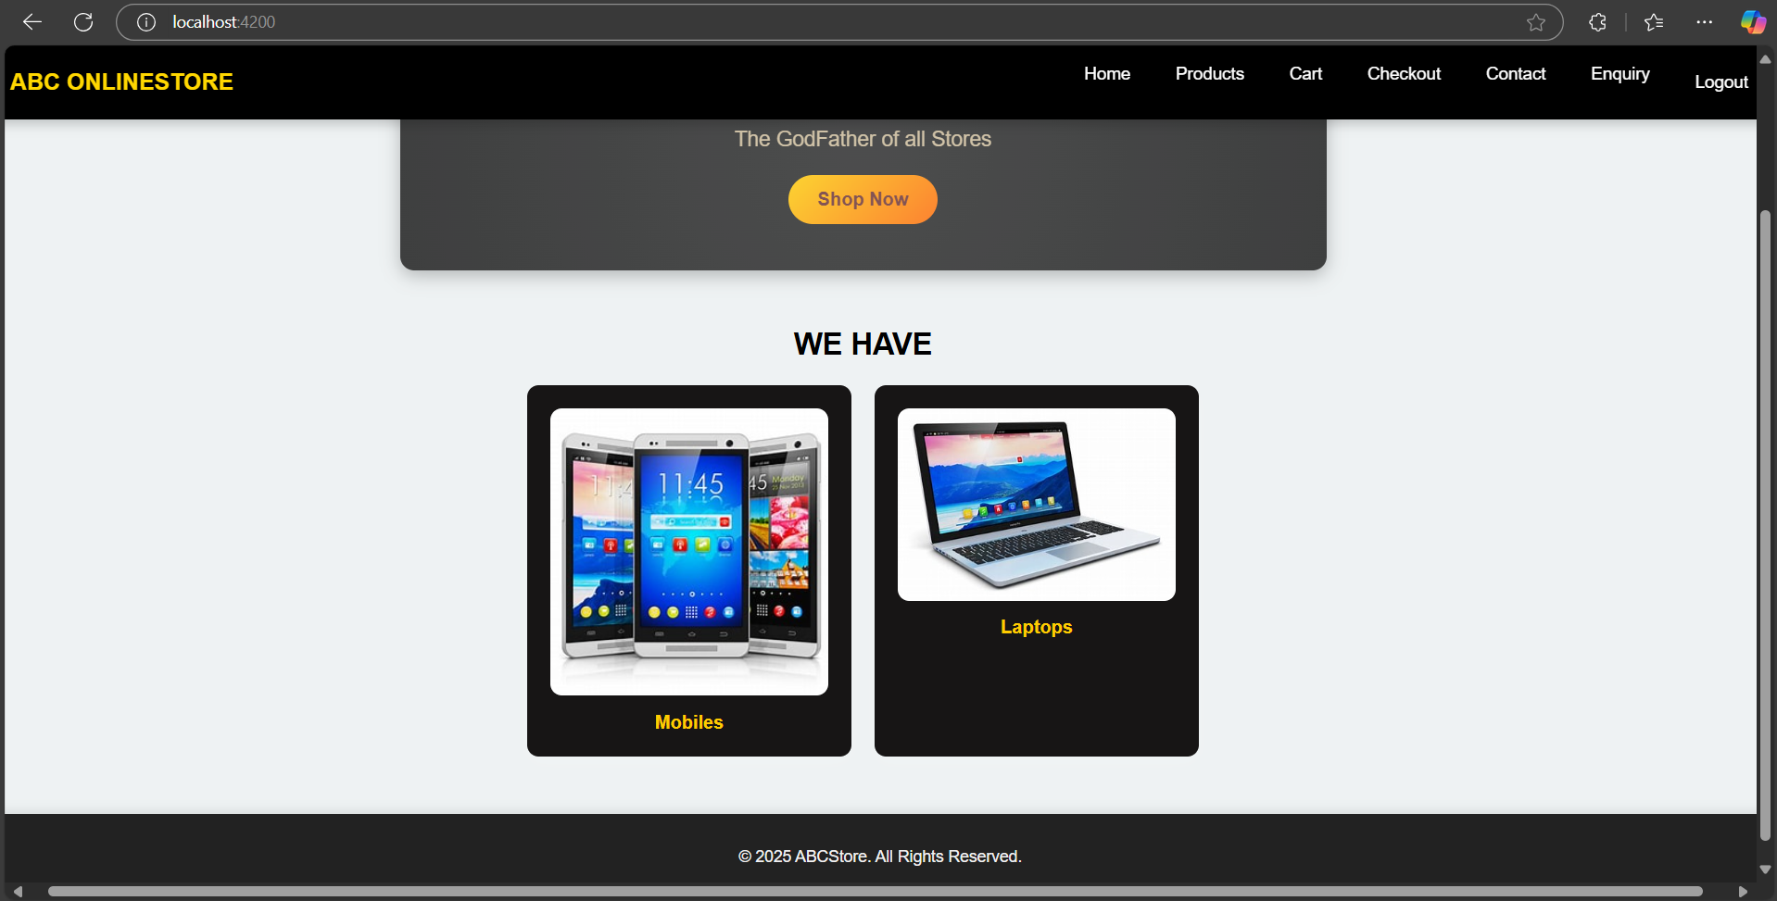
Screenshots & Demos
Home Page

Slide 7
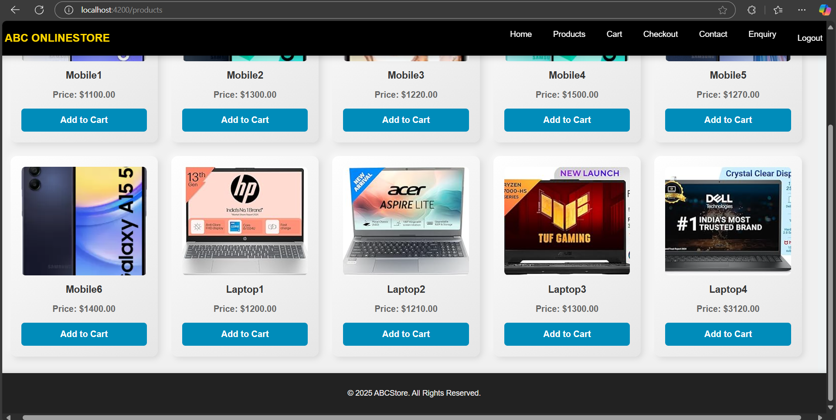
Screenshots & Demos
Products Page

Slide 8
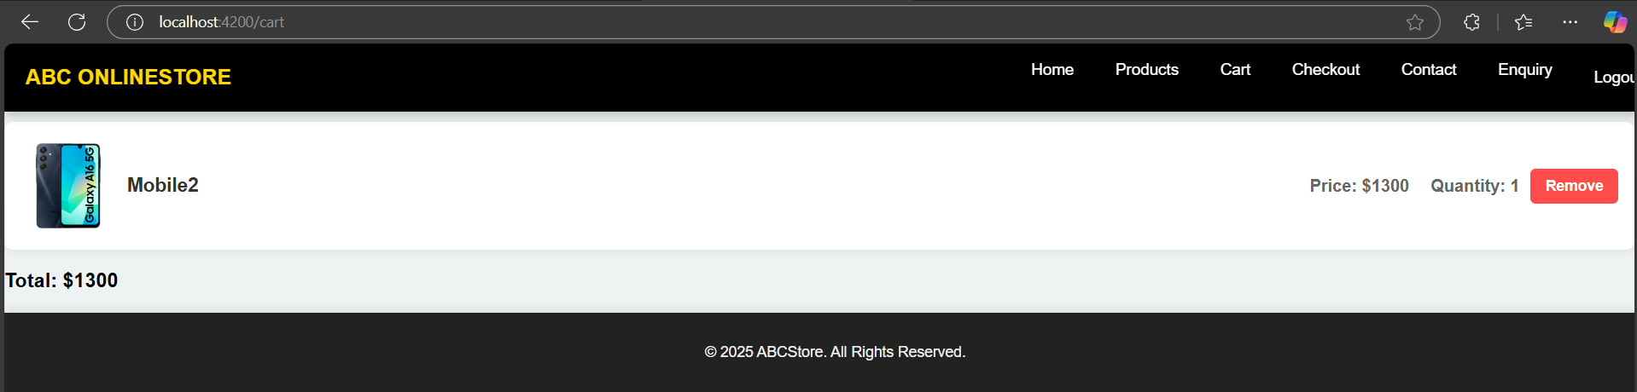
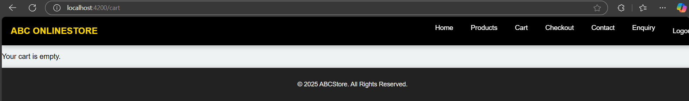
Screenshots & Demos
Cart Page

Slide 9
Problem Statement
ABCOnlineStore simplifies the online shopping experience for mobiles and laptops with easy navigation and secure transactions.
User authentication ensures a personalized shopping journey with order tracking and saved preferences.
Future enhancements include AI-powered product recommendations and UI improvements for an even better user experience.
Thank You!

