Slide 1
IS THAT VOICE REAL?
SOUNDSENTINAL: DETECTING DEEPFAKE SPEECH
FYP B FINAL PRESENTATION · OCTOBER 2026
MOHID KHANZADA · AMAAN MUHAMMAD · FARHAN MOHAMMED
Notes:
[Amaan · 0:00–0:15]
Good morning. We are Mohid, Amaan and Farhan, and our project is SoundSentinal: a tool that tells you how likely it is that a voice recording was generated by AI, and how far to trust that answer.

Slide 2
Acknowledgement of Country
Monash University recognises that its Australian campuses are located on the unceded lands of the people of the Kulin Nations, and pays its respects to their Elders, past and present.

Slide 3
WHICH ONE IS FAKE?
TWO CLIPS FROM OUR TEST DATA
CLIP A
CLIP B
Play both from the home page of soundsentinal.mohidkhanzada.workers.dev
Notes:
[Amaan · 0:15–1:00]
Before we explain anything: here are two short clips. [Play Clip A, then Clip B, from the sample panel on the site's home page: 'Synthetic speech' is A, 'Real recording' is B.] Hands up if you think A is the fake. ... A is synthetic; B is a real person. Most people can't tell reliably, and these are 2019-era fakes. Today's are better.

Slide 4
WHY THIS MATTERS
A CLONED VOICE NOW COSTS SECONDS
€220,000
1 clip
98.9%
sent after a call that cloned a CEO's voice (2019)
is all most people have, and no expert to ask
the kind of single accuracy claim detectors make
Flag a real voice
You accuse a real person of faking it.
Miss a fake
You fail to protect the person being scammed.
Notes:
[Amaan · 1:00–2:00]
Voice cloning is now cheap. In 2019 a company sent 220,000 euros after a phone call that imitated its chief executive, and consumer agencies now warn about 'family emergency' calls in a relative's cloned voice. The person at risk usually has one recording and no one to ask. Detectors exist, but they advertise one accuracy number, and that hides two different mistakes with different costs: flagging a real voice accuses someone; missing a fake leaves someone unprotected. Our project is built around showing both. Over to Mohid.

Slide 5
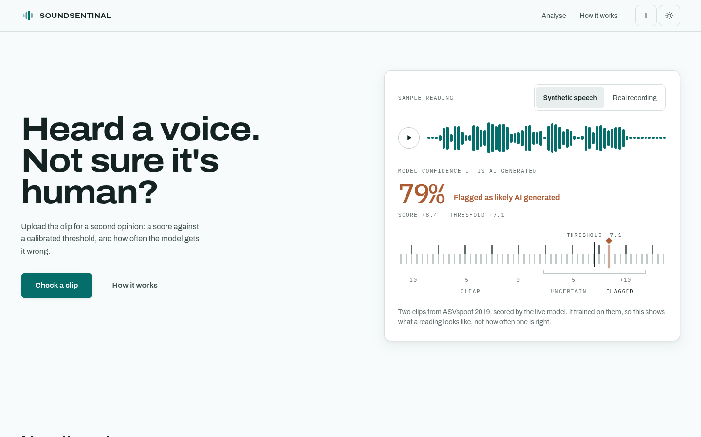
WHAT WE BUILT
A LIVE DETECTOR ANYONE CAN USE
Live demo
Upload a voice note, call or video.
Get a score against a line drawn on screen.
See how often the model is wrong.
soundsentinal.mohidkhanzada.workers.dev
Notes:
[Mohid · 2:00–3:30]
This is SoundSentinal, live. [Switch to the browser. Upload a clip, or press 'Check a clip' with the sample.] You upload a voice note, a call recording or a video; the audio is scored in memory and never stored. Instead of a red FAKE stamp, you get a reading: a needle on a scale, the line where the model flags a clip, and, underneath, how often this exact model is wrong on recordings it has never heard. [If the server is cold it takes ~30 s; keep talking over it, or use the screenshot.]

Slide 6
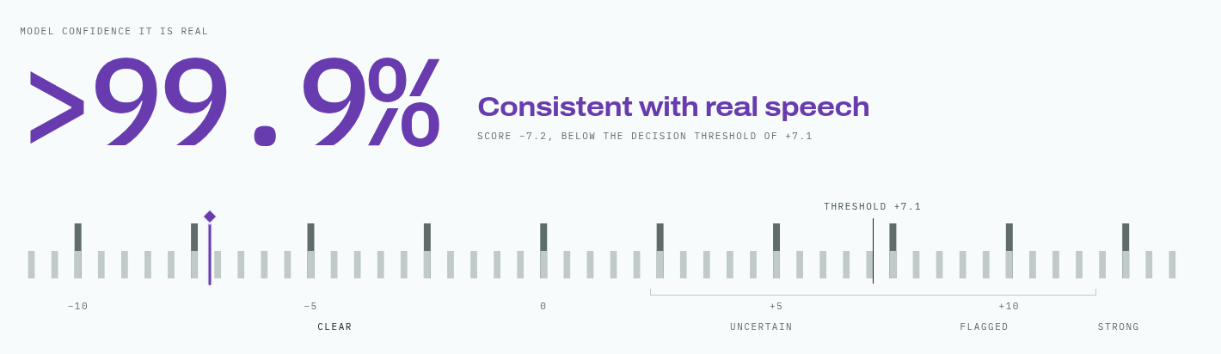
HOW IT WORKS
FROM A CLIP TO A READING IN ABOUT A SECOND
Upload
Prepare
Listen
Score
Compare
audio or video;
never stored
16 kHz mono,
first 4 seconds
speech model pre-trained
on 128 languages
how synthetic
it sounds
with a line set on
real speech
Notes:
[Mohid · 3:30–4:30]
Under the hood: we take the first four seconds, resample to 16 kHz, and pass it through a speech model that was pre-trained on real speech in 128 languages, with a small classifier on top. Out comes one score: how synthetic it sounds. The key step is the last one. We set the line using thousands of genuine recordings the model never trained on, so that only 1 in 100 real voices crosses it. That's what you see at the bottom: the score, the line, and a band where the model is unsure.

Slide 7
WHY THESE CHOICES
THE BENCHMARK MISLED US
Small CNN 267k parameters
AASIST 297k parameters
SSL-AASIST 316M, pre-trained
10.2%
error on the
benchmark
58.5%
error on real-
world audio
3.2%
error on the
benchmark
37.2%
error on real-
world audio
0.8%
error on the
benchmark
2.0%
error on real-
world audio
A reading, not a verdict
Any detector must pick a line. We show it, and its error rates.
Privacy where it matters
Private training cost 7.7 points of error and protected only public data. We protect your clip instead: never stored.
Notes:
[Mohid · 4:30–5:30]
We compared three model sizes. On the standard benchmark the bigger models win, as expected. But the benchmark was misleading: on real-world recordings of public figures, the small models were close to guessing. Only the large pre-trained model held up, so that's the one we serve. Two more choices: we show a reading against a visible line, not a verdict; and we measured privacy-preserving training, found it cost accuracy while protecting only public training data, so we protect the user's upload instead.

Slide 8
THE JOURNEY: 37% TO 2%
REAL-WORLD ERROR RATE, LOWER IS BETTER
Setback
Trained on the benchmark, our models collapsed on real audio.
What fixed it
A pre-trained model, plus many different fake generators, including 44,000 clips we generated ourselves.
Notes:
[Mohid · 5:30–6:30]
This chart is the project in one picture. Each bar is a model, in the order we built them; the measure is the error on real-world recordings it was never trained on. Our first models scored well on the benchmark and then collapsed here, to 37% and worse; 50% is a coin toss. Augmentation alone made it worse. What worked was the pre-trained model, then more variety of fakes: a public dataset, then 44,000 clips we generated ourselves with eight open text-to-speech systems. That took us from 37% to 2%. Farhan will explain how we managed it.

Slide 9
PROJECT MANAGEMENT
19 EXPERIMENTS IN 7 WEEKS
17 Aug
14 Sep
21 Sep
26 Sep
27 Sep–1 Oct
3 Oct
5 Oct
Model chosen
GPU cluster access
Real-world collapse
2.65% error
Threshold fixes
Own fakes: 2.02%
Live online
Control: pre-registration
Success criteria written down before each run, so results couldn't be tuned after the fact.
Critical path: GPU time
228.7 GPU-hours on Monash's M3 cluster; 12–13 hours per training run.
Setbacks, handled openly
The real-world collapse; a 2% target missed by 0.18 points and overridden, on record.
Notes:
[Farhan · 6:30–7:30]
We ran 19 experiments in seven weeks. Our critical path was GPU time on Monash's M3 cluster: each serious training run took 12 to 13 hours on one GPU, 228.7 GPU-hours in total. Our main project control was pre-registration: before every experiment we wrote down what would count as success, so we couldn't move the goalposts afterwards. That mattered for setbacks: when the models collapsed on real audio on 21 September we re-planned around it; and when the final model missed one of our own targets by 0.18 points, the decision to use it anyway was recorded before we switched it on.

Slide 10
CONSTRAINTS
COST, CARBON, PRIVACY, LICENCES
A$0.53
~90–125 kg
hosting cost to date: the server sleeps when unused
CO₂e estimated for all training (228.7 GPU-hours)
0 clips
100%
stored: uploads are scored in memory and dropped
of training data licensed for commercial use
Safety: the line is set so 1 in 100 real voices is flagged, because a false accusation does harm too.
Notes:
[Amaan · 7:30–8:30]
Constraints shaped the design. Cost: the model server scales to zero when nobody is using it, so hosting has cost 53 cents of student credit so far. Carbon: training is the expensive part, about 230 GPU-hours, which we estimate at 90 to 125 kilograms of CO2 at Victoria's grid intensity; using it costs almost nothing. Privacy: clips are never written to disk or logged. Licences: we only used data that allows commercial use, which ruled out one large dataset. And safety cuts both ways: we chose to flag only 1 in 100 real voices, because wrongly accusing someone is a harm as well.

Slide 11
WHAT IT STILL GETS WRONG
AND WHAT THE USER IS TOLD
1 in 5 to 8
64–84%
2.18%
4 s
clean, studio-quality fakes still get past it
of clips from two new voice generators still pass
real voices flagged, against our own 2% target
only the first four seconds are read
So the site says it plainly: a low score on a clean recording is not proof that it's real.
Notes:
[Mohid · 8:30–9:15]
It isn't perfect, and we'd rather say so. Clean, studio-quality fakes still get past it between one time in five and one in eight. Two brand-new voice generators mostly pass. It reads only the first four seconds. And the model we serve missed one of our own targets by 0.18 points; we chose to use it because everything else improved, and we wrote that down. That's why the site never says 'real': it says a low score on a clean recording isn't proof.

Slide 12
WHO BENEFITS
ANYONE HOLDING ONE CLIP AND ONE QUESTION
Scam targets
a second opinion on a suspicious voice note, before acting on it
Journalists
a measured reading of a clip, with its error rates, to cite
Moderators
a triage signal that says how far it can be trusted
Next: score whole clips, catch the newest generators, test the interface with users.
Thank you. Questions?
Notes:
[Farhan · 9:15–10:00]
Who benefits: anyone holding one recording and one question, such as someone who got a suspicious voice note, a journalist checking a clip, or a platform moderator, who gets an honest reading instead of a false certainty. Next steps would be scoring whole clips, catching the newest generators, and testing the interface with real users. Thank you; we're happy to take questions.

