Slide 1
Building Blocks of Deep Learning for Time Series
Md Mohidul Haque

Slide 2
Main Goal
Define Deep Learning and Time Series
Components of the Deep Learning System
Deep Learning for Time Series
Forecast Time Series

Slide 3
Introduction
Deep Learning:
Assembling Parameterized Modules
Optimizing it with Gradient-based Methods
Popularity:
Computational Availability
Data Availability

Slide 4
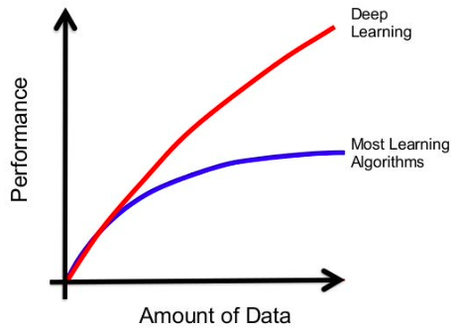
Deep Learning Vs Machine Learning

Slide 5
Time Series
Observations Taken Sequentially over the Time

Slide 6
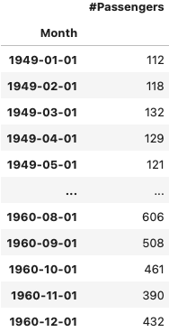
Time Series
Observations Taken Sequentially over the Time

Slide 7
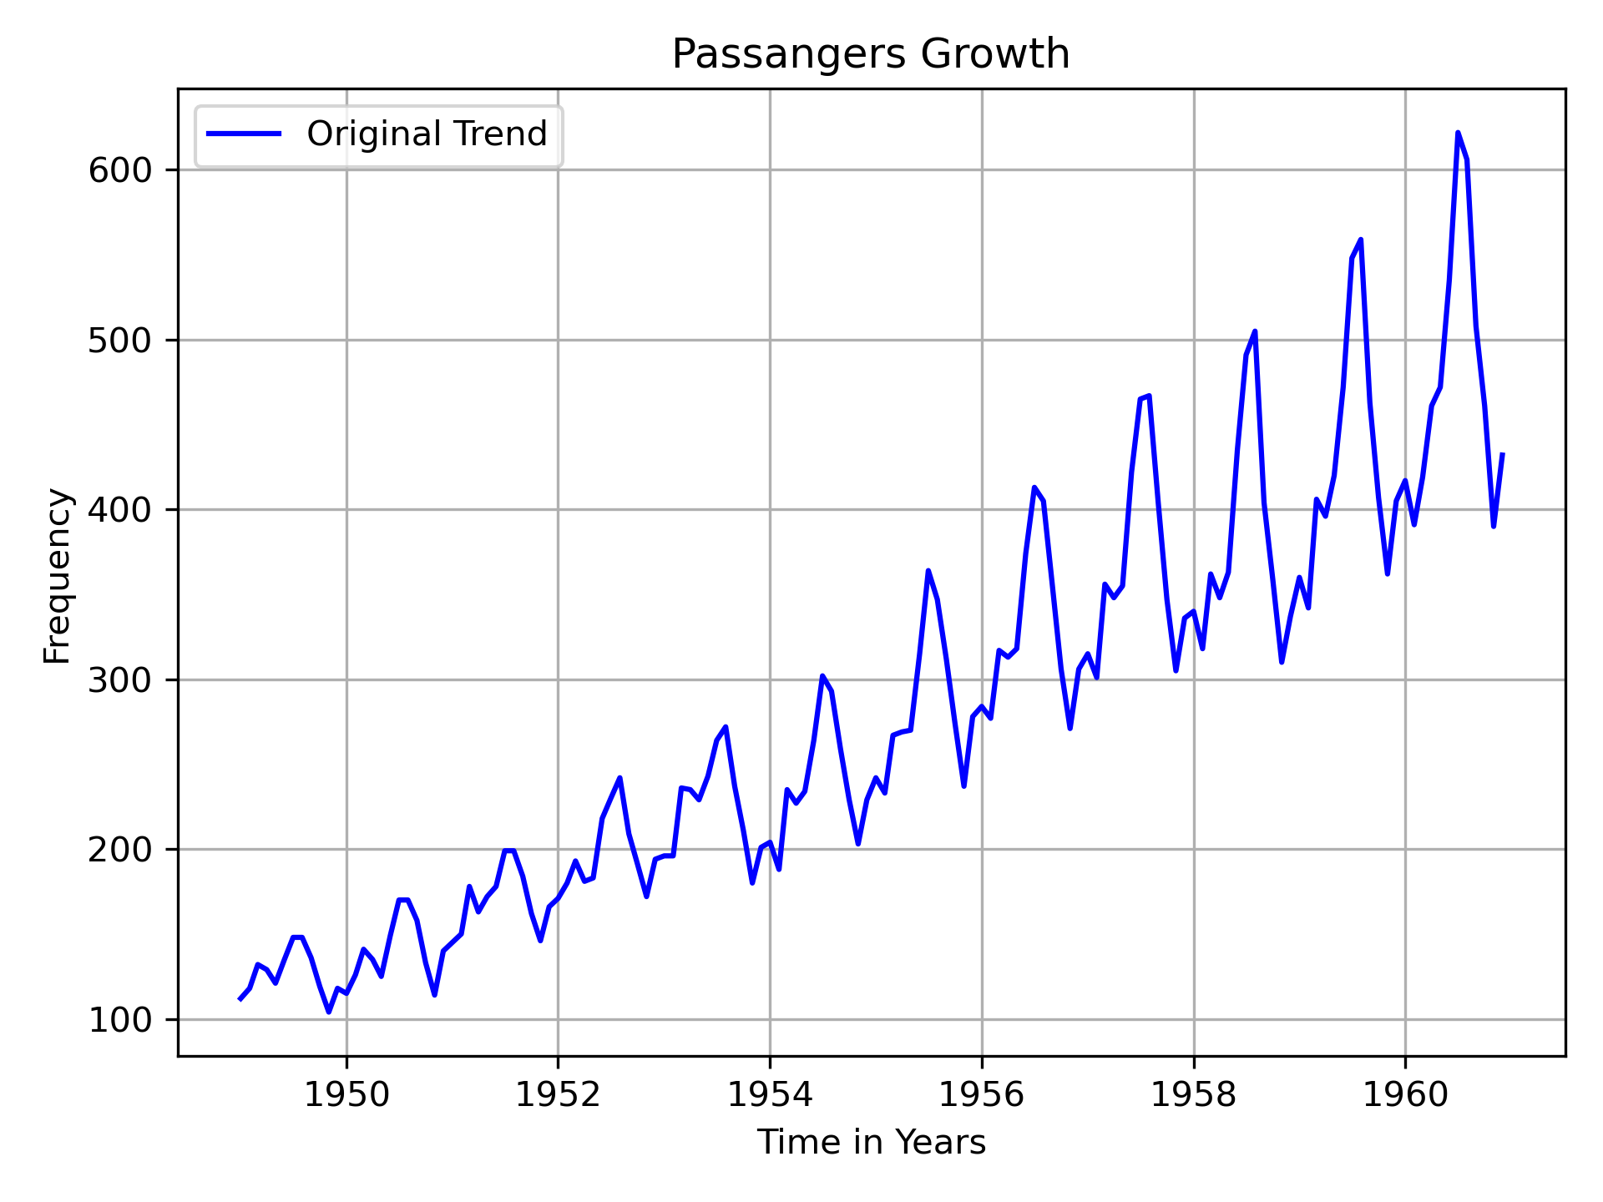
Time Series
Observations Taken Sequentially over the Time

Slide 8
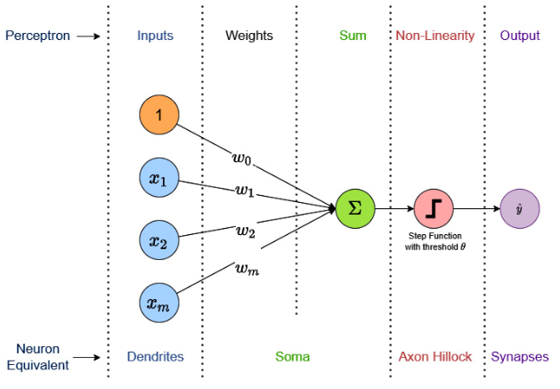
Deep Learning System Components
Perceptron
Key Points:
1.Inputs
2. Weighted Sum
3. Non-linearity

Slide 9
Deep Learning System Components
Popular Deep Learning System Paradigm
Raw Input Data
Representation Learning
Linear Classifier
Loss Function
Desired Output
Training Data
Linear Transformation
Activation Function
Linear Transformation
Output Activation Function
User Choice
1
2
3
4
5

Slide 10
Deep Learning System Components
Learns the best Features or Transformations
Representation Learning
Linear Transformation
Activation Function
2

Slide 11
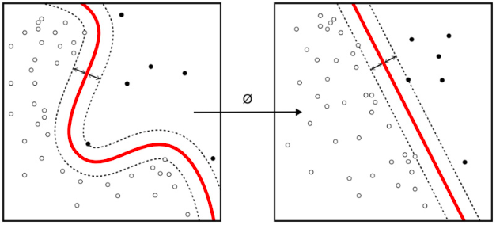
Deep Learning System Components
Learns the best Features or Transformations
Representation Learning
Linear Transformation
Activation Function
2

Slide 12
Deep Learning System Components
Learns the best Features or Transformations
Affine Transformations
Representation Learning
Linear Transformation
Activation Function
2

Slide 13
Deep Learning System Components
Learns best Features/Functions/Transformations
Affine Transformations
Representation Learning
Non-linear Differentiable Functions
Linear Transformation
Activation Function
2

Slide 14
Deep Learning System Components
Learns the best Features/Functions/Transformations
Affine Transformations
Representation Learning
Non-linear Differentiable Functions Examples:
1. Sigmoid
2. Hyperbolic Tangent (tanh)
3. ReLU
Linear Transformation
Activation Function
2

Slide 15
Deep Learning System Components
Rectified Linear Unit (ReLU)
g(x) = max(x,0)
Characteristics:
1. Values/inputs below zero are squashed to zero
2. Brings sparsity in the network
3. Output range is zero to infinity
4. Non-saturating
5. Cheap
6. Fast
Disadvantages:
1. Dead ReLUs
2. Average output is Positive

Slide 16
Deep Learning System Components
Produce Desirable Output
Linear Classifier
Linear Transformation
Output Activation Function
3

Slide 17
Deep Learning System Components
Produce Desirable Output
Enforce Desirable Properties to the Output
Linear Classifier
Linear Transformation
Output Activation Function
3

Slide 18
Deep Learning System Components
Produce Desirable Output
Enforce Desirable Properties to the Output
Linear Classifier
Regression: No Activation Function
Binary Classification: Sigmoid, tanh
Linear Transformation
Output Activation Function
3

Slide 19
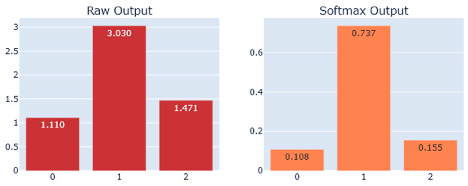
Deep Learning System Components
Produce Desirable Output
Enforce Desirable Properties to the Output
Linear Classifier
Multiclass Classification: Softmax
Linear Transformation
Output Activation Function
3

Slide 20
Deep Learning System Components
Measures Performance of the Model
Loss Function
User Choice
4

Slide 21
Deep Learning System Components
Measures Performance of the Model
Loss Function
Differentiable
User Choice
4

Slide 22
Deep Learning System Components
Train The System
Forward Propagation
Raw Input Data
Representation Learning
Linear Classifier
Loss Function
Desired Output
Training Data
Linear Transformation
Activation Function
Linear Transformation
Output Activation Function
User Choice
1
2
3
4
5
Backward Propagation

Slide 23
Deep Learning System Components
Gradient: Inform about local slope of the loss function

Slide 24
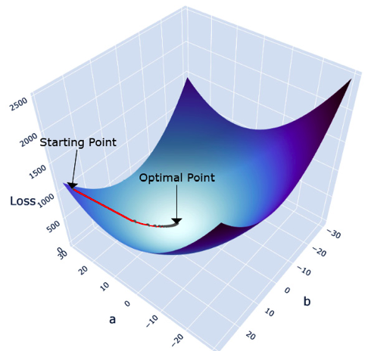
Deep Learning System Components
Gradient: Inform about local slope of the loss function
Gradient Descent: Optimize Loss Function

Slide 25
Deep Learning System Components
Gradient: Inform about local slope of the loss function
Gradient Descent: Optimize Loss Function
1. Batch Gradient Descent
2. Stochastic Gradient Descent
3. Mini-batch Gradient Descent

Slide 26
Deep Learning for Time Series
Encoder-Decoder Paradigm:
Input Space
Encoder
Latent Space

Slide 27
Deep Learning for Time Series
Encoder-Decoder Paradigm:
Input Space
Encoder
Latent Space
Decode
Prediction

Slide 28
Deep Learning for Time Series
Encoder-Decoder Paradigm:
Input Space
Encoder
Latent Space
Decode
Prediction
Loss
Loss Function

Slide 29
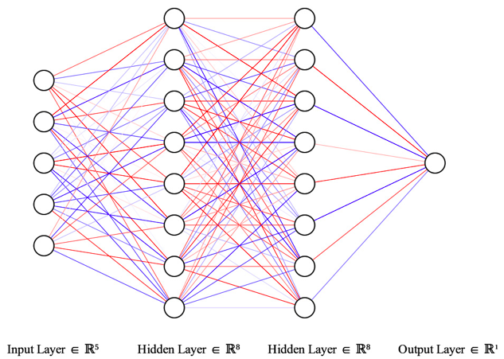
Deep Learning for Time Series
Feed-forward Networks (FFNs)

Slide 30
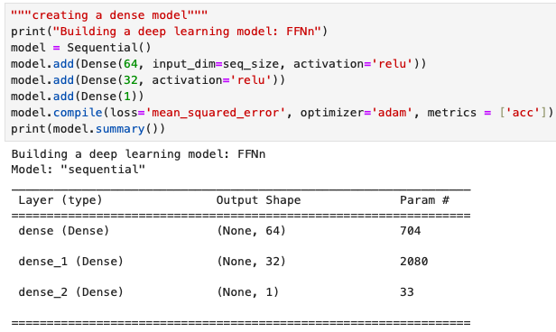
Deep Learning for Time Series
FFNs in This Project

Slide 31
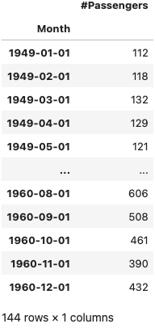
Forecast Time Series
Prepare Data for FFNs:
1. Transform Dataset (Optional but Effective)
2. Train-Test Set : splitting along the temporal axis
3. Create Input and Output from Train and Test Dataset

Slide 32
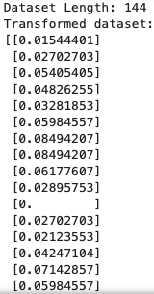
Forecast Time Series
1. Transform Dataset

Slide 33
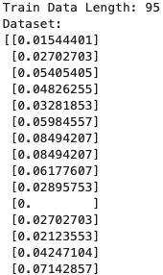
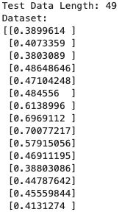
Forecast Time Series
2.Train-Test Set: Temporal Axis

Slide 34
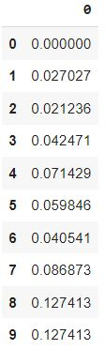
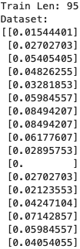
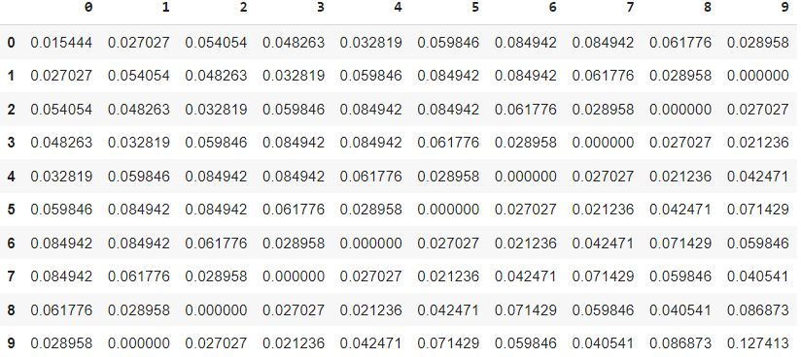
Forecast Time Series
3. Create Input and Output : sequence size 10
Output
Input

Slide 35


Forecast Time Series
3. Create Input and Output : sequence size 10

Slide 36
Forecast Time Series
Train the Model
Do Prediction
Measure Performance
Github Link

Slide 37
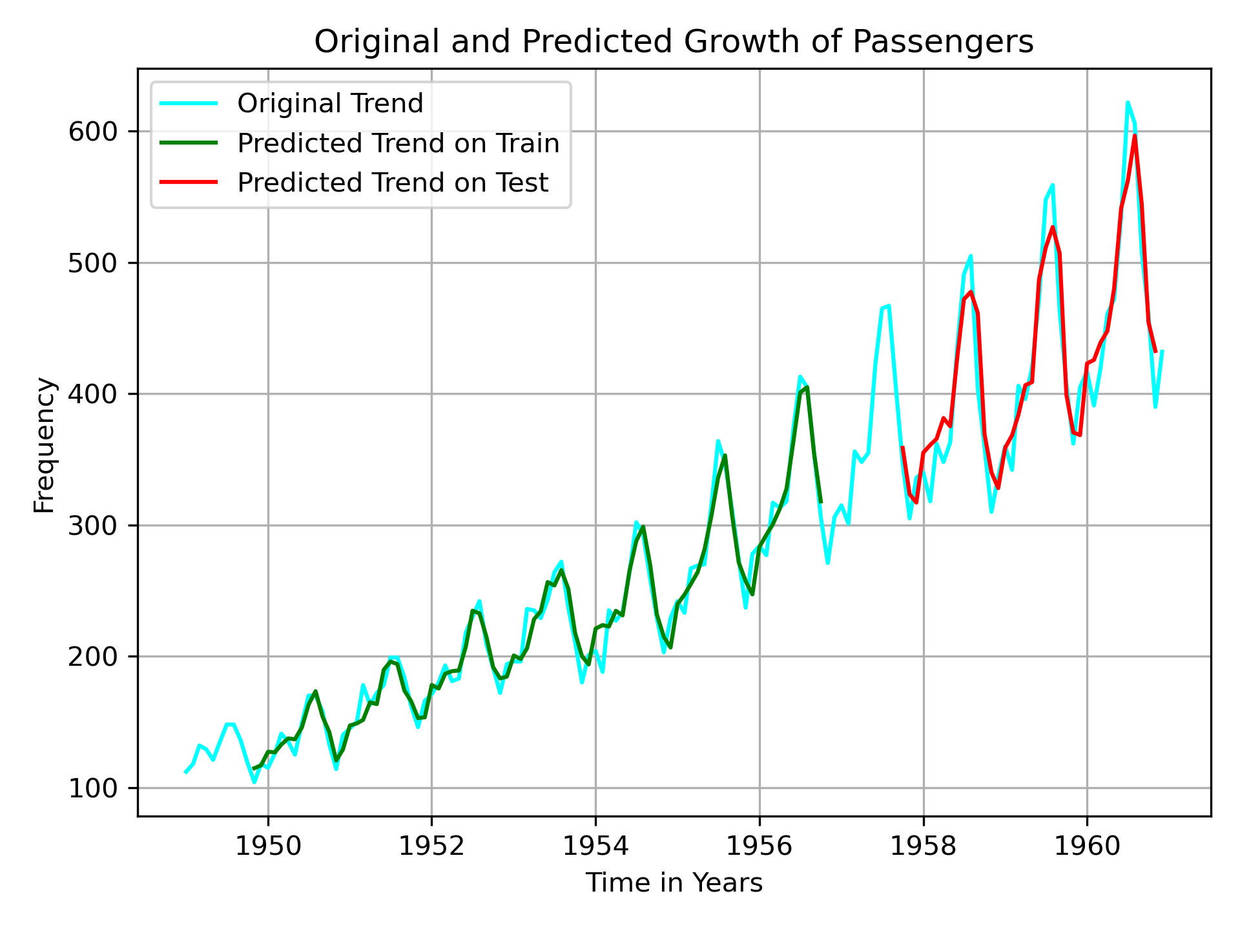
Forecast Time Series

Slide 38
Thank You Very Much
Any Questions?

