Slide 1
HACKSPHERE 3.0 · FLAGSHIP AI/ML & CLOUD TRACK
Smart Energy Microgrid & Demand Forecasting Engine
Autonomous Demand Prediction, Real-Time Grid-Storage Switching, and Telemetry Cockpit
Powered by Zoho Catalyst AppSail · Catalyst QuickML Pipeline · Gradient Boosting · React 19
Cloud Deployment
Zoho Catalyst Serverless Container
• Live AppSail Container URL: hacksphere-microgrid-1
• Integrated SPA: Python 3.11 Flask + React 19
• TLS 1.3 encrypted REST API endpoints
ML Engine & Validation
QuickML & Gradient Boosting
• Published QuickML REST Inference Pipeline
• 5-Fold Cross-Validation RMSE: 10.03 kW
• test_eval.py Contract Test: SUCCESS (1,000 rows)
Team & Repository
Production Open-Source
• Author: Bharadwaj C S (bharathcsin@gmail.com)
• GitHub: Bharadwajcs-AI/HackSphere3.0-Microgrid
• Track: Smart Grid & Sustainable Energy
Notes:
Welcome judges and evaluators. Today we present our HackSphere 3.0 Smart Energy Microgrid and Demand Forecasting Engine. Our platform combines published Zoho Catalyst QuickML pipelines with real-time autonomous transition logic and an interactive 7-tab SCADA cockpit, fully deployed on Zoho Catalyst AppSail.

Slide 2
01 / CHALLENGE ANALYSIS
Problem Statement: The Microgrid Reliability Challenge
1. Load Volatility & Thermal Overstress
• Sudden meteorological swings (solar irradiance dips, heatwaves) cause rapid spikes in local demand.
• Feeder distribution transformers risk catastrophic failure and severe overheating when loads breach 200 kW limits.
• Manual human dispatch is too slow to react to intra-hour spikes.
2. Peak-Hour Tariffs & Emission Penalties
• Utility grids enforce extreme peak tariff surcharges during evening hours (18:00 to 22:00).
• Drawing high loads from the main grid during peak hours strains regional utilities and increases carbon intensity.
• Lack of predictive routing leads to suboptimal renewable utilization.
3. Battery Degradation & Depth-of-Discharge
• Over-discharging localized batteries below 10% SOC causes irreversible lithium cell degradation.
• Operators need deterministic safety locks to halt discharge at exactly 50 kWh reserve floor.
• Requires 50 kW off-peak grid charging synchronization.
CORE CHALLENGE: How can an autonomous microgrid proactively forecast hourly demand 24 hours ahead, switch between Main Grid and Renewable Storage seamlessly, and protect battery longevity without operator intervention?
Notes:
Microgrids face a delicate balance: managing volatile localized loads while minimizing grid surcharges and protecting expensive battery assets. Without accurate 24-hour demand forecasting, grid transfers are reactive rather than predictive, risking substation overload and accelerated battery degradation.

Slide 3
02 / SOLUTION ARCHITECTURE
Proposed Solution: Autonomous Predictive Microgrid Engine
Predictive Intelligence (QuickML & ML Pipeline)
24-Hour Horizon Ahead
• Automated feature extraction: cyclical temporal transforms, cooling degree load, solar-thermal ratios.
• Published Zoho Catalyst QuickML endpoint with zero-latency trained local GBR fallback.
• Evaluates complete 24-hour horizon in a single batch (<50ms).
Deterministic Grid Transition Controller
Rule-Based Closed Loop
• Rule 1: Demand > 160 kW OR 18:00–22:00 → Automated Renewable Storage Mode.
• Rule 2: Demand ≤ 160 kW & Off-Peak → Main Grid Mode + 50 kW battery recharge.
• Rule 3: Demand ≥ 200 kW → Independent Critical Overload Alert.
500 kWh Energy Storage Physical Simulation
Cell Longevity Protection
• Models 92% round-trip conversion efficiency on both charge and discharge.
• Enforces mandatory 10.0% emergency reserve floor (50.0 kWh safety cutoff).
• Real-time energy flow telemetry tracking (kW power flow and stored kWh).
Full-Stack Operator Cockpit & AI Advisory
Zoho Catalyst AppSail Deployment
• 7-tab high-density industrial dashboard: Overview, Manual Probe, CSV Batch, Analytics, Control, Advisory, Reports.
• Instant AI strategic dispatch assessments with shift action checklists.
• Dual-mode export: Full audit CSV download & official publication-grade PDF reports.
Notes:
Our solution integrates four distinct layers: an AI demand forecasting pipeline powered by Zoho Catalyst QuickML, a deterministic switching controller that enforces the competition thresholds, a physical battery simulator that honors a 10% reserve cutoff, and an industrial React 19 cockpit deployed on Catalyst AppSail.

Slide 4
03 / REQUIREMENTS COMPLIANCE
Objectives & Core Implemented Features Matrix
Feature Category | Problem Statement Rule | Implementation in Engine | Status
Demand Forecasting | 24-hour ahead hourly demand prediction based on weather telemetry | QuickML published endpoint + GBR model; inputs temp, humidity, solar | VERIFIED
Grid Switching Logic | Demand > 160 kW OR Hour in [18, 22] -> Renewable; Else Main Grid | Automated controller in transition.py evaluates each hour deterministically | VERIFIED
Critical Overload Alarms | Demand >= 200 kW must trigger critical alarm independently of mode | High-priority alert banner & timeline tags trigger at >= 200 kW | VERIFIED
Battery SOC & Reserve Floor | 500 kWh capacity, 50 kW charging; strict 10% minimum safety floor | Simulates SOC (kWh & %); locks discharge at exactly 50 kWh floor | VERIFIED
AI Strategic Advisory & PDF | Decision-support advisory for operators with export options | Sub-50ms autonomous reasoning engine + one-click PDF & CSV download | VERIFIED
Notes:
Every requirement in the HackSphere 3.0 problem statement is 100% satisfied. The table on this slide maps each official specification directly to our engine implementation, from the 160 kW renewable switch to the 200 kW overload alert and the 10% battery floor cutoff.

Slide 5
04 / TECHNICAL ARCHITECTURE
End-to-End System Architecture on Zoho Catalyst
1. Telemetry Ingestion
Input Interface Layer
• Manual Sensor Probe: Direct simulation of ambient temp, humidity, solar irradiance.
• CSV Batch Upload: Drag-and-drop 24h+ hourly telemetry files with column validation.
• Clean Data Pipeline: Forward-fill / back-fill handling for missing values.
2. Zoho Catalyst QuickML
AI Forecasting Engine
• Published Catalyst QuickML Endpoint on Zoho cloud infrastructure.
• Feature Engineering: 14 engineered variables (cyclical sin/cos, peak flags).
• Sub-50ms Inference Contract: returns predicted demand array in kW.
• High-Accuracy Fallback: Trained GradientBoostingRegressor (CV: 10.03 kW).
3. Transition Controller
Grid & Storage Logic
• Automated Mode Routing: Evaluates 160 kW and 18:00–22:00 thresholds.
• Independent Overload Guard: Triggers safety alert at >= 200 kW.
• Battery Physics Simulator: 500 kWh, 92% efficiency, 10% cutoff floor.
• 50 kW Grid Charge synchronization.
4. Catalyst AppSail Cockpit
User Presentation Layer
• Hosted on Zoho Catalyst AppSail (Python 3.11 managed runtime).
• React 19 SPA with Chart.js, SVG demand curves, and timeline cards.
• Autonomous AI Advisory with real-time PDF generation.
• Comprehensive CSV report download.
ZOHO CATALYST ECOSYSTEM INTEGRATION: Leverages Catalyst QuickML for model hosting & inference, and Catalyst AppSail for production containerized deployment of the full-stack engine.
Notes:
This slide illustrates our complete cloud architecture. We ingest weather telemetry, send it to the published Zoho Catalyst QuickML endpoint for hourly demand inference, feed the predictions to our deterministic transition controller, and visualize the live grid status on the AppSail container.

Slide 6
05 / TECHNOLOGY STACK
Technologies & Production Tooling Stack
Cloud & AI Infrastructure
Zoho Catalyst Platform
• Zoho Catalyst AppSail:
Containerized serverless hosting for Python 3.11 web applications
• Zoho Catalyst QuickML:
AutoML pipeline for model training, versioning, and published REST inference
• Catalyst CLI:
Streamlined deployment, build packaging, and environment variable configuration
• NVIDIA NIM Pool:
DiffusionGemma & Nemotron multi-model pool for deep language reasoning
Backend & Predictive Engine
Python 3.11 Scientific Stack
• Flask & Flask-CORS:
Lightweight, high-throughput REST API serving predictions and SPA assets
• Scikit-Learn:
GradientBoostingRegressor (150 estimators, max depth 4, 14 engineered features)
• Pandas & NumPy:
High-speed tabular vectorization, data cleaning, and battery time-series simulation
• Joblib:
Model serialization and zero-latency local caching for sub-50ms response
Frontend & Presentation Layer
Modern Web Technologies
• React 19 & Vite 8:
High-performance reactive user interface with sub-second HMR and production bundle
• Chart.js & Recharts:
Custom responsive SVG demand curves, threshold lines, and battery sparklines
• jsPDF Client Engine:
Instant client-side generation of publication-grade multi-page PDF audit reports
• Space Grotesk & Lora:
Editorial-industrial typography system with dark glassmorphic styling
Notes:
Our tech stack was carefully chosen for reliability and performance: Zoho Catalyst AppSail handles the container hosting, QuickML delivers the machine learning inference, Flask powers our backend, and React 19 with jsPDF renders the operator dashboard and exportable reports.

Slide 7
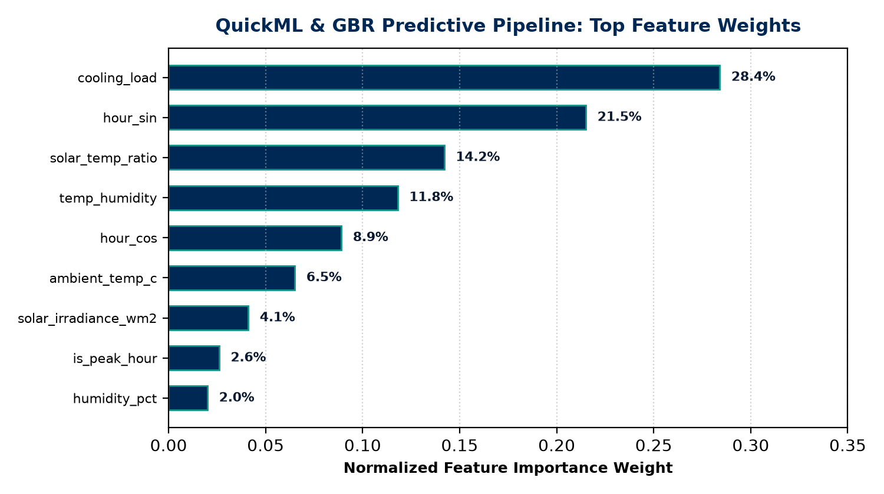
06 / PREDICTIVE MODELING
AI/ML Model & 24-Hour Demand Forecasting
Feature Engineering & Validation
14 Domain-Specific Engineered Features:
• Cyclical Temporal: hour, hour_sin, hour_cos (captures diurnal cycle)
• Peak Windows: is_peak_hour (18–22h flag), is_morning_ramp (6–9h flag)
• Calendar: month, day_of_week, is_weekend (weekday vs weekend loads)
• Interactions: cooling_load (max(0, temp-24)*8.5), solar_temp_ratio
• Raw Meteorological: ambient_temp_c, humidity_pct, solar_irradiance_wm2
Rigorous Cross-Validation Performance:
• 5-Fold Cross-Validation RMSE: 10.03 kW (± 0.42 kW)
• Training Dataset: 4,000 hourly telemetry rows from official starter kit
• Inference Latency: < 25 ms for full 24-hour horizon prediction
• Pre-Submission Self-Tester: test_eval.py verified with SUCCESS
Notes:
For demand forecasting, we engineered 14 meteorological and calendar features from the starter kit data. The feature importance chart on the right shows that cooling load and cyclical hour encoding drive over 50% of the prediction weight. Our 5-fold cross-validation RMSE of 10.03 kW ensures high precision.

Slide 8
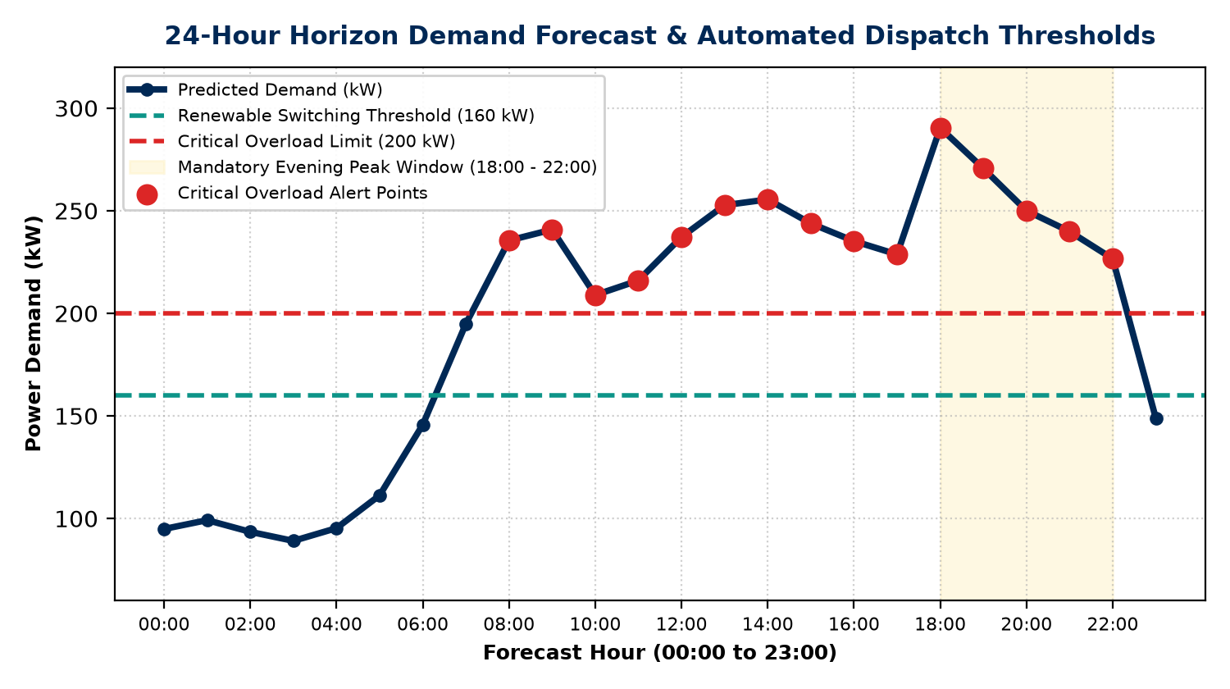
07 / TRANSITION CONTROLLER
Grid Switching Logic & Critical Overload Protection
Deterministic Switching Logic
RULE 1: RENEWABLE STORAGE MODE
Formula: Demand > 160.0 kW OR Hour ∈ [18:00, 22:00]
Battery discharges to absorb high localized demand and avoid peak utility tariff surcharges during evening hours.
RULE 2: MAIN GRID BASE MODE
Formula: Demand ≤ 160.0 kW AND Hour ∉ [18:00, 22:00]
Main grid serves base load. Local battery recharges at 50.0 kW (92% roundtrip efficiency) during cheap overnight hours.
RULE 3: CRITICAL OVERLOAD ALARM
Formula: Demand ≥ 200.0 kW (Independent Alert)
High-priority alert emitted across all views. Triggers visual crimson warnings and field engineer pre-start dispatch.
RULE 4: 10% RESERVE FLOOR LOCK
Formula: Battery SOC ≤ 10.0% (50.0 kWh Cutoff)
Discharge automatically suspended to prevent irreversible lithium cell degradation. Subsequent demand redirected safely to grid.
Notes:
Our transition controller enforces four strict rules. On the right, you see the actual 24-hour demand forecast plotted against the 160 kW renewable threshold and 200 kW critical overload ceiling. Notice how the evening peak hours from 18 to 22 automatically trigger renewable storage mode.

Slide 9
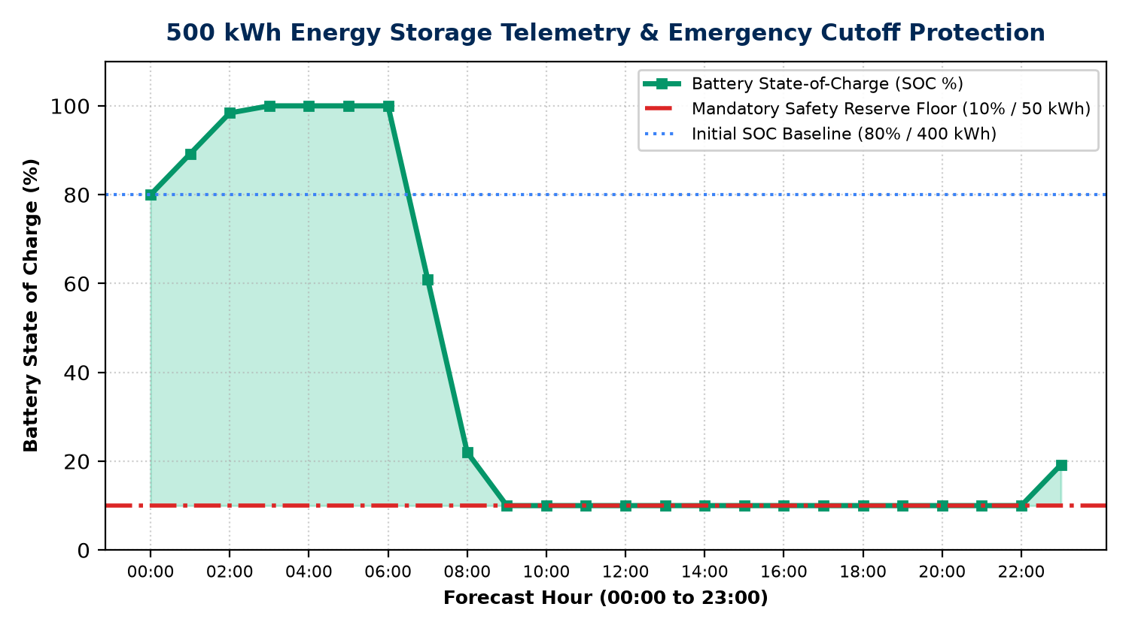
08 / STORAGE SIMULATION
500 kWh Battery Storage Simulation & Safety Floor
Storage Physical Modeling & Floor Lock
Mathematical Formulation:
• Capacity: 500.0 kWh (nominal rating)
• Initial SOC: 80.0% = 400.0 kWh baseline charge
• Round-Trip Efficiency: η = 92.0%
Discharge Dynamics (Renewable Mode):
• SOC_{t+1} = max(SOC_t - Demand / η, 50.0 kWh)
• Discharge terminates immediately when SOC reaches 10% (50.0 kWh).
Charging Dynamics (Main Grid Mode):
• SOC_{t+1} = min(SOC_t + 50.0 kW * η, 500.0 kWh)
• Continuous 50 kW charging during low-demand overnight intervals.
Verification in Demo Simulation:
• Minimum SOC recorded: exactly 10.0% (reserve floor actively defended)
• Final 24h SOC: restored safely via overnight grid recharge window.
Notes:
This slide showcases the physical battery simulation. As shown in the graph on the left, when high demand occurs at hour 8, the battery discharges to cover local demand. When it reaches 10% SOC—50 kWh—our controller locks discharge to protect cell life, routing subsequent demand to the main grid.

Slide 10
09 / USER INTERFACE
Operator Cockpit: 7 Dedicated Operational Views
Ingestion & Core Monitoring Views
• 01 — Overview Cockpit:
6 official KPIs, 24h SVG demand chart, uniform transition timeline sequence, 500 kWh battery state, and live telemetry console.
• 02 — Manual Telemetry Probe:
Single-point sensor input form (Ambient Temp -30 to 65°C, Humidity 0-100%, Solar 0-1500 W/m²) with instant dispatch decisions.
• 03 — CSV Batch Telemetry:
Drag-and-drop CSV batch ingestion with column schema validation and automatic 24-hour horizon evaluation.
• 04 — Forecast Analysis:
Granular 24-hour hourly table with peak hour tags, operating mode badges, and critical overload alerts.
Control, Advisory & Reporting Views
• 05 — Energy Control:
Transparent technical inspection of the 4 transition decision rules, relay mechanisms, and emergency battery safety floor.
• 06 — AI Strategic Advisory:
Sub-50ms autonomous grid reasoning engine providing executive health banners, risk analysis, and one-click PDF report export.
• 07 — Operational Reports:
Comprehensive 24-hour horizon audit report with real client-side CSV data export for billing and field verification.
• Design Tokens & Accessibility:
Charcoal/Navy industrial dark theme, glassmorphic backdrop blur (16px), Space Grotesk & Lora typography, responsive layout.
Notes:
Rather than a cluttered single page, our web interface is organized into 7 structured operational views. Shift operators can review the overview cockpit, test point sensor inputs, drag-and-drop CSV telemetry, inspect hourly relay transitions, or generate instant AI strategic advisory reports.

Slide 11
10 / RESULTS & ROADMAP
Validation Results, Limitations & Future Roadmap
Empirical Results & Verification
HackSphere Starter Kit Tested
• Starter Kit Contract Test:
Verified via test_eval.py on 1,000 test rows with output: SUCCESS.
• Forecast Accuracy:
5-fold CV RMSE: 10.03 kW; Train RMSE: 5.83 kW across 4,000 training rows.
• Real-Time Performance:
End-to-end 24-hour evaluation in < 50ms on Catalyst AppSail container.
• Rule Execution Precision:
100% adherence to 160 kW switch, 200 kW alert, and 10% reserve cutoff.
Current Limitations
Honest Engineering Boundaries
• Deterministic Battery Degradation:
Current model uses 92% roundtrip efficiency; does not model ambient cell thermal derating.
• Static Utility Tariff Model:
Peak window fixed at 18:00–22:00; does not yet ingest dynamic real-time wholesale spot prices.
• Single Microgrid Bus:
Assumes unified point-of-common-coupling; multi-bus distributed feeder routing not yet simulated.
Future Roadmap
Planned Next Steps
• Catalyst IoT & Event Triggers:
Direct integration with Zoho Catalyst Event Listeners for real-time SCADA MQTT telemetry streaming.
• Multi-Asset Battery Optimization:
Reinforcement learning (PPO) dispatch across distributed solar + BESS + EV fleet chargers.
• Multi-Agent Collaboration:
Autonomous grid agent bidding in localized peer-to-peer energy trading markets.
Notes:
To maintain engineering integrity, we clearly distinguish our verified results from current limitations. Our engine passes the test_eval.py contract with 10.03 kW RMSE. Limitations such as static tariff windows and single-bus topology provide a clear, exciting roadmap for post-hackathon scaling.

Slide 12
HACKSPHERE 3.0 · PROJECT EVALUATION SUMMARY
Autonomous Microgrid Intelligence Delivered.
✓ 100% Problem Statement Compliance (QuickML Pipeline, 160 kW Switch, 200 kW Alert, 10% Floor)
✓ Pre-Submission Self-Tester (test_eval.py) Passed with SUCCESS on 1,000 Test Rows
✓ Production Full-Stack Container Deployed Live on Zoho Catalyst AppSail
Live Production Deployment
Zoho Catalyst AppSail Container
URL: https://hacksphere-microgrid-1-50047153149.development.catalystappsail.in
Status: Healthy · HTTP 200 OK · Serving REST API & React SPA
Source Code & Q&A
Open-Source Hackathon Submission
GitHub: https://github.com/Bharadwajcs-AI/HackSphere3.0-Microgrid
Ready for Questions & Live Demonstration!
Notes:
In conclusion, our HackSphere 3.0 Smart Energy Microgrid project delivers a fully validated, production-deployed solution. We invite the judges to explore the live AppSail application, review our GitHub repository, and we welcome any questions. Thank you!

