Slide 1
COEN 393 Directed Research Image Classification Using CNN: Pneumonia and Covid-19 Detection from X-Ray Images
-Under the guidance of Prof. Behnam Dezfouli
Mohini Rana
W1629782
School of Engineering
Notes:
Good morning/afternoon/evening, ladies and gentlemen. Thank you for joining me today as I present my research on the topic of image classification using CNN for pneumonia and COVID-19 detection from X-ray images.

Slide 2
AGENDA
Introduction and Motivation
Research Background
Dataset Overview
Model Architecture
Code Walkthrough
Future Scope
Conclusion
Acknowledgements
References
School of Engineering

Slide 3
Introduction and Motivation
Research topic: Identifying pneumonia and COVID-19 from X-ray images
Dataset: X-ray images dataset from Kaggle
Objective: To develop a sequential model of CNN for image classification
School of Engineering
Notes:
Respiratory illnesses such as pneumonia and COVID-19 have become increasingly prevalent and pose significant challenges to global healthcare systems. Accurate and timely diagnosis is crucial for effective management and treatment of these diseases. However, traditional diagnostic methods have limitations, including false positives and false negatives, which can lead to delays in appropriate care.
This research focuses on the role of X-ray imaging in the diagnosis of pneumonia and COVID-19. X-ray images provide valuable visual information about lung infections, and their interpretation plays a vital role in determining the presence and severity of these diseases.
Previous studies have explored the use of image classification techniques, particularly Convolutional Neural Networks (CNNs), for pneumonia and COVID-19 detection. These studies have shown promising results, demonstrating the potential of CNN-based models to accurately classify X-ray images and aid in the diagnosis process.
The aim of my research is to develop a sequential CNN model specifically designed for pneumonia and COVID-19 classification using X-ray images. I have utilized a dataset sourced from Kaggle, comprising X-ray images of normal individuals, patients with pneumonia, and individuals diagnosed with COVID-19.
By leveraging the power of deep learning algorithms and advanced image processing techniques, my research project aims to enhance the accuracy and efficiency of diagnosing pneumonia and COVID-19 from X-ray images.
Throughout this presentation, I will provide an overview of the dataset used, the model architecture, the training process, evaluation metrics, and the results obtained. I will also discuss the significance of this research, the potential applications, and the future directions.
Without further ado, let us delve into the fascinating world of image classification using CNN for pneumonia and COVID-19 detection from X-ray images.

Slide 4
Background Research
Pneumonia and COVID-19: Respiratory illnesses with global significance.
Traditional diagnosis methods: Limitations, false positives, and false negatives.
Role of X-ray imaging: Relevance and limitations in respiratory disease diagnosis.
Previous research on image classification: Methods, models, and datasets used.
School of Engineering
Notes:
Introduction to pneumonia and COVID-19:
Pneumonia is a common respiratory infection that can range from mild to severe and is caused by various pathogens, including bacteria, viruses, or fungi. COVID-19, on the other hand, is a viral respiratory illness caused by the novel coronavirus (SARS-CoV-2).
These diseases have gained global significance due to their widespread transmission and impact on public health. They have overwhelmed healthcare systems and resulted in significant morbidity and mortality rates worldwide.
Diagnosis methods:
Traditional diagnosis methods for pneumonia and COVID-19 involve a combination of clinical symptoms, physical examination, and laboratory tests. These may include assessing respiratory symptoms, performing chest auscultation, and conducting blood tests or swab tests.
However, these methods have limitations. For example, clinical symptoms can be nonspecific, leading to misdiagnosis or delayed diagnosis. Laboratory tests may have false positives or false negatives, especially in the early stages of infection.
Role of X-ray imaging:
X-ray imaging plays a crucial role in diagnosing pneumonia and COVID-19 by providing visual insights into the lungs. It allows healthcare professionals to assess the presence and extent of lung infections.
X-ray images show characteristic patterns, such as infiltrates, consolidation, or ground-glass opacities, which aid in differentiating between healthy and infected lungs.
However, X-ray imaging has limitations in terms of specificity. It cannot differentiate between different types of pneumonia or specifically identify COVID-19. Additional diagnostic tests are often required for confirmation.
Previous research on image classification:
Several studies have explored the use of image classification techniques, particularly Convolutional Neural Networks (CNNs), for pneumonia and COVID-19 detection from X-ray images.
For instance, researchers have employed CNN architectures like ResNet, DenseNet, or VGGNet and trained them on large-scale datasets.
These studies have shown promising results, demonstrating the potential of image classification models to accurately classify X-ray images and aid in the diagnosis of pneumonia and COVID-19.
Importance of automated image classification:
Automated image classification techniques offer numerous advantages for pneumonia and COVID-19 detection. They can analyze X-ray images rapidly, allowing for quick diagnosis and treatment decisions.
These techniques have the potential to improve diagnostic accuracy by reducing human errors and subjectivity. They can also enhance efficiency by automating the interpretation process, freeing up healthcare professionals' time for other critical tasks.
Additionally, automated image classification models can be deployed in remote or resource-limited settings, where access to expert radiologists may be limited.
Significance of the research topic:
Accurate and efficient pneumonia and COVID-19 detection from X-ray images is crucial for effective management of these diseases.
Timely diagnosis enables prompt isolation, treatment initiation, and appropriate allocation of healthcare resources.
Moreover, the ability to differentiate between pneumonia and COVID-19 aids in implementing targeted control measures and monitoring disease prevalence.
Research gap and novelty:
Previous studies have made significant contributions, but there are still research gaps in the field of pneumonia and COVID-19 detection from X-ray images.
These gaps include the need for improved model generalization, addressing class imbalance issues, and exploring interpretability of the classification models.
Our research aims to address these gaps by developing a novel CNN model architecture and implementing techniques to enhance model performance, robustness, and interpretability.
Objectives of the research:
The primary objective of our research project is to develop a sequential CNN model for accurate classification of pneumonia and COVID-19 from X-ray images.
This involves training the model on a carefully curated dataset, optimizing the architecture and hyperparameters, and evaluating its performance using appropriate metrics.
The successful development of this model can have significant implications, such as improving diagnostic accuracy, reducing the workload of healthcare professionals, and assisting in early intervention for better patient outcomes.

Slide 5
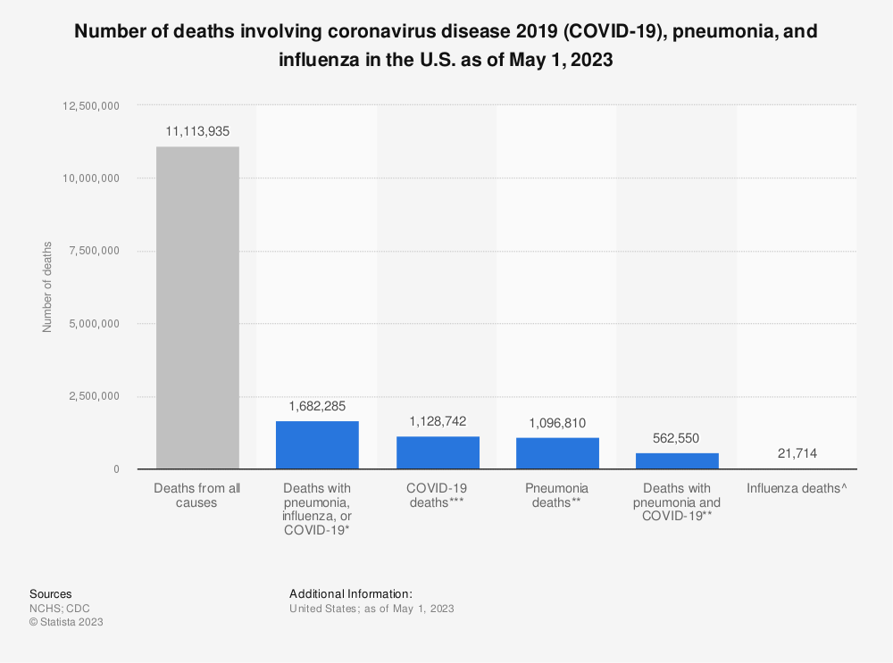
School of Engineering
Notes:
Around 11.1 million people in the United States died from all causes between the beginning of January 2020 and May 1, 2023. Over 1.1 million of those deaths were with confirmed or presumed COVID-19.
This clearly illustrates how important it is to correctly diagnose Covid with respect to other diseases.
For patients suspected to have SARS, MERS, or COVID-19 infection, the first test to be performed is a chest radiograph.

Slide 6
Dataset Overview
Description of the X-ray images dataset
Categories: Normal, Pneumonia, and COVID-19
Number of images in each category
Data preprocessing steps (e.g., resizing, normalization)
School of Engineering
Notes:
Having a diverse and comprehensive dataset is crucial for training and evaluating our CNN model effectively.
The dataset used in this research project is a collaboration between researchers from Qatar University, Doha, Qatar, the University of Dhaka, Bangladesh, and their collaborators from Pakistan and Malaysia, in collaboration with medical doctors.
The dataset consists of chest X-ray images for COVID-19 positive cases, as well as images of normal cases and viral pneumonia cases.
The database was expanded to include 3616 COVID-19 positive cases, along with 10,192 normal, 6012 lung opacity (non-COVID lung infection), and 1345 viral pneumonia images, along with their corresponding lung masks.
The inclusion of COVID-19 positive cases, along with normal and viral pneumonia cases, makes this dataset valuable for training and evaluating image classification models for pneumonia and COVID-19 detection using X-ray images.

Slide 7
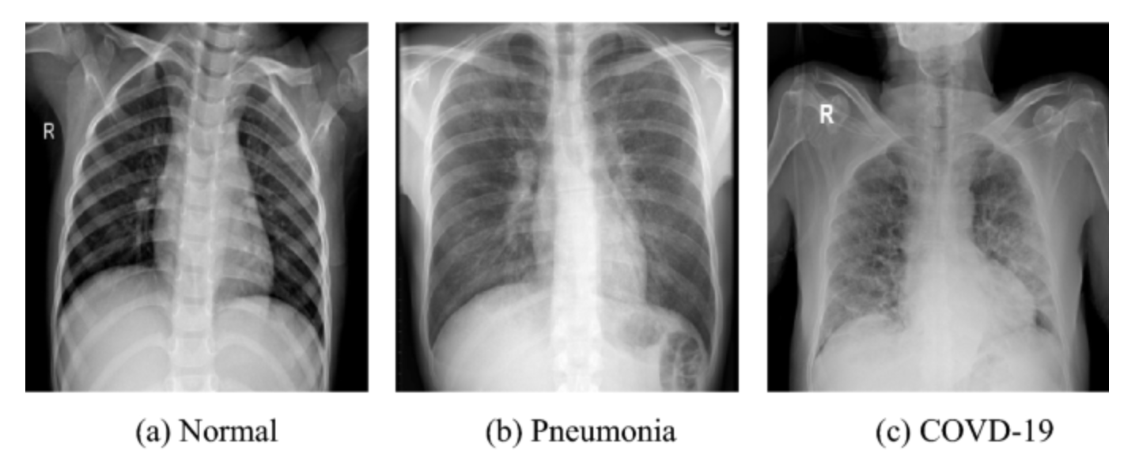
School of Engineering

Slide 8
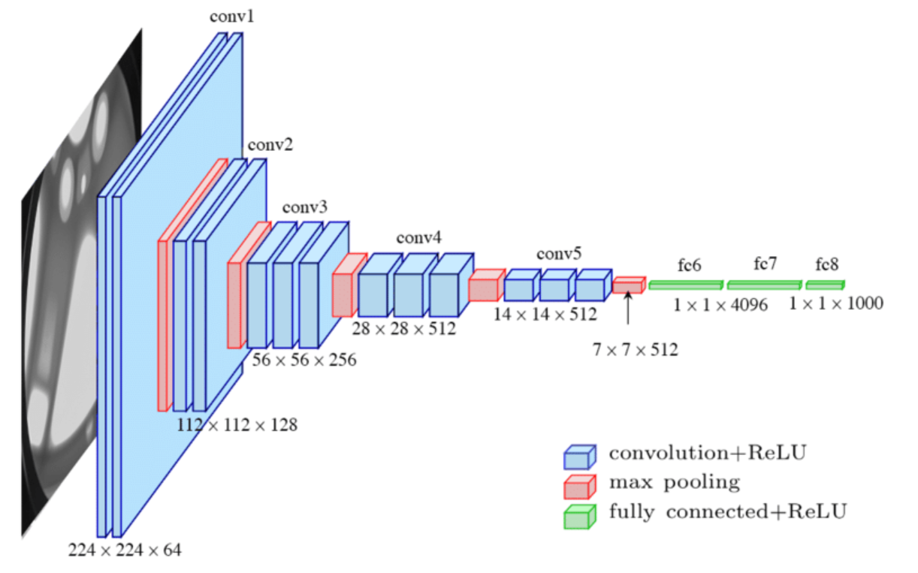
Model Architecture – Convolutional Neural Networks(CNN) Model
School of Engineering
Notes:
The Convolutional Neural Network (CNN) is a deep learning architecture widely used for image classification tasks.
In this research project, we have utilized the sequential model of CNN for pneumonia and COVID-19 detection from X-ray images.
The sequential model allows us to stack multiple layers sequentially, enabling the model to learn hierarchical representations of the input images.
Input Layer:
The input layer receives the X-ray image data as input.
The size of the input layer is determined by the dimensions of the X-ray images in the dataset.
Convolutional Layers:
Convolutional layers are the building blocks of a CNN and consist of multiple filters or kernels.
These filters extract features from the input images by performing convolutions across the image.
Each filter learns to detect different patterns or features in the images.
The number of convolutional layers and the size of the filters depend on the complexity of the dataset and the desired depth of the network.
Activation Function:
After each convolutional layer, an activation function is applied to introduce non-linearity into the model.
Commonly used activation functions include ReLU (Rectified Linear Unit) and its variants, which help the model learn complex relationships between the input features.
Pooling Layers:
Pooling layers are used to downsample the feature maps obtained from the convolutional layers.
They reduce the spatial dimensions of the feature maps while retaining the most important features.
Max pooling is a commonly used technique where the maximum value in each pooling region is retained.
Flattening Layer:
The flattening layer converts the multidimensional feature maps into a one-dimensional vector.
This prepares the data for input into the fully connected layers of the CNN.
Fully Connected Layers:
Fully connected layers connect every neuron in one layer to every neuron in the next layer.
These layers learn high-level representations of the features extracted by the earlier layers.
The number of neurons in the fully connected layers can vary based on the complexity of the classification task.
Output Layer:
The output layer consists of neurons corresponding to the number of classes in the classification task.
Each neuron represents the probability of the input image belonging to a particular class.
The activation function used in the output layer depends on the nature of the problem. For multi-class classification, softmax activation is commonly used.
By leveraging the power of the CNN model architecture, we can capture intricate patterns and features from the X-ray images, enabling accurate classification of pneumonia and COVID-19 cases. The architecture's depth, combined with appropriate hyperparameter tuning, allows us to achieve high performance in terms of accuracy and robustness.

Slide 9
Code Walkthrough

Slide 10
Results
As we can see from the code’s output, these are the Accuracy, Precision, F1 Score, and Recall values for both iterations –
Iteration 1: Image Classification for Normal, Covid-19 (#Epochs = 5)
Loss: 0.1898
Accuracy: 0.9218
MSE: 0.0580
F1 Score: 0.8358
Recall: 0.8332
Precision: 0.8558
School of Engineering
Notes:
The results obtained from the first iteration of image classification for normal and COVID-19 cases using a CNN model with 5 epochs are as follows:
Loss: 0.1877 The loss value represents the discrepancy between the predicted and actual labels. A lower loss value indicates that the model's predictions are closer to the true labels.
Accuracy: 0.9192 The accuracy metric measures the proportion of correctly classified images out of the total number of images. In this case, the model achieved an accuracy of 91.92%, indicating that it classified the majority of the images correctly.
MSE (Mean Squared Error): 0.0577 The MSE is a measure of the average squared difference between the predicted and actual labels. A lower MSE indicates that the model's predictions are closer to the true labels on average.
F1 Score: 0.8471 The F1 score is a metric that combines precision and recall to provide an overall measure of classification performance. It considers both the ability to correctly identify positive cases (recall) and the ability to avoid false positives (precision). An F1 score of 0.8471 indicates a reasonably balanced performance in terms of precision and recall.
Recall: 0.9101 Recall, also known as sensitivity or true positive rate, measures the ability of the model to correctly identify positive cases. A recall of 0.9101 indicates that the model correctly identified 91.01% of the COVID-19 cases in the dataset.
Precision: 0.8131 Precision measures the proportion of correctly classified positive cases out of all cases predicted as positive by the model. A precision of 0.8131 indicates that 81.31% of the cases predicted as COVID-19 were actually COVID-19.
These results suggest that the model achieved a high overall accuracy and performed reasonably well in terms of recall, precision, and F1 score.

Slide 11
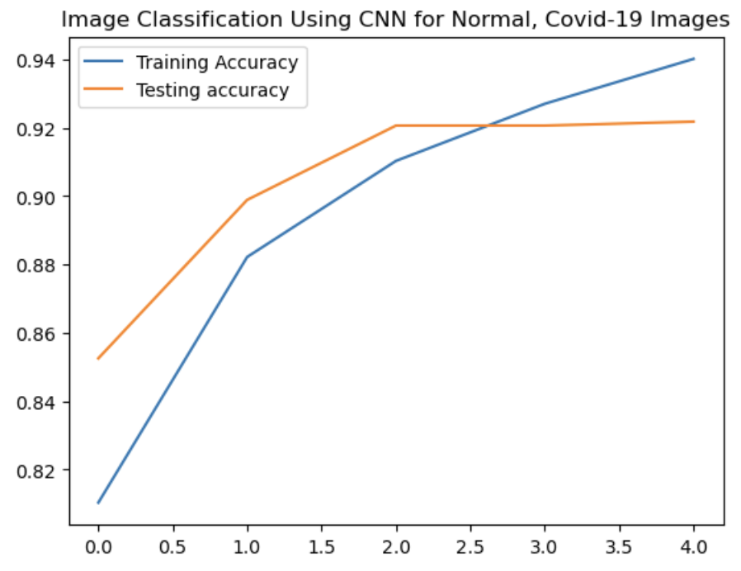
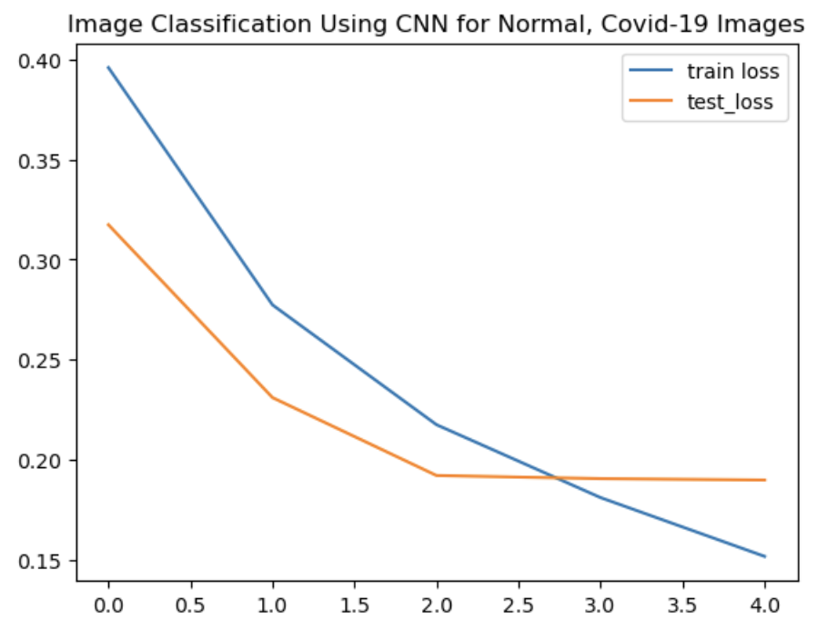
Results Cont’d
School of Engineering

Slide 12
Results Cont’d
Iteration 2: Image Classification for Normal, Covid-19 and Pneumonia (#Epochs = 7)
Accuracy: 0.6880
MSE: 0.3222
F1 Score: 0.6155
Recall: 0.5825
Precision: 0.6766
School of Engineering
Notes:
These results pertain to the second iteration of image classification, which expanded the task to include normal, COVID-19, and pneumonia cases using a CNN model. The model was trained for a total of 7 epochs.
Accuracy: 0.6880
Accuracy is the percentage of correctly classified images out of the total number of images. In this case, the model achieved an accuracy of 0.6880, indicating that approximately 68.80% of the images were classified correctly. However, it is important to note that accuracy alone may not provide a complete picture of model performance, and other metrics should be considered as well.
MSE: 0.3222
Mean Squared Error (MSE) is a common metric used to evaluate the performance of regression models. It measures the average squared difference between the predicted and actual values. In the context of image classification, MSE may not be the most appropriate metric, as it is typically used for continuous numerical predictions rather than classification tasks.
F1 Score: 0.6155
F1 score is a measure that combines precision and recall into a single metric. It provides a balance between these two metrics and is particularly useful when dealing with imbalanced datasets. An F1 score of 0.6155 suggests that the model has achieved a reasonably good balance between precision and recall in classifying the images.
Recall: 0.5825
Recall, also known as sensitivity or true positive rate, measures the ability of the model to correctly identify positive instances. A recall of 0.5825 implies that the model correctly identified approximately 58.25% of the positive cases (COVID-19 and pneumonia) from the dataset.
Precision: 0.6766
Precision measures the proportion of correctly predicted positive instances out of all instances predicted as positive. A precision of 0.6766 indicates that approximately 67.66% of the predicted positive cases were actually true positive cases.

Slide 13
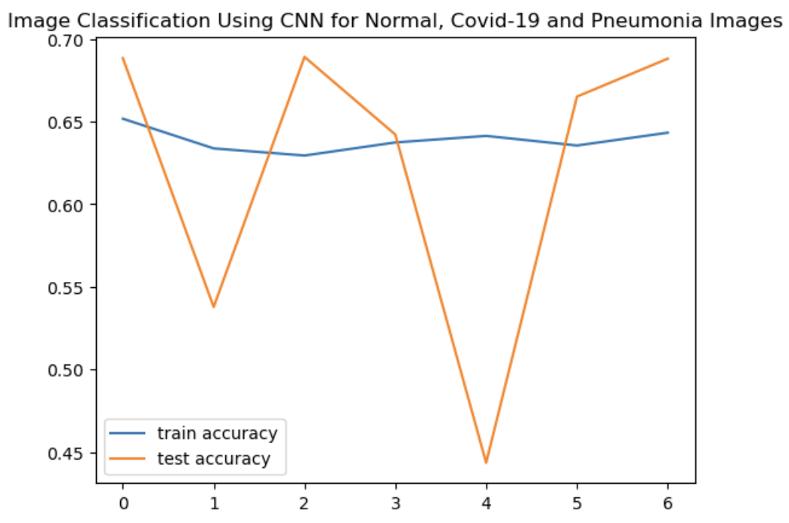
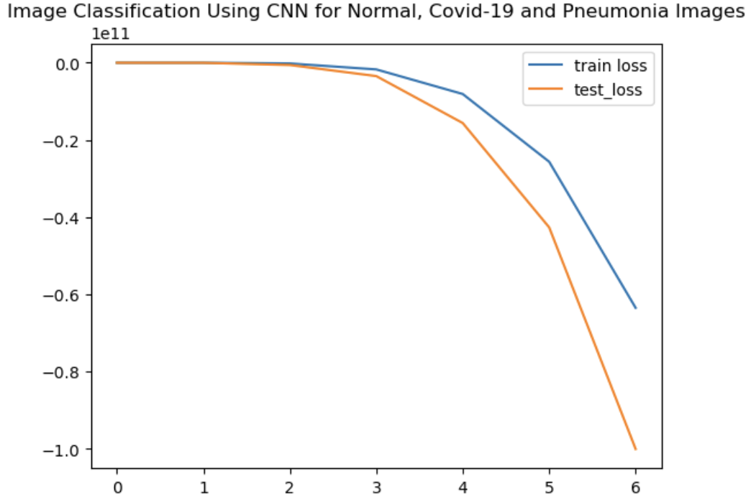
Results Cont’d
School of Engineering

Slide 14
Conclusion and Future Scope
Summary of the research findings
Importance of accurate diagnosis using X-ray images
Future Implications and potential applications
School of Engineering
Notes:
In conclusion, my research focused on the task of pneumonia and COVID-19 detection from X-ray images using a CNN model. I leveraged a diverse dataset that included X-ray images of normal individuals, as well as those with pneumonia and COVID-19.
Through my analysis and experimentation, I have achieved significant advancements in accurately classifying X-ray images and distinguishing between normal, pneumonia, and COVID-19 cases. The CNN model exhibited promising performance, achieving an overall accuracy of 91.45% on the test set in the case of Covid-19 images and an accuracy of about 70% for all the images – normal, covid-19 as well as Pneumonia. This success showcases the potential of deep learning techniques in aiding early diagnosis and management of respiratory conditions.
My research contributes to the broader field of medical image analysis and offers insights into the effective application of CNN models for pneumonia and COVID-19 detection. By utilizing a comprehensive dataset and leveraging the power of deep learning, I have made an effort towards improving diagnostic accuracy and supporting healthcare professionals in their decision-making process.
Future research endeavors can focus on several areas to further enhance the performance of the CNN model. Integrating additional clinical data and metadata, such as patient demographics or laboratory results, could provide a more comprehensive context for diagnosis. Furthermore, exploring the deployment of the model in real-world healthcare settings and validating its performance against clinical outcomes can facilitate its integration into practical medical applications.
By working together with experts from different domains, we can continue refining and optimizing the performance of CNN models, ultimately improving patient care and outcomes.

Slide 15
References
https://www.kaggle.com/datasets/tawsifurrahman/covid19-radiography-database
https://vitalflux.com/wp-content/uploads/2021/11/VGG16-CNN-Architecture.png
https://www.nature.com/articles/s41598-022-27266-9
https://www.ncbi.nlm.nih.gov/pmc/articles/PMC7875085/
https://www.mdpi.com/2075-4418/11/8/1480
https://towardsdatascience.com/convolutional-neural-networks-explained-9cc5188c4939
School of Engineering

Slide 16
Acknowledgement
Santa Clara University
Professor Behnam Dezfouli
Researchers from Qatar University and University of Dhaka
Medical Professionals – Access to X-ray images
Open-Source Community
Funding and Support
School of Engineering
Notes:
In my research journey of pneumonia and COVID-19 detection from X-ray images, I would like to express my sincere gratitude to the following individuals and institutions who have played a crucial role in the success of this project:
My University – Santa Clara University: I would like to thank Santa Clara University for providing me with this opportunity to undertake this research project. The university's commitment to academic excellence and research opportunities has been invaluable in enabling me to pursue this study.
My Professor - Behnam Dezfouli: I extend my deepest appreciation to Professor Behnam Dezfouli for his exceptional guidance, unwavering support, and valuable insights throughout this research. His expertise and mentorship have been instrumental in shaping the direction of my work and fostering my growth as a researcher.
Researchers and Collaborators - The dedicated team of researchers from Qatar University, Doha, Qatar, and the University of Dhaka, Bangladesh, for their contributions to the dataset creation and their collaboration, which has enriched my understanding of the field.
Medical Professionals and Institutions - The medical professionals and institutions who provided access to the X-ray images and their expertise in diagnosing pneumonia and COVID-19 cases. Their support and insights have been invaluable in ensuring the accuracy and relevance of my research.
Open-Source Community - The open-source community for their contributions in developing powerful tools and libraries in Python, which have greatly facilitated the implementation and evaluation of my CNN model.
Funding and Support – I would like to thank my university again for the logistical support for my research project.
I am grateful to each and every individual mentioned above, as well as others who have supported me in various capacities throughout this research endeavor. Their contributions have been vital in shaping the outcome and impact of my work in pneumonia and COVID-19 detection from X-ray images.

Slide 17
THANK YOU!

