Slide 1
Infosys Springboard
Supply Chain Visibility System with Optimization Analytics
End-to-End Logistics Dashboard using Power BI
1

Slide 2


Infosys Springboard
THE CHALLENGE
Problem Statement
Existing Challenges
Impact
No centralized supply chain monitoring
Poor inventory visibility
Delayed deliveries and order fulfillment
High transportation and logistics costs
Difficulty evaluating supplier performance
Low warehouse utilization
Slow business decision-making
The Consequence
These fragmented processes and visibility gaps create a compounding negative effect across the entire business ecosystem.
These challenges actively increase operational costs, significantly reduce internal efficiency, and directly hurt end-customer satisfaction.
Supply Chain Visibility System with Optimization Analytics
2

Slide 3

Infosys Springboard
The Solution
Project Overview
Modern supply chains generate massive amounts of operational data — from procurement and inventory to transportation, suppliers, warehouses, and deliveries. Organizations often struggle to monitor these moving parts because the data is fragmented and visibility stays limited to individual teams.
5
Connected Data
Domains
1
Unified Power BI
Dashboard
The Solution
This project develops an interactive Power BI dashboard that integrates supply chain data into a single platform — enabling real-time monitoring, KPI tracking, and data-driven decision-making across the entire logistics network.
360°
Operational
Visibility
Supply Chain Visibility System with Optimization Analytics
3

Slide 4






Infosys Springboard
GOALS
Project Objectives
The primary goal is to establish a single source of truth for global logistics operations.
Develop an end-to-end, highly interactive Power BI dashboard.
Improve inventory visibility and control mechanisms.
Monitor delivery performance and fulfillment rates in real time.
Evaluate supplier reliability and establish accurate rankings.
Analyze transportation costs and route efficiency globally.
Optimize warehouse utilization and storage capacity.
Enable faster, data-driven decisions at the executive level.
Supply Chain Visibility System with Optimization Analytics
4

Slide 5



Infosys Springboard
DATA FOUNDATION
Dataset & Tooling
PRIMARY DATASET
TOOLS USED
WHY THIS DATASET?
DataCoSupplyChainDataset (Kaggle)
Microsoft Power BI
Real-World Relevance
Includes orders, product, customer, shipment, delivery status and geographic location data.
Power Query for ETL, DAX for calculated measures and CSV files as the raw data source.
Comprehensive, real-world logistics and supply chain data — perfectly suited for deep, end-to-end analytics.
Supply Chain Visibility System with Optimization Analytics
5

Slide 6
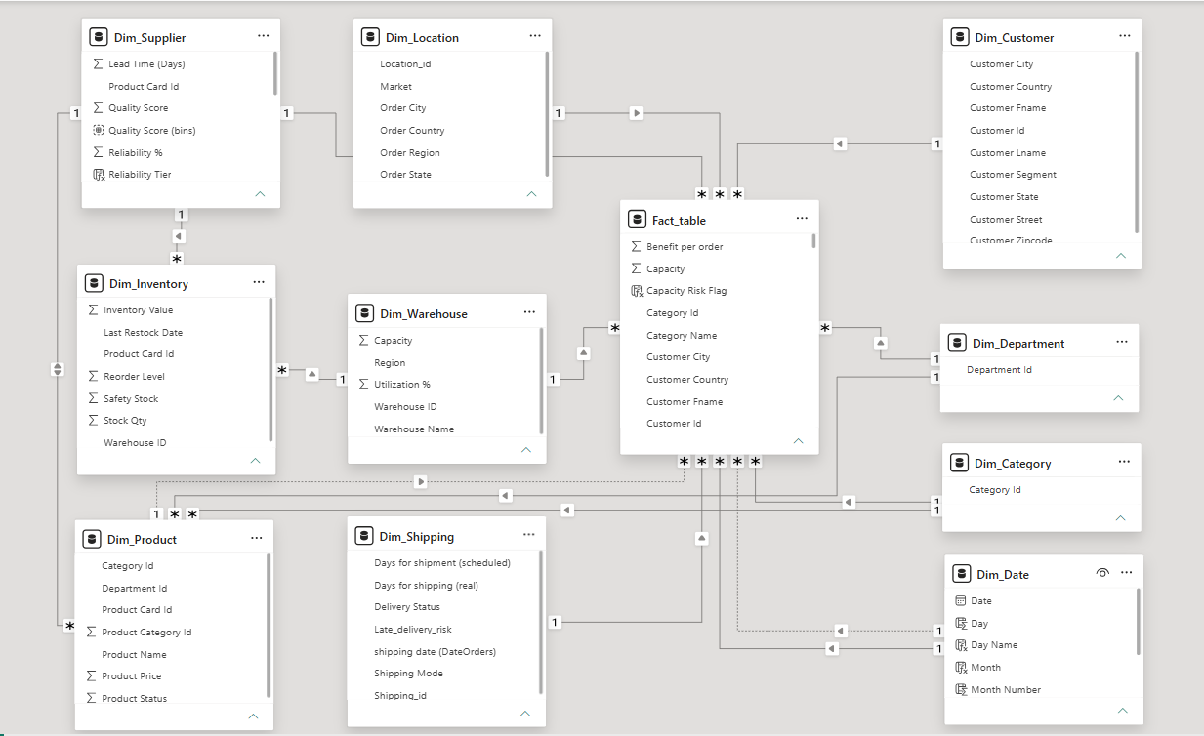
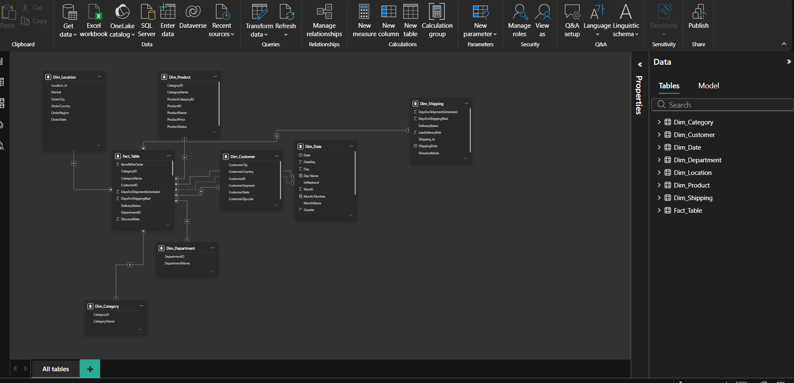
Infosys Springboard
DATA ARCHITECTURE
Star Schema Data Model
Fact Table
Fact Table: Orders, Sales, Quantity, Profit, Shipping Information, Customer, Product, Category, Department, Shipping, Location, Date.
Modeling Benefits
Significantly faster reporting
Optimized DAX query performance
Easy and accurate KPI calculations
Better scalability for future data loads
Supply Chain Visibility System with Optimization Analytics
6

Slide 7









Infosys Springboard
ANALYTICAL WORKFLOW
Dashboard Architecture
Data Sources
Data Ingestion
Data Cleaning
Star Schema Modeling
DAX Measures & KPIs
Interactive Dashboard
Business Insights & Decisions
KEY FEATURES
Interactive Filters
Drill-Through Reports
KPI Cards
Trend Analysis
Supply Chain Visibility System with Optimization Analytics
7

Slide 8
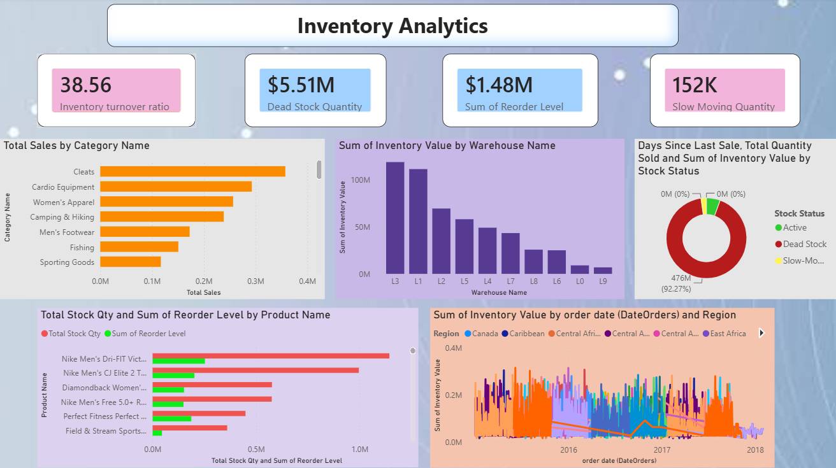

Infosys Springboard
Inventory Analytics
KEY METRICS
Inventory Turnover Ratio
Total Inventory Value
Dead Stock Identification
Slow Moving Products
Fast Moving Products
Reorder Status & Alerts
Business Benefit
Improves overall inventory planning and significantly reduces excess stock while ensuring high product availability for customers.
Supply Chain Visibility System with Optimization Analytics
8

Slide 9
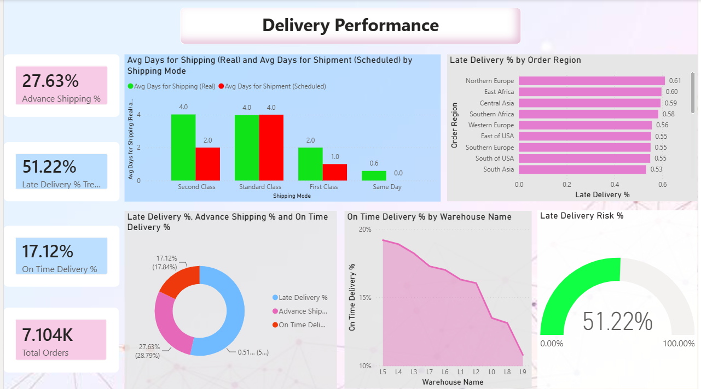
Infosys Springboard
Delivery Performance
KEY METRICS
On-Time Delivery %
Delayed Deliveries Count
Average Delivery Lead Time
Order Fulfillment Rate
Regional Delivery Performance
Historical Delivery Trends
Business Benefit
Improves logistical delivery efficiency, isolates regional bottlenecks, and directly enhances end-customer satisfaction.
Supply Chain Visibility System with Optimization Analytics
9

Slide 10

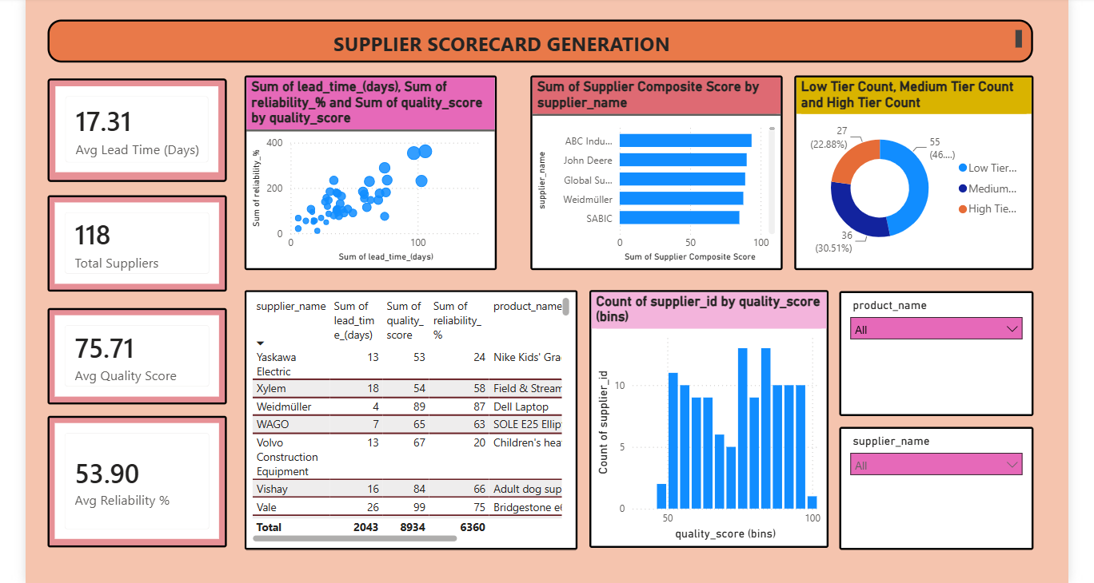
Infosys Springboard
Supplier Performance
KEY METRICS
Comprehensive Supplier Scorecard
Average Supplier Rating
Purchase Order Fulfillment %
Quality Performance
Historical Supplier Reliability
Global Supplier Ranking
Business Benefit
Helps explicitly identify top-performing suppliers, mitigate risk, and improves strategic procurement decisions.
Supply Chain Visibility System with Optimization Analytics
10

Slide 11
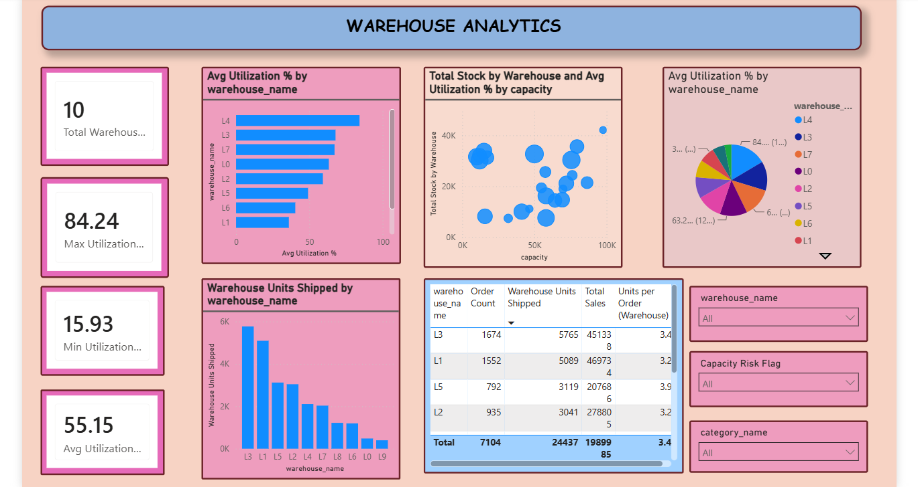
Infosys Springboard
Warehouse Analytics
KEY METRICS
Warehouse Space Utilization
Throughput Volume Analysis
Storage Efficiency %
Future Capacity Planning
Productivity Metrics
Inventory Count Accuracy
Business Benefit
Maximizes internal warehouse efficiency, prevents overloading, and optimizes physical resource utilization.
Supply Chain Visibility System with Optimization Analytics
12

Slide 12
Infosys Springboard
Glimpse of Dashboard
Interactive Features of Dashboard
Delivery Performance
Slicers
Drill-Down
Drill-Through
Tooltips
Cross-Filtering
Navigation Buttons
Dynamic KPI Cards
Time Period Toggle
Reset Filters
Transportation Analytics
Warehouse Analytics
Built end-to-end in Power BI on the DataCo Global Supply Chain dataset from raw CSVs to executive-ready insight.
Supply Chain Visibility System with Optimization Analytics
14

Slide 13
Infosys Springboard
FINDINGS
Key Insights Discovered
Visibility
Inventory
Delivery
Procurement
Achieved centralized visibility across the entire global supply chain.
Turnover metrics actively highlight fast- and slow-moving products for better procurement.
Delivery analytics drastically improve on-time shipment performance visibility.
Supplier scorecards provide empirical data to support vendor evaluation and negotiation.
Cost Reduction
Operations
Leadership
Transportation analysis successfully identifies immediate cost-saving opportunities in routing.
Warehouse KPIs improve space utilization and daily operational efficiency.
The Executive dashboard enables faster, highly confident data-driven decisions.
Supply Chain Visibility System with Optimization Analytics
15

Slide 14


Infosys Springboard
WRAPPING UP
Conclusion & Future Scope
Conclusion
Future Scope
The proposed Power BI solution successfully integrates inventory, supplier, transportation, warehouse, and delivery data into a unified dashboard.
AI-based demand forecasting
IoT-enabled warehouse monitoring
Real-time ERP integration
Predictive logistics analytics
It significantly enhances operational visibility, improves leadership decision-making, reduces complex logistics costs, and supports highly efficient modern supply chain management.
Mobile dashboard application
Automated alerts and push notifications
Supply Chain Visibility System with Optimization Analytics
16

Slide 15
Infosys Springboard
THE TEAM
Project Team
Abhay Kumar Inventory Analytics
David Mahesh Delivery Performance
Mohinish Sai Supplier Performance
AK
DM
MS
Nitish Kumar Yadav Transportation Analytics
Raghul Warehouse Analytics
Vigasvel Inventory Analytics
NK
R
V
Supply Chain Visibility System with Optimization Analytics
17

Slide 16

Infosys Springboard
Thank You
Questions & Answers

