Slide 1
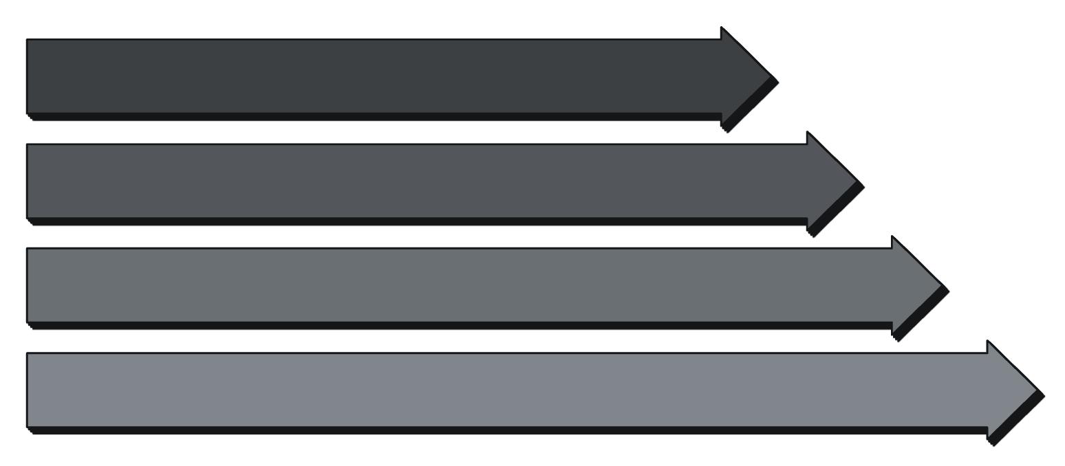
Detecting Hallucinations in Large Language Models
A Feature-Based Classification Approach
Mohit Sharma · EECE 5644: Introduction to Machine Learning
Why This Matters
Approach
LLMs deployed in healthcare, legal research, and education
They confidently generate factually incorrect content — hallucination
Industry losses exceed $250M annually
Current detection methods are expensive (LLM-as-a-Judge) or require model internals
LLM Response
8 NLP Features
Classifier
Used Lightweight classifier: No GPU or proprietary API required at inference
Hallucinated?
Goal of the project
Design an interpretable hallucination detection method using responses from 3 LLMs
Mistral Small
Llama 3.3 70B
Llama 3.1 8B

Slide 2
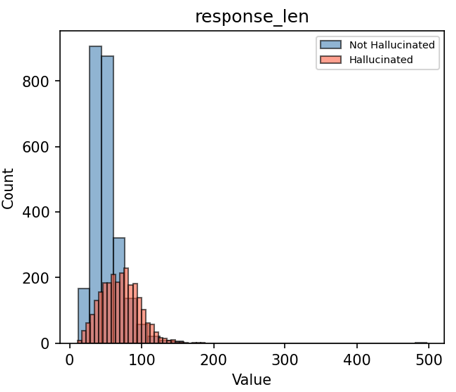
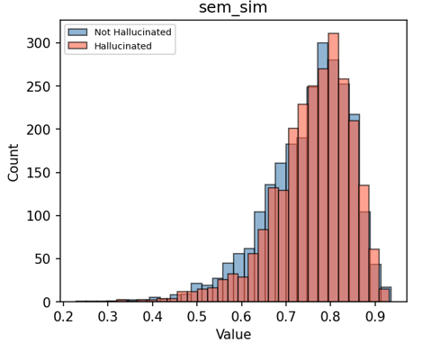
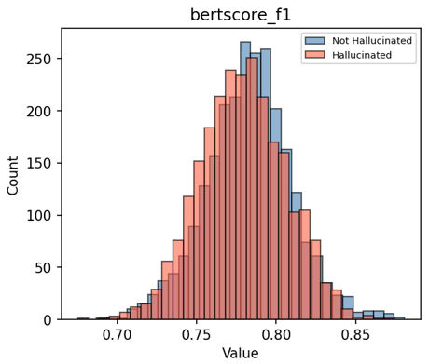
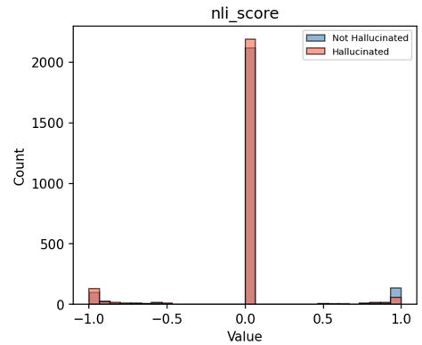
Dataset, Features & Key Discovery
HaluEval Summarization Subset — 5,000 balanced samples
Dataset – published at EMNLP 2023 Conference
Mean Feature Values by Label
10,000 CNN/Daily Mail articles with correct and hallucinated summaries
Subtle factual errors injected by ChatGPT
Sampled 5,000 rows — 2,500 per class
Feature
Correct
Hallucinated
Response length
50.3
70.4
ROUGE-1
0.152
0.183
Experiment
F1 Score
Semantic similarity
0.749
0.759
Response length only
0.94
BERTScore F1
0.783
0.779
All 8 features (QA)
0.95
NLI score
+0.010
−0.039
All 8 features (summarization)
0.74
Small caveat w.r.t dataset
QA subset achieved 96% F1. Response length alone achieved 94% F1. Switched to summarization subset: realistic 73% F1.
8 Features Computed Per Response
Response Length
Hedge Count
ROUGE-1
BLEU
Semantic Similarity
BERT Score F1
ROUGE-L
NLI Entailment

Slide 3

Model Comparison & Key Findings
Stratified 5-fold CV for tuning + 80/20 test set for final evaluation
Tuned Model Results on Test Set
1
Performance across models is more or less similar
Model
F1
Precision
Recall
AUC
Gradient Boosting and Random Forest have marginal edge compared to single models. Logistic regression performing well means features are aprrox. Linearly separable.
Gradient Boosting
0.728
0.746
0.710
0.801
Random Forest
0.726
0.738
0.714
0.794
2
Precision vs recall tradeoff
SVM/LR: high precision, lower recall which is conservative. RF/XGB: balanced, which is better for real deployment where missing hallucinations is costly.
Logistic Regression
0.723
0.752
0.696
0.805
SVM
0.722
0.759
0.688
0.806
3
AUC vs F1 split
SVM achieves highest AUC (0.806) despite lower F1. It is excellent at ranking predictions, threshold is adjustable for different use cases.
KNN
0.721
0.723
0.720
0.784
Decision Tree
0.691
0.708
0.674
0.758
4
Realistic performance
Tuning impact: Decision Tree +0.024 F1, KNN +0.016 F1. Ensemble methods already near ceiling.
73% F1 reflects genuine task difficulty. Even GPT-4 achieves ~75% on HaluEval (Zhang et al., 2023).

Slide 4
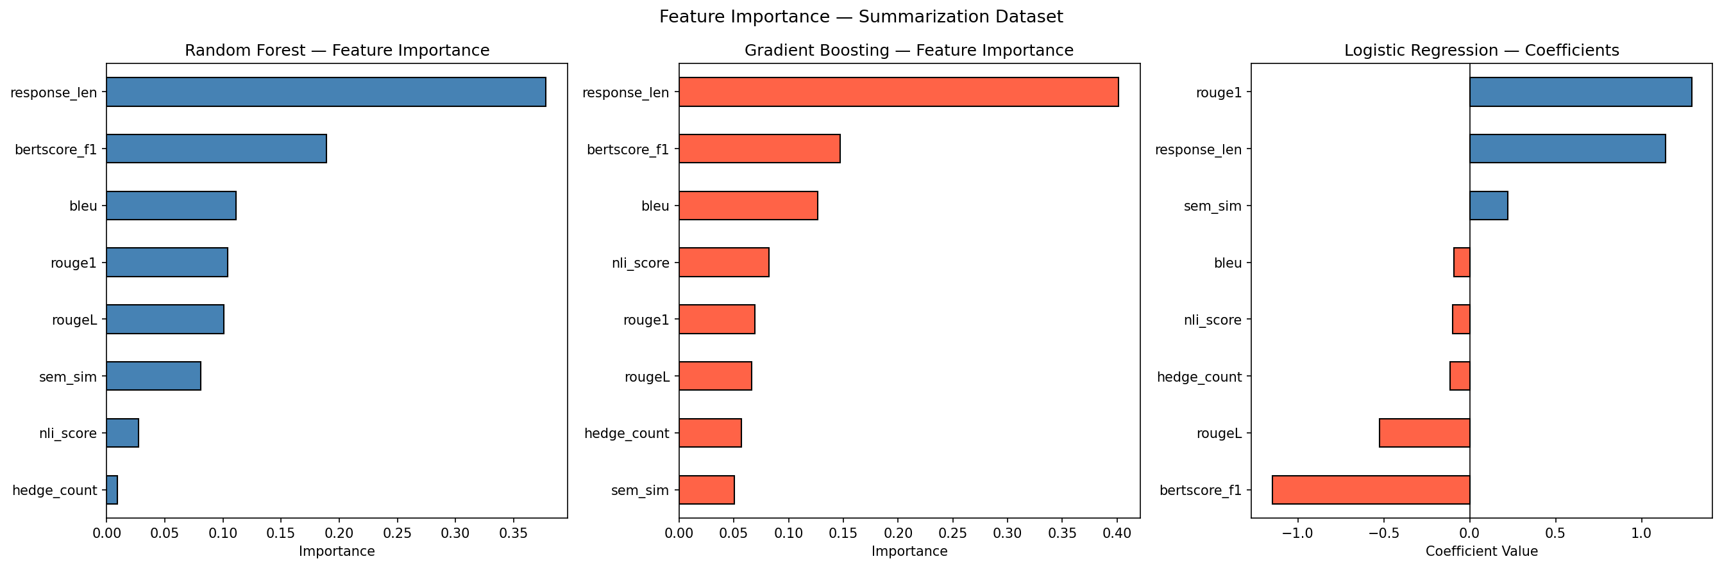
Conclusions, Limitations & Future Work
Key Conclusions
Comparison to Current Approaches
01
Approach
F1
Cost
Interpretable
Dataset quality > model choice
LLM-as-a-Judge (industry)
0.85+
High
QA length bias inflated scores to 96% artificially. All 6 models converged to similar F1 on cleaner summarization dataset.
No
SelfCheckGPT (zero-resource SOTA)
0.44
Medium
No
02
Hallucination detection is hard
73% F1 on subtle summarization hallucinations is realistic, consistent with SOTA results in literature.
Ours
(feature-based)
0.73
Low
Yes
03
Domain shift is a real challenge
Detector trained on news summaries does not transfer to conversational QA — need for domain-specific systems.
Future Work
Domain-adaptive detectors matched to deployment context
Fine-tuned transformer classifiers (DeBERTa, RoBERTa)
Token-level uncertainty features (entropy) to complement current set
Tradeoff: Some accuracy for interpretability and zero inference cost which is practical for resource-constrained deployments.

