Slide 1

Coca-Cola (KO) Stock Analysis: Live Price Trends and Investment Insights
This presentation analyzes Coca-Cola's (KO) live stock price trends. We use Jupyter Notebook for real-time data and visualizations. Technical indicators like moving averages are included. The goal is to provide key investment insights.
Notes:
1

Slide 2
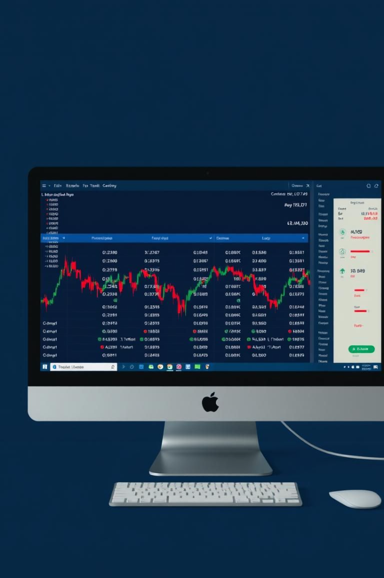



Data Extraction: Real-Time KO Stock Price via API
Real-Time Data
Jupyter Notebook
Automated Updates
Live stock prices are extracted using an API.
Data is processed in a Jupyter Notebook.
Data updates automatically for current analysis.
Real-time stock data is crucial for accurate analysis. The API provides up-to-date information.
Notes:
2

Slide 3
Moving Average Calculations: 20-Day and 50-Day Indicators
20-Day Moving Average
50-Day Moving Average
Calculates the average price over the last 20 days.
Calculates the average price over the last 50 days.
Moving averages help smooth out price fluctuations. They also reveal underlying trends in the stock.
Notes:
3

Slide 4
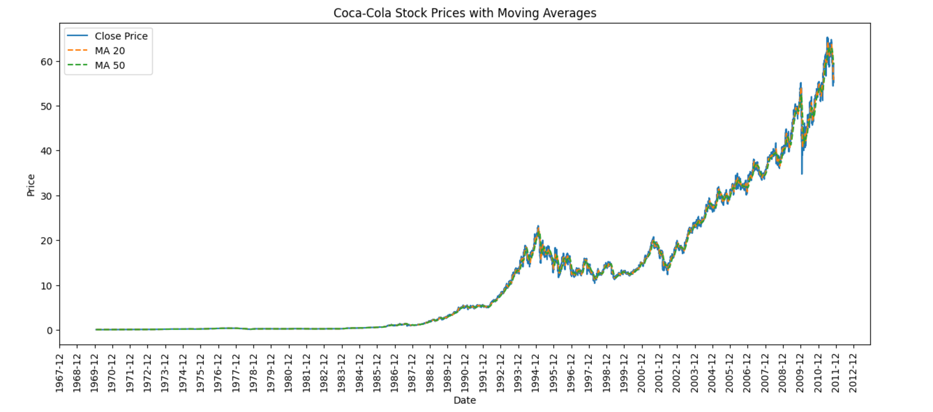
Visualizing Trends: Interactive Price Charts and Tables
Visualizations make trends easier to understand. Charts and tables provide clear data.
Notes:
4

Slide 5
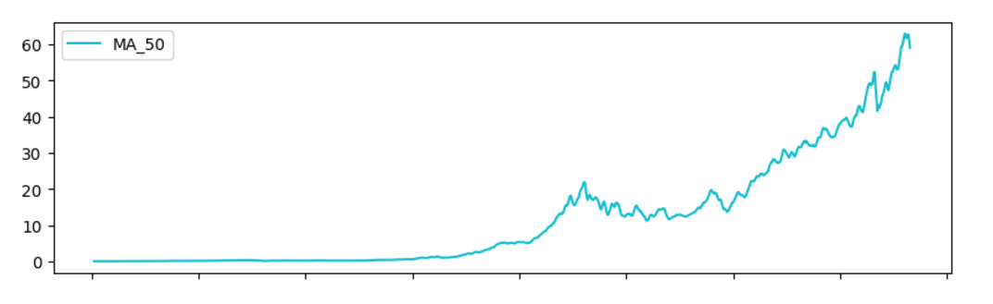
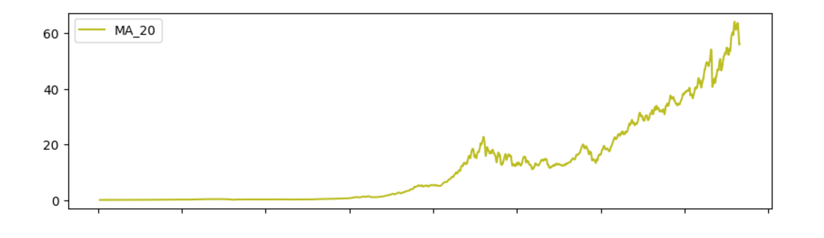
Some Project Visualization

Slide 6
BaseLine Model
XGBoost Regressor Model
Model Evalutaion
Mean Squared Error: 356.9661794862894
Mean Absolute Error: 15.55999950580679
Root Mean Squared Error: 18.89354862079354
This is our baseline Model we used to compare with and trained Decision Tree and Random forest
Notes:
7

Slide 7
Model for Prediction
Random Forest Regressor Model
Model Evalutaion
Mean Squared Error: 328.00422958885144
Mean Absolute Error: 14.670273055284303
Root Mean Squared Error: 18.11088704588628
As we can see for our case RandomForestRegressor works best for Tabular Data
Notes:
7

Slide 8
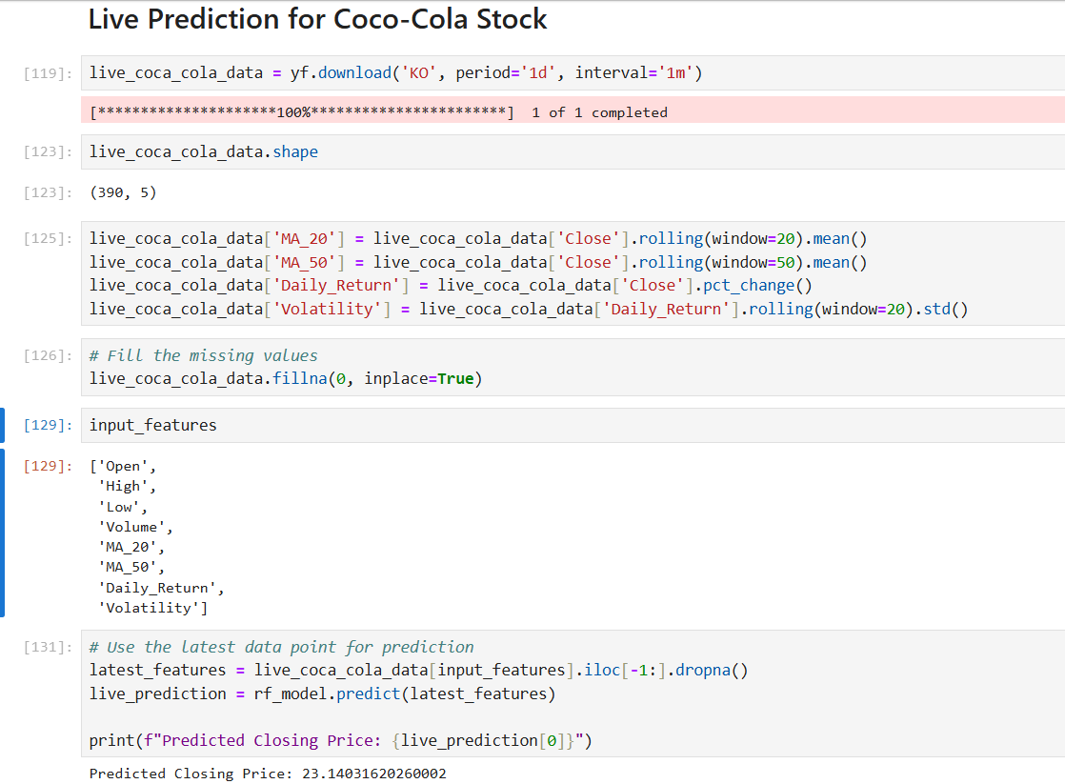
Live Prediction for Coco-Cola Stock
For Live Prediction We used Our Model Random Forest Regressor
To Fetch Live Data we used Yahoo Finance API
Fetch real time data with intervals and feed to model to get live prediction

Slide 9

Conclusion: Key Takeaways and Future Outlook for KO Stock
Real-time Data
Moving Averages
Essential for timely analysis.
Identify trends and signals.
Risk Management
Critical for investment.
Coca-Cola stock shows potential based on trend analysis. Continuous monitoring is essential.
Notes:
8

