Slide 1

I-FARM
Technology for better yield

Slide 2

INDEX:
1)PROBLEM STATEMENT
2)SOLUTIONS
2.1)CROP PREDICTION
2.2)PRICE PREDICTION
2.3)YIELD PREDICTION
2.4)FERTILISER SUGGESTION
2.5)DISEASE DETECTION
2.6)GOVERNMENT SCHEMES

Slide 3
1)PROBLEM STATEMENT
(OPEN INNOVATION)
Agriculture Sector is a major contributor to Indian Economy. In a country like India, which has ever increasing demand of food due to rising population , advances in agriculture sector are required to meet the needs.
India's agriculture sector is under crisis for nearly two decades now. The suicidal cases are growing in numbers over the years.
This project presents the concept of smart farming where agriculture is done by precisely managing data related to crop field parameters in order to achieve optimized outputs at minimum disturbances to the environment.

Slide 4
2)SOLUTIONS:
So, we have designed the system using machine learning algorithms and deep learning algorithms for the betterment of farmers.
Our system will predict :
Recommending crop to be grown based on soil and climatic conditions.
Predicting the Yield of the crop based on the geographical aspects
Predicting the modal price of the crop based on the historic data.
Classifying the health status of the crop based on the images of leaves.
Providing farmers regarding awareness about current government schemas.

Slide 5
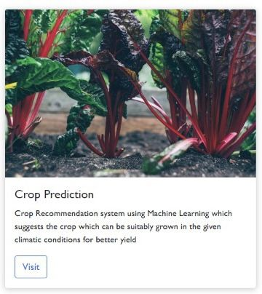
2.1)CROP PREDICTION:
The system requires inputs soil composition and its Ph, average annual rainfall(mm), temperature, from the user. Based on the given parameters the system will predict the Production (in quintals) for the crop and yield of the crop per acre.

Slide 6
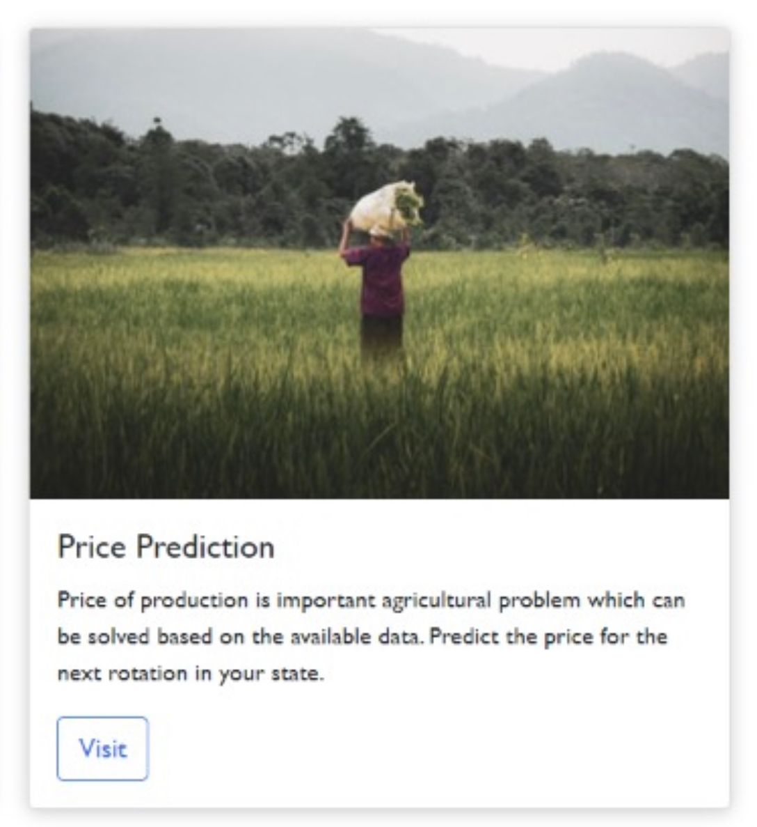
2.2)PRICE PREDICTION:
Price Prediction nowadays, has become a very important agricultural problem. The aim of this project is to predict the crop price for the next rotation. This provides the farmer with an insight of what the future price (per quintal) of the crop that farmer is going to harvest.

Slide 7
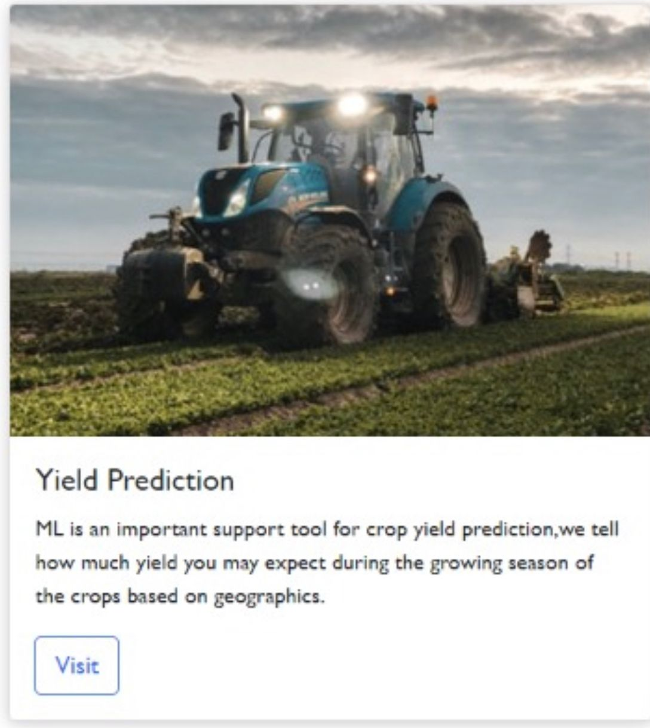
2.3)YIELD PREDICTION:
The system requires inputs such as state, year, crop name, area, average annual rainfall(mm) from the user. Based on the given parameters the system will predict the Production (in quintals) for the crop and yield of the crop per acre.

Slide 8
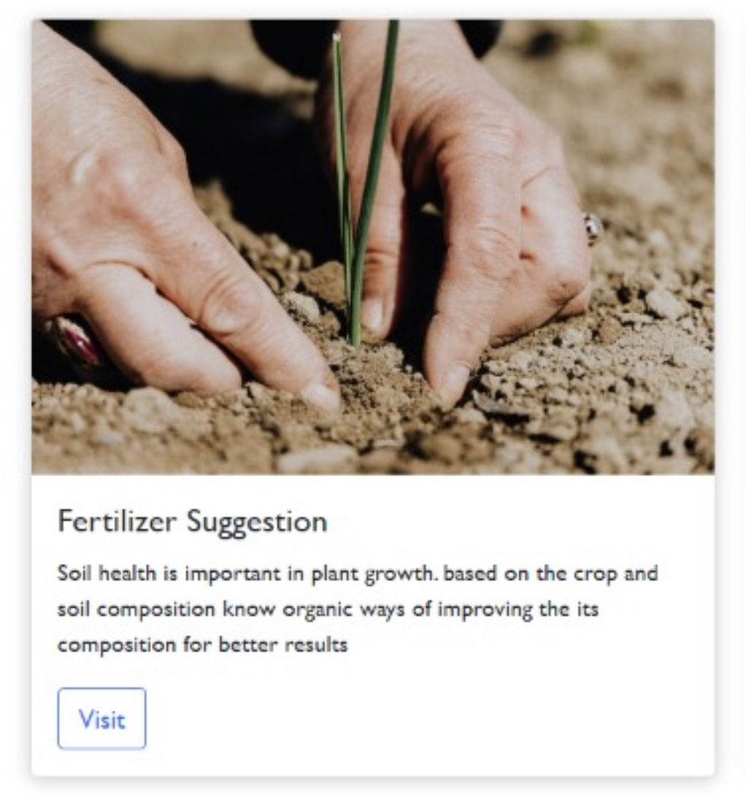
2.4)FERTILISER SUGGESTION:
Soil fertility refers to the ability of soil to sustain agricultural plant growth, i.e. to provide plant habitat and result in sustained and consistent yields of high quality. Based on the current composition of soil we suggest what to do to improve soil fertility.

Slide 9
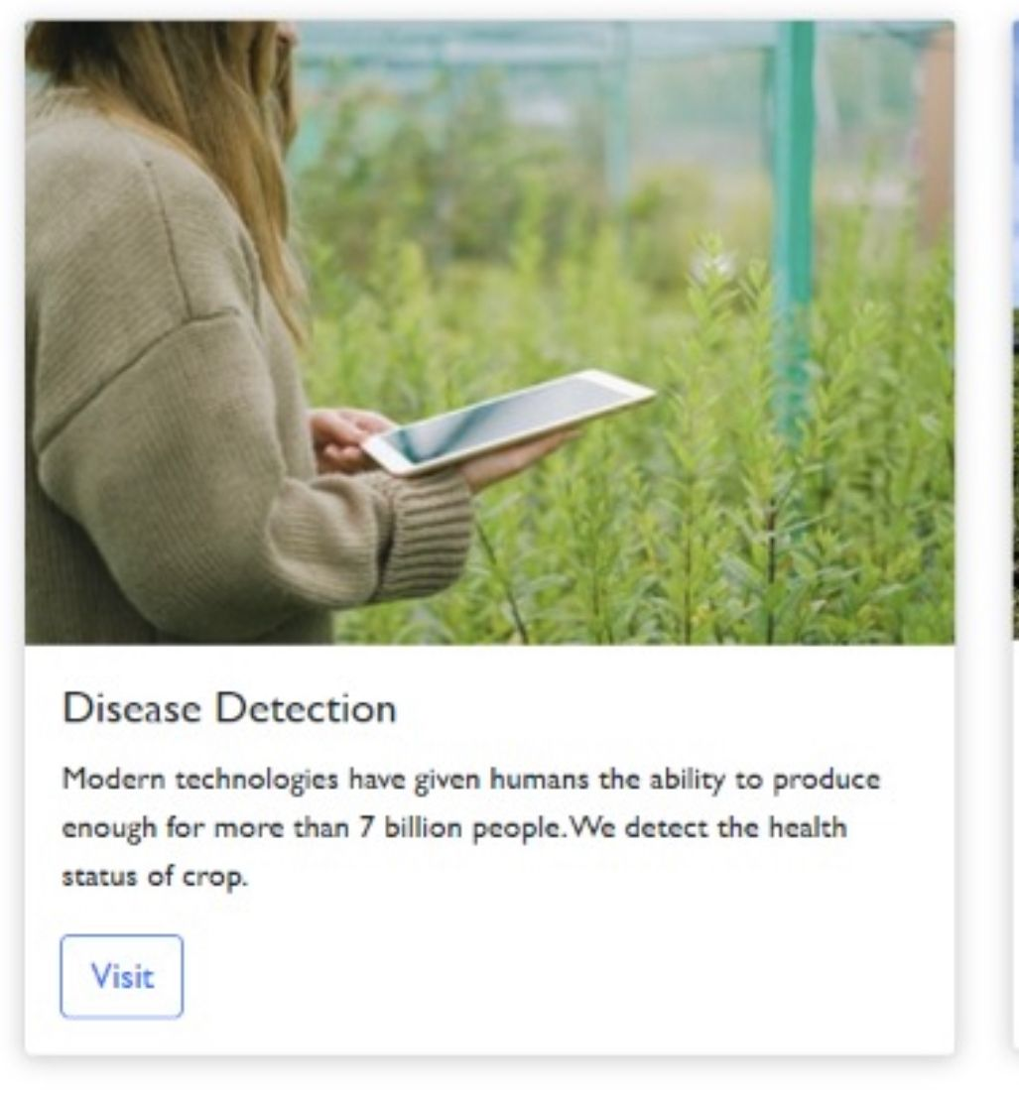
2.5)DISEASE DETECTION:
Crop diseases are a major threat to food security, but their rapid identification remains difficult in many parts of the world due to the lack of the necessary infrastructure. Plant diseases are not only a threat to food security at the global scale, but can also have disastrous consequences for smallholder farmers whose livelihoods depend on healthy crops.
We classify the leaf images of the following crops and predict the health the status and provide the details of the crop disease and some cures.

Slide 10
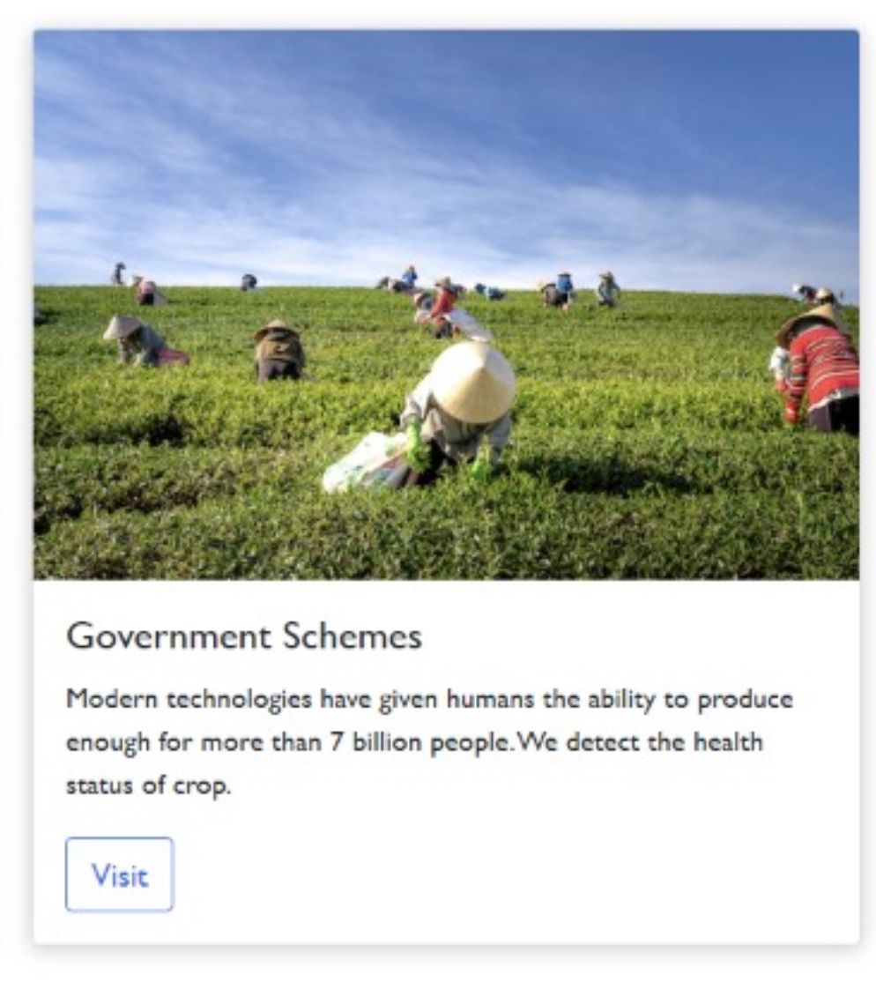
2.6)GOVERNMENT SCHEMES:
The government has introduced various schemes for the security of the farmers and the development of the agricultural sector. We are providing awareness about the schemes.

Slide 11
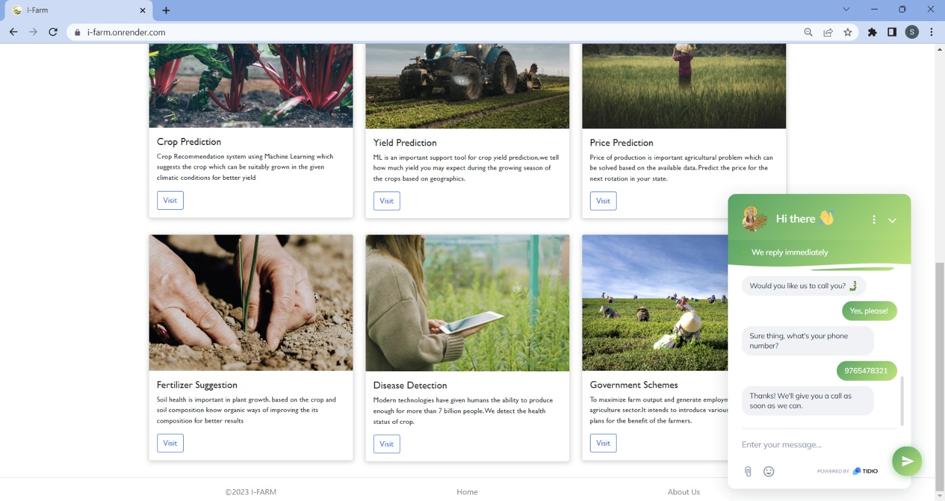
KEY FEATURES:
1)CHATBOT:
We have implemented the chatbot “farm expert” which helps in answering the queries of farmers and assist the farmers.

Slide 12
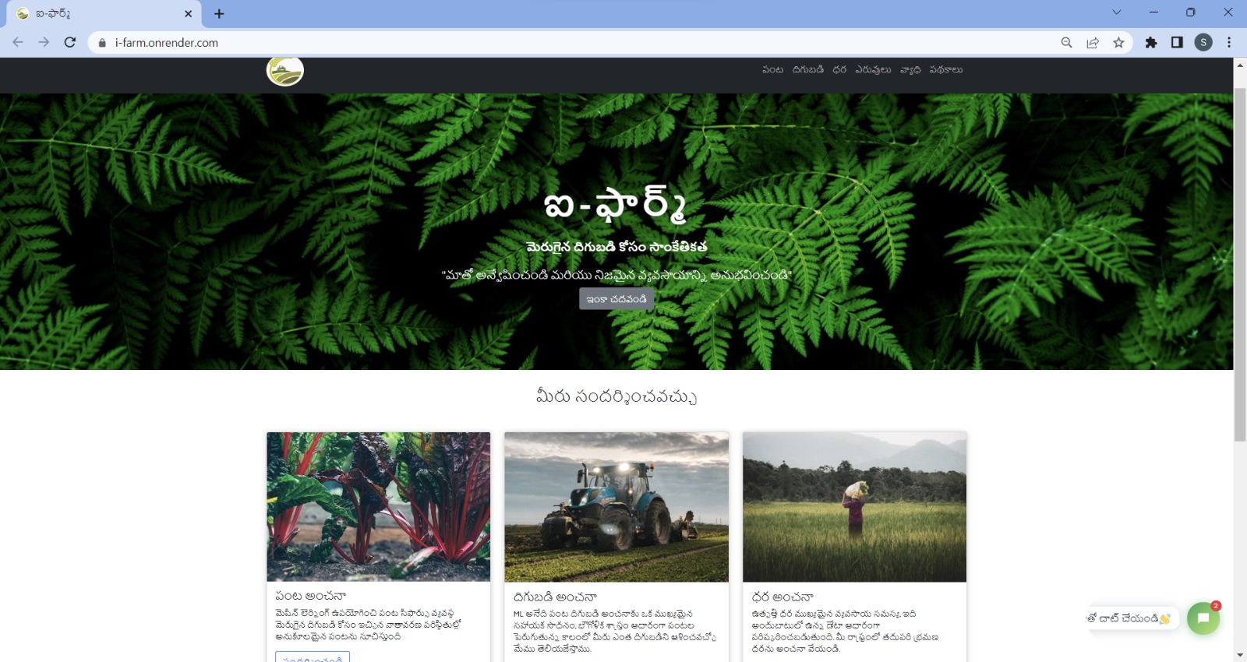
2)GOOGLE TRANSLATE WIDGET :
This creates a user- friendly environment for a farmer inorder to access the website in his/her native language.

