Slide 1
Adversarial Search Algorithms

Slide 2
INTRODUCTION-Game Playing
INTIAL STATE
FINAL STATE
INTERMITTENT STATE
WIN-LOSE-TIE
KNOWLEDGE-set of logical rules, how to proceed the next step.
MINI MAX ALGORITHM
ALPHA BETA PRUNING

Slide 3
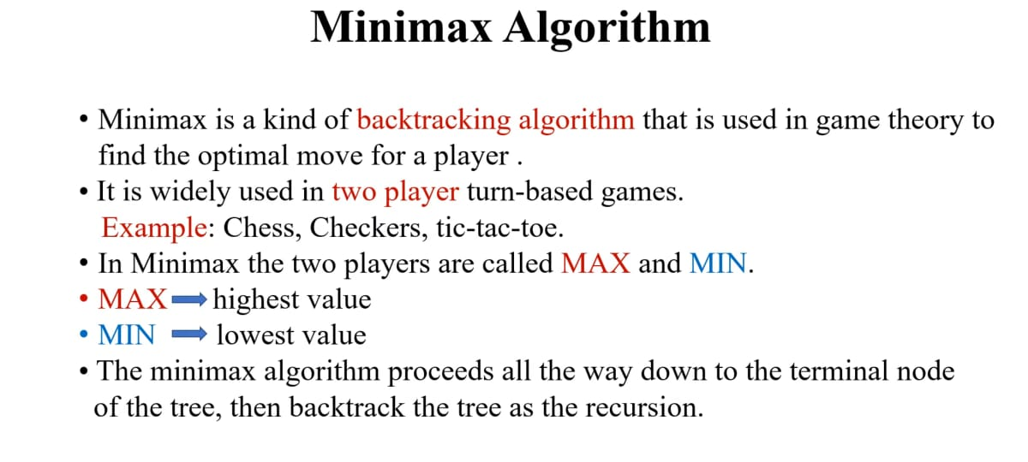

Slide 4
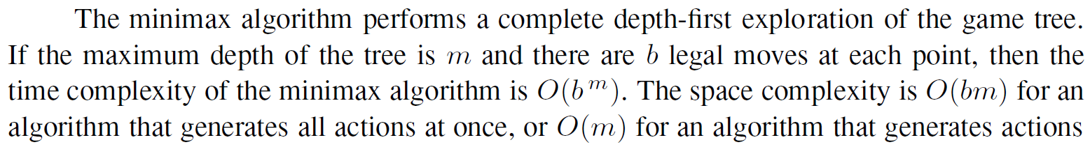

Slide 5
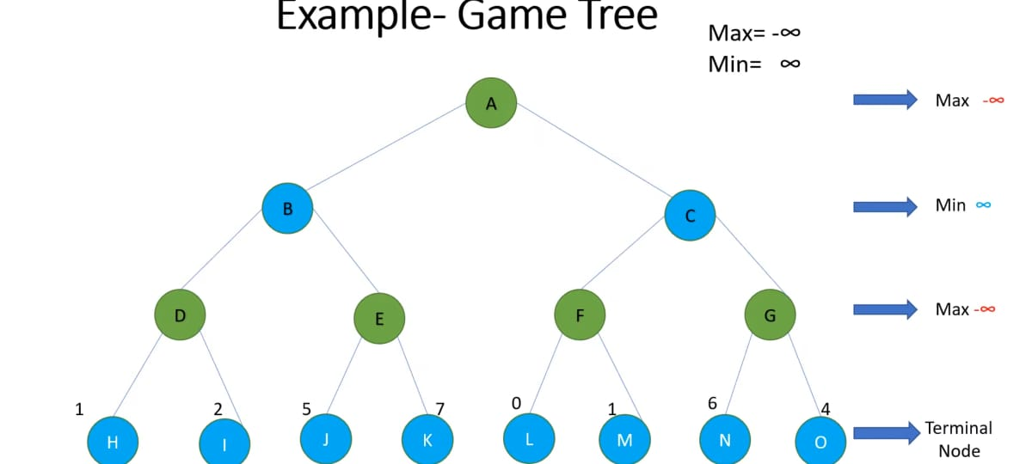

Slide 6
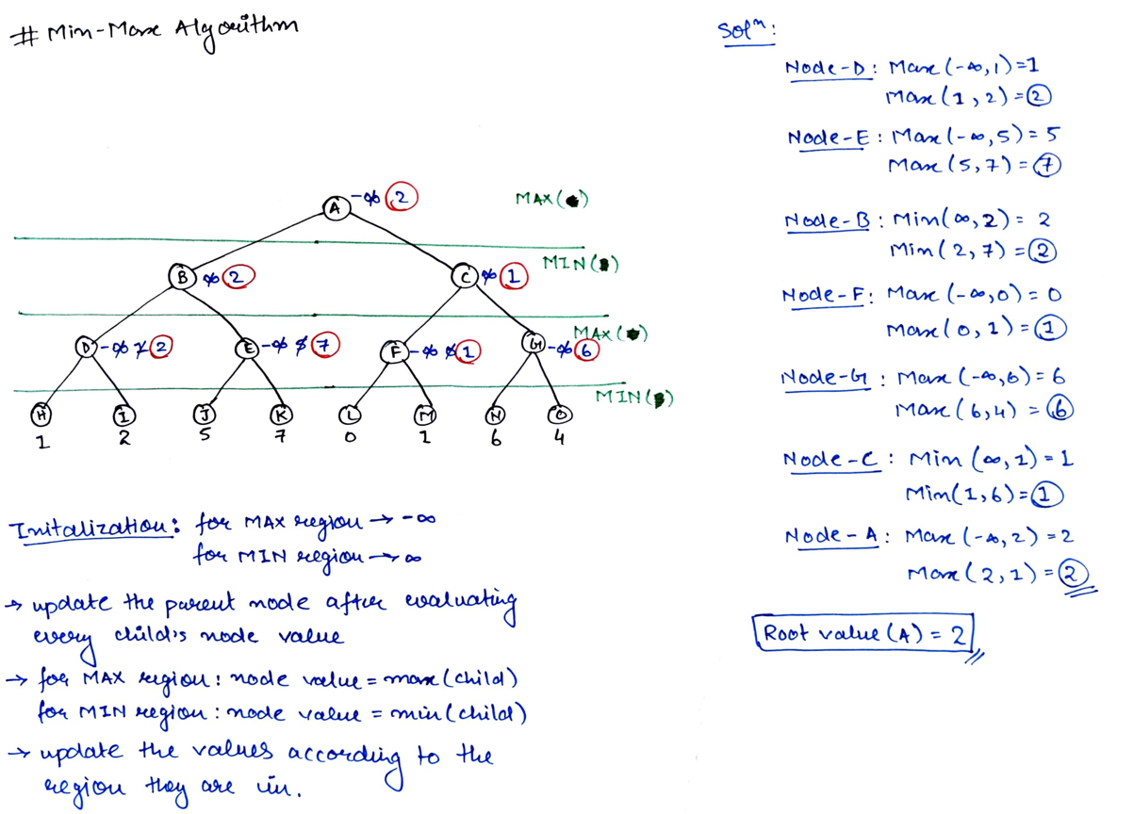

Slide 7
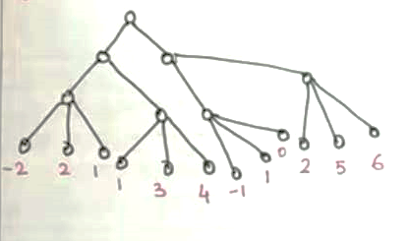

Slide 8
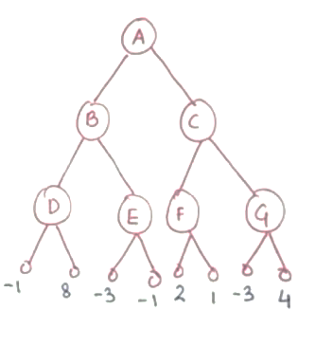

Slide 9
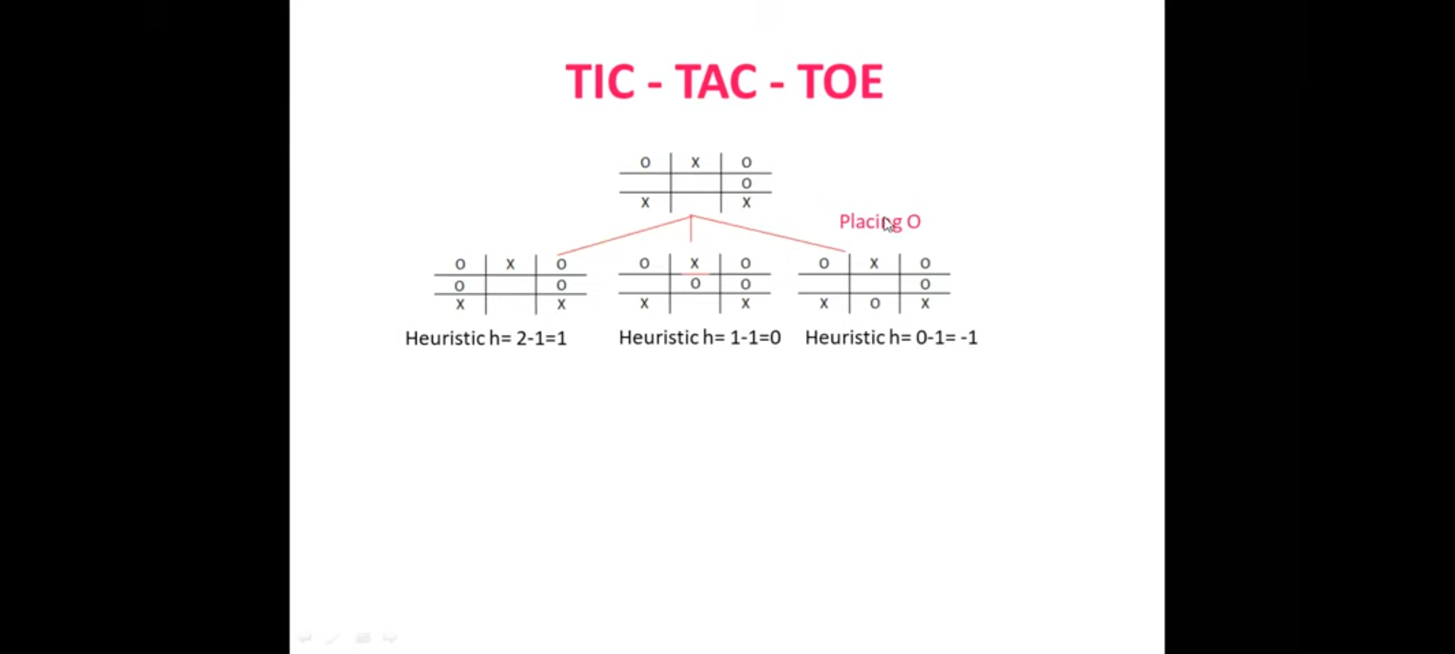
Tic Tac Toe
Heuristic=moves X wins-Moves O wins

Slide 10
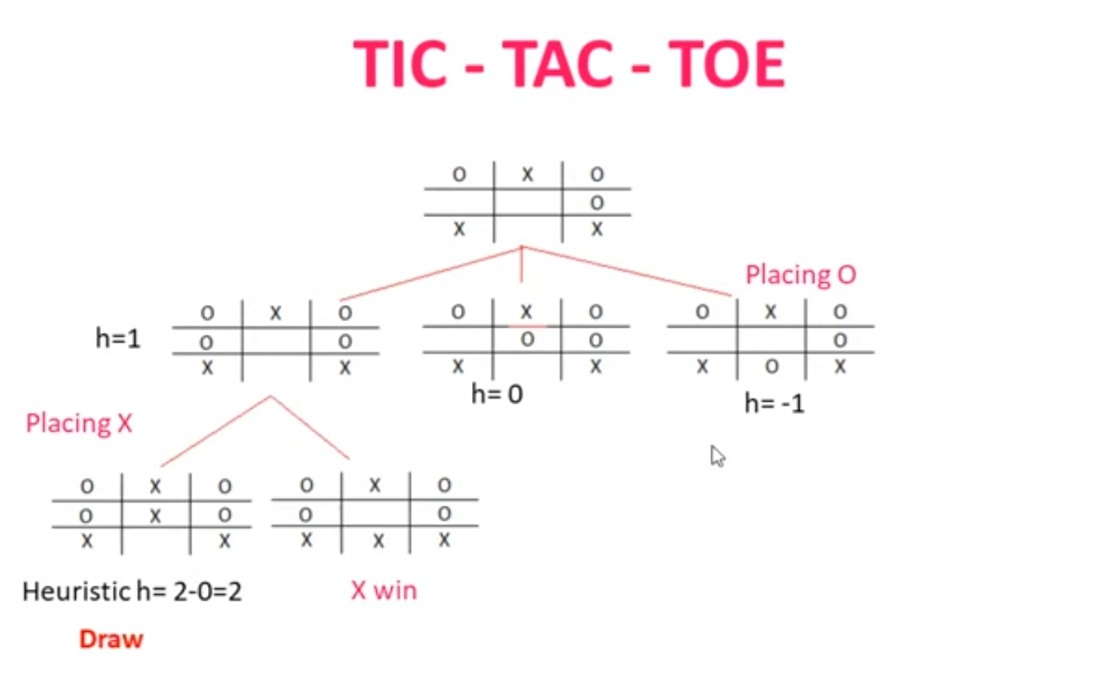

Slide 11
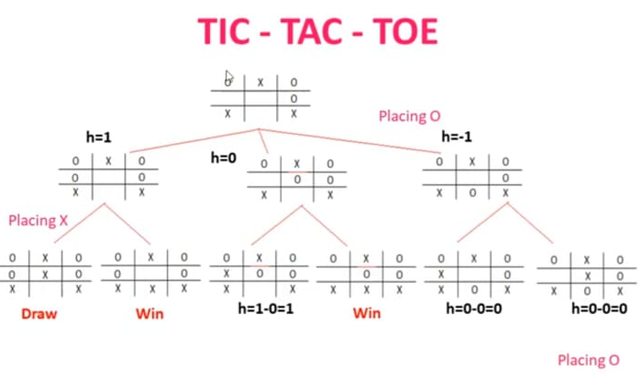

Slide 12
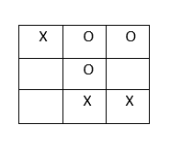
X OR O: WHO WINS?
Solve using minimax Algorithm- it’s X turn now

Slide 13
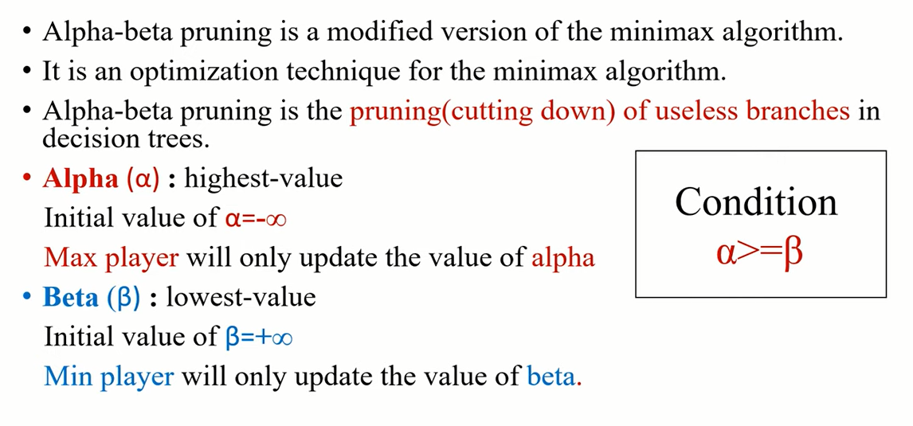
ALPHA BETA PRUNING

Slide 14
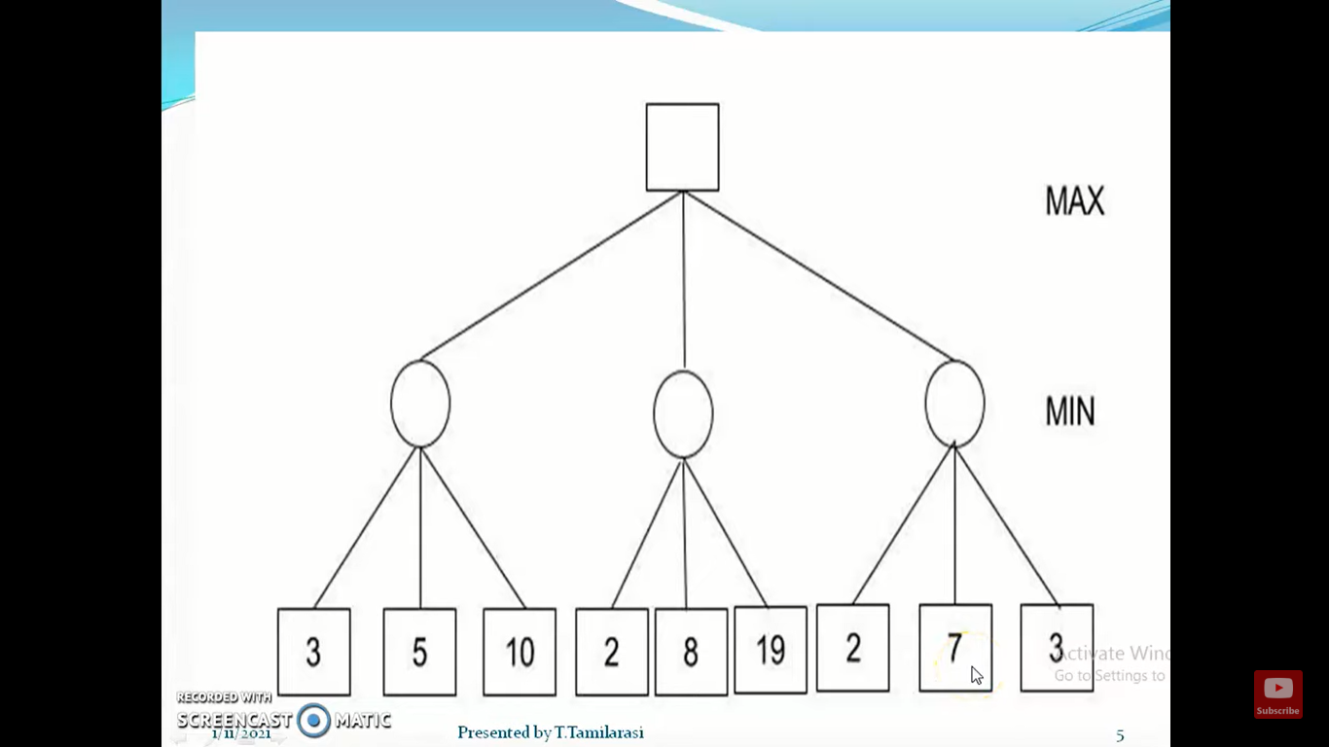
1

Slide 15
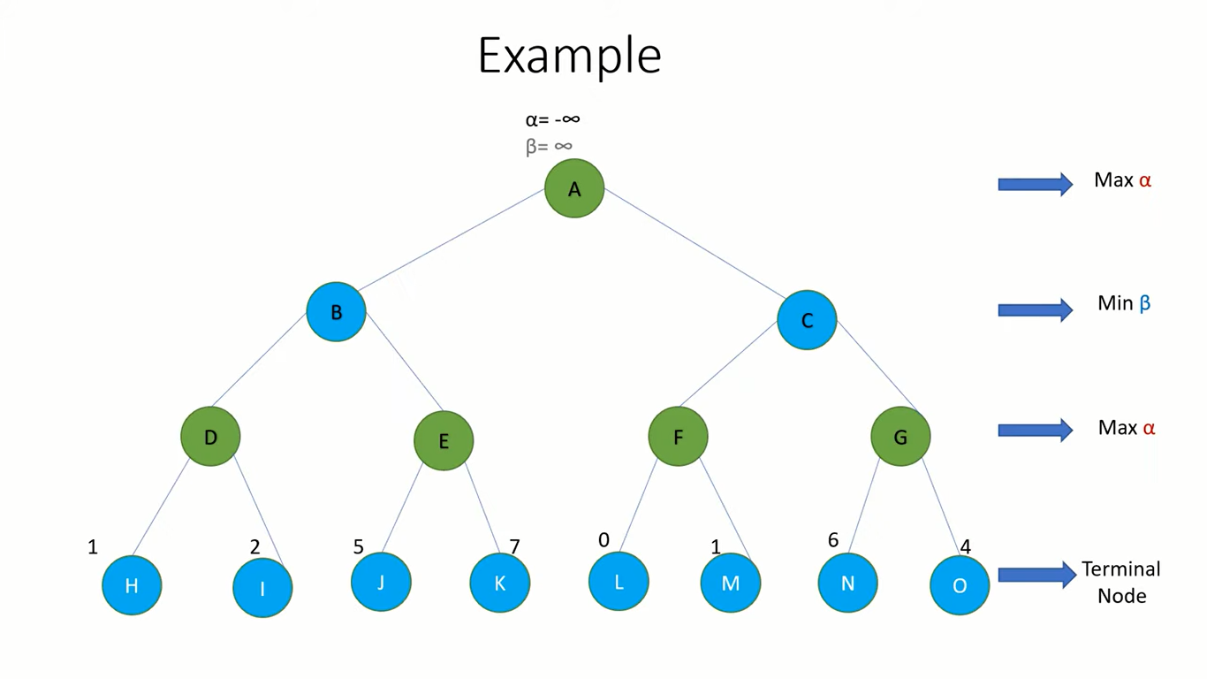
2

Slide 16
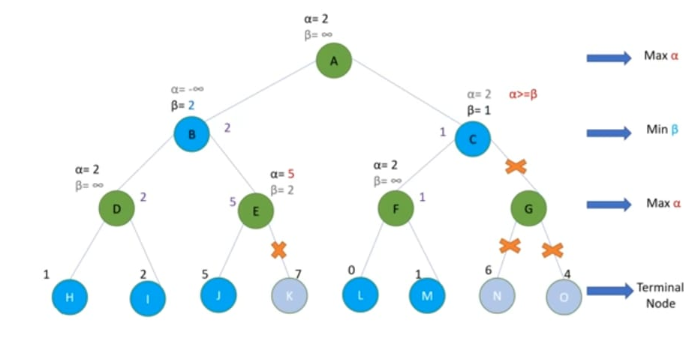

Slide 17
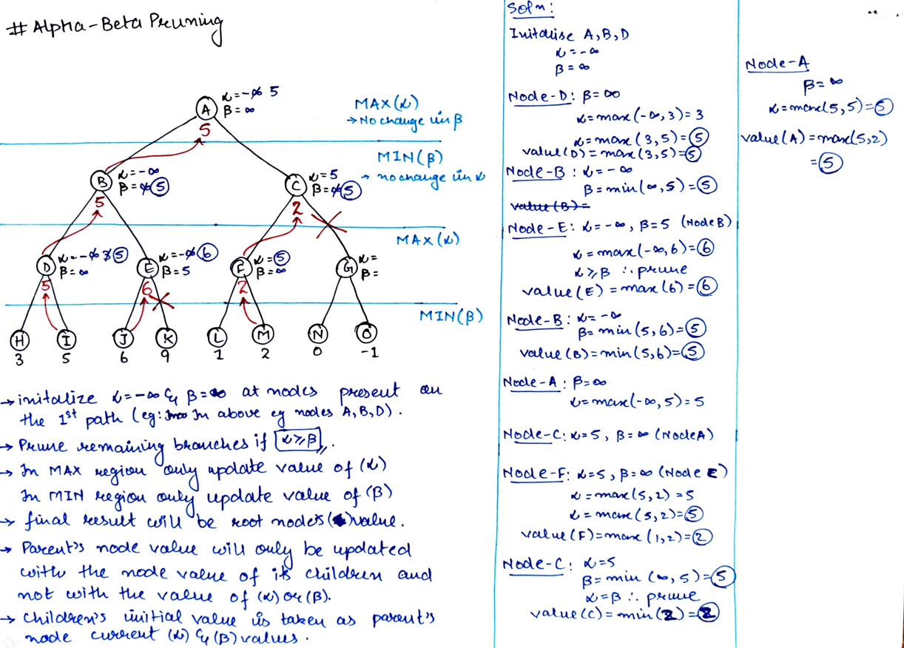

Slide 18
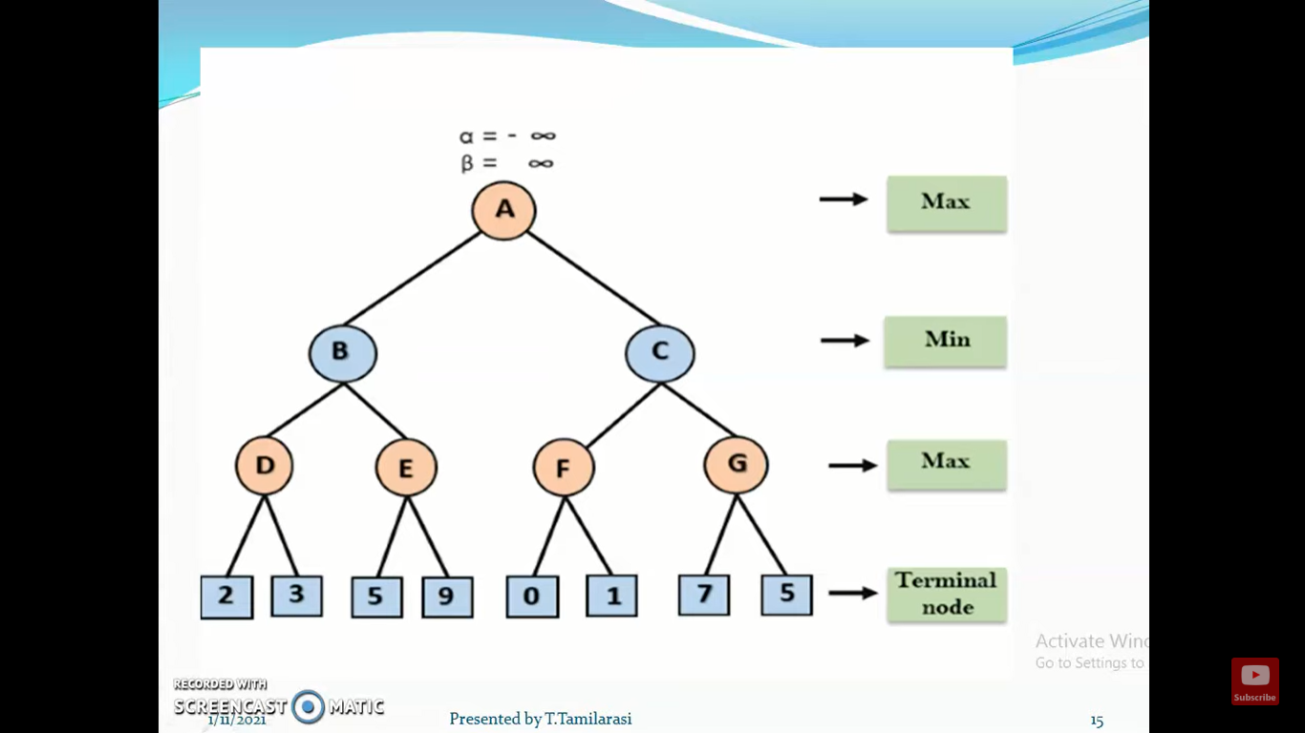
4

