Slide 1
Mu Sigma Capabilities
Revenue Growth Management
November 28, 2018

Slide 2
Agenda
Introduction to Mu Sigma
Industry Trends affecting CPG Revenue Growth
Mu Sigma Capabilities in RGM Space
What Mu Sigma partnership brings?
Case Studies:
Perfect Store
Consumer Promotion Optimization
Video - The next frontier for consumer analytics
Notes:
<number>

Slide 3






Rapidly changing industry trends and advancement of technology is impacting CPG revenue growth
Shifting power dynamics with retailers
Build trust in Manufacturer – Retailer Relationships
Growth of Localized Brand and Varied offerings
Small – Medium CPG companies/ brands capturing sales from CPG giants
Rise of Digital Retailers & Omni channels
Seamless experience across shopping platforms
Evolving consumer trends and need for holistic understanding
Leveraging more observational, passive and social data compared to survey questions
Integrated Marketing & Commercial decision making
Increasing revenue growth through integrated investment decision making across marketing and commercial levers
Notes:
<number>

Slide 4

In Trade Promotion, CPG companies are leveraging more customer data and rapidly experimenting
Trade Promotion Optimization
Test and Learn
Understanding event specific performance
Low risk rapid test and learn environments
Spend planning system
Analytics focused on shoppers
Defining appropriate balance of price spending
Incremental sales
Personalized pricing
Significant return on investment
Consumer Promotion Optimization
Precision Promotion
Trade Planning Management
5-7 Years Ago
Present
Next 2-3 years

Slide 5







Mu Sigma helps RGM teams to build capabilities around 12 key business themes
Price Sensitivity
Price Gap Analysis
Price Point Perception
Channel Trends/ Performance Reporting
Product Placement (Product Affinity)
Co-promotion/
Co-merchandizing
Impact of Execution Levers (display thresholds)
Bundle/ Offer Communication
Channel Assortment
Cannibalization Study
Impact of Flavor/ Product on Volume
Consumer Segment Switching Behavior

Slide 6
What Mu Sigma partnership brings…
1
Minimum Viable Solution (MVS) based experimental mindset
Rapid experimentation by developing minimum viable solutions
2
Interdisciplinary solutions
Build a mix of data engineering, data science and decision science solutions (D3)
The problems could be descriptive, inquisitive, predictive or prescriptive in nature (DIPP)
3
Building capability
While we execute on the program, we will build problem solving capability within ABI
Capability will be built with respect to mindset, skillset and toolset

Slide 7
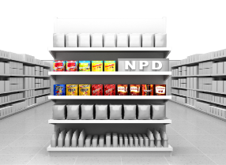
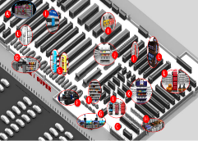
Established an Analytical Foundation, utilizing AI, to increase sales by analysing audit scores and volume impact
Temporary Secondary Display
Main Aisle
Permanent Secondary Display
Transaction Zone
Temporary Secondary Display
Signage
Position
Location
Assortment
Location
Position
4
Signage
CHANGE IN AUDIT SCORES
3
2
1
+ 0.10
Ex : ( 0.3 -0.4)
+ 0.20
Ex : ( 0.5 -.7)
+ 0.20
Ex : ( 1 – 1.2)
VOLUME LIFT OPPORTUNITY
6 %
2 %
1 %
#
Importance of area to focus to see volume lift
Notes:
Right hand side aestethics
<number>

Slide 8


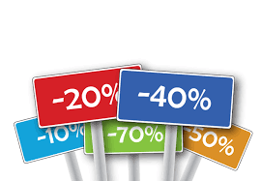




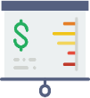


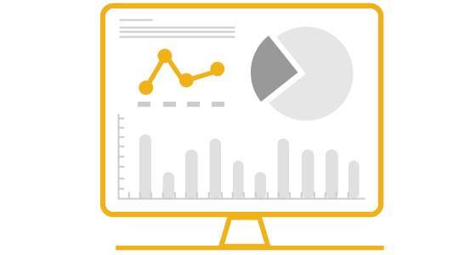
Developed Consumer Promotion capability within RGM function to improve promotion effectiveness
01
Data Gathering & Prep
02
Segmentation & Clustering
03
Model Building
Gather all sources of data and perform ETL queries
Remove outliers and create behavioral segments
Build models for each retailer at CTA, category, segment level
Brand Preference
Promotions
Product Features
Brand Loyal
Brand Switchers
Category Preference
Occasional Incidence
Competitor Loyal
Customer Loyalty
Sales
*PoS Data*
Infrequent
04
Model Insights
05
Prepare Simulator
06
Re-planning
Understand brand, package, and offer preferences per segment
Gather, generate, and load required files for simulator
Leverage model insights to run scenarios
Brand
Package
Current Promotion Plan
Re-planning dataset
Offer
Redemption Rate dataset
Lookup tables
Notes:
Consumer promotion optimization was a new initiative that took a similar approach to IA, but used consumer level shopper loyalty card data to build models
These models are able to simulate how different groups of consumers would react to different factors in the marketplace
There is a 6 step process that the client follows, ending with a labor intensive simulator that would help predict how many additional households would respond to events in the marketplace
This is not a time efficient solution because the simulator needs to be run a number of times to learn abuot consumer behavior
The next step is the build an automation tool that can run thousands of simualtions at a time, and then the business can shift through each of the plans to see which ones show the highest returns
<number>

Slide 9
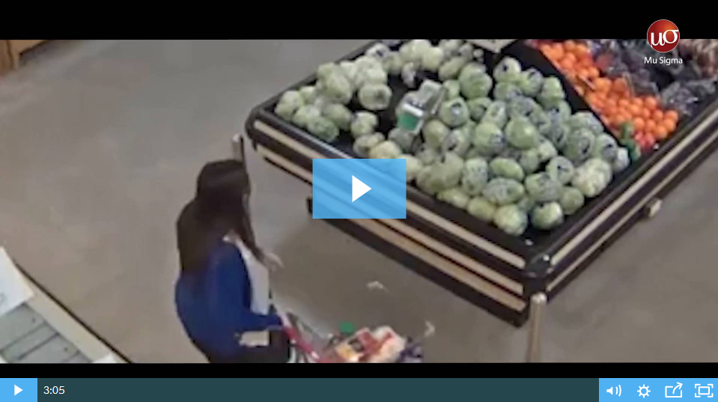
Getting closer to the Consumer – A leading beverage manufacturer

Slide 10





Mu Sigma partnership adds value in 3 ways: Delivery Velocity, Reusable Assets, and Capability Building
Increased Velocity Of Delivery
Reusable Assets Created
2019 Retail Strategy
Comprehensive Promotional Database
Conducted rapid analyses for similar problems across beverage categories that will directly impact 2019 RGM Strategy
Data-mart that acts as a single source of truth and enables key retail strategy analyses
Streamlined Use of Feature Data
Sales Attribution Model
Automated the integration of feature and advertisement data to promotional database
Aligned mathematical models (which attribute volume sales to different factors) to business context and action-ability
Scenario Builder Tool - Planning
CPO Simulator Automation
Planning team has ability to change planning inputs with business constraints, and see increased efficiency in planning cycles
Business is able to pick from 1000s of alternative promo plan scenarios that consider consumer preference
Capability Building
Best practices workshops to cross pollinate ideas from other verticals
AoPS adoption through active use of muPDNA, muUniverse

Slide 11
CPG is moving from traditional survey based methods to understand consumers to a holistic survey and social listening methodologies
Survey Spend
Visualization and Reporting
Decision Spine, Visualization & Reporting Layer
Use Cases: Incidence, Equity, Motivation
Analytics Layer
Powered by AI, to equalize and fuse disparate data sets
Data Storage Layer
In TCCC Data Lake and elsewhere, QC and loading of data
Database Layer
Sources: Sales Data, Search Data, CRM, Customer Metrics, Passive, Social, Location, Trends

Slide 12
Capability mindset is very important while starting a transformation journey
Tool Mindset
Capability Mindset
Design Abstraction
Moderate (built for specificity)
High (designed as capability)
Standard IT Solutions
High (standard and transactional)
Low (custom and strategic)
Scope for Adjacent Problems
Low (limited options; can’t add more)
High (can add more options on the fly)
Dealing with Ambiguity & Flexibility
Low (low context switching, not flexible)
High (ability to adapt; handle new context )
Total Cost of Ownership
High (scaling is expensive)
Low (scaling is efficient and economical)
Corporate initiatives integration
Low (low organizational synergy)
High (high organizational synergies)

Slide 13
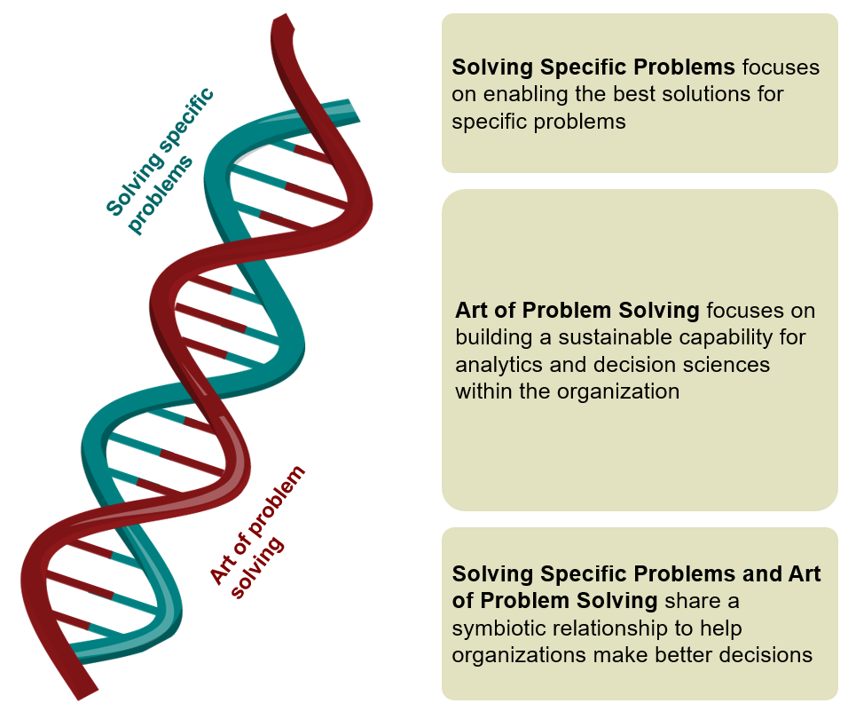
Placeholder
TPO - Transformation Playbook
FY 'XX | Phase
Q1 | Prototype | Building the base for trade promotion optimization journey for selected customer and selected region
Q2 | Start-up | Building the end to end optimization tool for trade promotions for selected customer all regions
Q3 | Ramp-up | Scaling the end to end TPO tool to a channel for all regions
Q4 | Steady State | Rolling out the TPO engine for the entire spectrum

Slide 14
Appendix

Slide 15
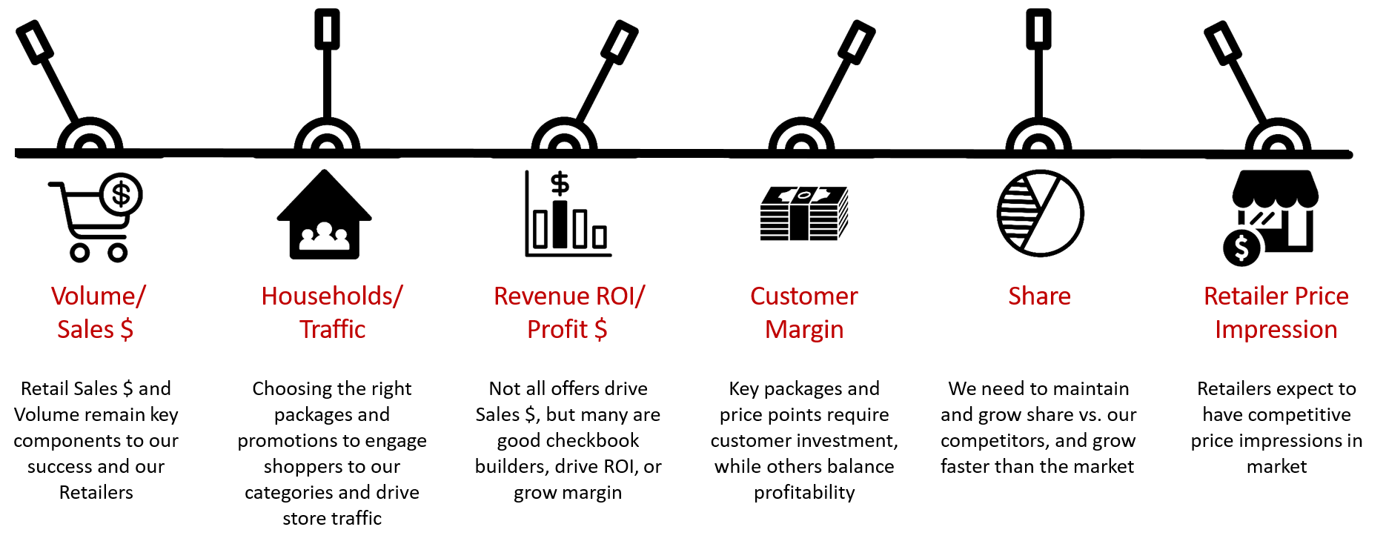
Trade and revenue management can influence the following levers
We often expect our promotions to do everything, but in reality, they pull different levers to drive the overall the success of our joint business goals
Notes:
<number>

Slide 16
CPG is moving from traditional survey based methods to understand consumers to a holistic survey and social listening methodologies
Survey Spend
Visualization and Reporting
Decision Spine, Visualization & Reporting Layer
Descriptive | Deterministic
Predictive | Visualization
Use Cases: Incidence, Equity, Motivation
Analytics Layer
Data Harmonization | Data Connection
Data Fusion | AI, ML, DL
Powered by AI, to equalize and fuse disparate data sets
Data Storage Layer
Data Access | Data Maintenance
Data Governance | Data Security
In TCCC Data Lake and elsewhere, QC and loading of data
Database Layer
Data Acquisition | Data Ingestion
Data Cleaning | Data Ontology
Sources: Sales Data, Search Data, CRM, Customer Metrics, Passive, Social, Location, Trends

Slide 17
Strategic Revenue Management could benefit from advanced analytical capabilities and support from the RGM team of a leading beverage manufacturer
Federated analytical capability to drive business growth
Strategic Revenue Management
Trade Capabilities
Retail Execution
Customer Decision Support
Consumer Engagement
Analytical Capabilities Required
Sources of Growth
Scenario Planning
Sales Driver Analytics
Margin Optimization
Personalization
Store Analytics

