Slide 1

Introduction to Map-Reduce
January 25, 2012

Slide 2
Knowledge sessions schedule
Knowledge sessions schedule
Date | Session
Wed Jan 18 | Introduction to Hadoop
Wed Jan 25 | Introduction to Map-Reduce
Fri Jan 27 | Introduction to RHadoop
Mon Jan 30 | Introduction to Java and Mahout
Wed Feb 1 | Introduction to Hive
Fri Feb 3 | Introduction to Pig
Mon Feb 6 | Lab session
* Sessions will include hands on exercises on need basis

Slide 3
Agenda
Introduction to Distributed computing
Example: Word count using map-reduce
Key-value pairs – The core of map-reduce
The map-reduce paradigm – The step-by-step approach
The map phase – Extreme parallelism
Shuffling, Sorting – The invisible middle operations
The reduce phase – Bringing it all together
Examples and exercises

Slide 4
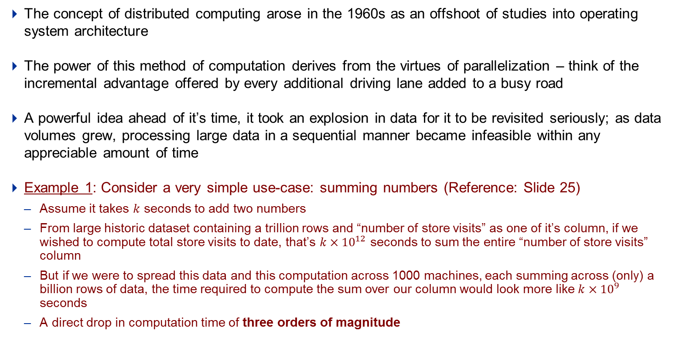
Introduction to Distributed computing
Distributed computation using multiple machines has been around since the 60s
The concept of distributed computing arose in the 1960s as an offshoot of studies into operating system architecture
The power of this method of computation derives from the virtues of parallelization – think of the incremental advantage offered by every additional driving lane added to a busy road
A powerful idea ahead of it’s time, it took an explosion in data for it to be revisited seriously; as data volumes grew, processing large data in a sequential manner became infeasible within any appreciable amount of time
Example 1: Consider a very simple use-case: summing numbers (Reference: Slide 25)
Assume it takes $k$ seconds to add two numbers
From large historic dataset containing a trillion rows and “number of store visits” as one of it’s column, if we wished to compute total store visits to date, that’s $k×{10}^{12}$ seconds to sum the entire “number of store visits” column
But if we were to spread this data and this computation across 1000 machines, each summing across (only) a billion rows of data, the time required to compute the sum over our column would look more like $k×{10}^{9}$ seconds
A direct drop in computation time of three orders of magnitude

Slide 5
Introduction to Distributed computing
Overview of Map-Reduce in Hadoop
Hadoop is an open-source programming framework for performing massively parallel processing
It implements the map-reduce programming model – inspired from the map and fold programming concepts in functional programming, map-reduce is a functional programming framework for parallelized computation on large distributed data
The model provides the user with an abstraction over parallel computing with the majority of computation being performed simply by defining the map and reduce functions
The user is buffered from implementation details like assigning data and computations to nodes, failover implementations and other internal management tasks
Ironically enough, the Hadoop implementation of map-reduce is in Java, a decidedly un-functional programming language
Map-reduce programs can be written and used in Hadoop in languages apart from Java – R, Perl, Python, Ruby, PHP are few examples

Slide 6
Agenda
Introduction to Distributed computing
Example: Word count using map-reduce
Key-value pairs – The core of map-reduce
The map-reduce paradigm – The step-by-step approach
The map phase – Extreme parallelism
Shuffling, Sorting – The invisible middle operations
The reduce phase – Bringing it all together
Examples and exercises

Slide 7
Example: Word count using map-reduce
Example 2: Word count using map-reduce
 | Input | Output
map | <K1,V1> | <K2,V2>
reduce | <K2, List(V2)> | <K3,V3>
The over all map-reduce word-count process
Input
Read
Map
Combine
Sort and Shuffle
Reduce
Final output
Key
Value
Key
Value
Key
Value
Key
Value
Key
Value
Key
Value
1
0x0001b
Bear Deer Bear Car
Bear , 1
Deer , 1
Bear , 1
Car , 1
2
Bear , 2
Deer , 1
Car , 1
3
Bear , 2
Bear , 1
4
Bear , 3
Deer , 1
Deer , 1
Car , 4
Bear Deer Bear Car
Car River Car Bear
River Car River Deer
Deer River Car Deer
Car , 1
River , 1
Car , 1
Bear , 1
Car , 2
River , 1
Bear , 1
Bear , 3
Deer , 2
Car , 4
River , 3
0x0001b
Car River Car Bear
Car , 1
Car , 2
Car , 1
Deer , 2
0x0001b
River Car River Deer
River , 1
Car , 1
River , 1
Deer , 1
River , 2
Car , 1
Deer , 1
River , 1
River , 2
River , 3
1
By default, the line address of every line is they key and value is the contents of the line. These Key-Value pairs will be the input to the map function
Key-Value pairs will be merged on the same key before sending it to the reducer. In this case, since word is the key, so all the key-value pairs associated with same word are merged
3
2
Each Mapper will generate new Key-Value pairs based on the map function, In this case new key is the word and value is 1.
4
Finally, the reducer function run on the values associated to same key, and produces the result

Slide 8
Agenda
Introduction to Distributed computing
Example: Word count using map-reduce
Key-value pairs – The core of map-reduce
The map-reduce paradigm – The step-by-step approach
The map phase – Extreme parallelism
Shuffling, Sorting – The invisible middle operations
The reduce phase – Bringing it all together
Examples and exercises

Slide 9
Key-value pairs – The core of map-reduce
Example 2 continued: Key-value pairs
 | Input | Output
map | <K1,V1> | <K2,V2>
reduce | <K2, List(V2)> | <K3,V3>
The over all map-reduce word-count process
Input
Read
Map
Combine
Sort and Shuffle
Reduce
Final output
Key
Value
Key
Value
Key
Value
Key
Value
Key
Value
Key
Value
1
0x0001b
Bear Deer Bear Car
Bear , 1
Deer , 1
Bear , 1
Car , 1
2
Bear , 2
Deer , 1
Car , 1
3
Bear , 2
Bear , 1
4
Bear , 3
Deer , 1
Deer , 1
Car , 4
Bear Deer Bear Car
Car River Car Bear
River Car River Deer
Deer River Car Deer
Car , 1
River , 1
Car , 1
Bear , 1
Car , 2
River , 1
Bear , 1
Bear , 3
Deer , 2
Car , 4
River , 3
0x0001b
Car River Car Bear
Car , 1
Car , 2
Car , 1
Deer , 2
0x0001b
River Car River Deer
River , 1
Car , 1
River , 1
Deer , 1
River , 2
Car , 1
Deer , 1
River , 1
River , 2
River , 3
1
By default, the line address of every line is they key and value is the contents of the line. These Key-Value pairs will be the input to the map function
Key-Value pairs will be merged on the same key before sending it to the reducer. In this case, since word is the key, so all the key-value pairs associated with same word are merged
3
2
Each Mapper will generate new Key-Value pairs based on the map function, In this case new key is the word and value is 1.
4
Finally, the reducer function run on the values associated to same key, and produces the result

Slide 10
Key-value pairs – The core of map-reduce
Notes: Key-value pairs are the core of the Map-Reduce paradigm
The idea behind key-value pairs has been around for about as long as the concept of distributed computing
Just as the primary key in any normalized table is used to uniquely identify its associated row, the key in a key value pair is used to uniquely identify its associated value
Within the context of Hadoop and map-reduce, however, keys needn’t be unique; duplication of keys is in fact a “key” factor in the versatility of the map-reduce framework
In the Hadoop implementation of map-reduce, the data types of both key and value must be serializable by the framework (serialization is the process of converting a data structure into a storable format)

Slide 11
Agenda
Introduction to Distributed computing
Example: Word count using map-reduce
Key-value pairs – The core of map-reduce
The map-reduce paradigm – The step-by-step approach
The map phase – Extreme parallelism
Shuffling, Sorting – The invisible middle operations
The reduce phase – Bringing it all together
Examples and exercises

Slide 12
The map-reduce paradigm – The step-by-step approach
Example 2 continued: Map-reduce workflow
 | Input | Output
map | <K1,V1> | <K2,V2>
reduce | <K2, List(V2)> | <K3,V3>
The over all map-reduce word-count process
Input
Read
Map
Combine
Sort and Shuffle
Reduce
Final output
Key
Value
Key
Value
Key
Value
Key
Value
Key
Value
Key
Value
1
0x0001b
Bear Deer Bear Car
Bear , 1
Deer , 1
Bear , 1
Car , 1
2
Bear , 2
Deer , 1
Car , 1
3
Bear , 2
Bear , 1
4
Bear , 3
Deer , 1
Deer , 1
Car , 4
Bear Deer Bear Car
Car River Car Bear
River Car River Deer
Deer River Car Deer
Car , 1
River , 1
Car , 1
Bear , 1
Car , 2
River , 1
Bear , 1
Bear , 3
Deer , 2
Car , 4
River , 3
0x0001b
Car River Car Bear
Car , 1
Car , 2
Car , 1
Deer , 2
0x0001b
River Car River Deer
River , 1
Car , 1
River , 1
Deer , 1
River , 2
Car , 1
Deer , 1
River , 1
River , 2
River , 3
1
By default, the line address of every line is they key and value is the contents of the line. These Key-Value pairs will be the input to the map function
Key-Value pairs will be merged on the same key before sending it to the reducer. In this case, since word is the key, so all the key-value pairs associated with same word are merged
3
2
Each Mapper will generate new Key-Value pairs based on the map function, In this case new key is the word and value is 1.
4
Finally, the reducer function run on the values associated to same key, and produces the result

Slide 13
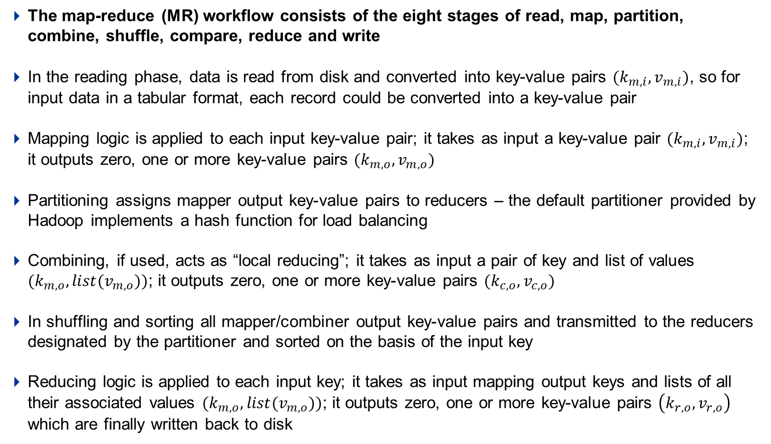
The map-reduce paradigm – The step-by-step approach
Notes: The map-reduce workflow
The map-reduce (MR) workflow consists of the eight stages of read, map, partition, combine, shuffle, compare, reduce and write
In the reading phase, data is read from disk and converted into key-value pairs $(k_{m,i},v_{m,i})$, so for input data in a tabular format, each record could be converted into a key-value pair
Mapping logic is applied to each input key-value pair; it takes as input a key-value pair $(k_{m,i},v_{m,i})$; it outputs zero, one or more key-value pairs $(k_{m,o},v_{m,o})$
Partitioning assigns mapper output key-value pairs to reducers – the default partitioner provided by Hadoop implements a hash function for load balancing
Combining, if used, acts as “local reducing”; it takes as input a pair of key and list of values $(k_{m,o},{list(v}_{m,o}))$; it outputs zero, one or more key-value pairs $(k_{c,o},v_{c,o})$
In shuffling and sorting all mapper/combiner output key-value pairs and transmitted to the reducers designated by the partitioner and sorted on the basis of the input key
Reducing logic is applied to each input key; it takes as input mapping output keys and lists of all their associated values $(k_{m,o},{list(v}_{m,o}))$; it outputs zero, one or more key-value pairs $\left(k_{r,o},v_{r,o}\right)$ which are finally written back to disk

Slide 14
Agenda
Introduction to Distributed computing
Example: Word count using map-reduce
Key-value pairs – The core of map-reduce
The map-reduce paradigm – The step-by-step approach
The map phase – Extreme parallelism
Shuffling, Sorting – The invisible middle operations
The reduce phase – Bringing it all together
Examples and exercises

Slide 15
The map phase – Extreme parallelism
Example 2 continued: Mapping & combining
 | Input | Output
map | <K1,V1> | <K2,V2>
reduce | <K2, List(V2)> | <K3,V3>
The over all map-reduce word-count process
Input
Read
Map
Combine
Sort and Shuffle
Reduce
Final output
Key
Value
Key
Value
Key
Value
Key
Value
Key
Value
Key
Value
1
0x0001b
Bear Deer Bear Car
Bear , 1
Deer , 1
Bear , 1
Car , 1
2
Bear , 2
Deer , 1
Car , 1
3
Bear , 2
Bear , 1
4
Bear , 3
Deer , 1
Deer , 1
Car , 4
Bear Deer Bear Car
Car River Car Bear
River Car River Deer
Deer River Car Deer
Car , 1
River , 1
Car , 1
Bear , 1
Car , 2
River , 1
Bear , 1
Bear , 3
Deer , 2
Car , 4
River , 3
0x0001b
Car River Car Bear
Car , 1
Car , 2
Car , 1
Deer , 2
0x0001b
River Car River Deer
River , 1
Car , 1
River , 1
Deer , 1
River , 2
Car , 1
Deer , 1
River , 1
River , 2
River , 3
1
By default, the line address of every line is they key and value is the contents of the line. These Key-Value pairs will be the input to the map function
Key-Value pairs will be merged on the same key before sending it to the reducer. In this case, since word is the key, so all the key-value pairs associated with same word are merged
3
2
Each Mapper will generate new Key-Value pairs based on the map function, In this case new key is the word and value is 1.
4
Finally, the reducer function run on the values associated to same key, and produces the result

Slide 16
The map phase – Extreme parallelism
Notes: Achieving efficiency with mapping and combining
Many mappers run independently of each other on each machine in parallel
Each mapper reads in one key-value pair and writes out zero, one or more key-value pairs; in most cases, the value of the mapper input key is irrelevant since it doesn’t get used
Mappers run on the same machines as the input data – each mapper explicitly runs on local data, Hadoop has no provision for mappers running in parallel to communicate with each other
Output from mappers get collected in an in-memory buffer where all values corresponding to the same key are collected into lists; each time this buffer is close to full, the sorted output is written to disk OR passed on to a combiner, freeing up the buffer again
A lot of data transformation tasks can be achieved using only mappers in conjunction with identity reducers, reducers that simply pass on the key-value pairs that they receive as input such that the output is another dataset consisting of some transformed form of the rows from the input dataset

Slide 17
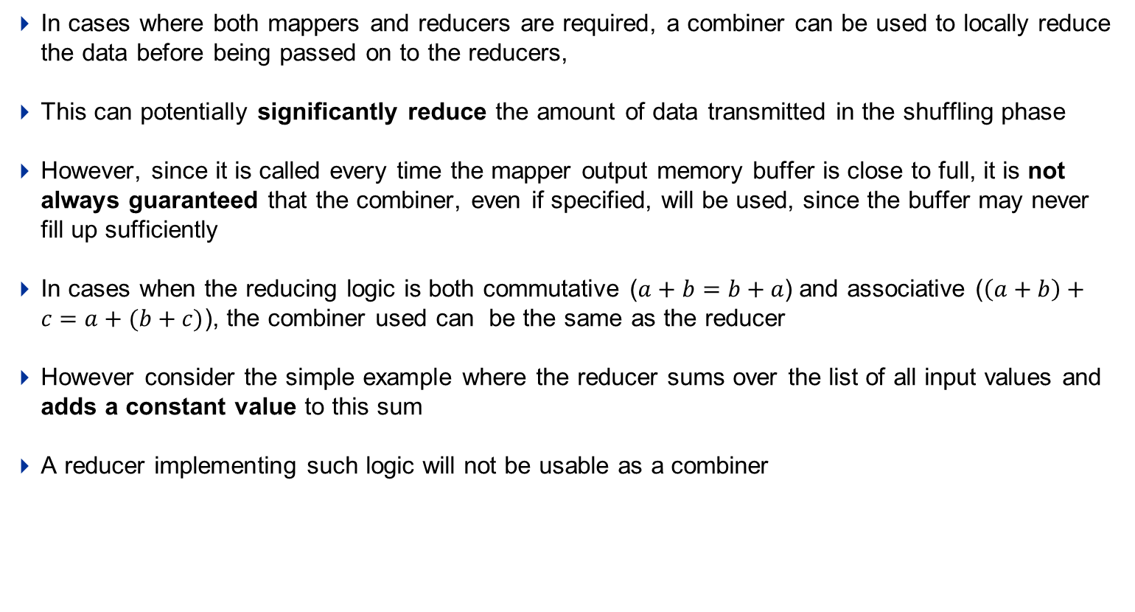
The map phase – Extreme parallelism
Notes: Achieving efficiency with mapping and combining continued..
In cases where both mappers and reducers are required, a combiner can be used to locally reduce the data before being passed on to the reducers,
This can potentially significantly reduce the amount of data transmitted in the shuffling phase
However, since it is called every time the mapper output memory buffer is close to full, it is not always guaranteed that the combiner, even if specified, will be used, since the buffer may never fill up sufficiently
In cases when the reducing logic is both commutative ($a+b=b+a$) and associative ($\left(a+b\right)+c=a+(b+c)$), the combiner used can be the same as the reducer
However consider the simple example where the reducer sums over the list of all input values and adds a constant value to this sum
A reducer implementing such logic will not be usable as a combiner

Slide 18
Agenda
Introduction to Distributed computing
Example: Word count using map-reduce
Key-value pairs – The core of map-reduce
The map-reduce paradigm – The step-by-step approach
The map phase – Extreme parallelism
Shuffling, sorting – The invisible middle operations
The reduce phase – Bringing it all together
Examples and exercises

Slide 19
Shuffling, Sorting - The invisible middle operations
Example 2 continued: Shuffling and sorting
 | Input | Output
map | <K1,V1> | <K2,V2>
reduce | <K2, List(V2)> | <K3,V3>
The over all map-reduce word-count process
Input
Read
Map
Combine
Sort and Shuffle
Reduce
Final output
Key
Value
Key
Value
Key
Value
Key
Value
Key
Value
Key
Value
1
0x0001b
Bear Deer Bear Car
Bear , 1
Deer , 1
Bear , 1
Car , 1
2
Bear , 2
Deer , 1
Car , 1
3
Bear , 2
Bear , 1
4
Bear , 3
Deer , 1
Deer , 1
Car , 4
Bear Deer Bear Car
Car River Car Bear
River Car River Deer
Deer River Car Deer
Car , 1
River , 1
Car , 1
Bear , 1
Car , 2
River , 1
Bear , 1
Bear , 3
Deer , 2
Car , 4
River , 3
0x0001b
Car River Car Bear
Car , 1
Car , 2
Car , 1
Deer , 2
0x0001b
River Car River Deer
River , 1
Car , 1
River , 1
Deer , 1
River , 2
Car , 1
Deer , 1
River , 1
River , 2
River , 3
1
By default, the line address of every line is they key and value is the contents of the line. These Key-Value pairs will be the input to the map function
Key-Value pairs will be merged on the same key before sending it to the reducer. In this case, since word is the key, so all the key-value pairs associated with same word are merged
3
2
Each Mapper will generate new Key-Value pairs based on the map function, In this case new key is the word and value is 1.
4
Finally, the reducer function run on the values associated to same key, and produces the result

Slide 20
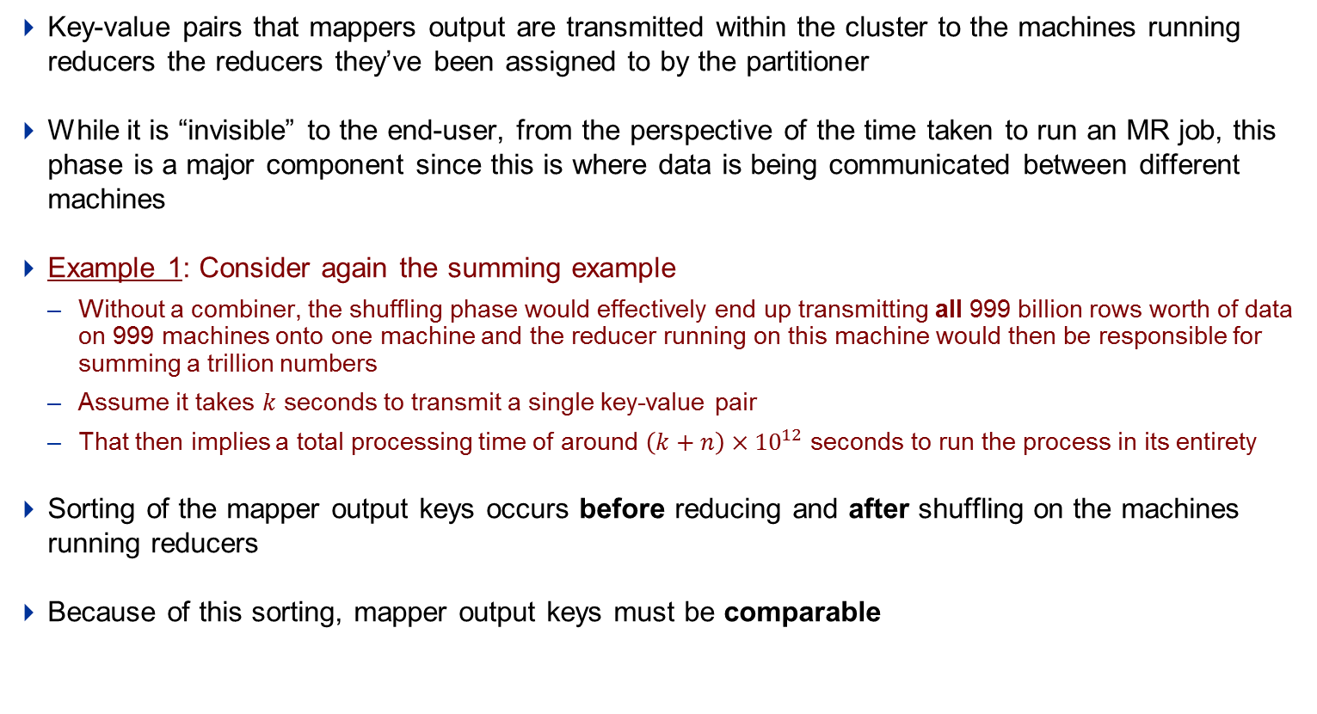
Shuffling, Sorting - The invisible middle operations
Notes: Shuffling and sorting – transferring data from mappers to reducers
Key-value pairs that mappers output are transmitted within the cluster to the machines running reducers the reducers they’ve been assigned to by the partitioner
While it is “invisible” to the end-user, from the perspective of the time taken to run an MR job, this phase is a major component since this is where data is being communicated between different machines
Example 1: Consider again the summing example
Without a combiner, the shuffling phase would effectively end up transmitting all 999 billion rows worth of data on 999 machines onto one machine and the reducer running on this machine would then be responsible for summing a trillion numbers
Assume it takes $k$ seconds to transmit a single key-value pair
That then implies a total processing time of around $\left(k+n\right)×{10}^{12}$ seconds to run the process in its entirety
Sorting of the mapper output keys occurs before reducing and after shuffling on the machines running reducers
Because of this sorting, mapper output keys must be comparable

Slide 21
Agenda
Introduction to Distributed computing
Example: Word count using map-reduce
Key-value pairs – The core of map-reduce
The map-reduce paradigm – The step-by-step approach
The map phase – Extreme parallelism
Shuffling, Sorting – The invisible middle operations
The reduce phase – Bringing it all together
Examples and exercises

Slide 22
The reduce phase – Bringing it all together
Example 2 continued: Reducing & writing out
 | Input | Output
map | <K1,V1> | <K2,V2>
reduce | <K2, List(V2)> | <K3,V3>
The over all map-reduce word-count process
Input
Read
Map
Combine
Sort and Shuffle
Reduce
Final output
Key
Value
Key
Value
Key
Value
Key
Value
Key
Value
Key
Value
1
0x0001b
Bear Deer Bear Car
Bear , 1
Deer , 1
Bear , 1
Car , 1
2
Bear , 2
Deer , 1
Car , 1
3
Bear , 2
Bear , 1
4
Bear , 3
Deer , 1
Deer , 1
Car , 4
Bear Deer Bear Car
Car River Car Bear
River Car River Deer
Deer River Car Deer
Car , 1
River , 1
Car , 1
Bear , 1
Car , 2
River , 1
Bear , 1
Bear , 3
Deer , 2
Car , 4
River , 3
0x0001b
Car River Car Bear
Car , 1
Car , 2
Car , 1
Deer , 2
0x0001b
River Car River Deer
River , 1
Car , 1
River , 1
Deer , 1
River , 2
Car , 1
Deer , 1
River , 1
River , 2
River , 3
1
By default, the line address of every line is they key and value is the contents of the line. These Key-Value pairs will be the input to the map function
Key-Value pairs will be merged on the same key before sending it to the reducer. In this case, since word is the key, so all the key-value pairs associated with same word are merged
3
2
Each Mapper will generate new Key-Value pairs based on the map function, In this case new key is the word and value is 1.
4
Finally, the reducer function run on the values associated to same key, and produces the result

Slide 23
The reduce phase – Bringing it all together
Notes: The last phase in the MR process depends on how the input has been mapped
Each reducer reads in a pair of one key and list of all it’s associated values and writes out zero, one or more key-value pair
Since each reducer takes as input all the values associated with a mapper output key, reducers can also run in parallel, but they cannot run before all mappers have completed running
One or more reducers can be run in a MR job, often depending on run-time considerations, but the idea of “more reducer the merrier” should be approached with care
Example 1 continued: In the summing example
All the mappers write out the same key, so it doesn’t make sense to run more than one reducer
However if we now wish to take subtotals of the “number of store visits” column across levels of another column, we can pass the rows of that column as the mapper output keys and the rows of “number of store visits” to be summed as the mapper output values
A lot of data summarization tasks can be achieved using only reducers in conjunction with identity mappers, mappers that simply pass on the key-value pairs that they receive as input such that the computed output is some aggregation over the input rows

Slide 24
Agenda
Introduction to Distributed computing
Example: Word count using map-reduce
Key-value pairs – The core of map-reduce
The map-reduce paradigm – The step-by-step approach
The map phase – Extreme parallelism
Shuffling, Sorting – The invisible middle operations
The reduce phase – Bringing it all together
Examples and exercises

Slide 25
Examples
Example 1: Problem statement
Consider data that tracks store daily visits at all outlets of a retail chain. Sample in Table A:
How would you compute total store visits across all stores?
How would you compute total store visits for all stores after 31 January 2011?
How would you compute store-wise total visits after 31 January 2011 for each store?
How would you sort this dataset on store?
Consider another dataset that tracks total number of sales made each day for each store. Sample in Table B:
how would you merge the two tables so that store visits and total number of sales made can be viewed side-by-side?
Table A
Visit Date | Store | Store visits
2011-11-30 | A | 128
2011-11-23 | A | 34
2012-01-11 | B | 435
2010-09-15 | A | 786
2012-01-19 | B | 93
2012-01-14 | B | 847
2010-11-30 | A | 297
2010-07-25 | B | 218
2011-07-04 | B | 454
2010-10-19 | A | 23
2010-02-01 | B | 634
2011-11-26 | A | 9
2011-08-18 | A | 12
… | … | …
Table B
Visit Date | Store | # Sales
2011-11-30 | A | 46
2011-11-23 | A | 15
2012-01-11 | B | 223
2010-09-15 | A | 497

Slide 26
Examples
Example 1: Pseudo-code for filtering and summation using Map-Reduce
In the example summing a trillion rows, let us now add one more constraint
We wish to now sum the values of “number of store visits” for only those rows that correspond to a visit date after 31 January, 2011 on the basis of the “visit date” column
Assume that “visit date” is the first column and “number of store visits” is the third column
In pseudo-code, the mapper, combiner and reducer would look something like:
let map(key, value) =
if (yyyymmdd(value[1]) > d"2011-01-31") emit(const, value[3])
let combine(key, values) =
foreach v in values:
sum += v
emit(key, sum)
let reduce(key, values) = combine
Notice that the reducer is implementing the same logic as the combiner, only that the values that it is summing across are all the locally computed subtotals that are output from each combiner

Slide 27
Examples
Example 1: Pseudo-code for filtering and computing monthly store-wise subtotals using Map-Reduce
In the example summing a trillion rows, let us now add a further constraint
we wish to now compute monthly subtotals of store-wise store visits for all visits after 31 January 2011
The “store” column contains string identifiers for stores and is the second column
in pseudo-code the mapper, combiner and reducer would look something like:
let map(key, value) =
if (yyyymmdd(value[1]) > d"2011-01-31")
emit(concatenate(year(value[1]), "-", month(value[1]), "-", value[2]), value[3])
let combine(key, values) =
foreach v in values:
sum += v
emit(key, sum)
let reduce(key, values) = combine(key, values)
Note that the reducer is still the same as the combiner, only that the values that it is summing across are all the locally computed subtotals that are output from each combiner corresponding to the same combiner output key
Notes:
OT: Question – why should we include the year component of the date in the first column as part of the mapper output key?

Slide 28
Examples
Example 1: Filtering and computing monthly subtotals explained visually
Input Data
Mapping
Combining
Reducing
Visit Date | Store | Store visits
2011-11-30 | A | 128
2011-11-23 | A | 34
2012-01-11 | B | 435
2010-09-15 | A | 786
2012-01-19 | B | 93
2012-01-14 | B | 847
2010-11-30 | A | 297
.
.
.
.
.
.
2010-02-01 | B | 634
2011-11-26 | A | 9
2011-08-18 | A | 12
2011-11-A, 128
2011-11-A, 34
2012-01-B,435
2012-01-B, 93
2012-01-B, 847
2011-11-A, 9
2011-11-A, 12
2011-11-A, 162
Node 1
2012-01-B, 435
2012-01-B, 940
2012-01-B, 1375
Node 2
2012-11-A, 162
Node 1000
2011-11-A, 21

Slide 29
Examples
Example 1: Pseudo-code for sorting the table using Map-Reduce
For sorting a dataset on the values of the first column, the MR pseudo-code would look something like:
let map(key, value) =
emit(value[2]), value)
let reduce(key, values) =
foreach v in values:
emit(key, v)
Since Hadoop sorts the reducer input keys before running the reducer, we leverage this property by simply setting the mapper output key to the value of the column we wish to sort on

Slide 30
Examples
Example 1: Pseudo-code for joining two tables using Map-Reduce
For joining two datasets, A and B on the second column in both, the MR pseudo-code would look something like:
let map(key, value) =
emit(value[2]), concatenate(name(input), "-", as.character(value)))
let reduce(key, values) =
foreach v in values:
if (splitString(v, "-")[1] == "A")
aData = splitString(v, "-")[-1]
exit foreach
foreach v in values:
if (splitString(v, "-")[1] != "A")
emit(key, concatenate(splitString(v, "-")[-1], “,", aData))
We use the mapper to group all rows from tables A and B corresponding to a store by setting the mapper output key as the store and since all values corresponding to a mapper output key are sent to one reducer
We then locally find the value corresponding to dataset A and concatenate that value with all other values (which will then be from dataset B)

Slide 31
Exercises

Slide 32
Exercises
1) The trickiness of parallelization – Averaging
Given the following data
Using the map-reduce framework, how would you calculate the average weekly customers by store for available data
Store | Week | No of customers
A | 1 | 300
A | 2 | 150
B | 1 | 200
B | 2 | 100
C | 1 | 250
C | 2 | 50
A | 3 | 500
A | 4 | 400
B | 3 | 350
C | 3 | 450
Node 1
Node 2
Notes:
A1 sum;count = 450;2, A2 sum;count = 900;2
B1 sum;count = 300;2, B2 sum;count = 350;1
C1 sum;count = 300;2, C2 sum;count = 450;1
A average = 337.5
B average = 216.66
C average = 250

Slide 33
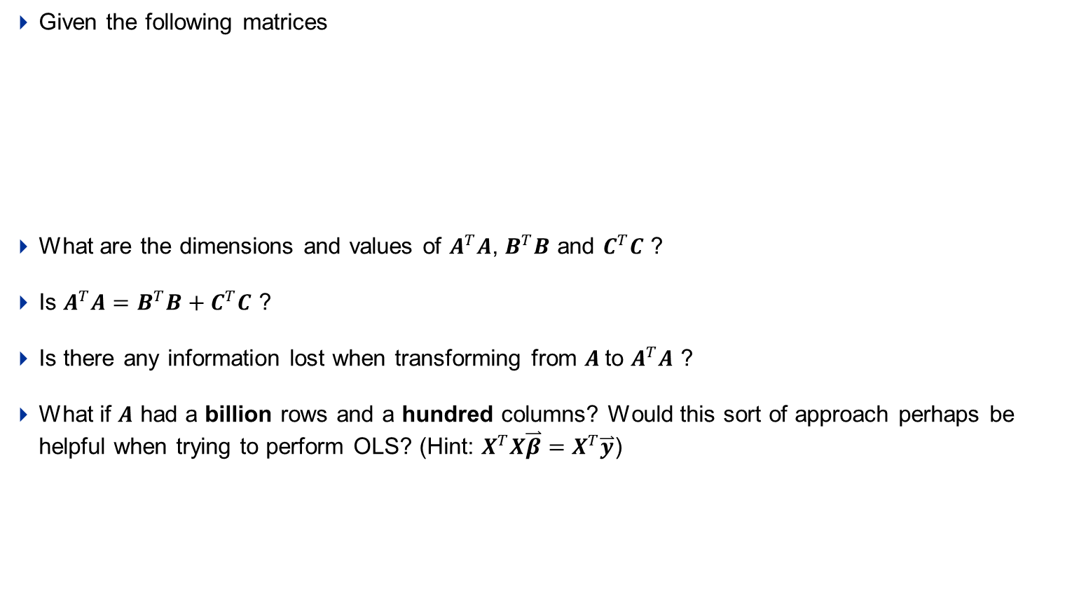


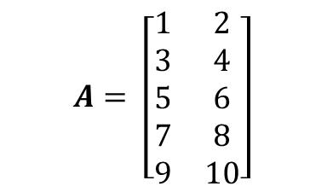
Exercises
2) Linear-algebra in map-reduce (hint: getting started with OLS)
Given the following matrices
What are the dimensions and values of $A^{T}A$, $B^{T}B$ and $C^{T}C$ ?
Is $A^{T}A=B^{T}B+C^{T}C$ ?
Is there any information lost when transforming from $A$to $A^{T}A$ ?
What if $A$ had a billion rows and a hundred columns? Would this sort of approach perhaps be helpful when trying to perform OLS? (Hint: $X^{T}X\overset{⃑}{β}=X^{T}\overset{⃑}{y}$)
$$A= \left[\begin{matrix}1 & 2 \\ 3 & 4 \\ 5 & 6 \\ 7 & 8 \\ 9 & 10\end{matrix}\right]$$
$$B= \left[\begin{matrix}1 & 2 \\ 3 & 4 \\ 5 & 6\end{matrix}\right]$$
$$C= \left[\begin{matrix}7 & 8 \\ 9 & 10\end{matrix}\right]$$
Notes:
T(A)*A = 165 190 ; T(B)*B = 35 44 ; T(C)*C = 130 146
190 220 44 56 146 164

Slide 34
Closing thoughts - Limitation of Map-Reduce
Closing thoughts – limitations of Map-Reduce
Given the data shown to the right, how can you compute a running total of the rows in map-reduce?
Not all computations are easily parallelized
As a thumb-rule, computations for which a divide and conquer scheme can be devised are amenable to map-reduce
As another thumb-rule, computations that inherently serial in nature and not of complexity type NC are not amenable to map-reduce
which is not to say they cannot be performed in a map-reduce framework,
it just means that the reductions in processing time that arise out of parallel computation in a map-reduce framework might not always be realizable in these cases
Problems like linear-programming, inversion of large dense matrices, agent-based methods are not easily parallelizable
Data
1
2
3
4
5
6
7
8
9
10
Node 1
Node 2

Slide 35
Reference material
Reference
On the Internet
http://wiki.apache.org/hadoop/HadoopMapReduce
http://code.google.com/edu/parallel/mapreduce-tutorial.html
http://en.wikipedia.org/wiki/MapReduce
http://developer.yahoo.com/hadoop/tutorial/module4.html
http://hadoop.apache.org/common/docs/current/mapred_tutorial.html
http://vimeo.com/3584536
http://www.cloudera.com/videos/programming_with_hadoop
http://www.cloudera.com/videos/mapreduce_algorithms
Google videos on Cluster Computing and Map Reduce
Lecture 1 - http://www.youtube.com/watch?v=yjPBkvYh-ss&feature=relmfu
Lecture 2 - http://www.youtube.com/watch?v=-vD6PUdf3Js&feature=relmfu
Lecture 3 - http://www.youtube.com/watch?v=5Eib_H_zCEY&feature=relmfu
Lecture 4 - http://www.youtube.com/watch?v=1ZDybXl212Q&feature=relmfu
Lecture 5 - http://www.youtube.com/watch?v=BT-piFBP4fE&feature=relmfu
Textbooks
Data-Intensive Text Processing with Map Reduce by Jimmy Lin
Hadoop: The Definitive Guide by Tom White.

Slide 36
Thank You
Chicago, IL
Bangalore, India
January 25, 2012
www.mu-sigma.com
Proprietary Information
"This document and its attachments are confidential. Any unauthorized copying, disclosure or distribution of the material is strictly prohibited"
Notes:
Purple Pantone 2765
R 12
G 4
B 79
Green Pantone 357
R 15
G 67
B 24
Blue Pantone 2 88
R 11
G 31
B 101
Black
Pantone Cool Gray 6
R 158
G 158
B 158
Red Pantone 485
R 252
G 5
B 14
Yellow Pantone 3965
R 232
G 244
B 4
Aqua Pantone 319
R 126
G 204
B 189
White

