Slide 1
Spark – Lightening Fast Cluster Computing
Introduction
Sep 2014

Slide 2
Brief History of Spark Challenges with Hadoop & MapR What is Spark Where in companies is Spark used

Slide 3
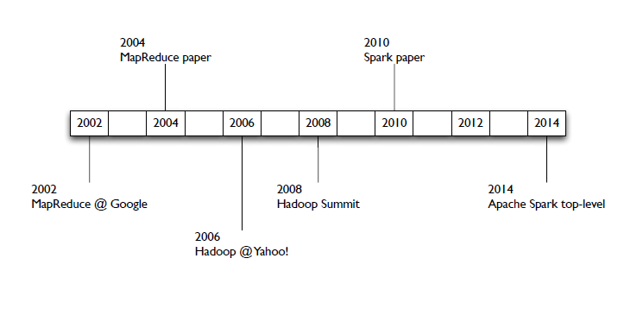
Brief History
HW in 2000
Disk was cheap – primary source of data
Network was expensive
RAM was expensive
Single Core machines dominant
HW- Now
RAM is cheap – primary source of data
Network is faster
Multi-core machines
SW Now
Functional Programming on the rise
Exploit multiple cores on single node
Frameworks to create distributed systems
No SQL is real alternative
SW in 2000
Object Oriented Programming
Optimized for Single Core
SQL was the dominant for data analysis

Slide 4
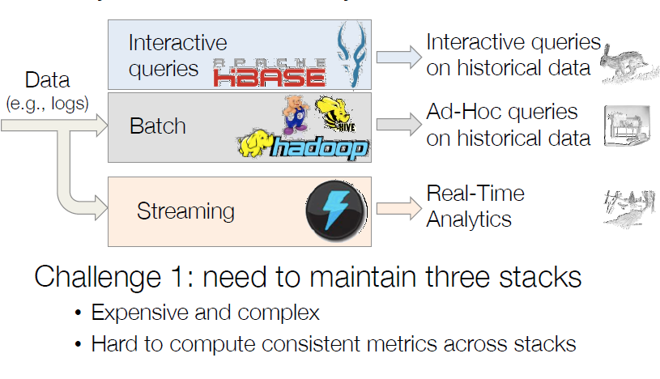
Today’s state of the art Analytics Stack

Slide 5
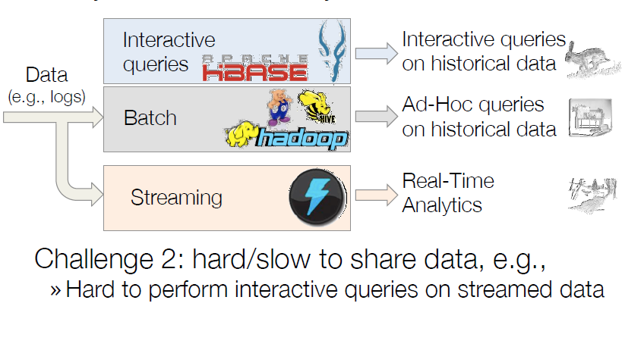
Today’s state of the art Analytics Stack

Slide 6

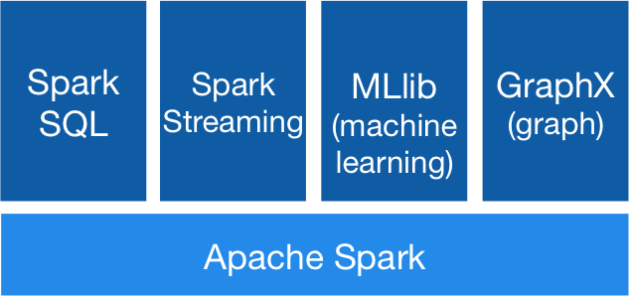
Spark Unifies batch, streaming & interactive comp.

Slide 7
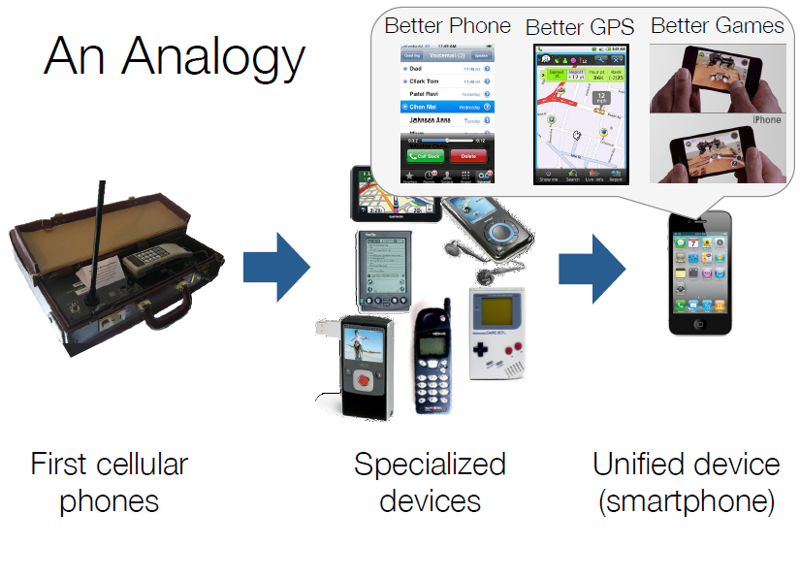
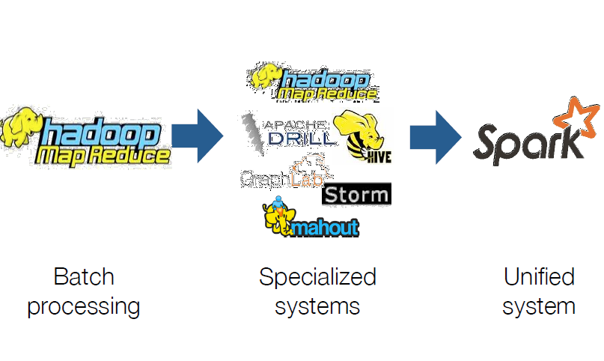

Slide 8
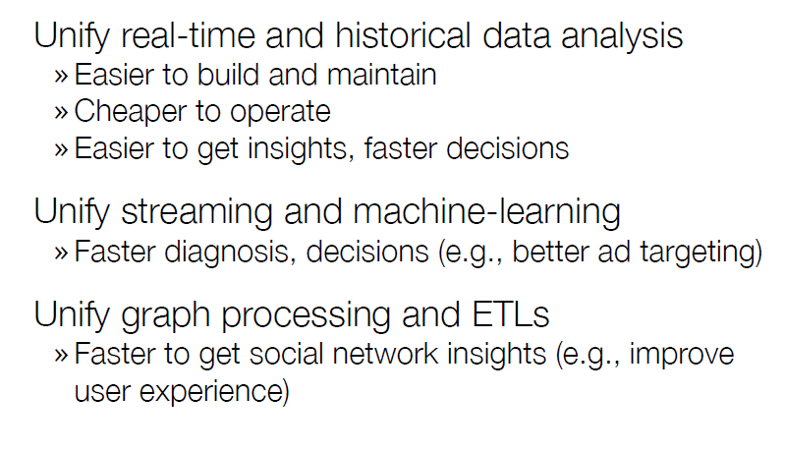
Spark – Unification is biggest benefit
Main abstraction of Spark is Resilient Distributed Dataset

Slide 9
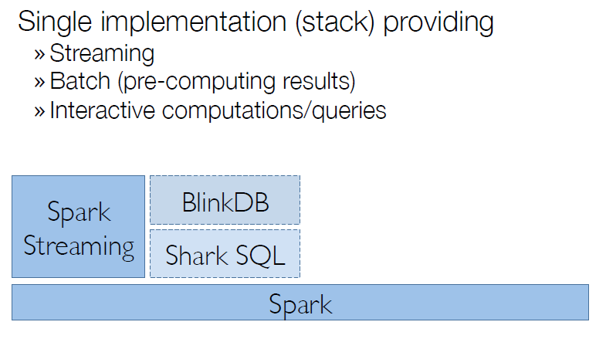
Unify Real-time & historical Analysis
Returns fast approximate answers with error bars
Verifies the correctness of the error bars that it returns at run time
SQL queries & Spark Programs
Unified Data Access
Standard Connectivity
Scalability

Slide 10
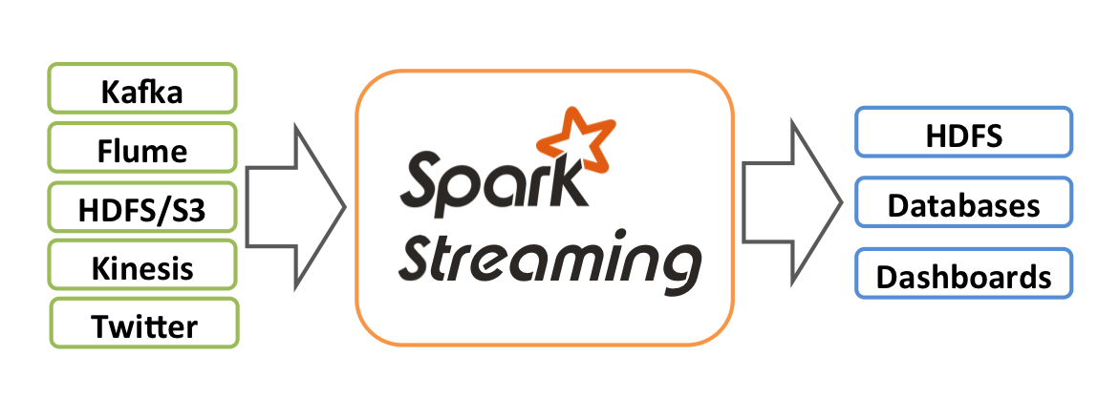
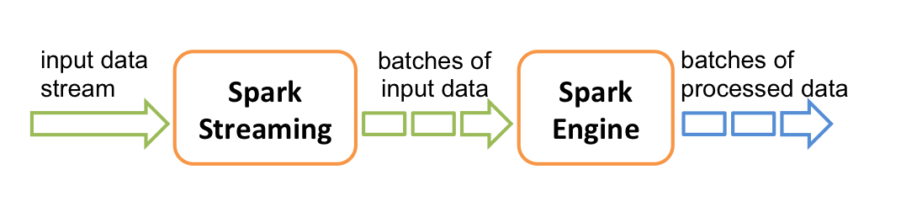
Spark Streaming allows scalable, high throughput & fault tolerant stream processing of live data streams

Slide 11
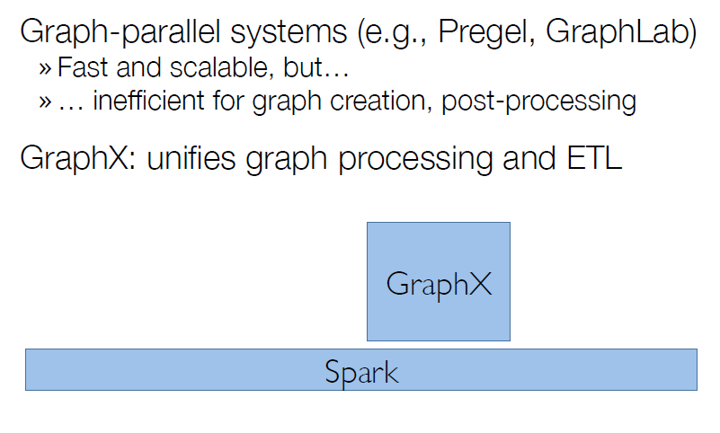
Unify Graph Processing and ETL

Slide 12
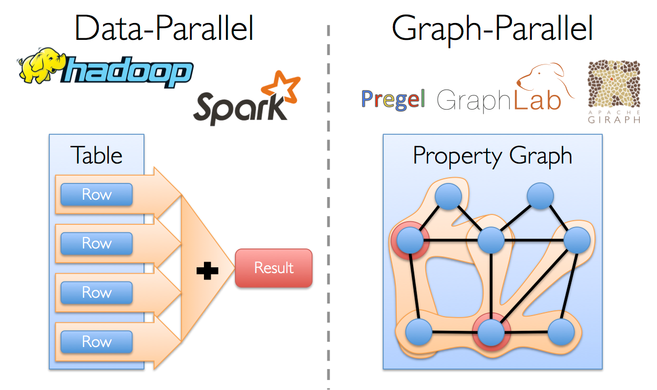
Graph Parallel systems faster than Data Parallel systems

Slide 13
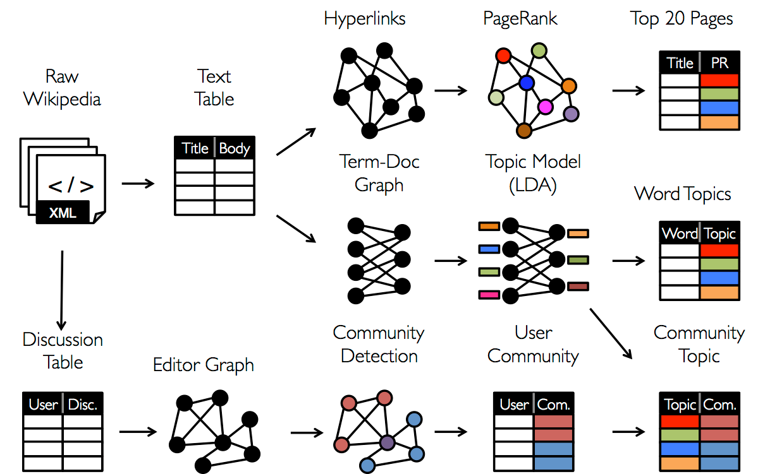
Depending on our objective we need different table & graph views throughout the analytical process

Slide 14
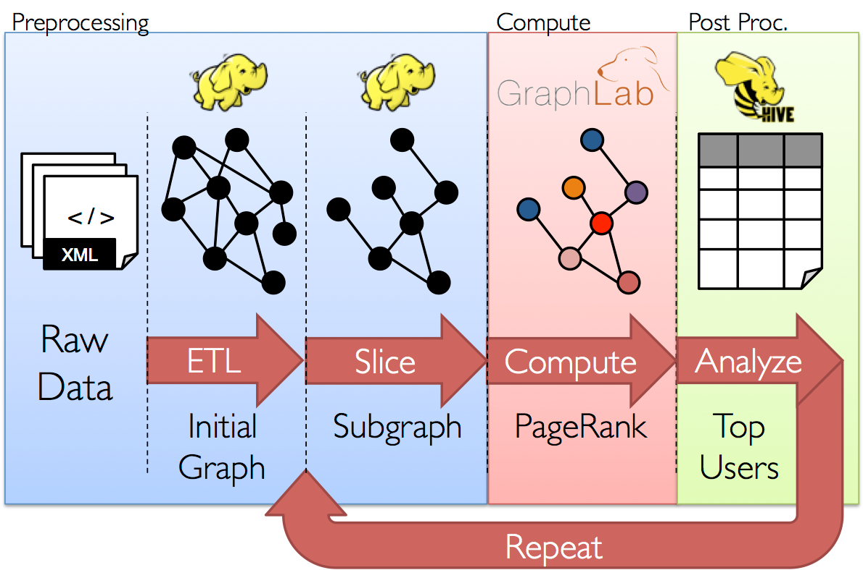
GraphX unifies data parallel & graph parallel computation

Slide 15
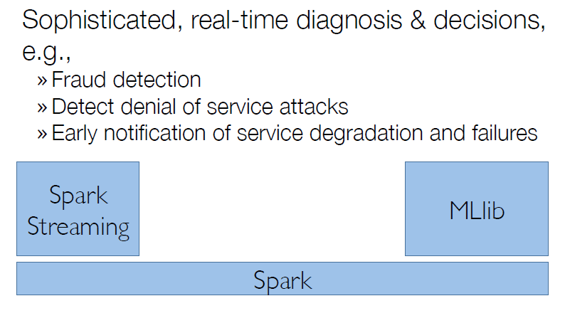
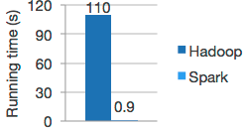
Unify Streaming and Machine Learning
Logistics regression in Hadoop and Spark

Slide 16
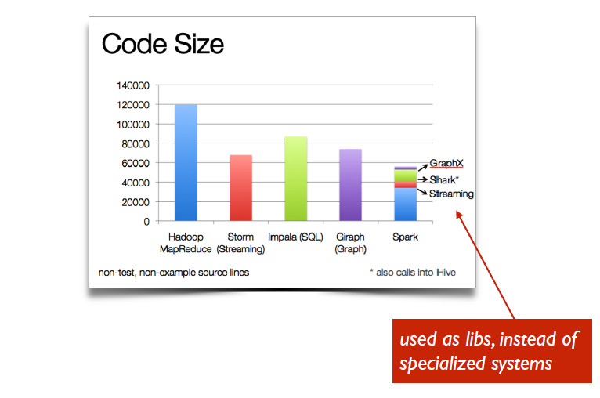
Spark – Need less code for creating applications

Slide 17
In memory aka Speed
In Spark you can cache HDFS data in main memory
Spark analysis can be executed directly on in memory data
Shuffling can also be done in memory
Fault Tolerant

Slide 18
Where can Spark be applied
Marketing & Sales: Analysis of customer engagement and conversion, powering real-time recommendations while customers are still on the site or in the store.
Customer Service & Billing: Analysis of contact center interactions, enabling accurate remote troubleshooting before expensive field technicians are dispatched.
Manufacturing: Real-time, adaptive analysis of machine data (e.g., sensors, control parameters, alarms, notifications, maintenance logs, and imaging results) from industrial systems (e.g., equipment, plant, fleet) for visibility into asset health, proactive maintenance planning, and optimized operations.
Information Technology: Log processing to detect unusual events occurring in streams of data, empowering IT to take remedial action before service quality degrades.
Risk Management: Anomaly detection and root cause forensics, which sometimes makes it possible to stop fraud while it happens.

