Slide 1
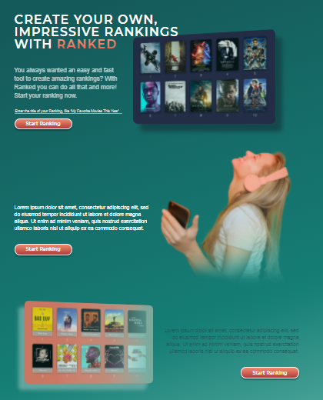
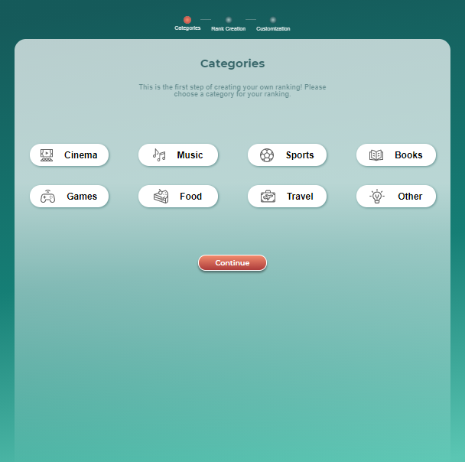
Home Page
‘Start Ranking’ CTA should work, also when the user doesn’t enter a title. All ‘Start Ranking’ CTA’s on homepage should lead to the next page (Categories).

Slide 2
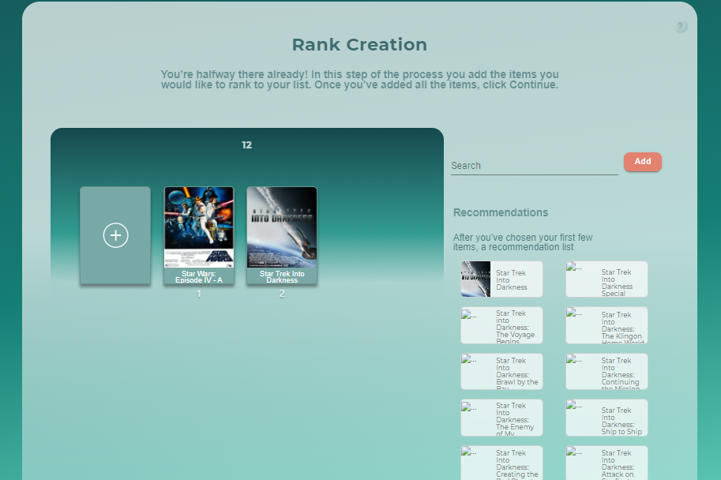
Rank Creation
Name should be editable
Add Drag & Drop functionality
Need a possibility to add/change rank name when creating it
Should be able to Drag/Drop the icons from Recommended to the list

Slide 3
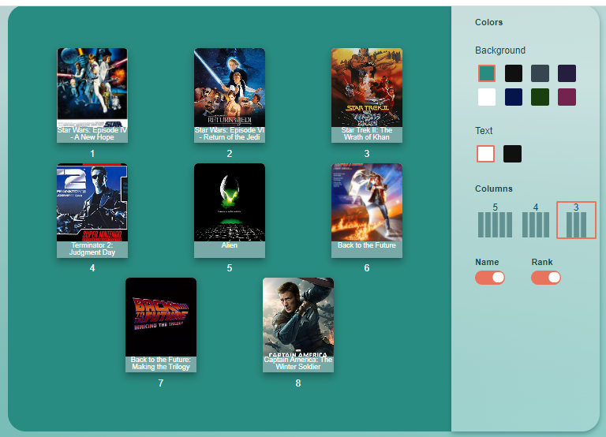
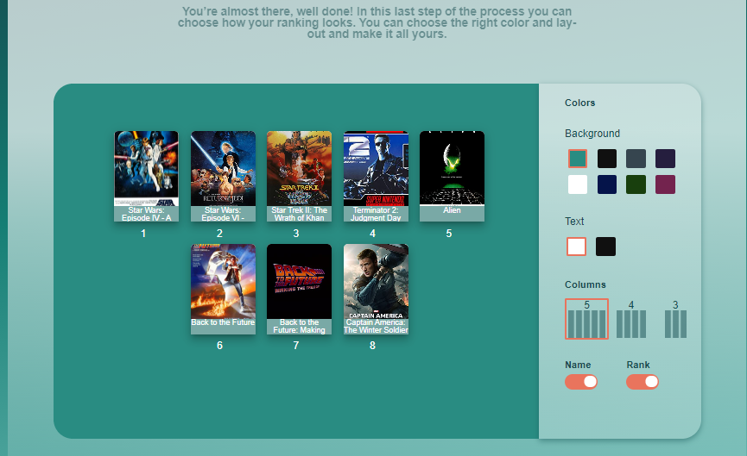
Rank customization ‘design’
Items need to align from left to right (applicable in all pages, all rankings)
Can we add Drag& Drop to change the position of items?
Please align all rows to the left no matter how many items are added, no matter how many columns are formed

Slide 4
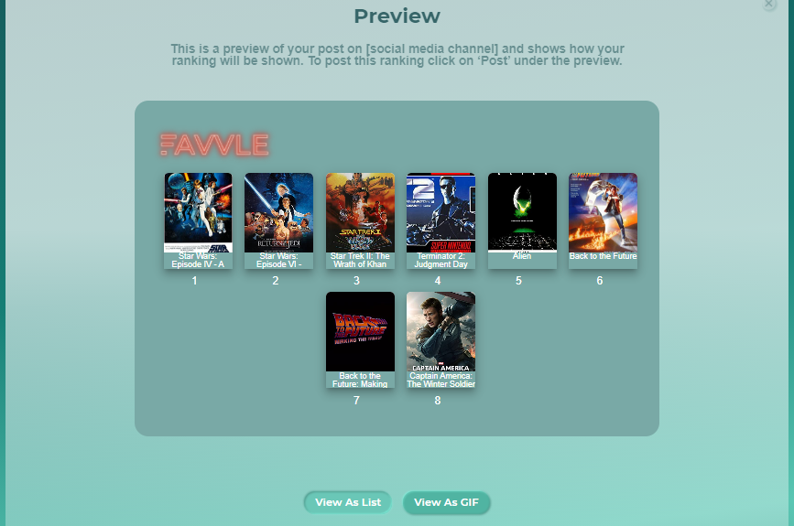
Preview Page
Please align all rows to the left no matter how many items are added, no matter how many columns are formed

Slide 5
Preview Page
No more than 5 items per row
Alignment from left to right
Title of ranking to be added
Name of the list
All items aligned to left
Not more then 5 items in a row

Slide 6
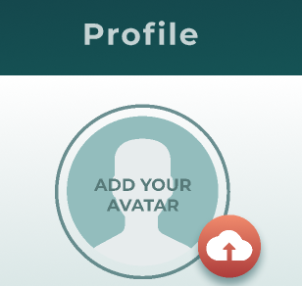

Library & profile page
This picture was just a placeholder/example. In a live environment the circle should be filled with the icon (please see Figma for both PC & mobile https://www.figma.com/file/ULRFYRpwmQiJ6BHZZzmyab/13.04.21.-Favvle?node-id=0%3A10714

Slide 7
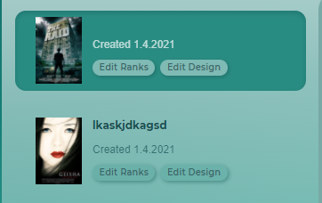

Library
To make sure all rankings show a title in the library, both on the left and on the right:

Slide 8
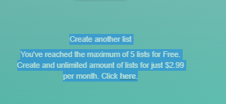
Library
The following text is part of a pop-up that shows once you click on ‘Create new list’ after you’ve created the maximum amount of lists. It should be removed as text on this page:

Slide 9
Library
Once the user clicks on ‘Plans’ from the Library, the Library is gone. You can’t navigate to it from anywhere

Slide 10
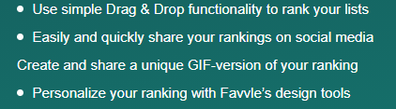
Signup page
Need to add a bullet here:
Once you have created your account, the user is to be redirected to the Library

Slide 11
ALL PAGES
Top menu should remain the same on all pages for the logged in user, except the rank creation process = categories + rank creation + design.
From left to right:
Favvle logo (home) - About - Library - Pricing - Profile – Logout For the Unregistered user: Favvle logo (home) - About - Pricing - Login

Slide 12
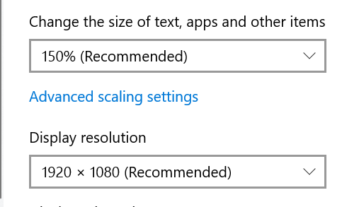
ALL PAGES
CTA should show above-the-fold on all pages. I have checked on 2 laptops:
HP Pavilion Laptop, with the following screen setting: CTA should show above-the-fold on all pages. I have checked on 2 laptops:
HP Pavilion Laptop, with the following screen setting:

