Slide 1
READYNEST · TEAM CODETITANS
HealTrackAI
Clinical AI Engine — Platform Update & Phase 3 Roadmap
Product Release Summary • ML Model Progress • Clinical AI Architecture • 7-Day Delivery Plan
01

Slide 2
AGENDA
What we'll cover
01
Product Update
New features shipped and bugs resolved this cycle across the patient, clinic and admin portals.
02
ML Model Progress
How the AI engine's clinical reasoning evolved from generic replies to context-aware guidance.
03
Clinical AI Engine
High-level architecture, data flow and the medical knowledge base powering it.
04
Phase 3 Plan
Module ownership, the 7-day build timeline and the goal for this phase.
02

Slide 3
PRODUCT UPDATE
Features shipped this cycle
Across patient, reception, clinic-admin and super-admin portals.
1
2
3
In-App Video Conferencing
Broadcast from Clinic
Admin Oversight Controls
Native consultation calls — no third-party dependency.
Clinics can now broadcast announcements directly to patients.
Admins can view/suspend patients & clinics, and manage a clinic’s doctors & departments.
4
5
6
Flexible Payments
Cancel & Reschedule
Google Sign-In
Cash or online (Razorpay) at reception, plus pay-at-counter / pay-online for in-person visits.
Patient-side cancel/reschedule with an automatic refund request to admin.
Firebase-based Google authentication added for patients.
7
8
9
Editable Profiles
Smarter Validation
Improved Parkinson Disease Detector
Patients can now edit their details and upload a profile photo.
Enforced email format, strong passwords, valid DOB and country-correct mobile numbers.
Higher detection accuracy, rebuilt on the updated ML model.
03

Slide 4
PRODUCT UPDATE
Bug fixes & reliability
Data-integrity and portal-behaviour issues resolved across the platform.
Portal & Data
Bookings & Records
Form Validation
✓
Notification count bug fixed
✓
Reception not showing payment status — fixed
✓
Email format validation enforced
✓
Clinic add (no email/password) bug fixed in super admin portal
✓
Cancelled appointments still showing on doctor dashboard — fixed
✓
Strong password policy: 6+ chars, upper, lower, digit, special
✓
No payment history shown on mobile — fixed
✓
Placeholder vitals (e.g. random blood sugar) for new patients — fixed
✓
DOB can no longer be set to a future date
✓
Random earnings/settlement data for new clinic-admins — fixed
✓
Test data left in the transaction ledger — fixed
✓
Mobile number validated against country code (e.g. +91 → 10 digits)
04

Slide 5
TEAM NOTES
Some changes apart the project changes
Additional development work happening alongside the core AI-Engine build.
Professional app audit for a better understanding of the app
Manas working on UI
1
4
Karamveer working on app development
Dedicated team created for ML (model training, rebuilding the model from scratch) led by Mohit
2
5
Structured, phase-wise plan for the upcoming app development
Restructured code for the better app development
3
6
05

Slide 6
ML MODEL PROGRESS
From generic replies to personalised clinical reasoning
The rebuilt model, led by Mohit's dedicated ML team, now reasons over the patient's full clinical context.
Patient input: “I have fever.”
BEFORE
NOW
Generic answer
Personalised advice
No patient history considered — the same advice for every patient, regardless of underlying conditions or medication.
✓
Diabetes
✓
Hypertension
✓
High glucose
✓
Penicillin allergy
✓
Current medicines
AI weighs each of these before generating a response.
06

Slide 7
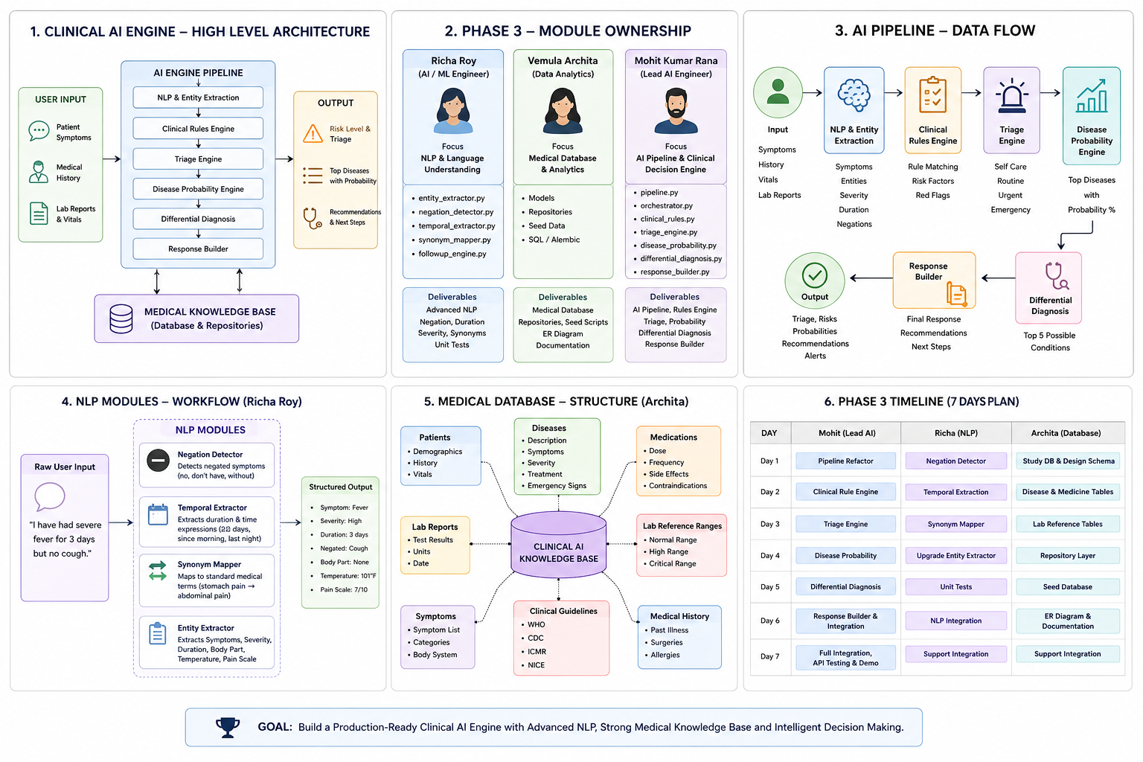
PHASE 3 – SOURCE DIAGRAM
Full Architecture Reference Diagram
07

Slide 8
CLINICAL AI ENGINE
High-level architecture
USER INPUT
AI ENGINE PIPELINE
OUTPUT
Patient Symptoms
Risk Level & Triage
NLP & Entity Extraction
Medical History
Clinical Rules Engine
Top Diseases with Probability
Lab Reports & Vitals
Triage Engine
Recommendations & Next Steps
Disease Probability Engine
Differential Diagnosis
Response Builder
MEDICAL KNOWLEDGE BASE — Database & Repositories
08

Slide 9
CLINICAL AI ENGINE
AI pipeline — data flow
Input
NLP & Entity
Extraction
Clinical
Rules Engine
Triage
Engine
Symptoms, history,
vitals, lab reports
Symptoms, entities,
severity, negations
Rule matching, risk
factors, red flags
Self care, routine,
urgent, emergency
Output
Response
Builder
Differential
Diagnosis
Disease Probability
Engine
Triage, risks,
probabilities, alerts
Final response,
recommendations
Top 5 possible
conditions
Top diseases
with probability %
Each stage narrows the picture — from raw patient language down to a ranked, explainable clinical output.
09

Slide 10
TEAM WORKFLOW
How We Built HealTrack.AI
Six teammates, two focused groups, one shared platform.
Deepinder Singh
TEAM LEAD
Contributed across every part of the website.
FULL-STACK & PLATFORM TEAM
AI / ML TEAM
Manas
UI DEVELOPMENT
Designed and built the app's user interface.
Karamveer Chaudhary
APP DEVELOPMENT
Built the app's core features and functionality.
Vemula Architha
MEDICAL KNOWLEDGE BASE ENGINEER
Built the disease, medication & lab reference database.
Richa Roy
AI / ML ENGINEER — NLU
Advanced NLP: negation, duration & symptom extraction.
Mohit Kumar
AI PIPELINE ENGINEER
Built the clinical rule, triage & diagnosis pipeline.
HEALTRACK.AI — UNIFIED PLATFORM
Two tracks, six teammates, one shipped product.
10

Slide 11
THE GOAL
Build a production-ready Clinical AI Engine
with advanced NLP, a strong medical knowledge base, and intelligent decision-making — delivered in Phase 3.
Advanced NLP
Medical Knowledge Base
Intelligent Decisioning
7-Day Delivery
ReadyNest · Team CodeTitans · HealTrackAI
11

